Slide 1
DocuSense
Intelligent Invoice Analysis & Fraud-Screening System
IBM SkillsBuild-AICTE-BharatCares (CSRBOX)
ML & Applied AI Internship 2026
Academic prototype | All metrics from actual code runs | Add your Name / Roll No.

Slide 2
Problem Statement
Manual invoice processing is slow, error-prone and hard to audit
• Wrong totals — subtotal + tax ≠ grand total goes unnoticed
• Duplicate invoices — same invoice submitted twice, sometimes with altered amounts
• Poor scan quality — missing or unreadable fields delay payment approval
• Unusual amounts — no systematic flag for outlier values
• Audit trail — no centralised log of extracted fields and validation decisions

Slide 3
Project Objectives
1
OCR & extraction
PDF text layer or Tesseract; extract vendor, number, dates, amounts, currency
2
Validation
7 deterministic rules for total consistency, dates, amounts, invoice number format
3
Duplicate detection
Exact, near and conflicting-number matches via RapidFuzz fuzzy similarity
4
Anomaly indicator
Unsupervised Isolation Forest on log-total and tax-ratio (no fraud labels)
5
Transparent UI
Human-readable review prompts; reviewer makes the final decision

Slide 4
System Architecture
Five-signal pipeline with transparent human-review output
Upload
(PDF/JPG/PNG)
document_loader
(validate, load pages)
OCR / text layer
(preprocess, Tesseract)
field_extraction
(regex rules)
Screening
→ Review UI
→
→
→
→
financial_validation
(7 rules, PASS/REVIEW/FAIL)
duplicate_detection
(exact / near / conflict)
anomaly_detection
(Isolation Forest)
screening.py → Low concern / Needs review / High concern → SQLite + CSV/JSON export

Slide 5
Dataset
What we used, how we obtained it, and its licence
Dataset:
CORD v2 (Consolidated Receipt Dataset)
Source:
Naver Clova AI | naver-clova-ix/cord-v2 on Hugging Face
Licence:
CC BY 4.0 — free to use for research with attribution
Acquisition:
python scripts/download_dataset.py --cord-hf 250
Subset size:
250 receipt images (train split, first 250)
Scorable records:
109 receipts have all three: subtotal, tax, total
Fraud labels:
None — CORD is a receipt-parsing dataset, not a fraud dataset
SROIE:
Registration required at ICDAR 2019; not downloaded (access needed)
Raw data:
Not committed to the repository (listed in .gitignore)

Slide 6
Methodology
How each pipeline stage works
Image preprocessing
Grayscale conversion, upscaling to ≥1400px wide, fastNlMeans denoise, skew correction (projection-profile, ±10°). Optional Otsu binarization. Degraded images get median blur only.
OCR
Tesseract 5.4.0 (LSTM, OEM3) with PSM6. Returns per-word confidence; mean shown in UI. Digital PDFs bypass OCR via PyMuPDF text layer.
Field extraction
Rule-based: regex anchored on keywords (Total, Tax, Invoice No.). Handles OCR spacing artifacts in numbers (e.g. '36 , 300'→36300). Three statuses: extracted, uncertain, missing. Never guesses missing values.
Validation (7 rules)
required_fields, invoice_date_valid, due_date_order, amount_plausibility, total_consistency (subtotal+tax≈total within configurable tolerance), tax_ratio, invoice_number_format. Each rule is PASS / REVIEW / FAIL / SKIPPED.

Slide 7
OCR & Extraction — Real Evaluation Results
CORD v2 • 100 receipts • 0 failures • Exact match after normalisation
CORD v2 is a restaurant-receipt dataset (Indonesian/English). Most receipts do NOT have vendor, invoice number or date labels → those fields show null recall.
Field
Truth N
Predicted
Correct
Precision
Recall
subtotal
72
23
20
87.0%
27.8%
tax
45
9
4
44.4%
8.9%
total
98
43
20
46.5%
20.4%
vendor
0
84
0
0.0%
—
invoice_number
0
0
0
—
—
invoice_date
0
0
0
—
—
Low total recall is expected: CORD labels receipt-style totals; Tesseract OCR yields low character-count text on many images. Precision is high when the field is found.

Slide 8
Validation & Duplicate Detection
Financial validation (7 deterministic rules):
Duplicate detection (RapidFuzz):
• required_fields — vendor, number, date, total
• 3 match types: exact, conflict, near
• invoice_date_valid — parseable, not future, not >5y
• Exact: same invoice no., vendor, total, date
• due_date_order — due ≥ invoice date
• Conflict: same number + vendor, but amounts differ
• amount_plausibility — non-negative, <1 billion
• Near: weighted similarity score ≥ configurable threshold
• total_consistency — |subtotal+tax−total| ≤ tolerance
• tax_ratio — tax/subtotal ≤ 50%
Weights (transparent heuristics, not validated):
• invoice_number_format — 3–30 chars, contains digit
invoice_number 30% | vendor 20% | amount 25%
date 10% | text excerpt 15%
Precision/recall not reported: rules are tested via 11
unit tests, not learned from labelled data.
No ground-truth duplicate pairs → precision/recall NOT claimed.

Slide 9
ML Component — Anomaly Detection
Unsupervised Isolation Forest | No labelled fraud data | score ≠ fraud probability
Algorithm:
sklearn.ensemble.IsolationForest (200 trees, random_state=42)
Features:
log_total and tax_ratio (= tax ÷ subtotal) — two continuous features
Training data:
109 CORD v2 receipts with complete subtotal, tax and total
Contamination:
0.05 — assumed 5 % of training records are outliers (sets decision threshold)
Trained on:
2026-10-11 | model saved to models/anomaly_model.joblib
Output:
Isolation score (more negative = more unusual) + binary flag
NOT claimed:
No accuracy, precision or recall — no fraud labels exist
Interpretation:
Flag = 'unusual relative to training distribution', not 'fraud detected'

Slide 10
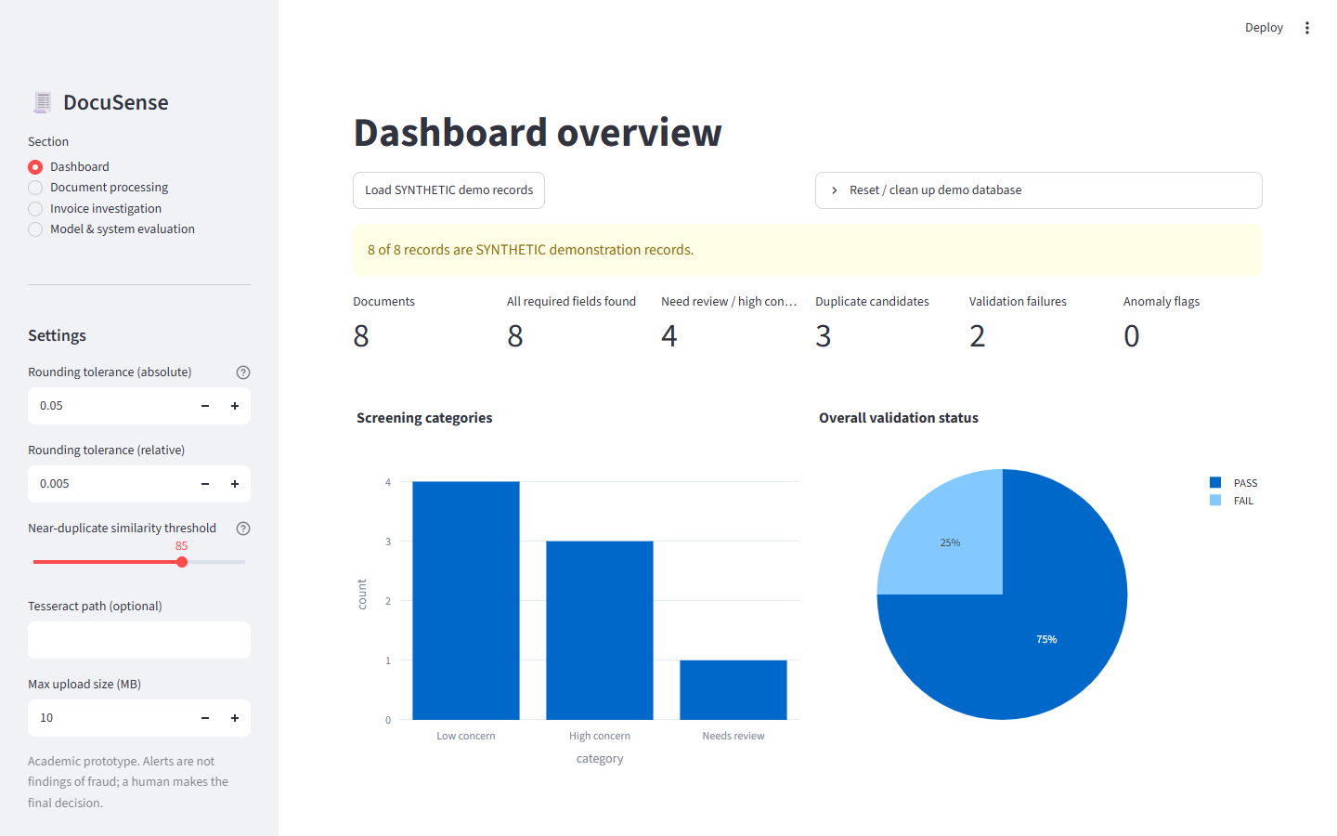
Dashboard — Live Demo
Loaded with SYNTHETIC demo records; labelled as synthetic_demo in the database

Slide 11
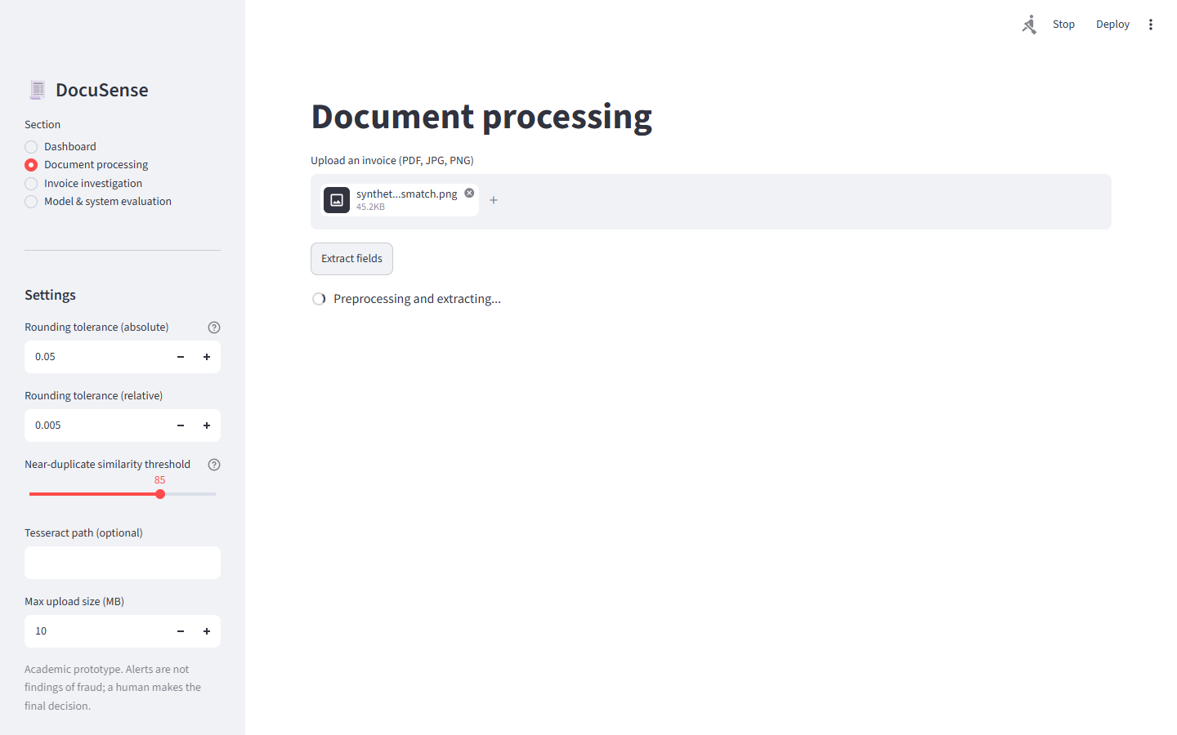
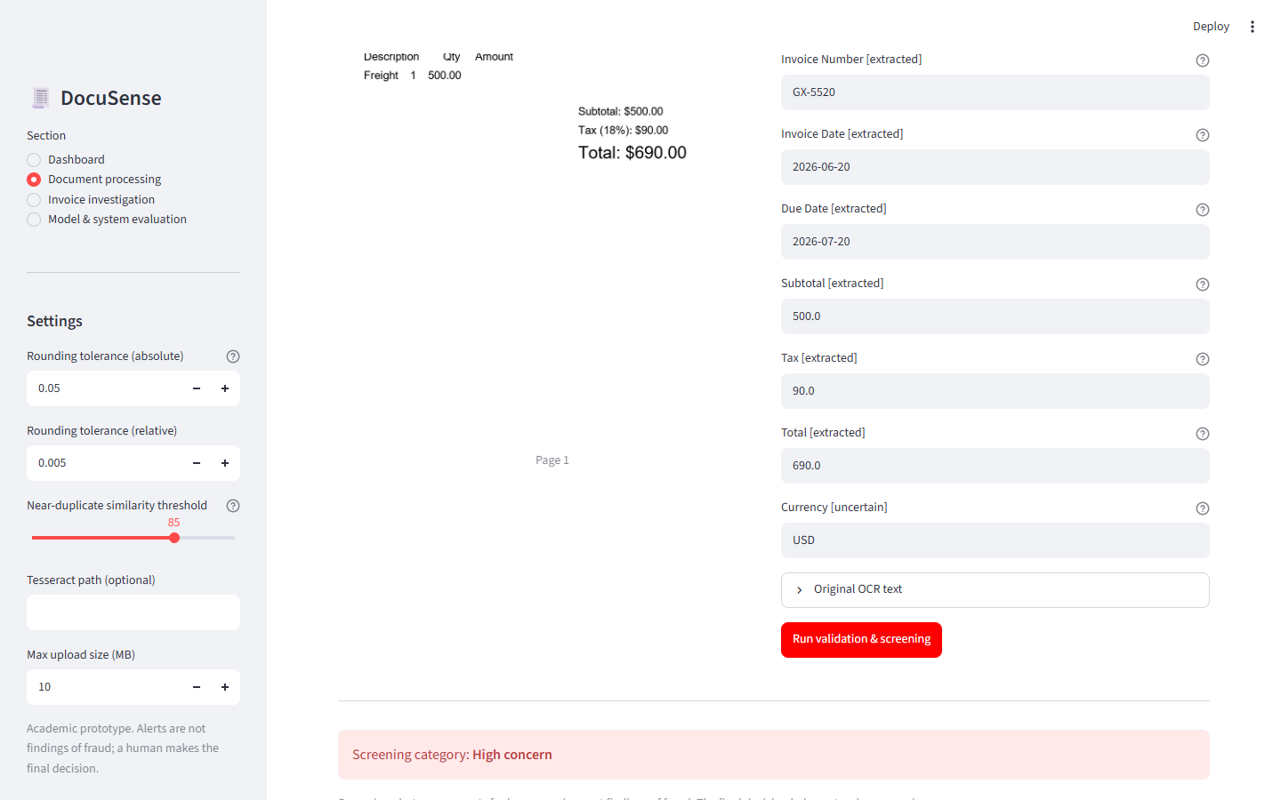
Document Processing — Upload, Extract, Validate
Left: upload + OCR preview | Right: extracted fields + validation results | synthetic_003_mismatch.png

Slide 12
Limitations & Future Scope
Honest assessment — what works, what does not
Limitations:
Future Scope:
• Rule-based extraction: misses complex layouts, non-English text, handwriting; low recall on degraded images
• Layout-aware models: LayoutLM, Donut for token-level document understanding
• OCR quality: Tesseract struggles with small fonts and noisy CORD receipt scans (mean text: 133 chars/image)
• Supervised classifier if labelled fraud data becomes available
• No fraud labels: anomaly score is a distribution outlier flag, NOT a fraud probability
• Line-item extraction, multi-currency, multi-language OCR
• Metrics limited: CORD lacks vendor/invoice_number/date labels → only financial fields evaluated
• Enterprise: authentication, encrypted storage, REST API, audit trail
• Heuristics uncalibrated: duplicate weights and screening rules not statistically validated
• No line-item extraction: individual line items not parsed
• Alerts are REVIEW PROMPTS: a human reviewer decides — DocuSense is not an audit tool
All numbers shown in this presentation come from code actually run on this machine.
No results are fabricated. Alerts = human review prompts, never fraud findings.

