Slide 2
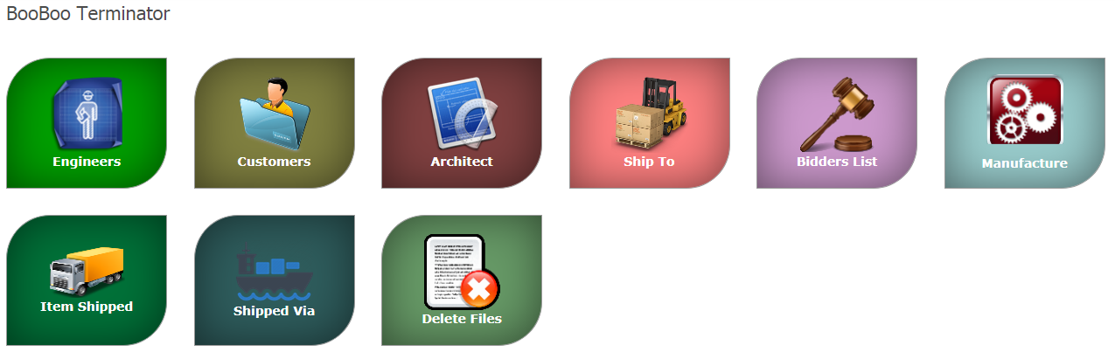
BBT

Slide 3
Details for Engineer
Field Name | Description | Remark
Engineer*
Address
City
State
Zip
Phone
Fax
Email
Website
SP
UC
UC2
Basic Specification*
Notes:
What the Engineer stands for, is it the vendor who are providing the different part.
Need some more details for
SP: SalesPerson ??
UC,
UC2
Engineer: Person who is reading to drawing

Slide 4
Customer details
Field Name | Description | Remark
Customer
Address
City
State
Zip
Phone
Fax
Email
Website
SP
UC
UC2
Notes:
The page tile mentioned Manage Contractor
What the customer stands for, is it the vendor who are providing the different part.
Need some more details for
SP: SalesPerson ??
UC,
UC2

Slide 5
Architect Management
Field Name | Description | Remark
Architect
Address
City
State
Zip
Phone
Fax
Email
Website
SP
UC
UC2
Notes:
The page tile mentioned Manage Architect
What the Architect stands for, is it the vendor who are providing the different part.
Need some more details for
SP: SalesPerson ??
UC,
UC2

Slide 6
Shipping Address management
Field Name | Description | Remark
ShipTo | Address
UC
UC2
Notes:
Shipping address, needs to get more clarity on the flow.

Slide 7
Manufacturer List
Field Name | Description | Remark
Product
Type
UC
UC2
Notes:
Every manufacturer will have different product and its description. In the #type should show number of different type of product they will have.
Manufacturer → Type
Type → Description, Model, $1-300, $300-25K, $25K+, UC, UC2, MSG
Need to understand the Type table how its going to related, its impact (why it is required to mention the range of the product)

Slide 8
Bidder List
Field Name | Description | Remark
Bidder | Bidder Name
Address
City
State
Zip
Office Phone
Cell Phone
FAX
Email
Website
SP
UC
UC2
Notes:
Who are the bidder, role? and its impact inter of flow

Slide 9
Item Shipped
Field Name | Description | Remark
Item Shipped
UC
UC2
Notes:
Need to understand the flow, how to add the Item Shipped

Slide 10
Shipped via
Field Name | Description | Remark
Item Shipped
UC
UC2
Notes:
Need to understand the flow
how its related and impact

Slide 11
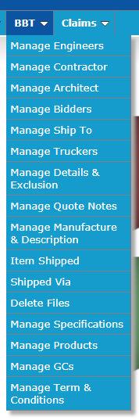
Options Available for BBT

