Slide 1

Indian Currency Recognition
Under the guidance of:
Ajaya Kumar Dash
Group Members:
Apurva Kumar Srivastav(B111010)
Chaitan Majhi(B111017)
Jayant Kumar Nayak(B11067)

Slide 2
Need for currency recognition
Currency counting is time consuming.
Reduces human effort
Bulk counting of notes is very easier
Banks need counting machines which can also recognize currency

Slide 3
INTRODUCTION
Our Goal : Recognizing image of Indian currency by using available image processing techniques and neural network
What does image processing mean?
How it works in our project?

Slide 4
Steps involved in Image Processing
1. Image Acquisition
The image has been taken through scanner for detection purpose .
Scanner Details: HP Deskjet 1050 J410 series
Scanned Image DPI: 200 dpi ,Background for the image was provided with the help of an A4 size black paper to reduce initial noise while capturing image
Total Scanned Images= 600 ( 100 scanned images for each denomination)
The resolution of each scanned image is 1700x2338 with a dpi of 200.

Slide 5
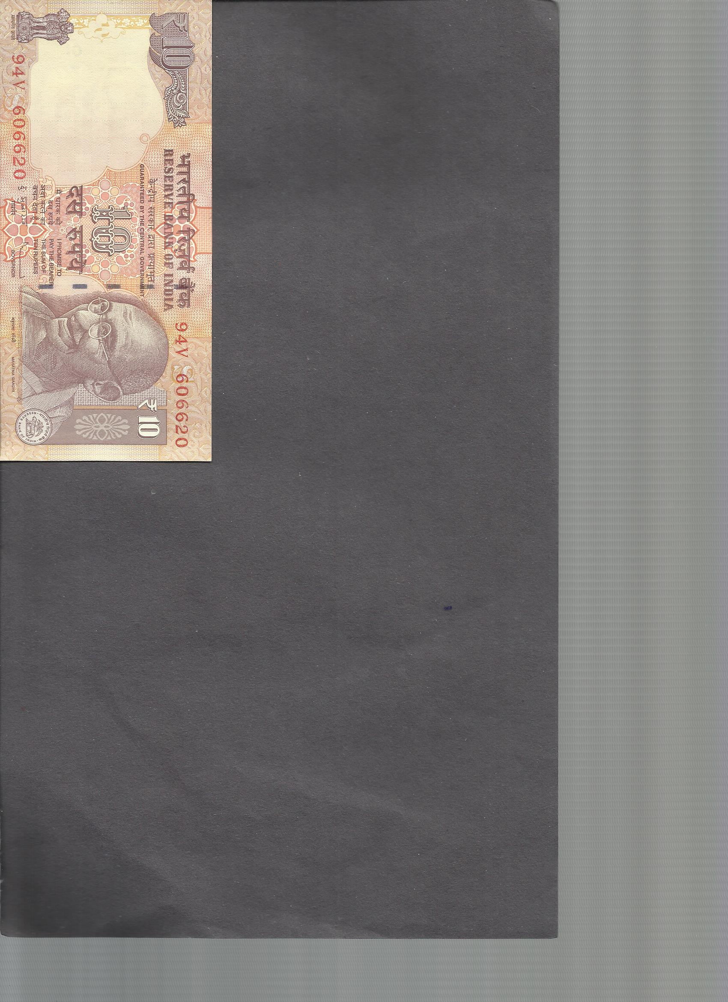
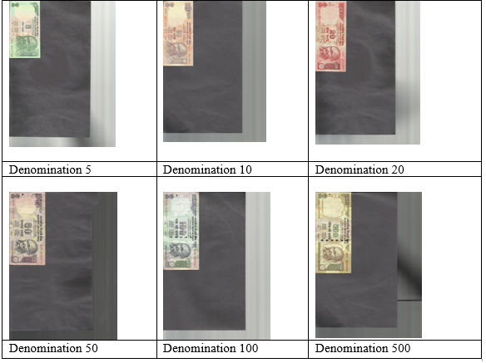

Slide 6
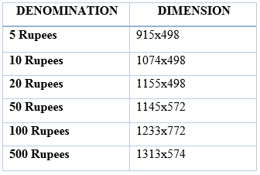
2.Data Extraction
There are various functions used in this stage which are
crop :
The crop function takes in the masking values as parameters and crops the scanned image files accordingly.
The dimensions for various cropped images according to 200dpi are as follows
These cropped images of various resolution are converted to a standard resolution of 250x125.

Slide 7
Deciding Region Of Interest (ROI)
Standard images are then further cropped to generate the region of interest for each image file. The dimension of the region of interest after thorough study has been taken to be 59x39.
To make the database more robust and tolerant to errors the database has been increased by the following method.
We have increased the initial database of 600 images by varying the region of interest by introducing marginal error with the help of 21 masking values.
Hence total images obtained in the cropSeg folder : 21 X 90 X 6 = 1134
The 21 masks which were used on the original ROI [90 36 58 38] on standard image are as follows.
Example
#0 mask #2 mask
mask = [90 36 58 38]+[0 0 0 0]; mask = [90 36 58 38]+[1 -1 0 0];
#1 mask #3 mask
mask = [90 36 58 38]+[1 1 0 0]; mask = [90 36 58 38]+[-1 1 0 0];
The images generated in each step are placed in their respective folders namely cropImg,
stdImg and cropSeg.

Slide 8
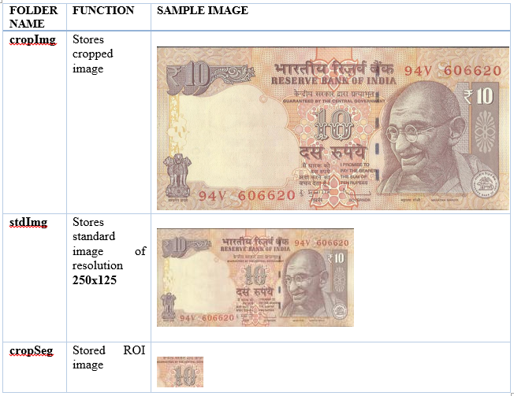
Results of crop function
1074 x 498
59x39

Slide 9

ROI Mask: Currency segmentation takes the region of interest and finds out the masking.
Region_seg – This function implements Chan Vese active contours without edges.
It takes image from cropSeg folder and stores the result in maskSegData folder.

Slide 10
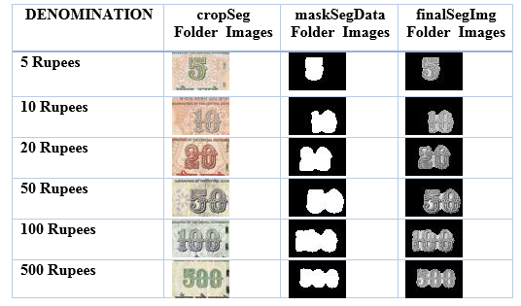
ROI Data Extraction: Here the data is extracted for making the database.
Datasegment:
In this function the RGB values of the Crop segmented images are converted to grayscale values and the ROI Mask segmented images pixel values are divided by 255 to convert the image to binary mask image.
The matrix obtained from the above two images operation is scalar multiplied to produce the final segmented image matrix which is then stored in the folder finalSegImg.

Slide 11
3. Database Creation:
File’s created :
data.mat : variables X and y used for training
dataCross.mat: variables Xval and yval used for testing and cross validation purpose.
Function used to create database :
Database_script :
It takes all the images from finalSegImg folder and applies laplacian filter to them and stores the resulting image and denominations in the above .mat files.

Slide 12
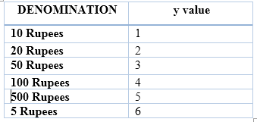
data.mat file
Variables X and y used for training
X is an M x N matrix where,
‘M’ =total no of images in the database.
‘N’ = total no. of pixels in an image.
y is an M x 1 matrix where,
It contains denominations values

Slide 13
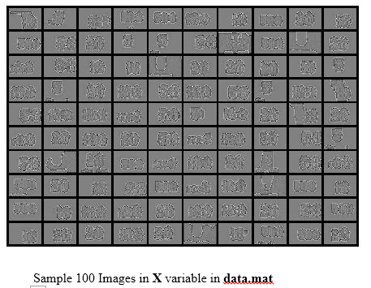
data.mat

Slide 14
What is a neural network ?
Layer 1
Layer 2
Layer 3
Layer 4
ANN or Artificial neural networks (or simply neural networks) are simplified models of biological neuron system.
Like brain it basically learns from experience and stores information as patterns, utilizing those patterns, and then solving problems like humans recognising faces.

Slide 15
3. Currency Recognition
The neural network concept
Backpropagation, an abbreviation for "backward propagation of errors", is a common method of training artificial neural networks used in conjunction with an optimization method such as gradient descent.
The neural network consists of 3 layers with one hidden layer ,and an input and output layer.
ex: function which executes the training of neural network.
%% Setup the parameters
input_layer_size = 59 * 39; % 59x39 i.e number of pixels
hidden_layer_size = 100; % 100 hidden units
num_labels = 6; % 6 labels, from 1 to 6

Slide 16
Output layer values:
Denomination 10 20 50 100 500 5
Learned Weights:
As the neural network consists of only one hidden layer so we have two weight Theta1 and Theta2 parameters which are saved in weights.mat which are used for prediction purpose

Slide 17
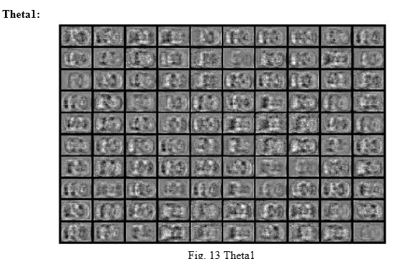

Slide 18
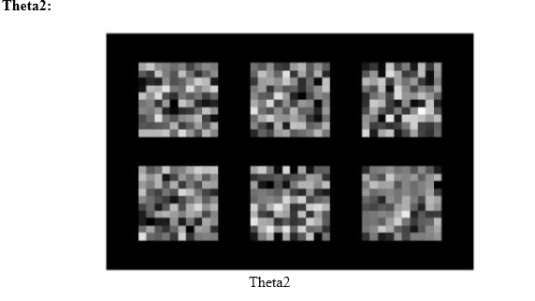

Slide 19
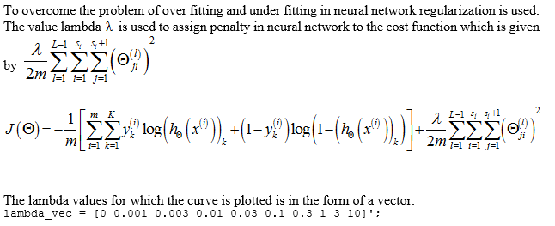

Slide 20
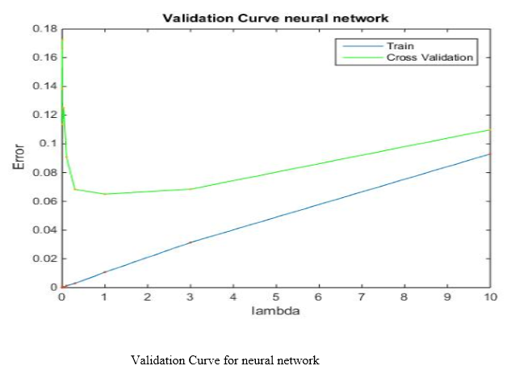

Slide 21
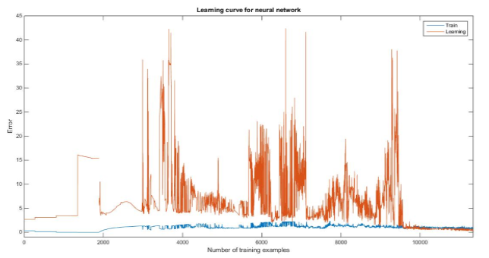
Learning Curve:
The learning curve for the graph was plotted for 11340 training examples from the data.mat database
and 73 testing examples from the dataCross.mat database.

Slide 22
Accuracy
For lambda = 0.01
Prediction accuracy on trained database is 100%.
Prediction accuracy on test database is 97.260274%.

Slide 23
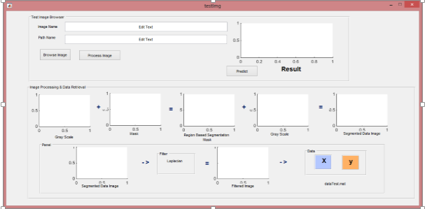
User Interface
How the system looks like ?

Slide 24
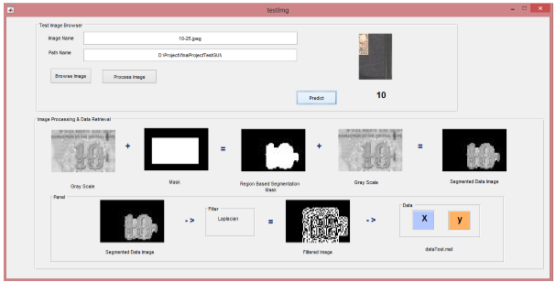

Slide 25
CONCLUSION
100% accuracy for normal quality notes and approx. 97% accuracy for very highly soiled notes.
robust due to its large database
The segmentation technique and defining the region of interest along with the appropriate standard resolution was done on trial and error basis to get the best results as possible for extraction of data features.
Moreover, the initial problem of low database for training purpose was solved in an intelligent manner by taking different region of interest masks with little co-ordinate positional difference . This resulted in different image databases after implementing Chan –Vese, as a result the database was increased.

Slide 26
FUTURE ENHANCEMENTS
Improvements could be done so as to recognize currency images which also have random background rather than a standard background.
Moreover, certain improvements can be done to recognize currency images of any degree of orientation and any resolution.
Counterfeit currency detection could also be incorporated.

Slide 27
THANK YOU

