Slide 1

FLOWFORGE: AI-POWERED UNIVERSAL WORKFLOW COMPILER USING FORMAL LANGUAGE AND DFA
Course: CSA1304 THEORY OF COMPUTATION
PRESENTED BY:
D.NAVEEN KUMAR (192511401)
B.JAYANTH (192511375)
J.JAYADEEP (192511304)
Under the guidance of:
K.BASKAR

Slide 2


INTRODUCTION
FlowForge converts real-world process descriptions into structured, validated workflows.
Users first define team members, their skills, specialties, and availability.
AI transforms natural-language requirements and optional reference documents into structured workflow data.
The frontend validates dependencies, assignments, and transitions before visualization.
Designed for multiple real-world domains rather than a single industry, with workflows represented using formal states and transitions.

Slide 3
PROBLEM STATEMENT
Real-world procedures are often scattered across documents, manuals, and informal instructions.
Manual task assignment is difficult when people differ in skills, availability, and workload.
Existing workflow tools require users to construct every dependency by hand; AI-generated workflows can contain incorrect or inconsistent steps.
A system is needed to convert natural-language procedures into structured, validated, visual workflows.

Slide 4
OBJECTIVES
To develop a universal AI-powered workflow compiler.
To generate structured workflows from natural-language descriptions.
To incorporate team skills, specialties, availability, and constraints.
To validate AI-generated workflow data deterministically.
To model sequential workflows using formal states and transitions, generating DFA representations and transition tables.
To automatically create schedules and task assignments.
To support reference-document uploads and PDF report export.

Slide 5
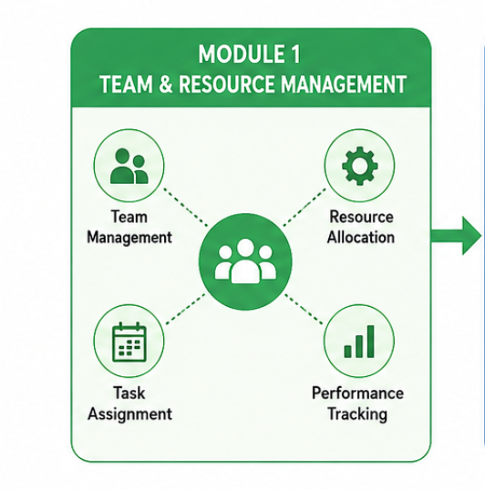
MODULE 1: TEAM & RESOURCE MANAGEMENT
Purpose: Manages team members, resources, roles, and task allocation required for workflow development and execution.
Key Features:
Team creation and role assignment
Resource allocation and management
Task assignment and scheduling
Performance tracking
Collaboration and communication

Slide 6
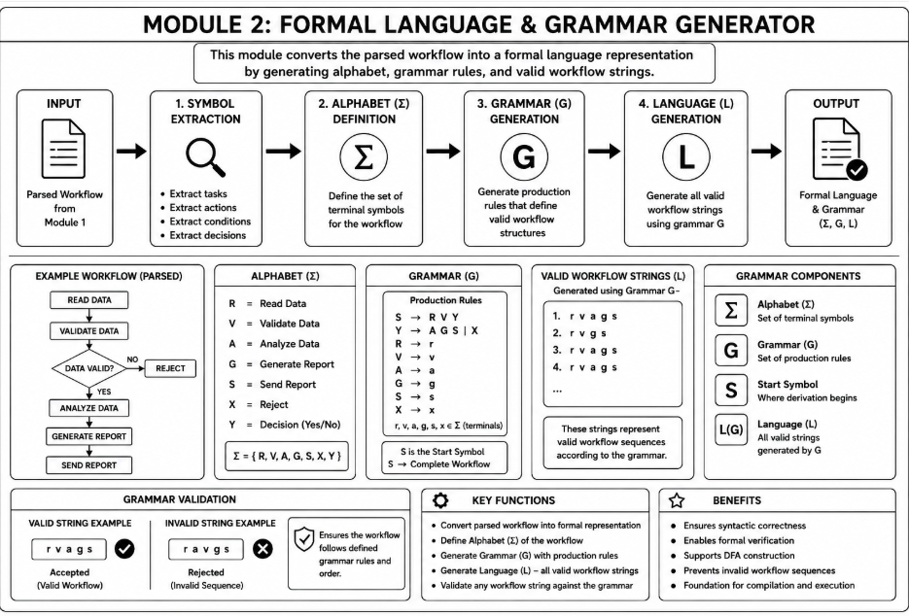
MODULE 2

Slide 7
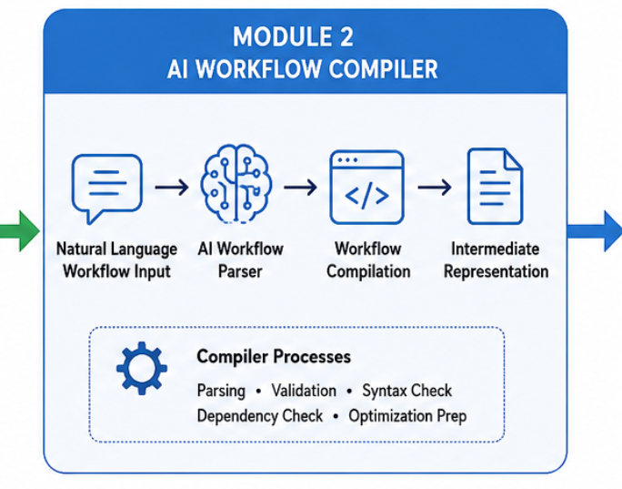
MODULE 3: AI WORKFLOW COMPILER
Purpose: Converts natural-language workflow descriptions into structured and executable workflow representations.
Key Features:
Natural-language workflow input
AI-based workflow parsing
Task and dependency identification
Syntax and workflow validation
Workflow compilation
Intermediate workflow representation

Slide 8
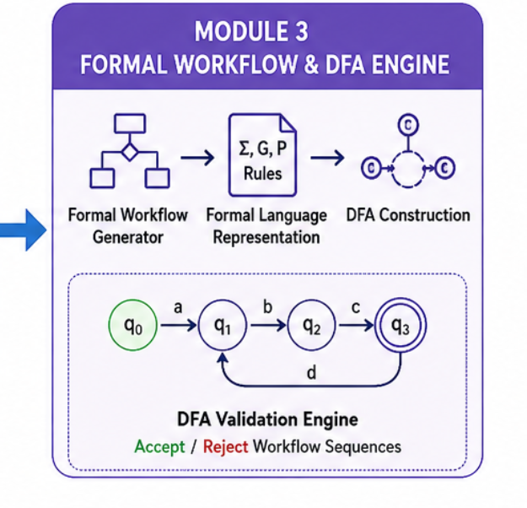
MODULE 4: FORMAL WORKFLOW & DFA ENGINE
Purpose: Represents workflows using formal language and validates workflow sequences using a Deterministic Finite Automaton (DFA).
Key Features:
Formal workflow generation
Formal language representation
Alphabet and grammar definition
DFA construction
Workflow sequence validation
Accept/Reject decision using DFA
Detection of invalid workflow transitions

Slide 9
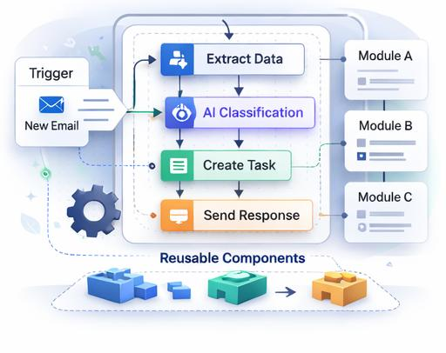
TECHNIQUES APPLIED
Formal Model: Deterministic Finite Automata (DFA)
Dependency Handling: Graph-Based Dependency Analysis
Scheduling: Constraint-Based Scheduling Algorithms
Validation: Schema & Constraint Validation (Zod)
Frontend Stack: Next.js, React, TypeScript
Client-Side Storage: IndexedDB with Dexie.js
AI & Output: Provider-Independent AI API + PDF Export

Slide 10
OUTCOMES
Faster workflow creation and reduced manual planning.
Structured, dependency-aware task assignment and scheduling.
Formal validation of sequential workflows using DFA.
Visual outputs: interactive workflow graph, flowchart, dependency graph, and Gantt timeline.
Reusable documentation via PDF export covering team, tasks, workflow, DFA, schedule, and risks.
Multi-domain applicability: healthcare, software, food, maintenance, manufacturing, research, construction, education.

Slide 11
FUTURE IMPROVEMENTS
Richer formal models beyond DFA, including NFA-based workflow representations.
Resource-constrained scheduling and workflow optimization.
Offline / local AI support and additional AI providers.
Document comparison, versioning, and workflow execution monitoring.
Mobile application and enterprise collaboration features.
Advanced analytics and failure-recovery / alternative workflow paths.

Slide 12
CONCLUSION
FlowForge bridges natural-language process planning, artificial intelligence, and formal language theory, converting informal procedures into structured, validated workflow representations.
AI is used for workflow generation rather than blindly trusted, with deterministic validation, DFA-based sequencing, and automatic scheduling ensuring consistent, visual workflow representations.
The same architecture supports healthcare, software, food, maintenance, manufacturing, research, and many other real-world domains — providing a path from human instructions to machine-processable workflows.

Slide 13


