Slide 1
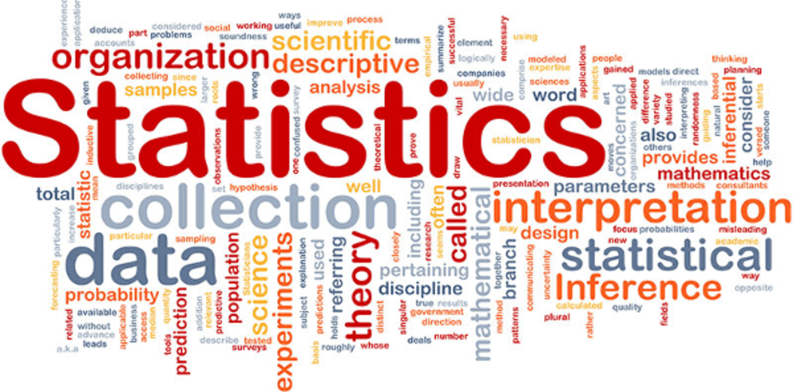

Slide 2
What is MEAN
Mean is nothing but of an average
We can find the mean by using the formula :
Sum of all data points in a given data set ________________________________________ Total number of data points in a data set

Slide 3
Finding the Mean
Example : a) data set = 7,11,16,14,11,13,19,13,13
mean = 7+11+16+14+11+13+19+13+13/9 = 13
b) data set = 16,15,16,17,19,12,14,9
mean = 16+15+16+17+19+12+14+9/8 = 14.75
c) data set = 27,66,24,81,60,41,74,81,97
mean = 27+66+24+81+60+41+74+81+97/9 = 60

Slide 4
What is Median
Median is a mid point value of among all the data points in a given data set.
There is two cases in median: 1. odd case 2. even case
In odd case we can identify the mid value by directly selecting the mid point in a data set.
Odd case: Median = (n+1/2)th observation Even case: Median = (n/2)th+(n/2+1)th observation/2

Slide 5
Finding the Median
Example : a)data set = 7,11,16,14,11,13,19,13,13
after arranging in a ascending order : 7,11,11,13,13,13,14,16,19
median = 13(mid value)
b) data set = 16,15,16,17,19,12,14,9
after arranging in a ascending order : 9,12,14,15,16,16,17,19
median = 15.5
c) data set = 27,66,24,81,50,40,74,81,97
after arranging in a ascending order : 24,27,40,50,66,74,81,81,97 median = 66(mid value)

Slide 6
What is mode
Mode is a most common value in a given data set among all the data points
Example : a) data set = 7,11,16,14,11,13,19,13,13
mode = 13(occurred 3 times)
b) data set = 16,15,16,17,19,12,14,9
mode = 16(occurred 2 times)
c) data set = 27,66,24,81,50,40,74,81,97
mode = 81(occurred 2 times)

Slide 7
What is standard deviation
Standard deviation is the number that tells us how far the data points are spread out to its mean value
There are two cases in standard deviation: 1.Low 2.high
When it is in low case it indicates that most data points are close to the mean value
When it is in high case it indicates that most data points are far to the mean value.
Variance is another number that tells us how far the data points are spread out to its mean value
Standard deviation = square root(variance)

Slide 8
Finding the standard deviation
Example : a)data set = 7,11,16,14,11,13,19,13,13
mean =13
after taking differences from data points from the mean = -6,-2,3,1,-2,0,6,0,0
after taking the squares of a differences = 36,4,9,1,4,0,36,0,0
after taking the average of above squares = 10
we know that
square root(variance) = standard deviation
=square(10) = 2.23

Slide 9
b) data set = 16,15,16,17,19,12,14,9
standard deviation = 2.90
c) data set = 27,66,24,81,60,41,74,81,97
standard deviation = 24.42

Slide 10
What is population mean and sample mean
Population is everything in group that we want to learn about.
The mean of that particular group is called population mean.
Sample is the some part of the population.
The mean of that some part of the population is called sample mean.

