Slide 1
742
42
Job Market
Total Jobs
Columns
Analysis
37
$101.56K
using SQL & Power BI
States
Avg Salary
Analyzing 742 data science job postings to uncover
salary trends, skill demand, and hiring patterns.
SQL · Power BI · DAX · Power Query
Data Analyst Internship
Project · 2026
Confidential — Internship Submission

Slide 2
PROJECT OBJECTIVE
02
What This Project Aims to Solve
Understand the current landscape of data science job openings across the US — identifying where opportunities are, how salaries differ, and what skills employers actually look for.
Geographic Trends
Role & Skill Demand
G
R
Map job distribution and salary ranges across US states
Identify most in-demand job titles and technical skills
Education vs Salary
Industry Insights
E
I
Analyze how degree levels influence compensation
Find which industries are actively hiring data talent
Job Market Analysis using SQL and Power BI

Slide 3
DATASET OVERVIEW
03
About the Data
742
42
37
60
Job Postings
Features / Columns
US States
Industries
Key Features in the Dataset
Job Info
Compensation
Company
Job Title, Job Description, Seniority Level
Avg Salary (K), Min Salary, Max Salary
Company Name, Size, Ownership Type, Rating
Location
Skills
Education
State, City, Headquarters
Python, SQL, AWS, Spark, Tableau, Hadoop...
Degree required (PhD, Masters, Not Specified)
Job Market Analysis using SQL and Power BI

Slide 4
TOOLS & TECHNOLOGIES
04
What Powered This Project
SQL
SQL
PBI
Power BI
Used for data extraction and initial cleaning from the database.
Primary tool for building the interactive job market dashboard.
Connected to relational DB
Imported cleaned SQL data
Ran aggregation queries
Created KPI cards & charts
Filtered & grouped data
Built filter slicers
PQ
Power Query
DAX
DAX
Used for additional data transformation inside Power BI.
Used to define calculated measures for KPIs and analysis.
Replaced -1 salary values
Total Jobs, Avg Salary
Split columns & renamed fields
DISTINCTCOUNT measures
Removed nulls & duplicates
Min/Max salary metrics
Job Market Analysis using SQL and Power BI

Slide 5
DATA PIPELINE
05
Collection & Cleaning Workflow
01
DB Connection
Connected to SQL database using provided credentials and extracted the raw dataset.
02
SQL Cleaning
Handled nulls, removed duplicates, standardized formats, and filtered irrelevant rows.
03
Power Query Transform
Replaced -1 salary placeholders, renamed columns, split compound fields for clarity.
04
DAX Measures
Built calculated columns and measures for KPIs including average salary and job counts.
Specific Cleaning Actions
-1 salary → handled
Nulls removed
State standardized
Job titles normalized

Slide 6
SQL QUERIES
06
Data Extraction & Aggregation
Job Distribution by State
Top 5 Industries by Hiring
↳ Identify which states have the most data science job openings
↳ Find industries actively recruiting for data roles
SELECT state, COUNT(*) AS total_jobs
FROM jobs
GROUP BY state
ORDER BY total_jobs DESC;
SELECT industry, COUNT(*) AS total_jobs
FROM jobs
GROUP BY industry
ORDER BY total_jobs DESC
LIMIT 5;
Average Salary by Job Title
↳ Compare compensation across different data science roles
SELECT job_title,
AVG(avg_salaryK) AS avg_salary
FROM jobs
GROUP BY job_title;
Job Market Analysis using SQL and Power BI

Slide 7
DAX MEASURES
07
Calculated KPIs in Power BI
Total Jobs
Avg Salary
Total Companies
= COUNTROWS(Jobs)
= AVERAGE(Jobs[avg_salaryK])
= DISTINCTCOUNT(Jobs[Company Name])
→ 465
→ $101.56K
→ 341
Counts total job postings in the filtered view
Mean salary across all job listings
Unique companies with active postings
Total Industries
Avg Min Salary
Avg Max Salary
= DISTINCTCOUNT(Jobs[Industry])
= AVERAGE(Jobs[lower_salary])
= AVERAGE(Jobs[upper_salary])
→ 60
→ ~$74K
→ ~$134K
Number of distinct industries represented
Average lower bound of posted salary ranges
Average upper bound of posted salary ranges
Job Market Analysis using SQL and Power BI

Slide 8
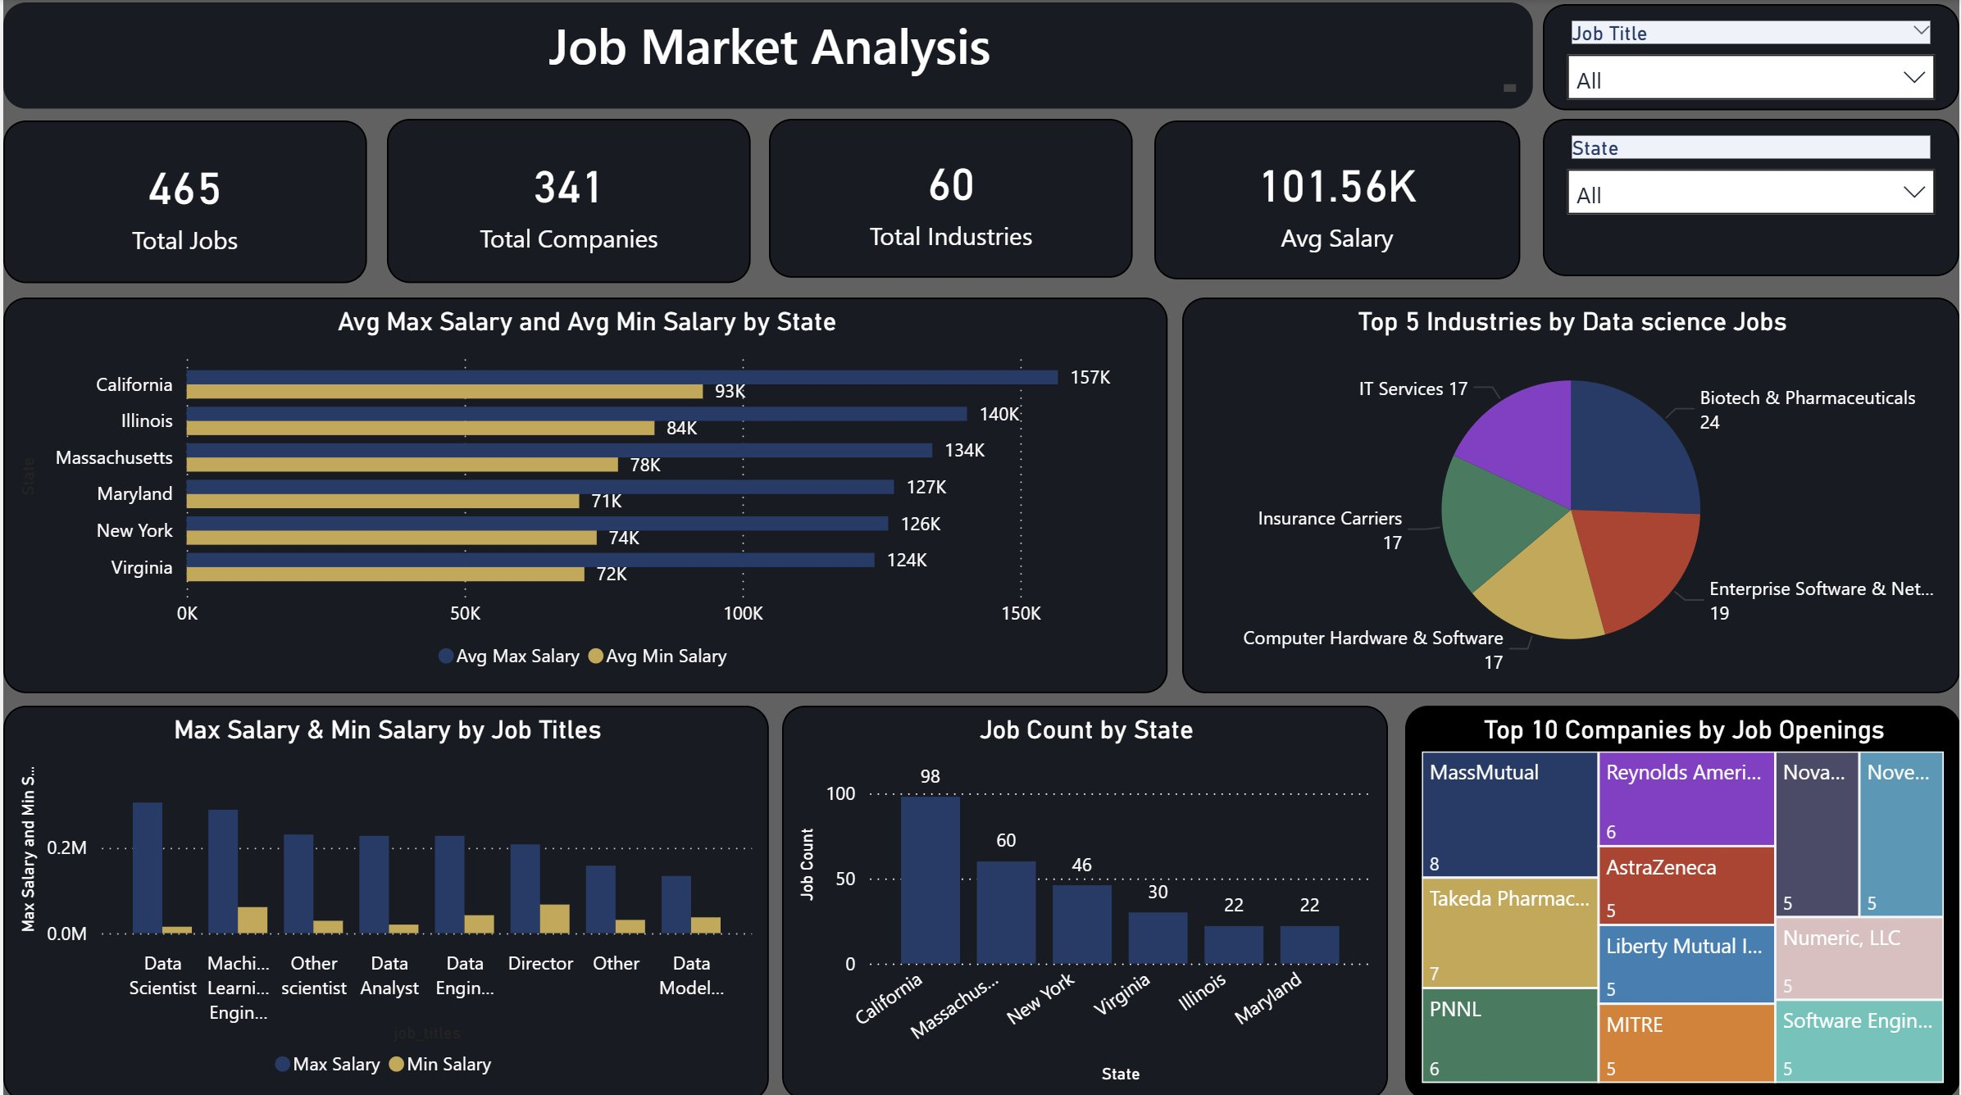
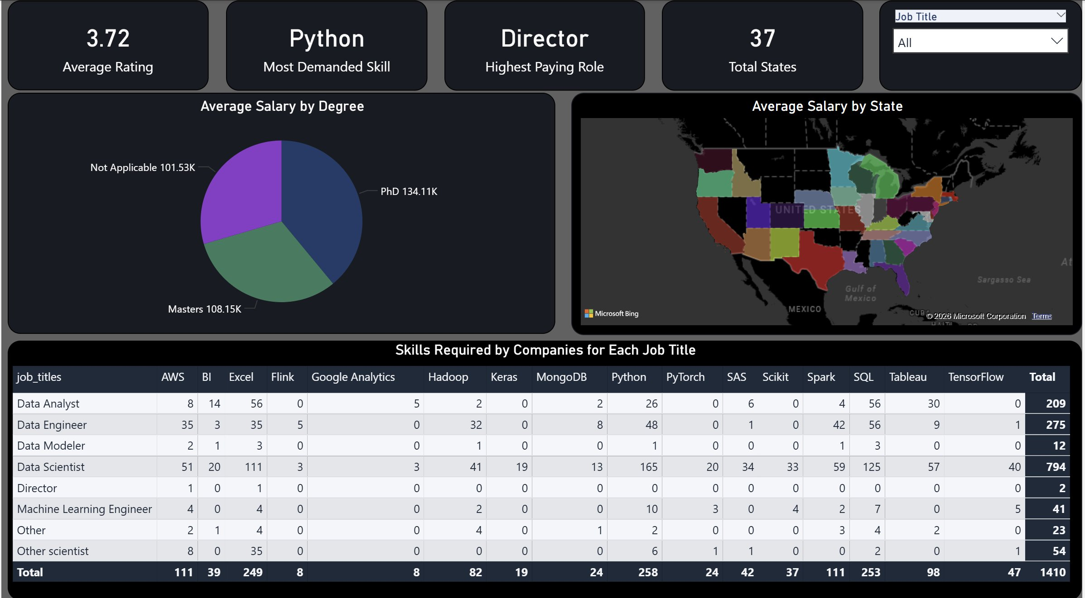
DASHBOARD OVERVIEW
08
Interactive Power BI Dashboard
Page 2 — Skills & Education
KPI Cards
Bar Charts
Pie Charts
Map Visual
Treemap
Matrix Table
Slicers
Page 1 — Salary & Job Distribution
Job Market Analysis using SQL and Power BI

Slide 9
GEOGRAPHIC ANALYSIS
09
States & Salary Distribution
★ California dominates both in job volume (98 postings) and salary ceiling ($157K avg max) — making it the #1 state for data science careers.

Slide 10
INDUSTRY & COMPANY
10
Who Is Hiring?
Top Companies by Job Openings
MassMutual
8
Takeda Pharmaceuticals
7
PNNL
6
Reynolds American
6
AstraZeneca
5
Liberty Mutual
5
MITRE
5
★ Biotech & Pharma leads with 24 postings, followed closely by Enterprise Software. Healthcare and tech sectors are the biggest recruiters of data talent.
Job Market Analysis using SQL and Power BI

Slide 11
SKILLS & ROLES
11
What Employers Are Looking For
★ Python (258) and SQL (253) are the most in-demand skills. Directors earn the highest salaries while Data Scientist is the most common listed role.
Job Market Analysis using SQL and Power BI

Slide 12
EDUCATION ANALYSIS
12
Does Your Degree Level Impact Salary?
PhD
+32%
$134.11K
Above Not Applicable baseline
Masters
+6%
$108.15K
Moderate salary premium
Not Applicable
—
$101.53K
★ PhD holders earn on average $32.58K more than those without a specific degree requirement. Education remains a strong salary differentiator in data science.
Base compensation level
Job Market Analysis using SQL and Power BI

Slide 13
KEY INSIGHTS
13
What the Data Tells Us
01
California leads with 98 job postings and the highest salary ceiling at $157K average max.
02
Data Scientist is the most demanded role — appearing in over a third of all job listings.
LOCATION
ROLE
03
Python (258) and SQL (253) are near-universal requirements across all data science roles.
04
Biotech & Pharmaceuticals is the #1 hiring industry, surpassing enterprise software and IT services.
SKILLS
INDUSTRY
05
PhD holders command $134K avg salary — 32% above candidates without a degree requirement.
06
Machine Learning Engineers see some of the highest salary bands among individual contributor roles.
EDUCATION
SALARY
Job Market Analysis using SQL and Power BI

Slide 14
RECOMMENDATIONS
14
Actionable Suggestions
▶ For Job Seekers
▶ For Hiring Companies
Target California, Massachusetts, and New York for maximum opportunity density.
Expand talent pipelines beyond California to states like Virginia and Illinois.
Prioritize Python and SQL — these appear in over 95% of listings.
Offer competitive salary bands to attract ML Engineers and senior Data Scientists.
Consider pursuing a Masters or PhD to access the higher salary tiers.
Clearly specify required skills in JDs to improve quality of applicant pools.
Develop cloud skills (AWS) and big data tools (Spark, Hadoop) as secondary differentiators.
Consider sponsoring advanced education to build internal PhD-level talent.
Build a portfolio that showcases Data Scientist or ML Engineer skills — both high-demand and high-paying.
Partner with universities in Massachusetts — a high-concentration state for data talent.
Job Market Analysis using SQL and Power BI

Slide 15
CONCLUSION
15
Wrapping It Up
This project provided a comprehensive view of the data science job market across the United States using SQL for data extraction and Power BI for visualization. The analysis uncovered meaningful patterns in salary distribution, hiring trends, skill demand, and the impact of education on compensation.
Skills Developed During This Project
SQL Querying
Power Query
DAX Formulas
Wrote aggregation, grouping & ordering queries on real data
Cleaned and transformed messy salary and location data
Built KPI measures used across all dashboard visuals
Data Storytelling
Dashboard Design
Business Thinking
Turned raw numbers into actionable hiring insights
Designed a clean, filterable Power BI dashboard
Linked data findings to real-world hiring recommendations
Job Market Analysis using SQL and Power BI

Slide 16
Thank You
for your time and attention
Job Market Analysis using SQL and Power BI
Data Analyst Internship Project · 2026
742
42
10
4
Jobs Analyzed
Features
Key Insights
Tools Used

