Slide 1
LENDING CLUB CASE STUDY
EXPLORATORY DATA ANALYSIS(EDA)

Slide 2
Problem Statement
Given is the sample data from a consumer finance company which specializes in lending various types of loans
The business lends various types of loans to customers based on whether the customer will be able to repay them or not
Even though the Approval/Rejection process considers the ability to repay, we see certain customers are ‘defaulted’
We need to analyze various factor influencing a customer to be ‘defaulted’

Slide 3
Business Objective
Analyze the information about past loan applicants and whether they ‘defaulted’ or not
Analyze how consumer attributes and loan attributes influence the tendency of a customer to default using Exploratory Data Analysis(EDA)
Identify patterns and draw insights from the analysis that the business can utilize

Slide 4
Data Cleaning
Columns with all null values are dropped
Columns that have mostly null values are dropped
Removed special characters(<, +, %) and formatted numerical variables to contain only numbers
Converting the type of numerical variable to number

Slide 5
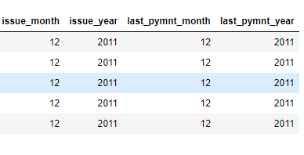
Derived Metrics
Derived month and year columns from date variables(“issue_d”, “last_payment”)
For making analysis based on date variable easier

Slide 6
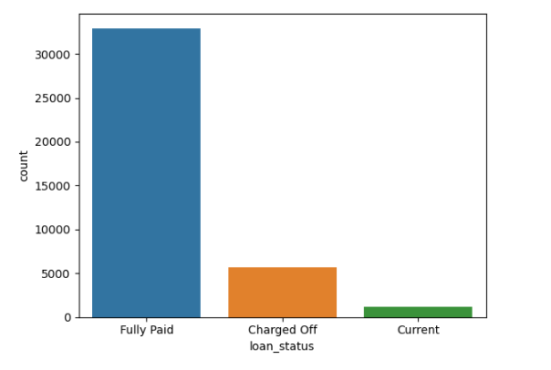
Univariate Analysis – Loan Status
About 5000 of loans are Charged Off
Significant number of loans have been defaulted

Slide 7
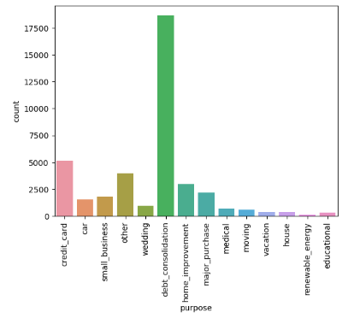
Univariate Analysis – Loan Purpose
The most common purpose of loan is “Debt Consolidation”

Slide 8
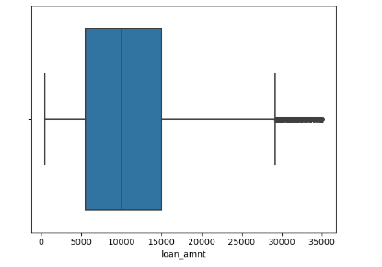
Univariate Analysis – Loan Amount
Most of the loans have a loan amount ranging between 5000(25th percentile) and 15000(75th percentile)

Slide 9
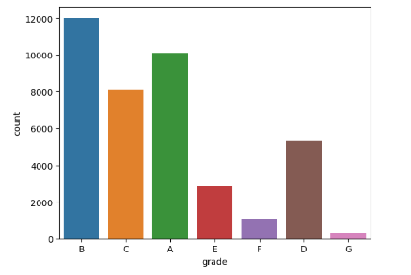
Univariate Analysis – Loan Grade
The most common loan grade is “B” followed by “A”

Slide 10
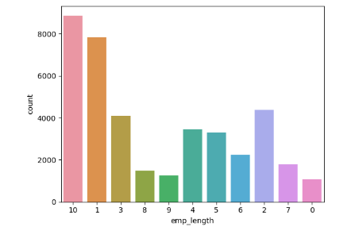
Univariate Analysis – Employment Length
Most of the borrowers have 10 or more years of employment/experience
Followed by borrowers who have only one year of experience

Slide 11
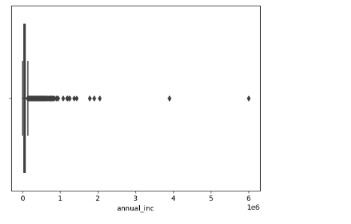
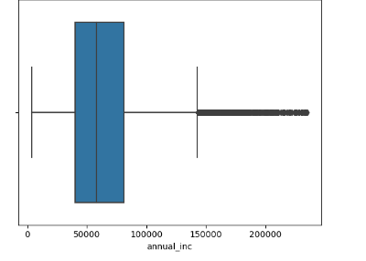
Univariate Analysis – Annual Income
Annual Income has outliers where only two borrowers have an annual income more than 30 Lakhs
After removing the outliers, borrower’s annual income can be analyzed.
Outlier Handling

Slide 12
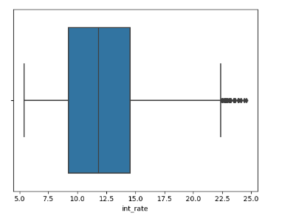
Univariate Analysis – Interest Rate
Most loans had the interest rates ranging from 9.0 to 15.0

Slide 13
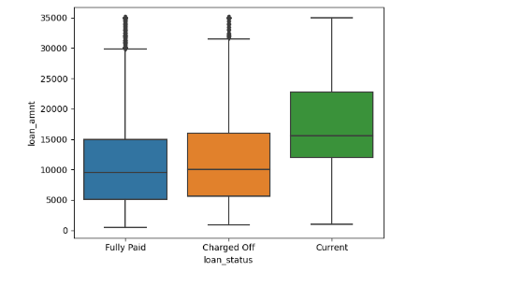
Segmented Univariate Analysis Loan Amount across Loan Status Categories
The 25th, 50th and 75th percentile of Loan amount for Fully Paid Loans and Charged off Loans are similar

Slide 14
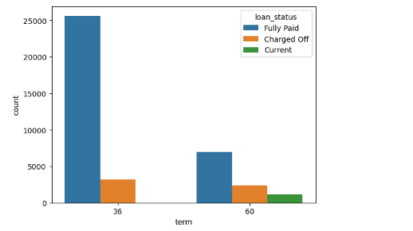
Segmented Univariate Analysis Loan Term across Loan Status Categories
Significant Charged off loans have a loan term of 36 or 60 months
Most loans are fully paid across loan terms

Slide 15
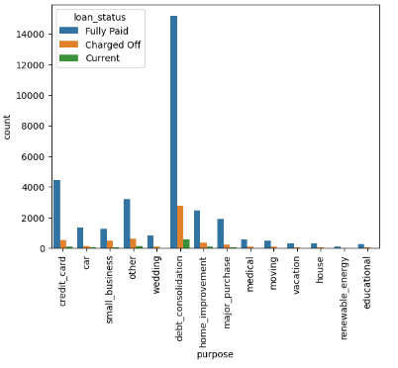
Segmented Univariate Analysis Loan Purpose across Loan Status Categories
Most loans have a loan purpose of “Debt Consolidation” across all loan statuses

Slide 16
Derived Metrics for Bivariate Analysis
Categorized numerical variables(“loan_amnt”, “int_rate”, “annual_inc”) into bucket based on the range of the numerical values they hold
Derived a total columns that sums the number of loans that are Fully Paid, Charged Off and Current
Total = Fully Paid + Current + Charged Off
Derived a column that signifies the probability of the loan being defaulted
Charge Off Likeliness = Charged Off / Total
This derived column “Charge Off Likeliness” is used for bivariate analysis

Slide 17
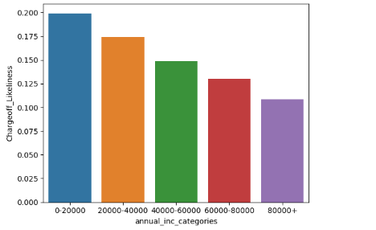
Bivariate Analysis Annual Income Categories VS Charge Off Likeliness
The probability of the loan being defaulted is high if the annual income is low, so the annual income has negative correlation to charge off likeliness

Slide 18
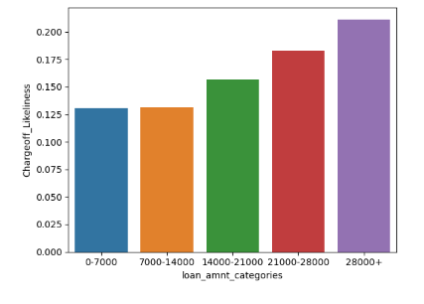
Bivariate Analysis Loan Amount Categories VS Charge Off Likeliness
The probability of loan being defaulted increases if the loan amount increases, so high loan amount likely indicates high Charge Off Likeliness

Slide 19
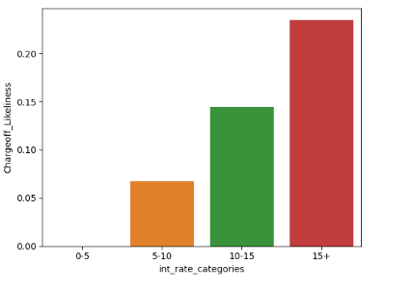
Bivariate Analysis Interest Rate Categories VS Charge Off Likeliness
The probability of loan being defaulted increases if the interest rate increases, so high interest rate likely indicates high Charge Off Likeliness

Slide 20
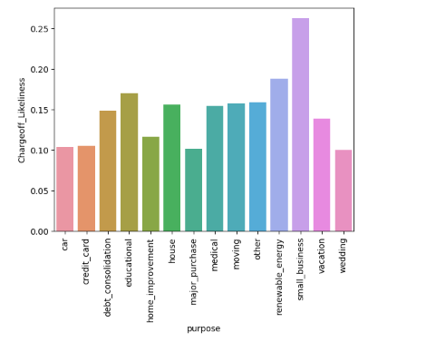
Bivariate Analysis Loan Purpose VS Charge Off Likeliness
The probability of a loan being defaulted is high if the loan purpose is “Small Business”, followed by “Renewable Energy” and “Educational”

Slide 21
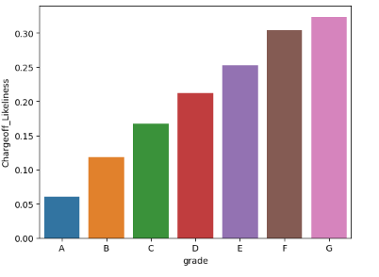
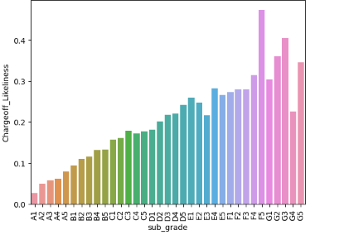
Bivariate Analysis Grade and Sub Grade VS Charge Off Likeliness
The probability of a loan being defaulted increases as we move from grade ‘A’ to ‘G’
The probability of a loan being defaulted increases as we move from sub grade in ‘A’ to ‘G’

Slide 22
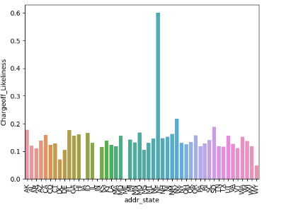
Bivariate Analysis Address State VS Charge Off Likeliness
The probability of a loan being defaulted is high for the state ‘NE’, followed the states ‘NV’, ‘SD’ and ‘FL’

Slide 23
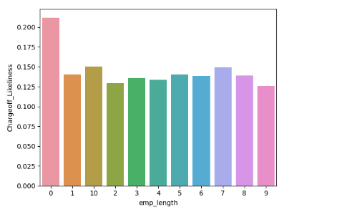
Bivariate Analysis Employment Length VS Charge Off Likeliness
The probability of a loan being defaulted is high if the employment length or experience 0 years

Slide 24
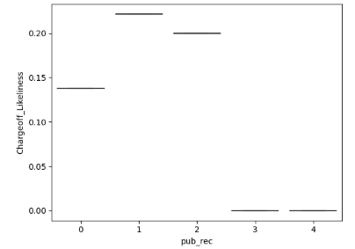
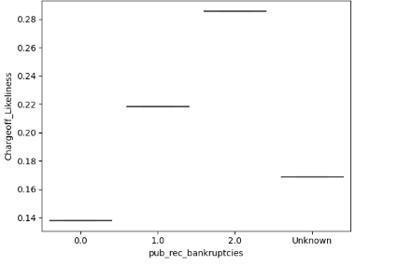
Bivariate Analysis Public Record Fields VS Charge Off Likeliness
The probability of a loan being defaulted is high if public records is 1 or 2
Apart from the unknown values, the probability of a loan being defaulted increases as the public bankruptcy record increases

Slide 25
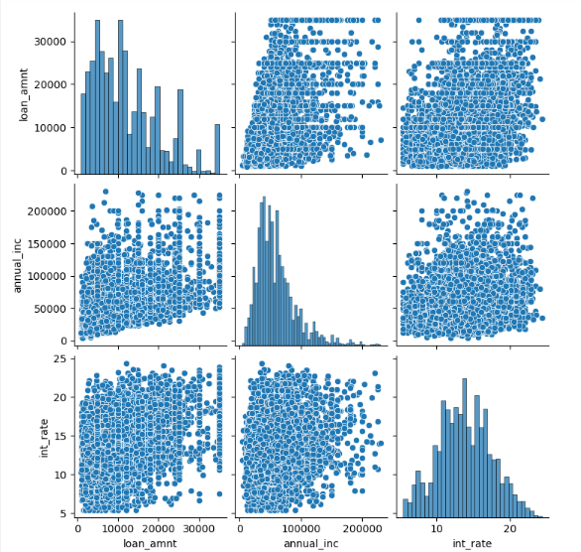
Multivariate Analysis Annual Income VS Interest Rate VS Loan Amount For Charged Off Loans

Slide 26
Summary
About 5000 loans(considerable amount) out of the sample data are charged off or defaulted
Most Charged Off Loans and In general most loans with various loan statuses have a loan purpose of “Debt Consolidation”. In other words “Debt Consolidation” is the common loan purpose
Positive correlation : The probability of a loan being defaulted(Charge Off Likeliness) is high if the Annual Income of the borrower is low
Negative correlation : The probability of a loan being defaulted(Charge Off Likeliness) is high if Loan Amount is high. Same applies to Interest Rate as well.
The probability of a loan being defaulted(Charge Off Likeliness) is high if the Public records is 1 or 2. It also increases as the Public Bankruptcy record increases
The probability of a loan being defaulted(Charge Off Likeliness) is high if the loan purpose is “Small Business”
The probability of a loan being defaulted(Charge Off Likeliness) is high if address state is “NE”
The probability of a loan being defaulted(Charge Off Likeliness) is high if Employment Length is 0
The probability of a loan being defaulted(Charge Off Likeliness) is high if we move through grades and sub grades “A” to “G”, so that loans with Grade G has highest probability.

