Slide 1
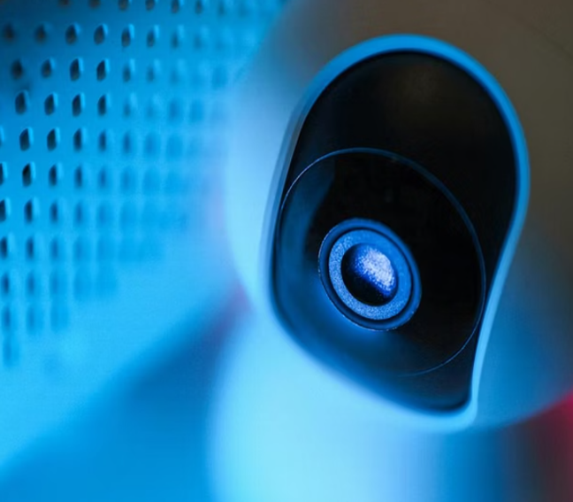
AI-Powered Botnet Detection in Virtual Smart Homes
“Protecting IoT ecosystems through intelligent simulation and machine learning”

Slide 2

Introduction
Interconnected Living: Rapid adoption of smart cameras, thermostats, and automated controllers.
The Convenience Focus: Manufacturers prioritize "plug-and-play" ease of use over robust security.
Hardware Constraints: Low CPU/RAM limits prevent traditional antivirus or heavy encryption.
Permanent Vulnerability: 24/7 connectivity and default credentials create unmonitored entry points.
The Weakest Link: Unmanaged IoT devices are now the primary targets for global network hijacking.

Slide 3
The Transition: From Smart Home to Cyber Weapon
The Chain Reaction: Unsecured devices lead to silent infections (Botnets), creating a global threat.
Invisible Compromise: Users remain unaware as their devices maintain normal local functionality.
Botnet: Botnets are networks of compromised devices controlled by attackers to launch coordinated attacks like DDoS. IoT devices in smart homes—cameras, thermostats, bulbs—are prime targets due to weak security and default credentials.
Scalability: A single home’s vulnerability contributes to a "Zombie Army" capable of taking down national infrastructure.
The Critical Gap: Current home routers cannot see these internal infections or stop outgoing malicious traffic.

Slide 4
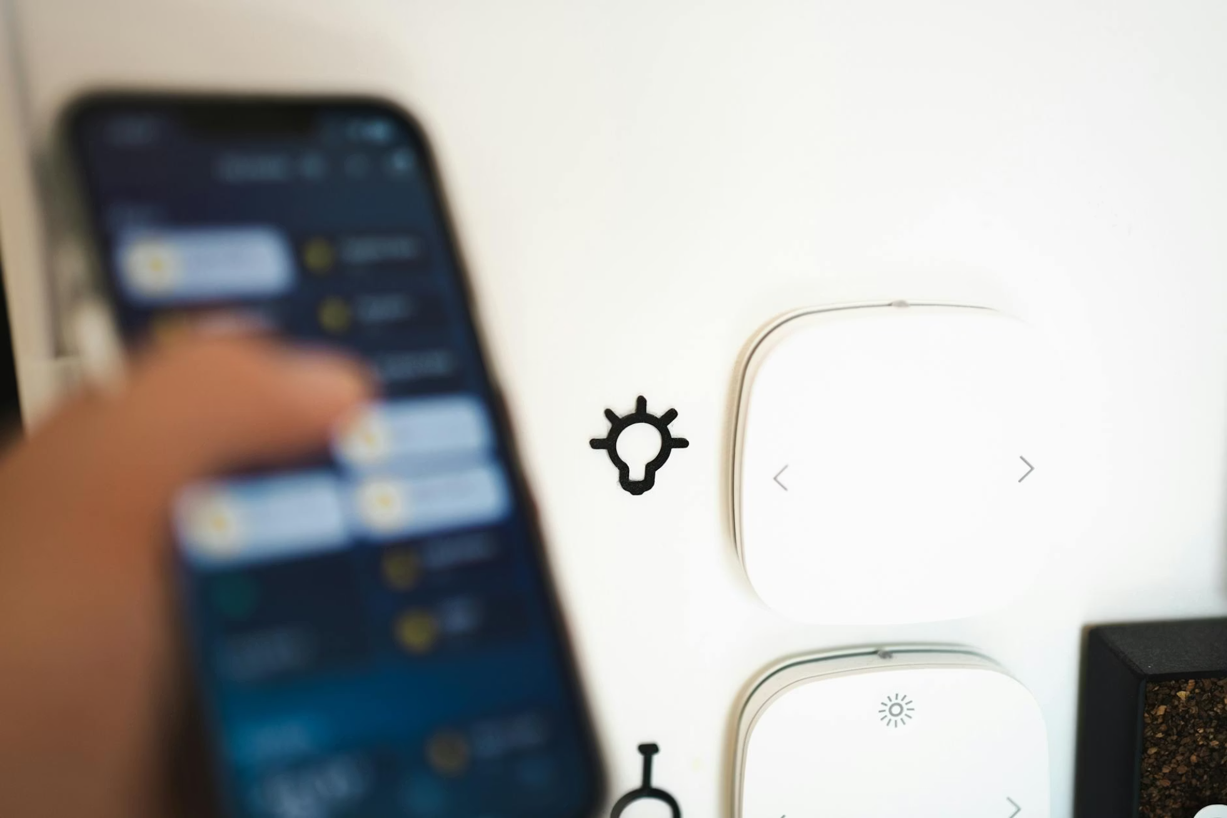
Problem
Inadequate Defense: Standard firewalls fail to detect polymorphic, "Zero-Day" botnet traffic.
Resource Gap: IoT hardware is too weak for local encryption or antivirus software.
Detection Crisis: Botnet patterns are increasingly difficult to distinguish from legitimate user data.
The Solution: Need for an ML-driven intelligent firewall at the network edge.

Slide 5
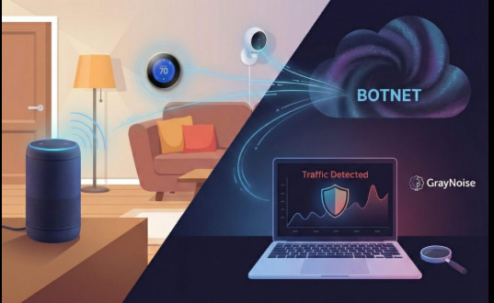
Project Objectives
Real-Time Detection: Identify and flag malicious traffic with sub-second latency.
High Reliability: Achieve a 99% detection rate with near-zero False Positive Rates.
Optimized Edge AI: Use a lightweight Random Forest algorithm to minimize computational overhead.
Feature Engineering: Extract critical network metadata (Packet size, jitter, frequency) for anomaly detection.
Traffic Isolation: Automatically quarantine "Zombie" devices before they can participate in external attacks.

Slide 6
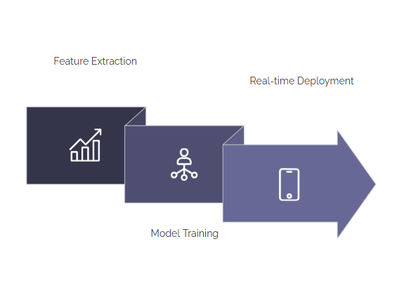
Methodology
System Architecture
Data Collection: Capturing traffic from 9 device types (cameras, doorbells, etc.).
Traffic Mirroring: Diverting network packets to the AI analyzer without interrupting user flow.
The "Brain": Implementing the Random Forest algorithm as the decision-making core.
Response Mechanism: Flagging and isolating the "zombie" node once an anomaly is detected.

Slide 7
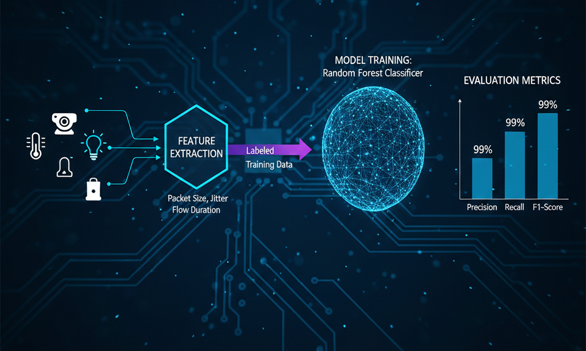
Methodology
Technical Implementation
Feature Extraction: Focus on metadata like Packet Size, Jitter, and Flow Duration.
Model Training: Supervised learning using labeled "Normal" vs. "Attack" data.
Evaluation Metrics: Precision, Recall, and F1-Score will be used to measure success.

Slide 8
Result
1.Detection Efficacy (The 10/90 Stress Test)Metric: Achieved 99.9% Accuracy and F1-Score across all IoT device profiles.
Significance: Validated the model using a high-stress 10% Training / 90% Testing split, proving extreme robustness in data-sparse environments.
Insight: Shallow architecture ($Depth=2$) successfully captures "Universal Behavioral DNA" rather than malware-specific noise.
2. Real-Time Deployment MetricsMirai Latency: 3.45 $\mu$s per packet.
Bashlite Latency: 5.56 $\mu$s per packet.
Throughput: Capable of processing >180,000 packets per second, exceeding the requirements for high-speed industrial IoT gateways.
3. Cross-Malware Transferability (The "Uniqueness" Factor)Observation: Bidirectional testing between Mirai and Bashlite resulted in ~50% accuracy.
Technical Proof: This mathematically proves that Mirai and Bashlite signatures are orthogonal (non-overlapping).
Conclusion: Justifies a Modular Ensemble approach where specialized lightweight models provide 360-degree coverage.
4. Explainability (XAI)Feature Dominance: Identified $L0.01\_weight$ and $L0.01\_mean$ as the primary diagnostic heartbeats.
Transparency: Model decisions are based on immediate packet frequency, allowing for clear forensic auditing.

Slide 9
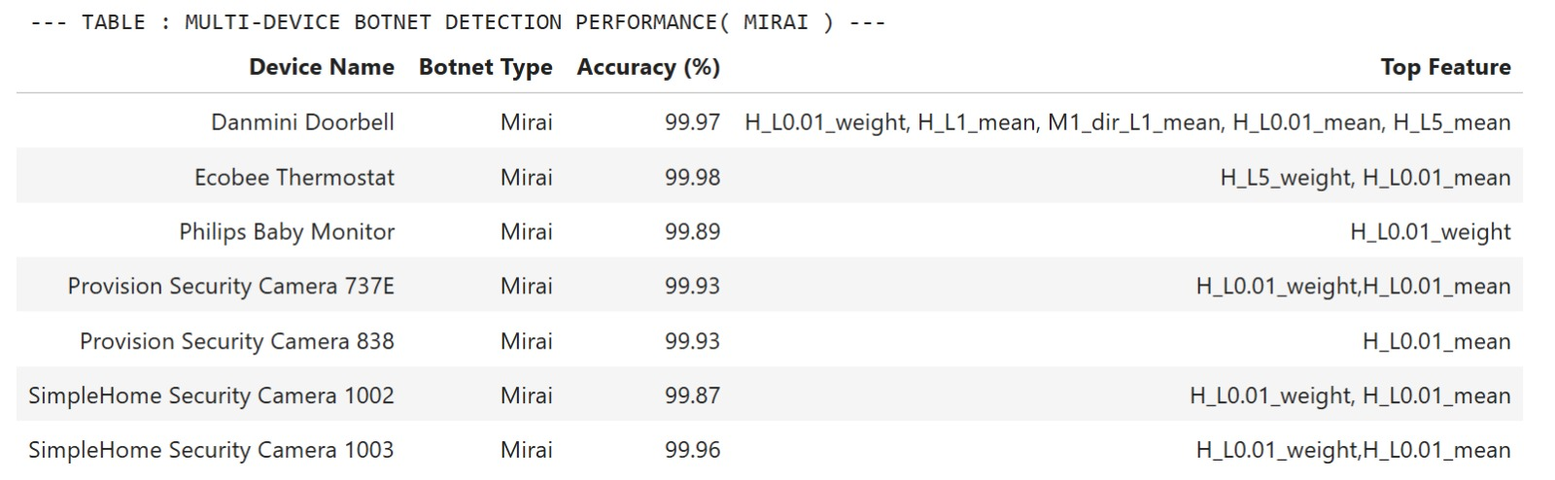
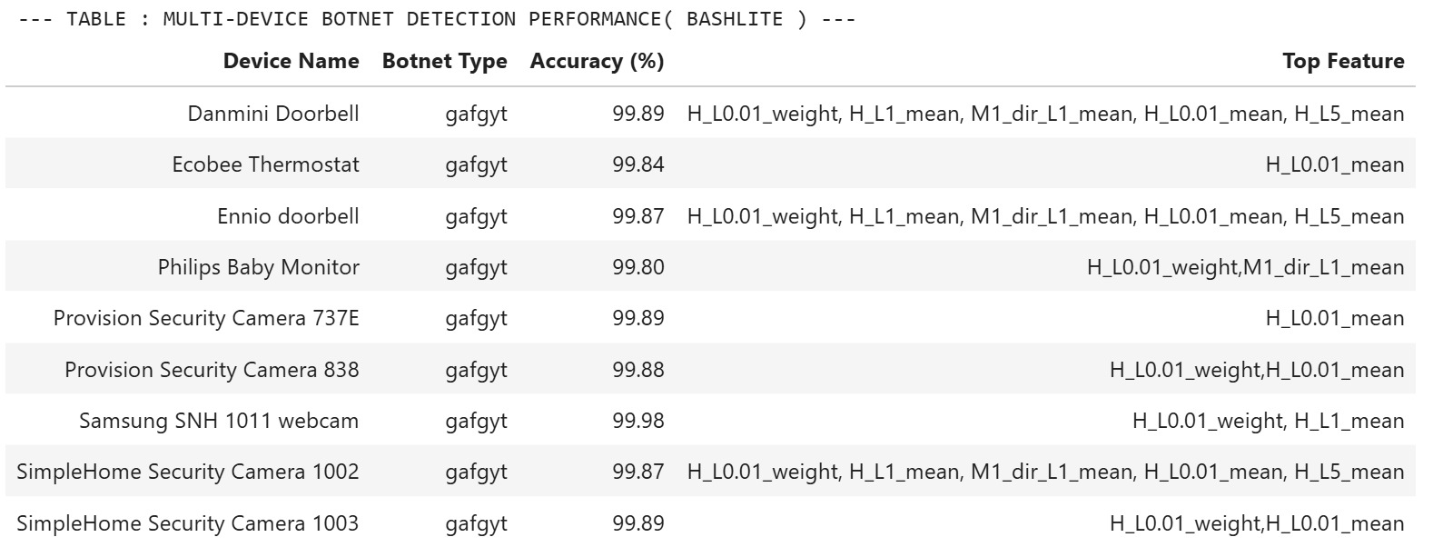
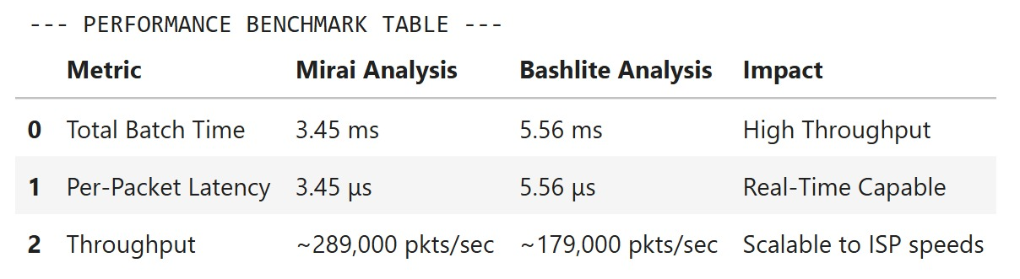
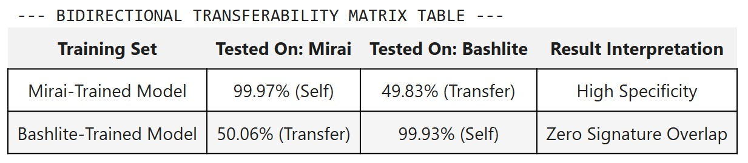
Result

Slide 10
Future Scope
Hybrid Ensemble Security Orchestration: Implementing a "Master Classifier" that uses the high classification uncertainty (~50%) discovered in our tests as a diagnostic trigger to route unknown traffic for forensic analysis.
Hardware-in-the-Loop Validation: Deploying optimized models onto physical microcontrollers (e.g., ESP32) to measure real-world power consumption and CPU utilization during active botnet mitigation.
Adversarial Resilience: Investigating the impact of "poisoned" packets designed to mimic benign traffic and developing retraining protocols to counter sophisticated evasion tactics.
Privacy-Preserving Federated Learning: Exploring decentralized training to allow IoT devices to update local weights based on new threat signatures without compromising sensitive user data.
Extended Malware Taxonomy: Expanding the behavioral library to include emerging threats like Mozi and Dark_Nexus for universal, 360-degree IoT protection.

Slide 11
References
Y. Meidan et al., "N-BaIoT: Network-based Anomaly Detection of IoT-Botnet Attacks Using Deep Autoencoders," UCI Machine Learning Repository, 2018. [Online]. Available: https://archive.ics.uci.edu/ml/datasets/detection_of_IoT_botnet_attacks_N_BaIoT
F. Pedregosa et al., "Scikit-learn: Machine Learning in Python," Journal of Machine Learning Research, vol. 12, pp. 2825-2830, 2011.
M. Antonakakis et al., "Understanding the Mirai Botnet," in Proc. 26th USENIX Security Symposium, 2017, pp. 1093-1110.
L. Breiman, "Random Forests," Machine Learning, vol. 45, no. 1, pp. 5-32, 2001.
W. McKinney, "Data Structures for Statistical Computing in Python," in Proc. 9th Python in Science Conf., 2010, pp. 51-56.
J. D. Hunter, "Matplotlib: A 2D Graphics Environment," Computing in Science & Engineering, vol. 9, no. 3, pp. 90-95, 2007.

Slide 12
Thank you
23BCE8392, T. Jayanth
23BCE8391, M. Anirudh Krishna
23BCE9801, P. Ravi Chandra
23BCE, Karthik Sai

