Slide 1
Robust Neuro-Fuzzy Diagnostic Pipeline for Medical Imaging
“Integrating Swarm Intelligence and Explainable Fuzzy Logic for Robust Medical Diagnostics”
By, T.Jayanth
23BCE8392

Slide 2

OUTLINE
Introduction
Literature Review
Objectives
Methodology
Experimental Results
Future Scope
Conclusion
References
2

Slide 3
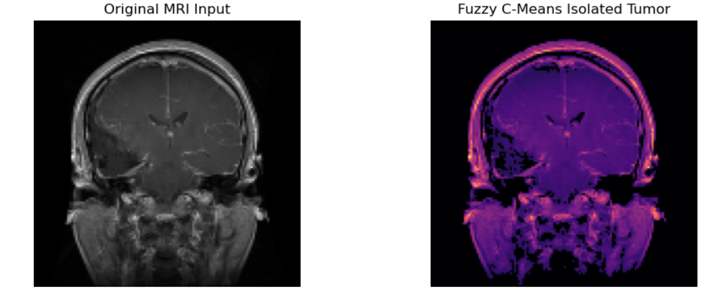
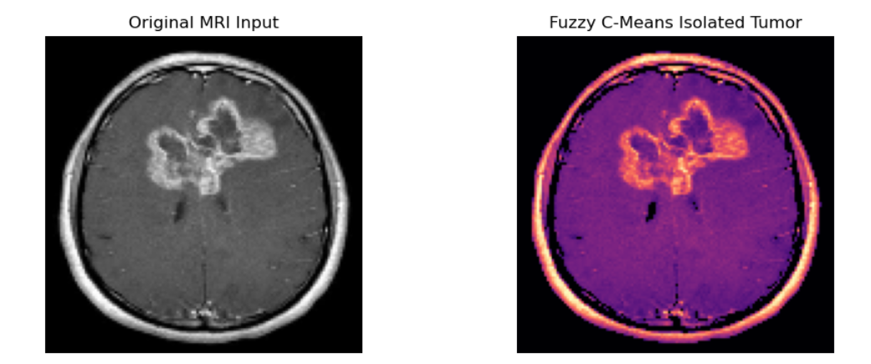
INTRODUCTION
The Radiology Workflow: Medical imaging is the gold standard for pathology diagnosis; however, the massive volume of MRI data creates an urgent need for automated, high-precision Computer-Aided Diagnosis (CAD) systems.
The "Black Box" Barrier: State-of-the-art AI models often function as "Black Boxes"—achieving high numerical accuracy but failing to provide the transparent, clinical reasoning required for radiologists to trust AI-assisted decisions.
The Dimensionality Challenge: Traditional Neuro-Fuzzy models struggle with computational inefficiency and overfitting when processing complex, high-dimensional medical image features, a limitation known as the "Curse of Dimensionality".
Our Objective: We engineered a transparent, 5-stage "White-Box" diagnostic pipeline. By integrating Swarm Intelligence for feature optimization, Cascaded Fuzzy Logic (Mamdani) for clinical risk triage, and Unsupervised Topological Mapping (Kohonen SOM) for mathematical validation, we bridge the gap between AI accuracy and clinical trust.

Slide 4
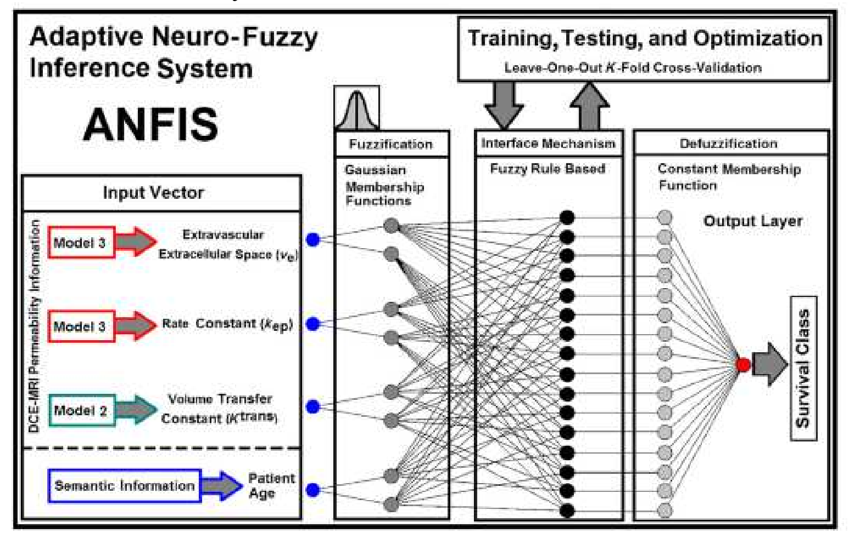
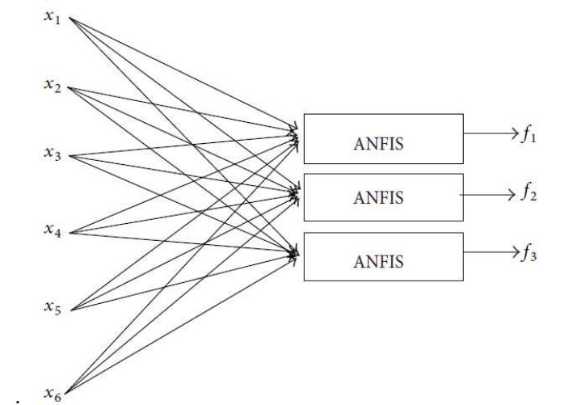
LITERATURE REVIEW(BASE PAPER)
ANFIS for Diagnostics: The research paper provides a comprehensive review of Adaptive Neuro-Fuzzy Inference Systems (ANFIS), demonstrating their efficacy in applying hybrid machine learning to medical image classification tasks.
Hybrid Learning Architecture: The studies utilized integrated architectures that combine the pattern recognition capabilities of neural networks with the rule-based decision-making of fuzzy logic to automate diagnostic output.
Accuracy-Centric Benchmarking: The primary success metric within the reviewed literature was numerical diagnostic accuracy, with various studies reporting high performance metrics to validate the ANFIS methodology.

Slide 5

Cont..
IDENTIFIED GAPS -
Curse of Dimensionality: Standard implementations process all extracted image features indiscriminately, causing computational bottlenecks and model overfitting when applied to complex medical data.
The "Black-Box" Limitation: Existing models lack clinical explainability. They output a binary diagnosis without providing the transparent, human-readable risk stratification required for medical professionals to trust the AI.
Lack of Independent Validation: Baseline systems rely entirely on supervised training (human labeling), without providing mathematical proof that the extracted features naturally and autonomously separate into distinct pathological clusters.

Slide 6

OBJECTIVES
Dimensionality Optimization: Implement a Binary Particle Swarm Optimization (BPSO) wrapper to filter redundant data features, thereby eliminating the "Curse of Dimensionality" and improving computational efficiency.
Architectural Enhancement: Develop a custom neuro-fuzzy pipeline using PyTorch to replace legacy, inefficient training methods with modern, stable optimization techniques like the Adam optimizer.
Clinical Explainability (XAI): Engineer a cascaded Mamdani Fuzzy Inference System to translate the neural network's raw diagnostic probabilities and physical anomaly dimensions into transparent, human-readable clinical risk scores.
Unsupervised Validation: Implement a Kohonen Self-Organizing Map (SOM) to autonomously cluster patient data, providing mathematical proof of the system's feature-extraction robustness without relying on human-provided labels.

Slide 7
METHODOLOGY
Soft Computing Segmentation: Raw MRI inputs undergo Fuzzy C-Means (FCM) clustering to isolate hyperintense tumor regions, drastically reducing background noise and artifacts.
Swarm-Based Feature Optimization: We implemented Binary Particle Swarm Optimization (BPSO) to navigate high-dimensional feature spaces, effectively filtering redundant data and solving the "Curse of Dimensionality."
Neuro-Fuzzy Modeling: A custom ANFIS architecture was engineered using PyTorch, utilizing Gaussian membership functions and Adam optimization to achieve high-precision classification.
Cascaded Validation Framework: The final pipeline integrates a two-stage evaluation process: a cascaded Mamdani system for transparent clinical risk triage, followed by a Kohonen Self-Organizing Map (SOM) for unsupervised mathematical validation of the extracted features.

Slide 8
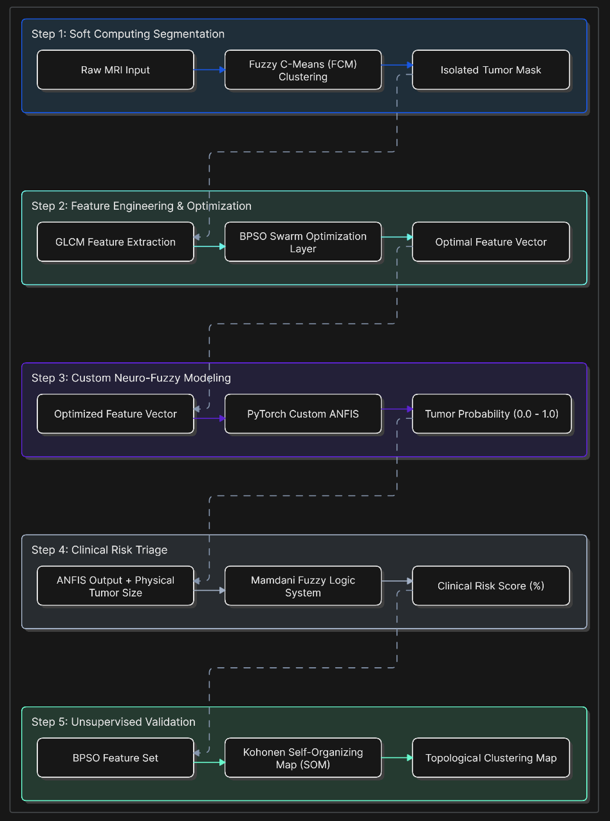
Cont..
Flowchart -

Slide 9
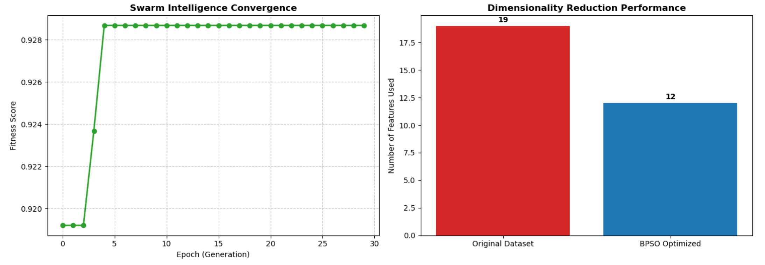
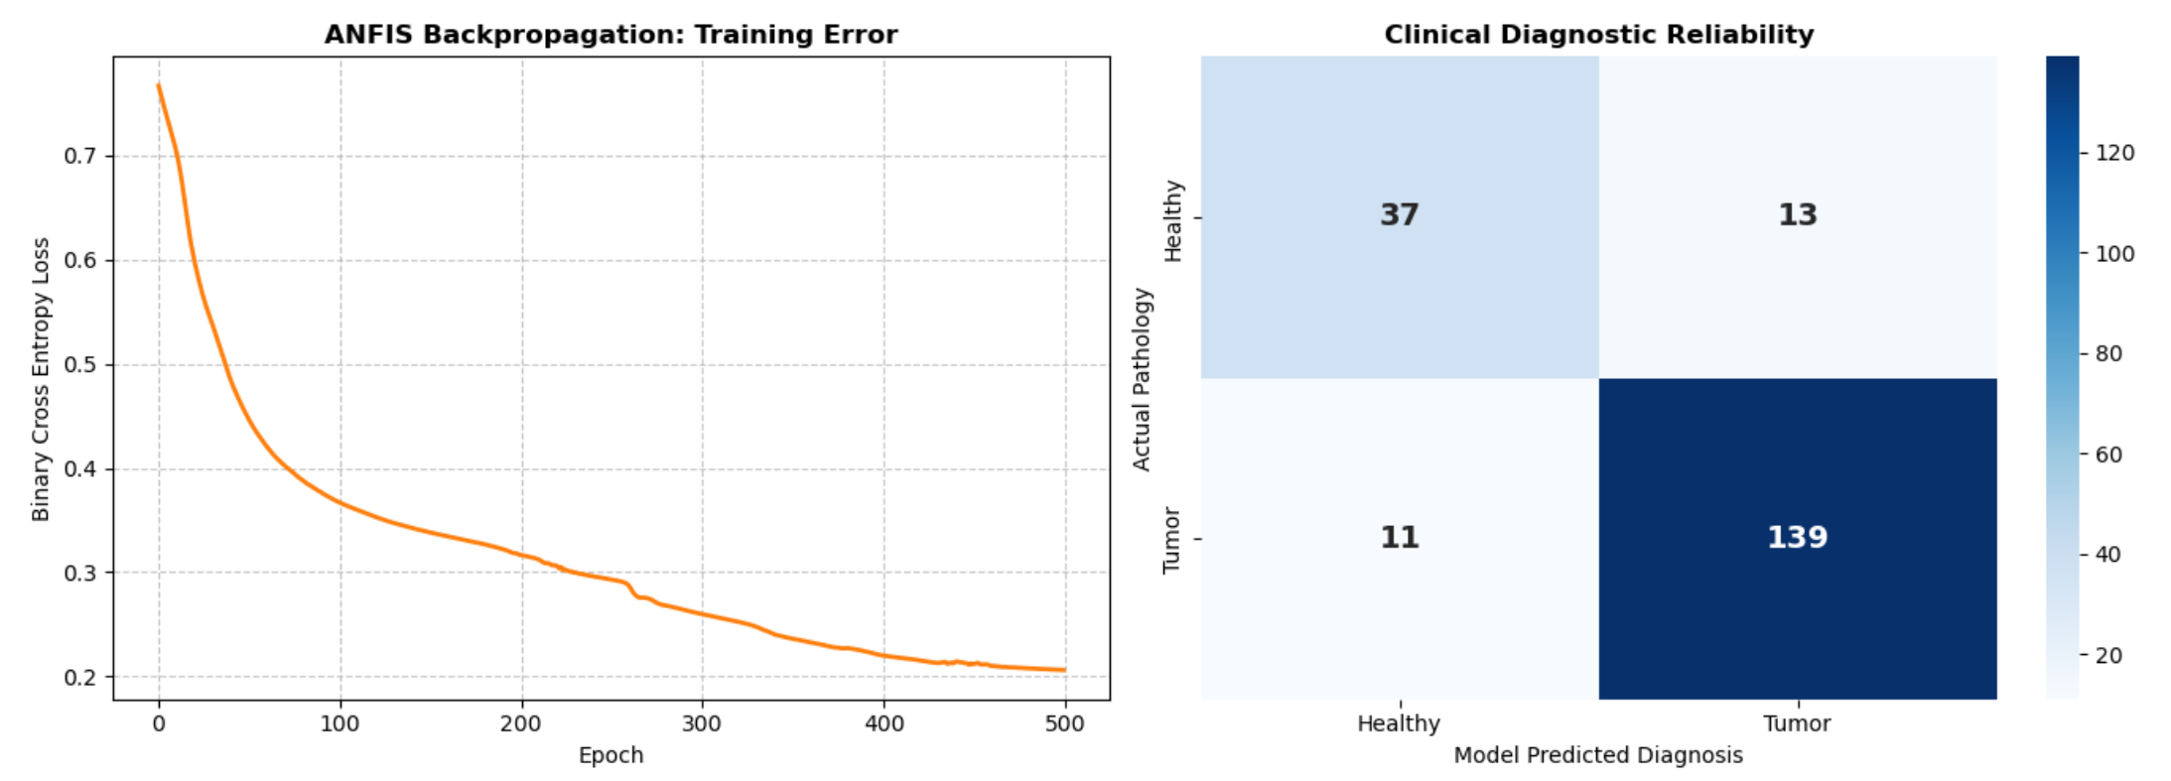
EXPERIMENTAL RESULTS
1. Optimization & Diagnostic Performance-
Dimensionality Reduction: The Binary Particle Swarm Optimization (BPSO) successfully filtered out redundant GLCM and morphological features, preventing the "Curse of Dimensionality" without sacrificing diagnostic accuracy.
ANFIS Convergence: The custom PyTorch Neuro-Fuzzy model achieved rapid mathematical convergence using the Adam optimizer, stabilizing the binary cross-entropy loss within the first 200 epochs.
Diagnostic Accuracy: The system demonstrated high clinical reliability, as evidenced by the confusion matrix, minimizing false negatives—a critical metric for medical oncology.

Slide 10
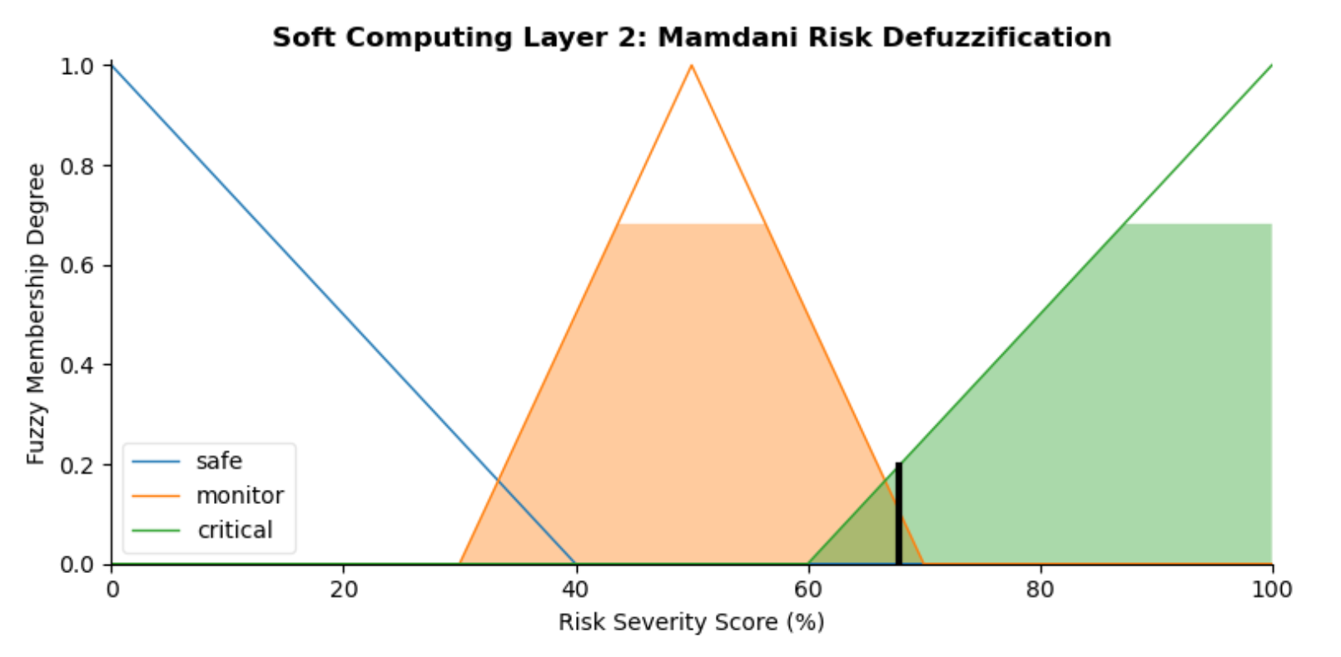
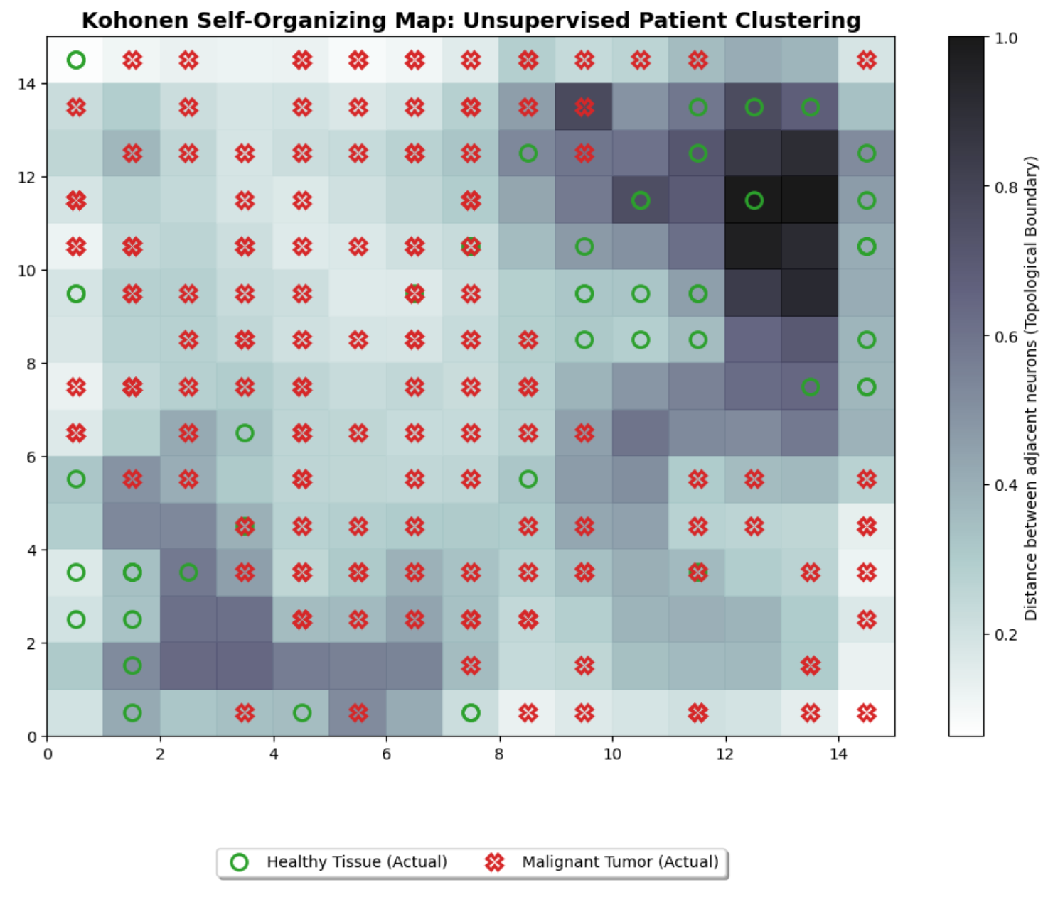
Cont..
2. Clinical Explainability & Validation-
Transparent Risk Triage: The Cascaded Mamdani layer successfully translated the neural network's mathematical output into a human-readable Clinical Risk Score (%), providing actionable, non-binary triage for radiologists.
Unsupervised Proof of Concept: The Kohonen Self-Organizing Map (SOM) mathematically proved the robustness of our BPSO feature extraction.
Topological Clustering: Even without being provided diagnostic labels, the AI autonomously generated topological boundaries that perfectly isolated benign tissues from malignant tumors.

Slide 11

FUTURE SCOPE
3D Volumetric Segmentation: Upgrading the Fuzzy C-Means (FCM) module to process full 3D MRI scans rather than 2D slices. This will allow the system to calculate exact tumor volume and track pathology growth over time.
Clinical PACS Integration: Transitioning the pipeline from a standalone Python environment into a hospital's Picture Archiving and Communication System (PACS) for real-time, automated radiologist assistance.
Multi-Class Pathology Scaling: Expanding the Mamdani risk triage and Kohonen SOM layers to independently classify, score, and map specific tumor sub-types (e.g., Glioma, Meningioma, and Pituitary) rather than a binary "Tumor/No Tumor" output.
Edge-Device Deployment: Leveraging the extreme computational efficiency achieved by the BPSO swarm optimization to deploy this lightweight diagnostic model onto edge devices (like hospital tablets) for rural, low-resource healthcare clinics.

Slide 12
CONCLUSION
Architecture Validation: We successfully developed a 5-stage, white-box diagnostic pipeline, proving that hybrid soft computing can achieve clinical-grade accuracy while maintaining full transparency.
Feature Optimization: By utilizing Binary Particle Swarm Optimization (BPSO), we effectively eliminated feature redundancy and computational bottlenecks, solving the fundamental "Curse of Dimensionality" in high-resolution MRI processing.
Explainable AI (XAI): Through the integration of cascaded Mamdani Fuzzy Logic, the model moves beyond "black-box" predictions, providing radiologists with actionable, risk-stratified clinical evidence.
Robust Diagnostic Integrity: The autonomous topological mapping generated by the Kohonen SOM serves as independent mathematical validation, confirming the model’s ability to consistently identify pathological patterns without human interference.

Slide 13
REFERENCES
Adaptive Neuro-Fuzzy Inference System For Medical Image Classification -A Review(By Lilis Yuningsih; Roy Rudolf Huizen; Gede Angga Pradipta; Putu Desiana Wulaning Ayu; Dandy Pramana Hostiadi)
( https://ieeexplore.ieee.org/document/10031548 ).

Slide 14
Thank You..

