Slide 1
Agentic RAG Chatbot for Document QA
An Agent-based Multi-format QA System with MCP Integration
Presented by: Jayanth Chatrathi
Date: July 2025

Slide 2
Agent-Based Architecture with MCP
• IngestionAgent: Parses and extracts text from uploaded documents, then sends structured output to the RetrievalAgent
• RetrievalAgent: Retrieves top-k relevant text chunks using semantic search over encoded document embeddings.
• LLMResponseAgent: Generates final answers using retrieved context and query via GPT-4o in a RAG setup.
• MCP: Standardizes inter-agent communication by wrapping messages with sender, receiver, type, trace ID, and payload.

Slide 3
System Flow with MCP Integration
User Upload → IngestionAgent → [Parsed Content]
↓ MCP msg
RetrievalAgent → [FAISS Search]
↓ MCP msg
LLMResponseAgent → [Final Answer]
↓
UI Output
Message Types: ContextMsg, QueryMsg, RetrievalResult, FinalAnswer

Slide 4
Tech Stack Used
• Frontend/UI: Streamlit
• Backend Orchestration: Python
• Document Handling: PyMuPDF, python-docx, python-pptx, pandas
• Vector Search: FAISS, SentenceTransformers (MiniLM-L6-v2)
• Model: GPT-4o (OpenAI)
• Agent Protocol: MCP

Slide 5
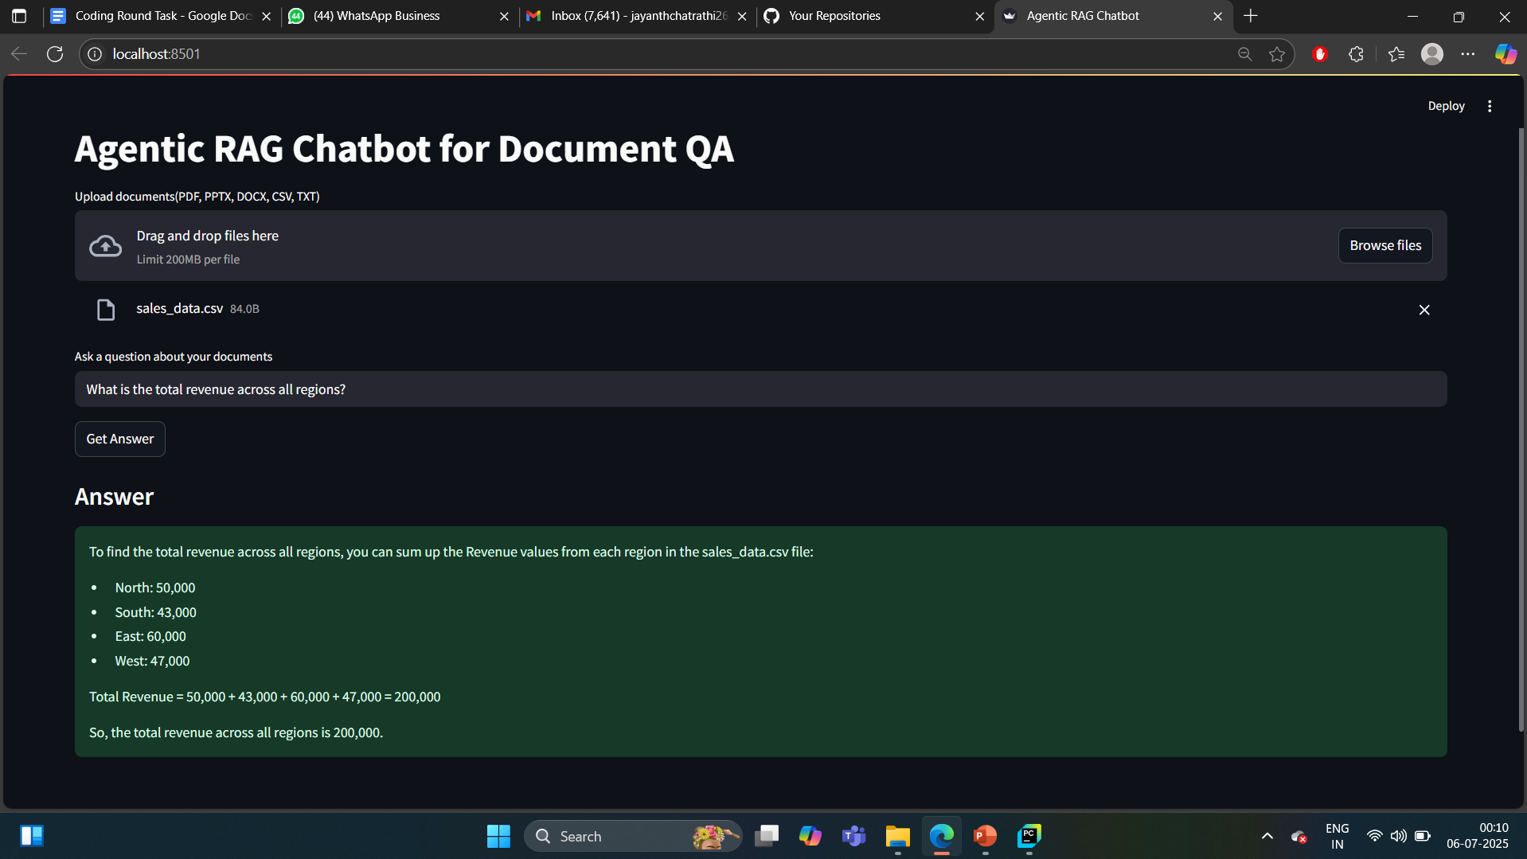
UI Screenshot of Working App

Slide 6
Future Scope / Improvements
• Add OCR support for image-based documents
• Integrate with enterprise storage (e.g., SharePoint, GDrive)
• Enable document summarization & exportable reports
• User feedback loop for LLM response refinement

