Slide 1

aiml internship
HENOTIC TECHNOLOGY PRIVATE LIMITED
7th July 2022 to 06th September 2022
Presented by:
Ch.Jayanth
¾ AI&DS
RegdNo: 20B91A5405
DEPARTMENT OF INFORMATION TECHNOLOGY,SRKREC

Slide 2
CONTENTS
INTRODUCTION ABOUT DATASET
OBJECTIVE
DATA SCIENCE PROJECT LIFE CYCLE
RESULTS
RECOMMENDATIONS AND CONCLUSIONS
REFERENCES

Slide 3
AIRLINE PASSENGER’S SATISFACTION
DATASET:

Slide 4
INTRODUCTION ABOUT DATASET
Airline industry is currently the biggest industry of transportation in the world. It focuses on service strategy to get customers because the great quality of service is a way to get customer loyalty.
Customer satisfaction is what guarantees the future of airlines and it is achievable by an adoption between their service and passenger needs.
the study aims will find out the relationship between customer experiences on airline services and customer satisfaction and also define the operational characteristic that influences customer choice in an airline
Each element has a different level of impact on customer satisfaction. However, most of the services provided by the airline are intangible.

Slide 5
OBJECTIVE
The main agenda of this project is:
Perform extensive Exploratory Data Analysis(EDA) on the airlines passengers satisfaction Dataset.
Build an appropriate Machine Learning Model that will help various customers to predict their satisfaction based on certain features

Slide 6
Data Science Project Life Cycle
Data Pre-processing
Check the Duplicate and low variation data
Identify and address the missing variables
Handling of Outliers
Categorical data and Encoding Techniques
Feature Scaling
Selection of Dependent and Independent variable
In my dataset, target variable is rating
3. Training Models

Slide 7
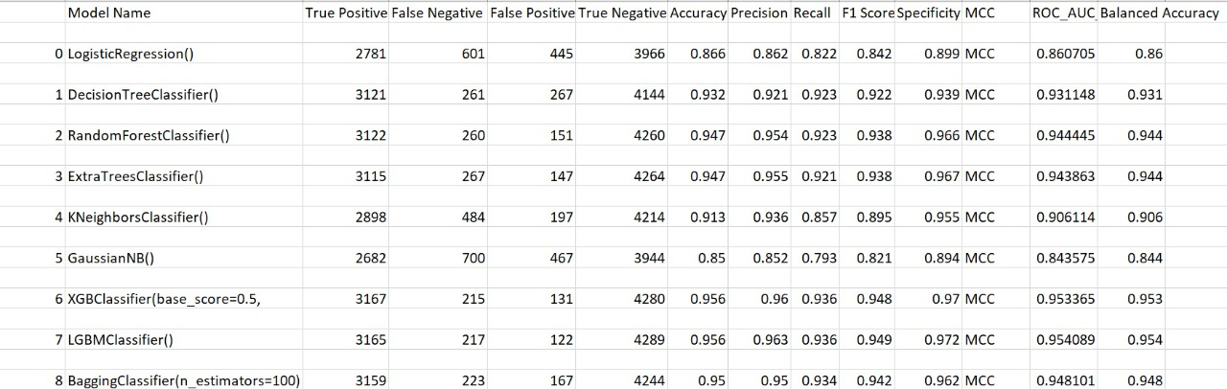
results
Based on the analysis , these are the results generated from different models

Slide 8
results
The model results in the following order by considering the model accuracy, F1 score and RoC AUC score.
1) Random Forest
2) Extra Trees Classifier

Slide 9
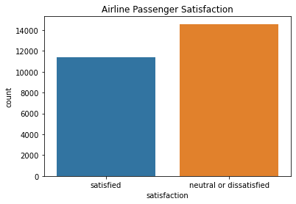
RECOMMENDATIONS AND CONCLUSIONS
It is so evident from the survey,

Slide 10
REFERENCES
https://www.kaggle.com/datasets/teejmahal20/airline-passenger-satisfaction

