Slide 1
Domain : Transportation Project : Prediction of Traffic Situation Based on Vehicle Metrics
Team :
Nandini
CLIENT : Vajra.ai

Slide 2
Understanding the Goal of the Project:
From the dataset, the goal appears to be building a predictive model that can analyze traffic patterns and predict the traffic situation (e.g., high, low, or normal traffic) based on various features such as time, date, day of the week, and vehicle counts (cars, bikes, buses, trucks, etc.).
Goal: Help public transport operators schedule buses and trains to align with traffic patterns. And help city planners and traffic authorities optimize traffic flow by predicting congested areas.
Benefits :
1)Avoid delays by planning routes during low traffic periods.
2)Allocate traffic resources(e.g., traffic police, signals) based on predictions.
3)Enhance commuter satisfaction by minimizing travel time.

Slide 3
Data collection Information:
The Dataset is collected from Kaggle
The dataset contains the following Features:
Time: Timestamp of the record (e.g., 12:00:00 AM).
Date: Day of the month (e.g., 10).
Day of the week: Name of the day (e.g., Sunday, Monday, etc.)
CarCount: Count of cars observed during the time interval.
BikeCount: Count of bikes observed during the time interval.
BusCount: Count of buses observed during the time interval.
TruckCount: Count of trucks observed during the time interval.
Total: Total traffic count during the interval.
Traffic Situation: Traffic condition categorized as low, normal, heavy.

Slide 4
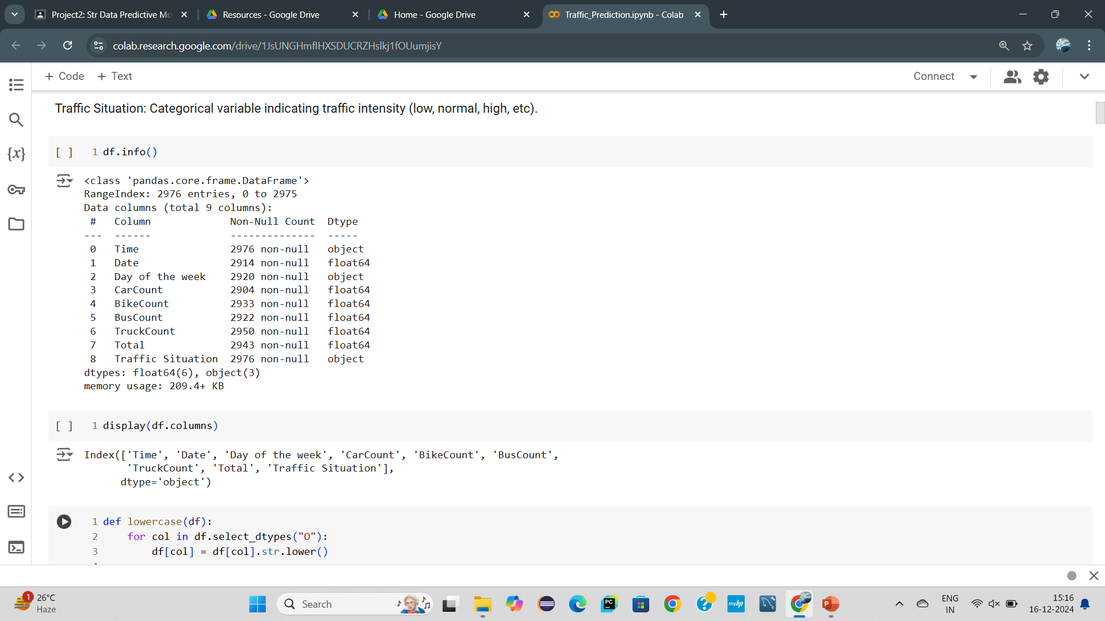
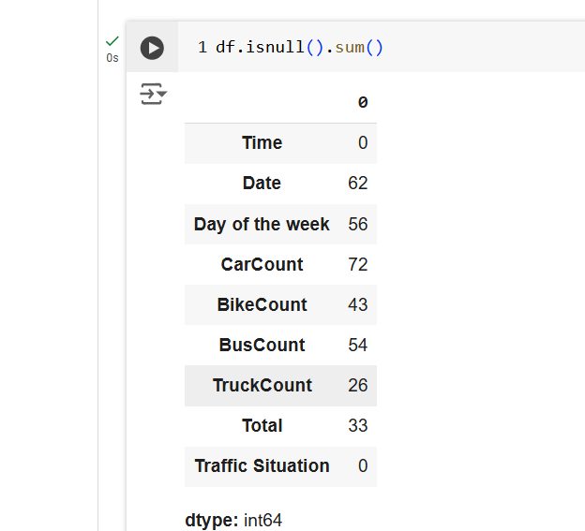
Checking and Validating the Data :
Shape of the dataset is (2976, 9) i.e., 2976
rows and 9 columns

Slide 5
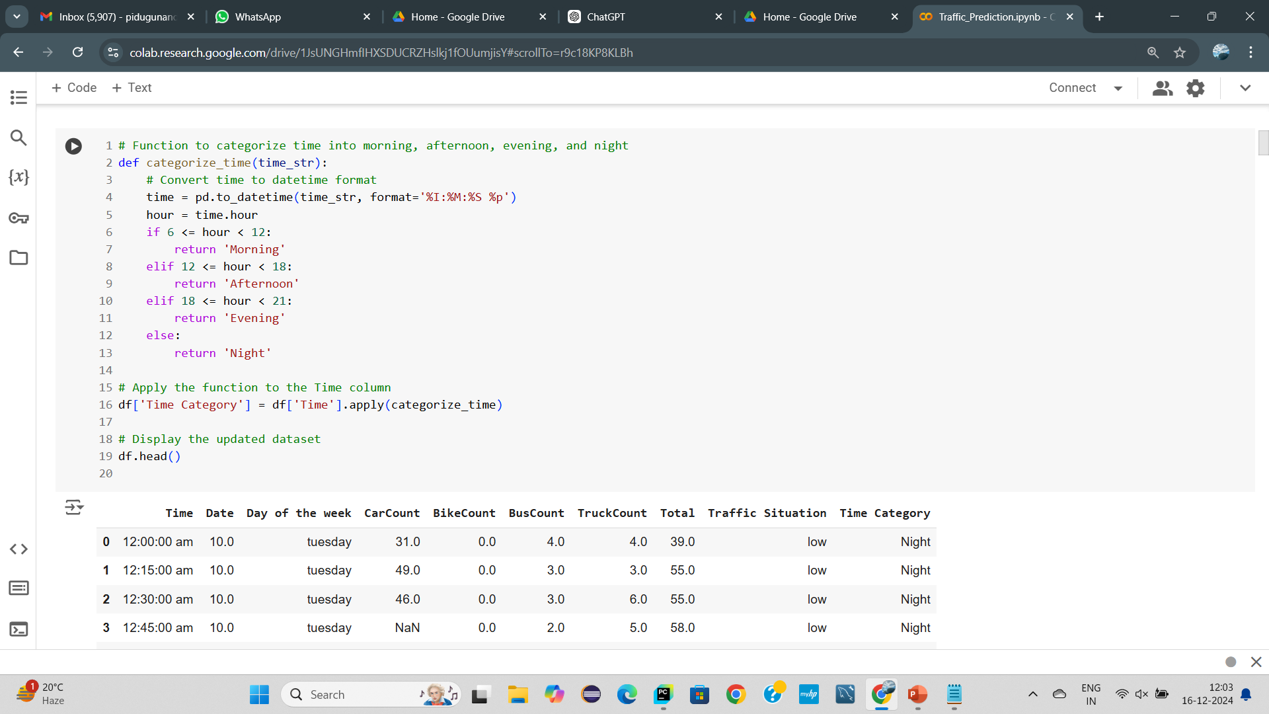
Validating the Time Column:
For the Time column, we categorized it into morning, afternoon, evening, and night.

Slide 6

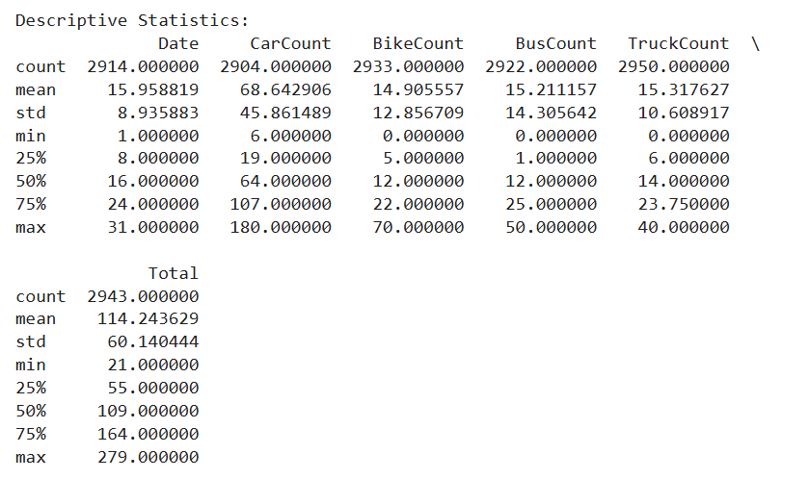
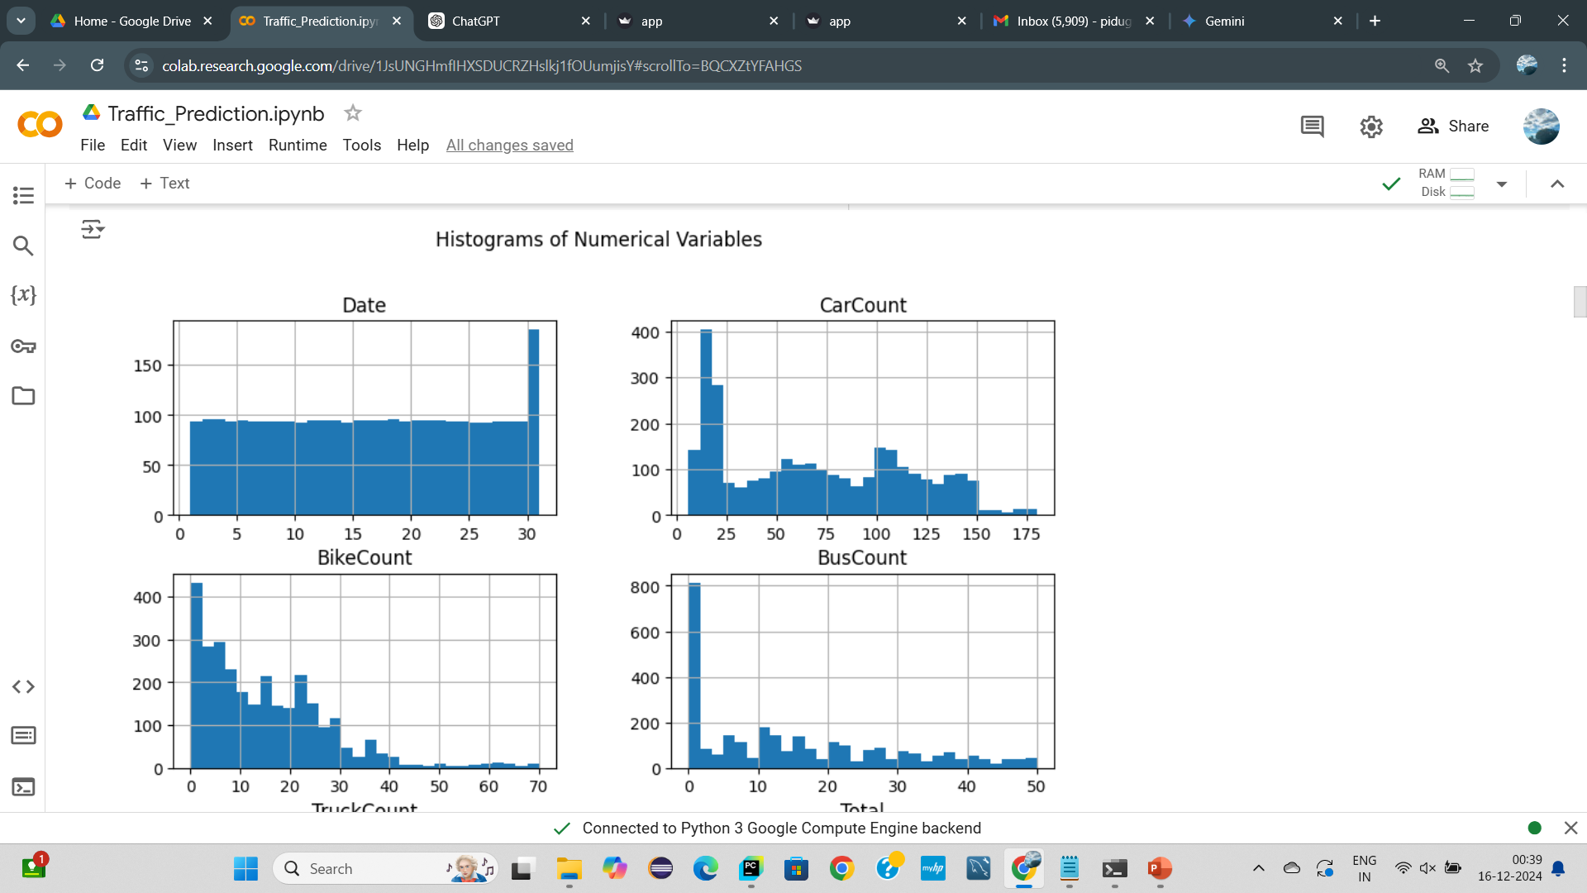
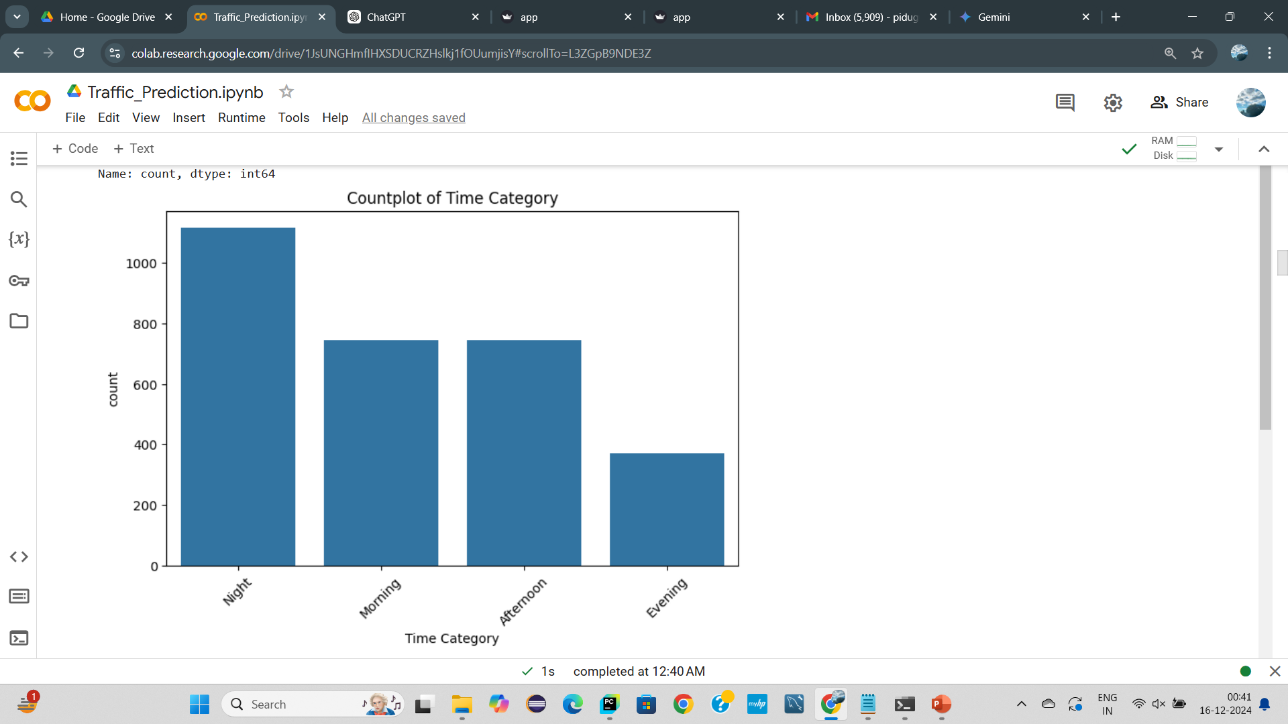
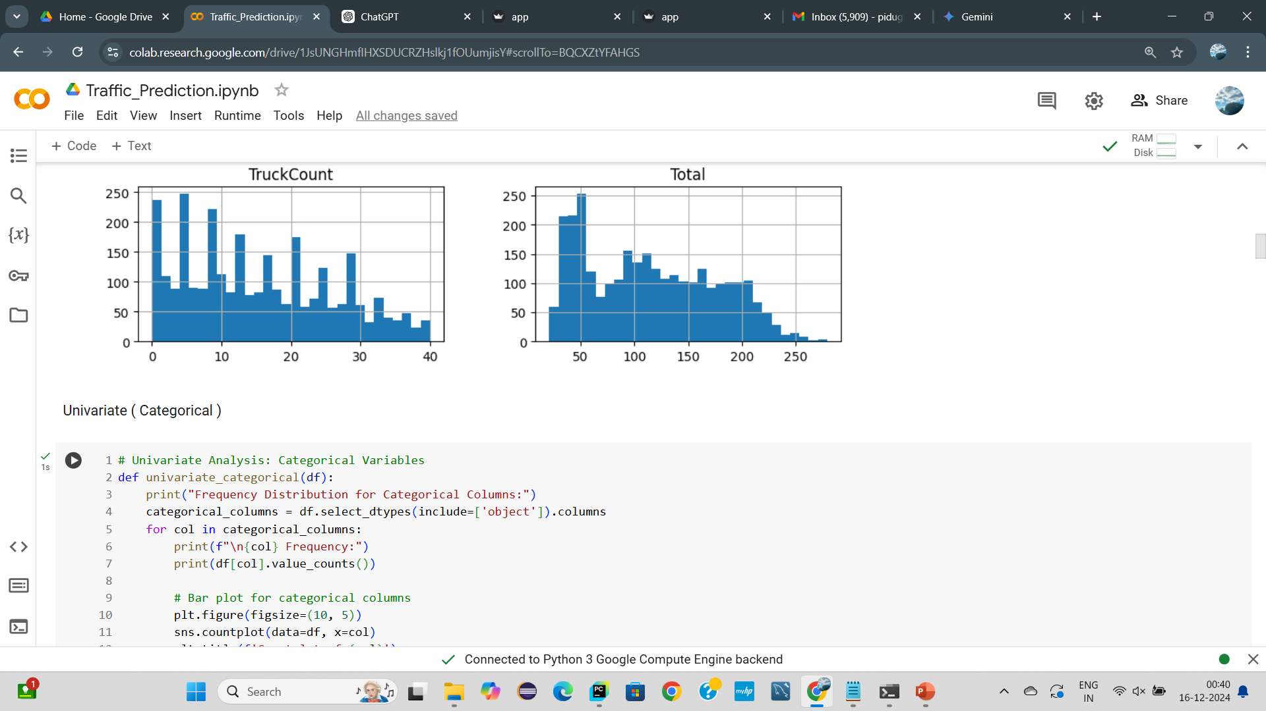
EDA(Exploratory Data Analysis):

Slide 7
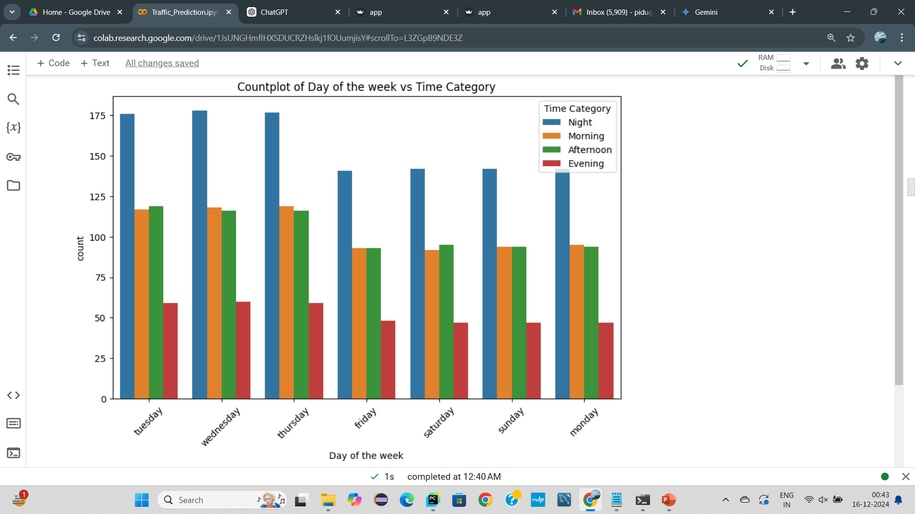
Bivariate:
By observing the above bar chat, the traffic situation on the week days Tuesday, Wednesday, Thursday is more at night times.

Slide 8
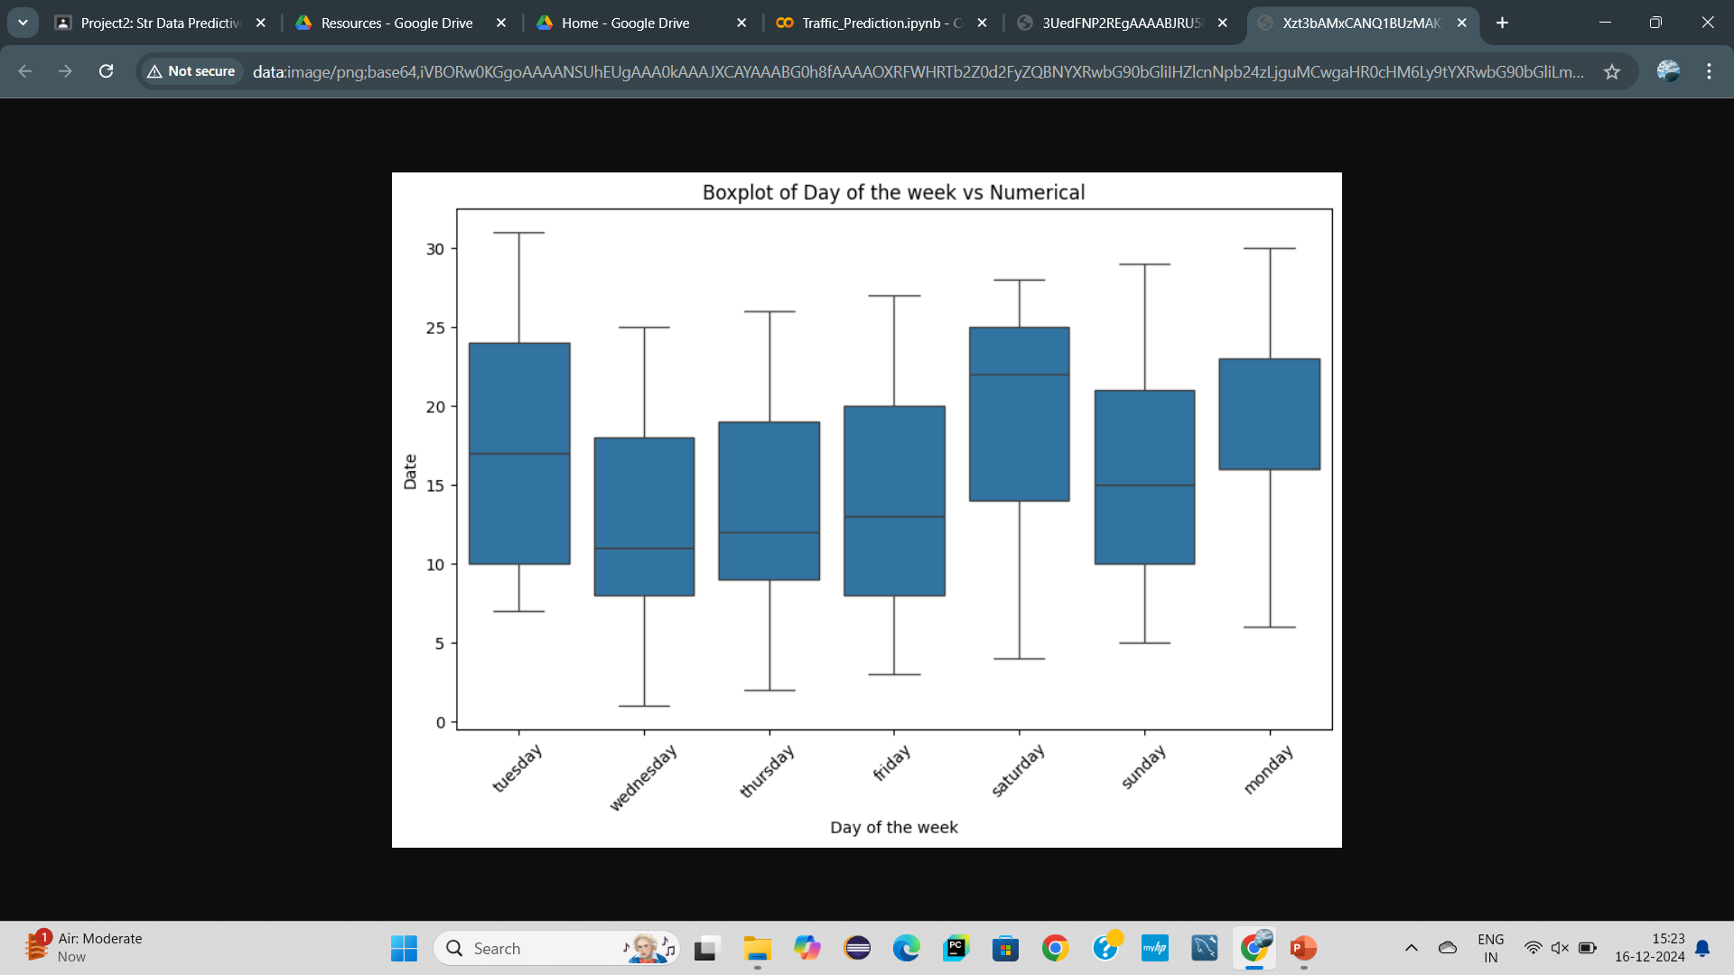
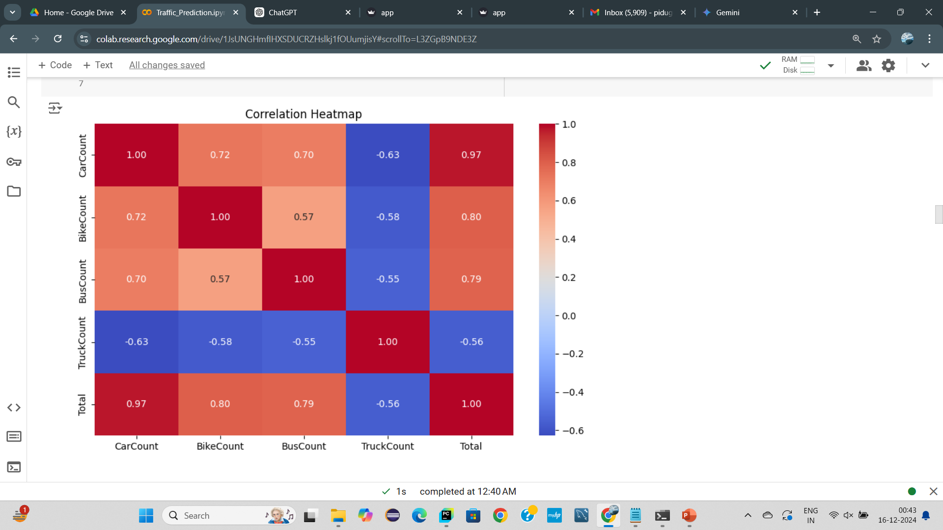

Slide 9
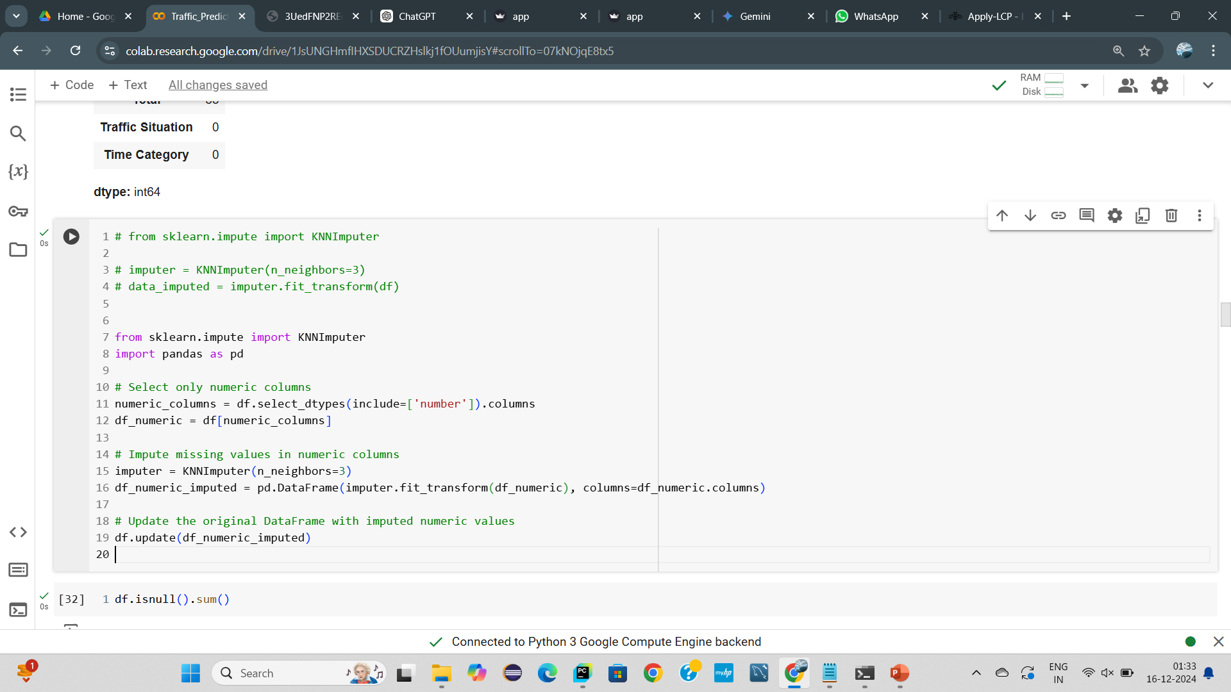
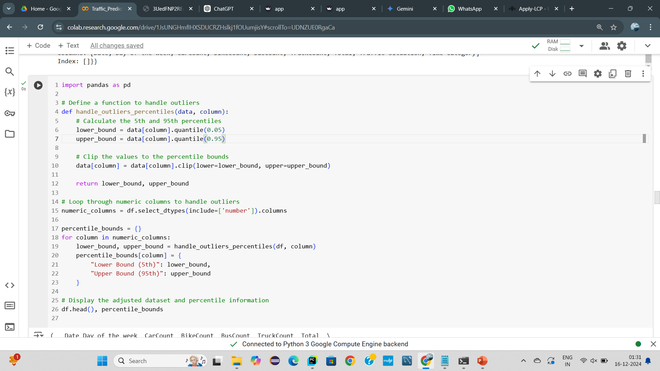
About Missing values and Outliers:
For Handling Missing values we used KNN Imputer for numerical columns and Mode for categorical columns.
For Handling Outliers we used 5TH & 95th Qunatile Technique.
Handling Missing :
Handling Outliers :

Slide 10
Divide X and y :
Divided Features (X) and Target (y):
X(Features):
1.Time
Date
Day of the week
CarCount
BikeCount
BusCount
TruckCount
Total
y( Target column) : Traffic Situation ( since it categorizes the traffic level.)

Slide 11
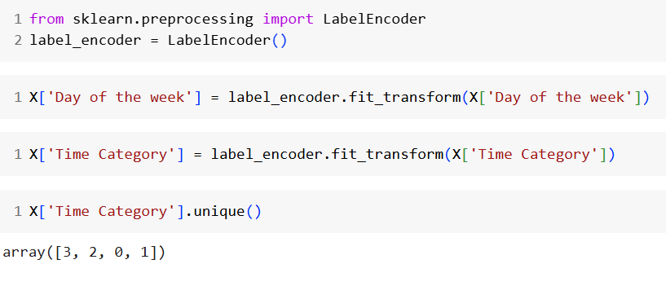
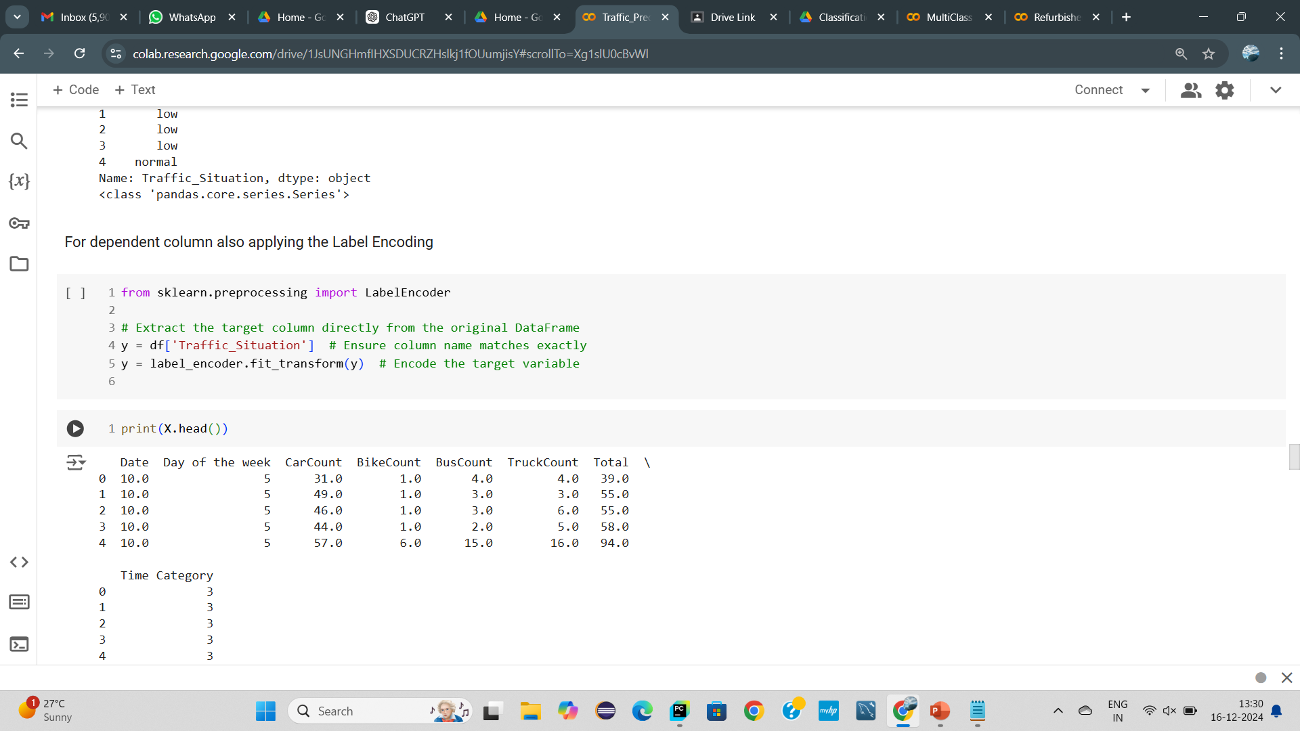
Data Preprocessing :
Converted Categorical columns into Numerical columns using Label Encoding.
For Independent categorical columns
For Independent categorical columns:
For Dependent categorical column :

Slide 12
Model selection :
Here we used Classification Algorithms to train the X and y.
The models we used are :
LogisticRegression.
KNearestNeighbors
Naive bayes
SVM
Decision Tree
Random Forest
XGBoost

Slide 13
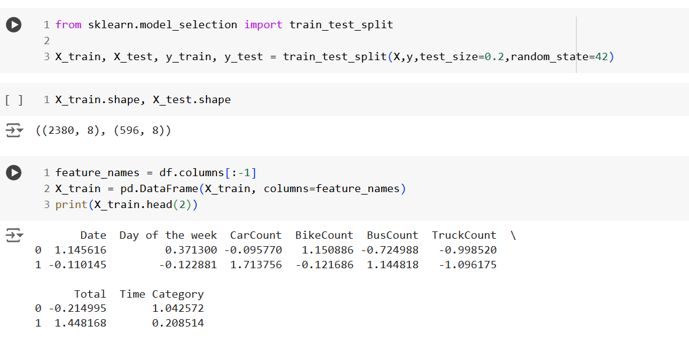
Model Training results :
Here we used train-test-split to divide the data for Training and Testing and we go with the 80:20 ratio i.e., 80% data is for Training and 20% of data is for Testing.

Slide 14
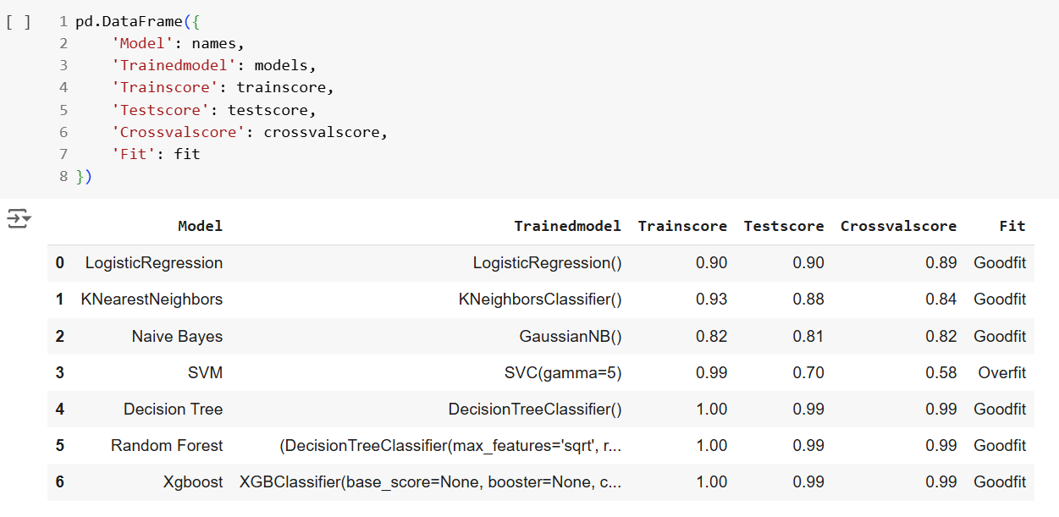
Model Evaluation and best model selection :
From all the classification models we selected the XGBoost model for Real Time prediction.

Slide 15
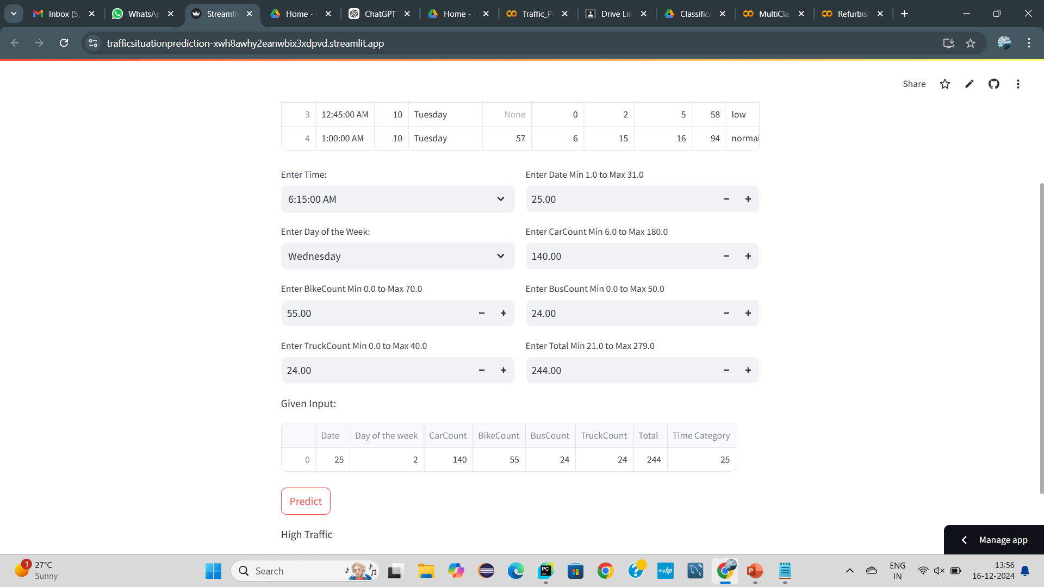
Real time prediction using best model :
After deployed the best model into the cloud, the Real Time predictions are this :

Slide 16
Cloud deployment link :
https://trafficsituationprediction-xwh8awhy2eanwbix3xdpvd.streamlit.app

Slide 17
THANKYOU

