Slide 1

DEPARTMENT OF COMPUTER SCIENCE AND ENGINEERING
SPCB1503 - JAVA FULLSTACK DEVELOPMENT
Online E-Commerce Store
JAVA FULLSTACK - 02
43110431 – K. Jayanth Reddy

Slide 2
ABSTRACT
The E-Commerce Store is a full-stack web application developed using React.js for the frontend and Spring Boot for the backend. It allows users to register, log in, browse products, and add items to the cart through a clean and interactive interface. The backend efficiently handles authentication, product management, and data processing using H2 and MySQL databases. Communication between the client and server is managed through RESTful APIs, ensuring seamless data exchange. The project focuses on providing a secure, scalable, and user-friendly online shopping experience. It highlights the effective use of modern web technologies to build a dynamic and reliable e-commerce platform.

Slide 3
EXISTING SYSTEM
In the existing system, most traditional shopping methods require customers to visit physical stores, which is time-consuming and limited by location and store hours. Some small online platforms lack user-friendly interfaces and secure authentication mechanisms. They often fail to manage large product data efficiently and provide limited search or filtering options. Many systems do not support real-time product updates or smooth integration between frontend and backend .Data handling and user management are also not centralized, making maintenance difficult. Overall, the existing systems lack automation, scalability, and seamless user interaction for efficient online shopping.

Slide 4
PROPOSED SYSTEM
The proposed system is a Java Full Stack E-Commerce web application built using React.js for the frontend and Spring Boot for the backend. It aims to provide a smooth, secure, and efficient online shopping experience. Users can easily register, log in, browse products, and manage their cart through an interactive and responsive interface. The backend handles authentication, product management, and order processing effectively. Data is stored and managed using both H2 and MySQL databases for flexibility and performance. Communication between client and server is handled through RESTful APIs. The system ensures better scalability, faster response, and improved user experience. It automates shopping operations and simplifies management for both users and admins.

Slide 5
ADVANTAGES
Provides a user-friendly and responsive interface using React.js for smooth navigation.
Ensures secure authentication and data handling through Spring Security and RESTful APIs.
Uses both H2 and MySQL databases for easy testing, scalability, and efficient data management.
Offers real-time updates for products, cart, and user actions.
Enables faster performance and reduced load time with optimized frontend-backend communication.
Simplifies maintenance and future enhancement due to modular full-stack architecture.
Enhances customer convenience by enabling shopping anytime and anywhere.
Allows centralized product and user management for better control and automation.

Slide 6
DISADVANTAGES
Initial development and deployment cost can be high due to multiple technologies used.
Data security risks exist if the system is not properly configured or updated.
Maintenance requires technical knowledge of both frontend (React) and backend (Spring Boot).
Integration of third-party payment gateways may involve complex configuration.
Performance may reduce when handling very large datasets or heavy traffic
Scalability and hosting costs can increase as the number of users grows.

Slide 7
HARDWARE REQUIREMENTS
Processor: Intel Core i3 or above.
RAM: Minimum 4 GB (8 GB recommended for smoother performance)
Hard Disk: At least 250 GB of storage space.
Monitor: 15-inch or above with a minimum resolution of 1024×768.
Keyboard & Mouse: Standard input devices.
Network: Stable internet connection for frontend-backend communication.
System Type: 64-bit Operating System (Windows / Linux / macOS).

Slide 8
SOFTWARE REQUIREMENTS
Operating System: Windows 10 / 11, Linux, or macOS.
Frontend Technology: React.js,HTML,CSS.
Backend Technology: Spring Boot (Java).
Databases: H2 Database (for testing) and MySQL (for production).
Backend Framework: Spring Framework with Spring Security and RESTful APIs.
Frontend Tools: Node.js, npm, and Visual Studio Code.
Backend Tools: IntelliJ IDEA / Eclipse IDE.
Build Tool: Maven or Gradle.

Slide 9
MODULES
User Module:
1. Allows users to register, log in, and manage their profiles securely.
2. Handles authentication and authorization using Spring Security.
Product Module:
1.Displays available products with details such as name, price, and description.
Cart Module:
1. Manages items added to the shopping cart by the user.
Order Module:
1. Handles order placement, tracking, and order history.
2. Connects the cart with checkout and payment processes.
Database Module:
1. Stores user, product, and order information using H2 and MySQL databases.
2. Ensures data consistency, integrity, and fast retrieval.

Slide 10
MODULE DESCRIPTION
User Module: This module allows users to register, log in, and manage their personal profiles. It ensures secure authentication and authorization using Spring Security. Users can view products, add them to the cart, and place orders after successful login.
Product Module: This module manages all product-related operations such as displaying product lists, details, and categories. It allows users to search, filter, and view products dynamically using React.js components.
Cart Module: The cart module enables users to add, view, and modify selected items before checkout. It automatically updates total prices and quantities and communicates with the backend to store cart data temporarily.

Slide 11
MODULE DESCRIPTION
Order Module: This module manages the complete order process — from checkout to order confirmation. It maintains order history, tracks status, and ensures smooth integration between cart and payment operations.
Database Module: The database module handles all data storage and retrieval processes using H2 and MySQL databases. It stores information such as user details, product data, cart items, and order records, ensuring data consistency and reliability.

Slide 12
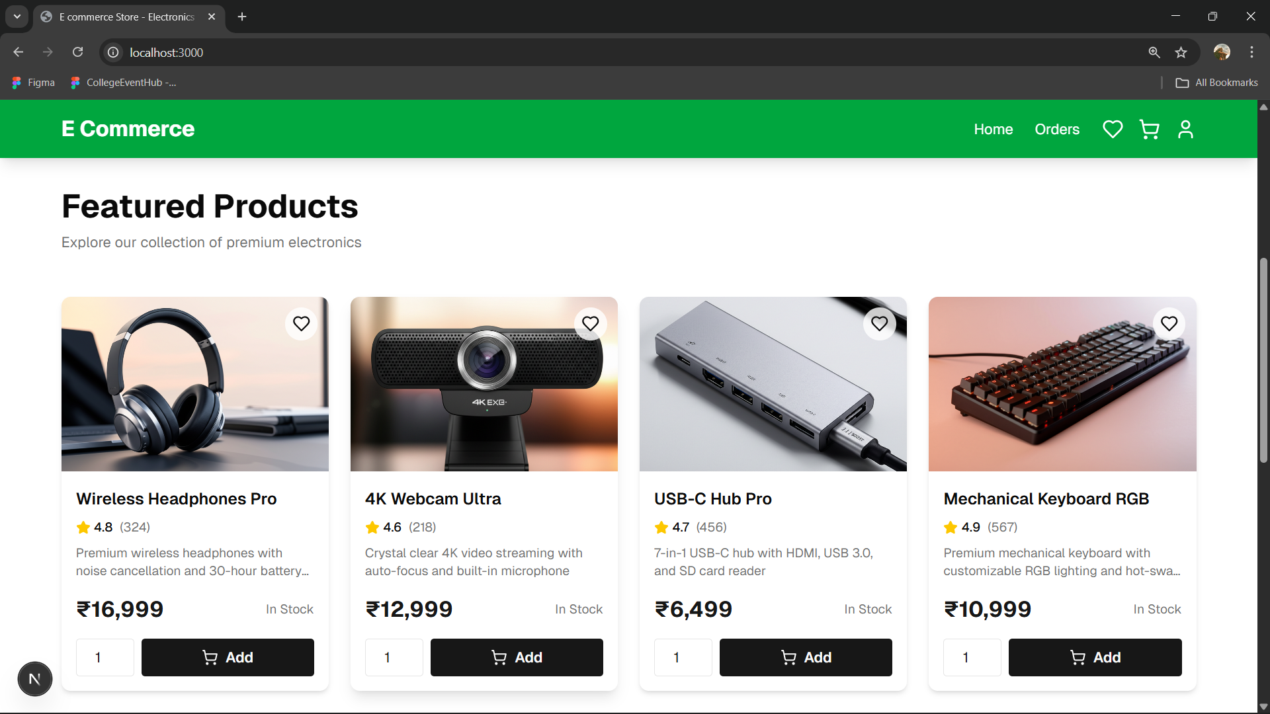
SAMPLE OUTPUT
Fig: Home Page

Slide 13
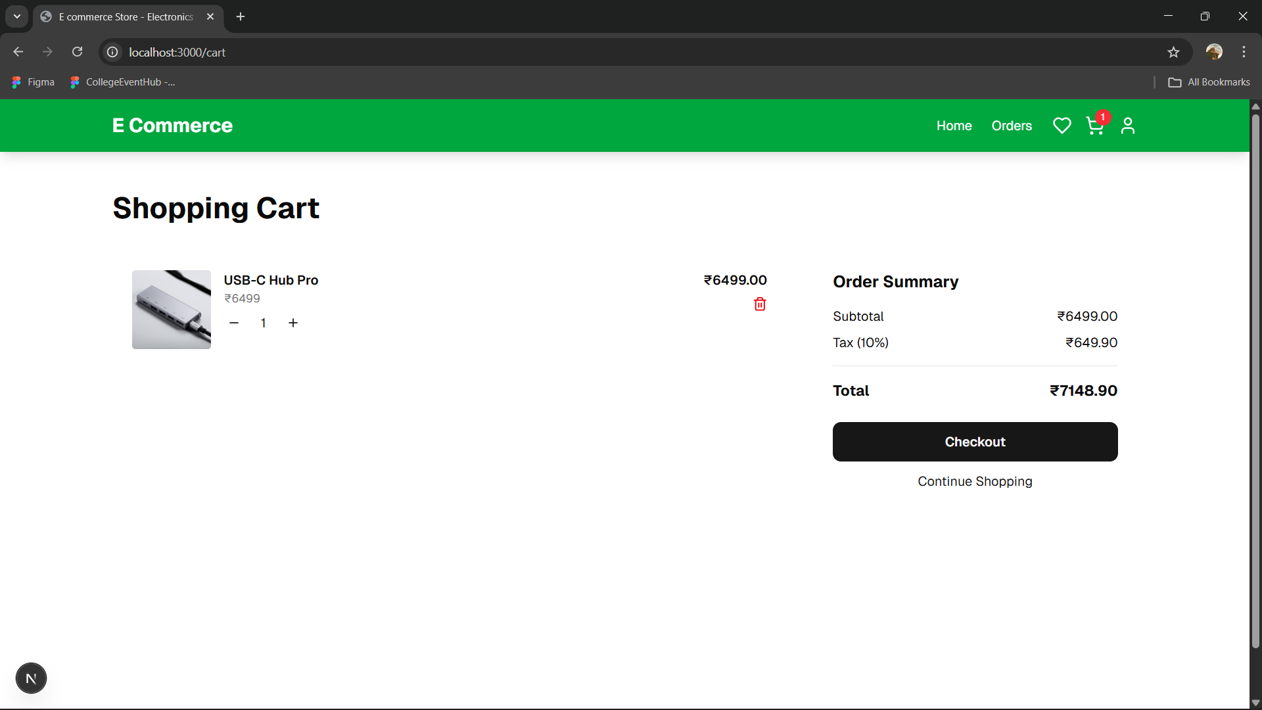
SAMPLE OUTPUT
Fig: Cart Page

Slide 14
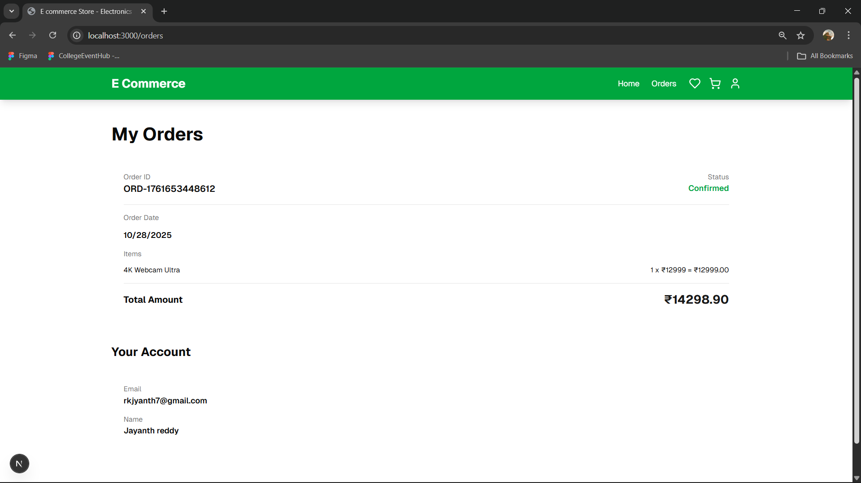
SAMPLE OUTPUT
Fig: My Orders Page

Slide 15
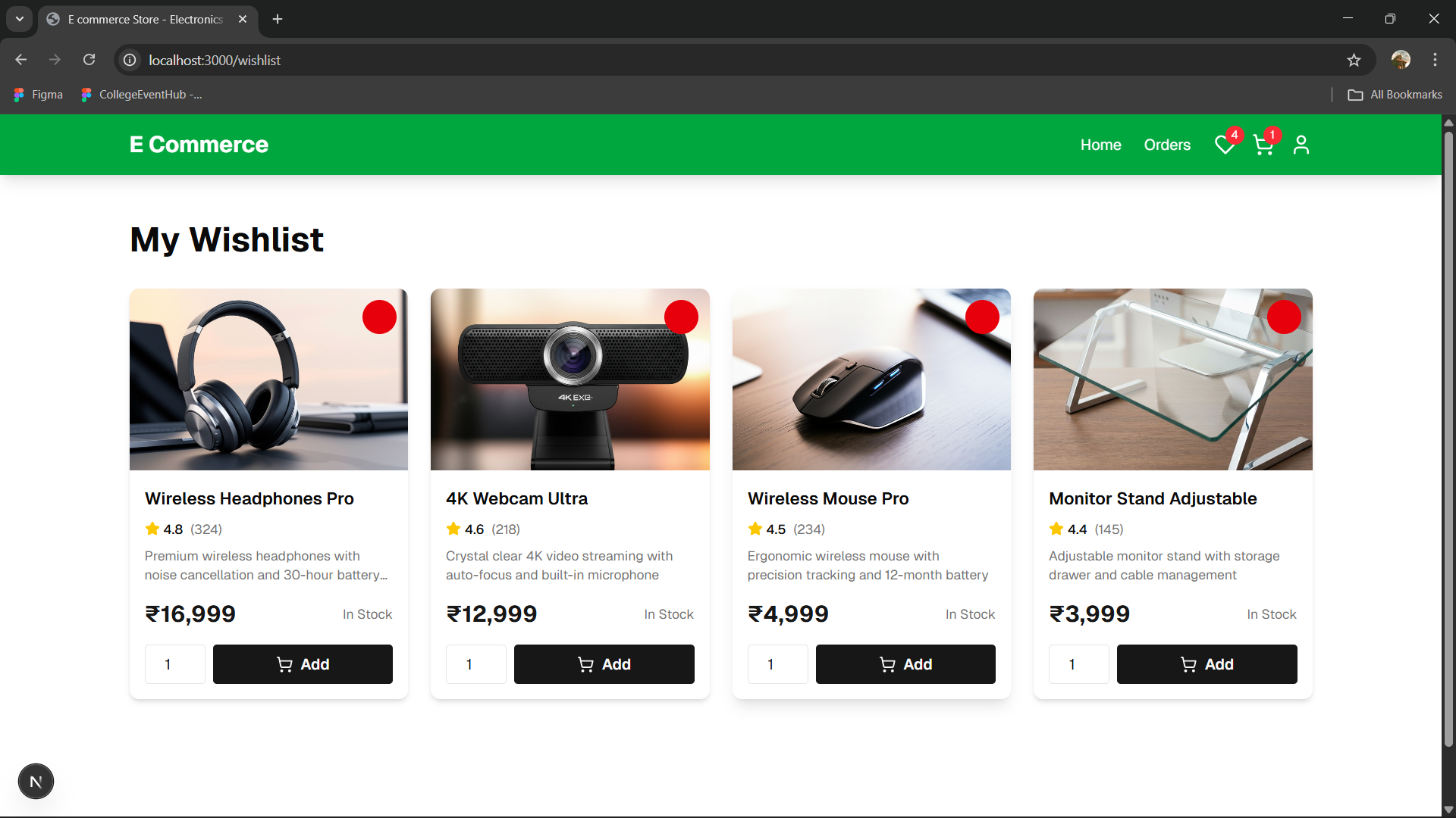
SAMPLE OUTPUT
Fig: Wishlist Page

Slide 16
CONCLUSION
The E-Commerce Store project successfully demonstrates the integration of React.js and Spring Boot to build a dynamic and efficient online shopping platform. It provides a seamless user experience with secure login, product browsing, and order management features. The use of H2 and MySQL databases ensures reliable data handling and smooth backend operations. The system effectively bridges the gap between customers and sellers through a responsive and user-friendly interface. It enhances accessibility, scalability, and performance using modern full-stack technologies. By implementing RESTful APIs, the project ensures efficient communication between frontend and backend. Overall, it achieves the goal of automating online shopping processes while maintaining security and usability. The system can be further expanded with payment gateways and advanced analytics for future improvements

