Slide 1





NEURO
FLEETX
Presented by: M.jayanth

Slide 2
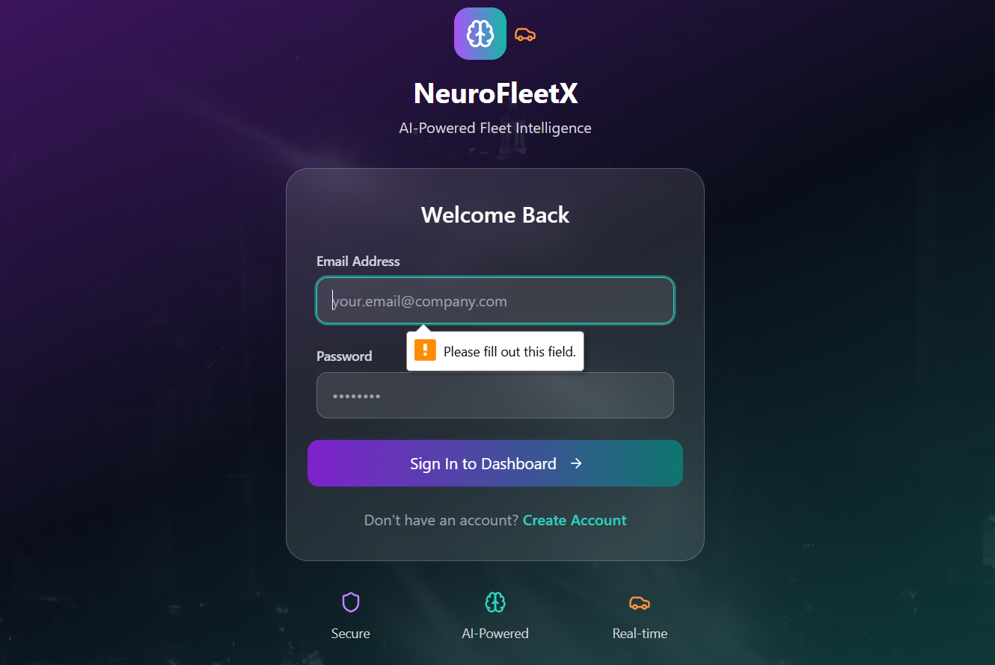


CONCEPT 1
Login page
testing the login page by not giving the email address and password that works good.

Slide 3
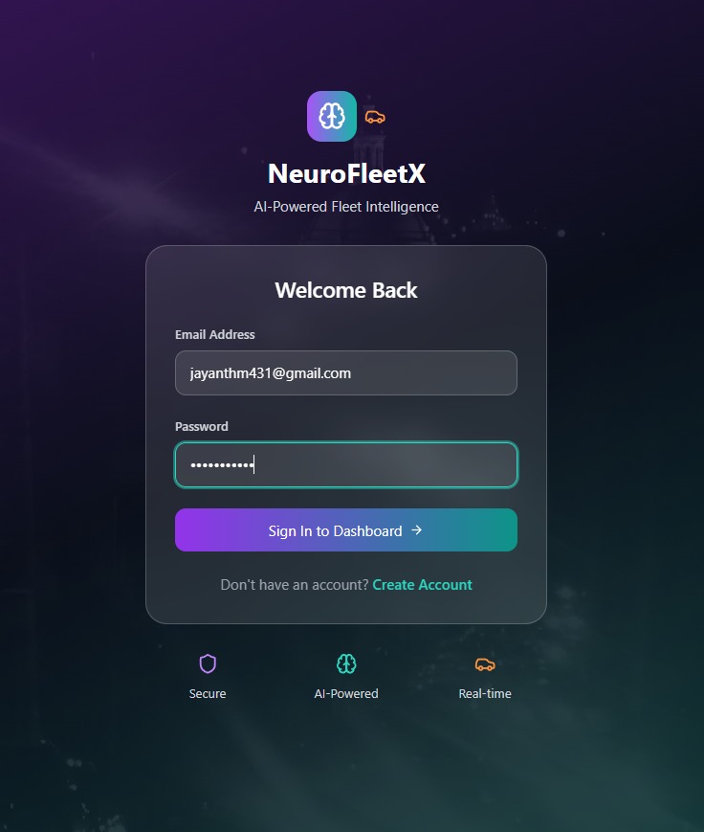
CONCEPT 1.1
Login page
Testing the login page by entering the email address and password that work well. and shows the dashboard.

Slide 4
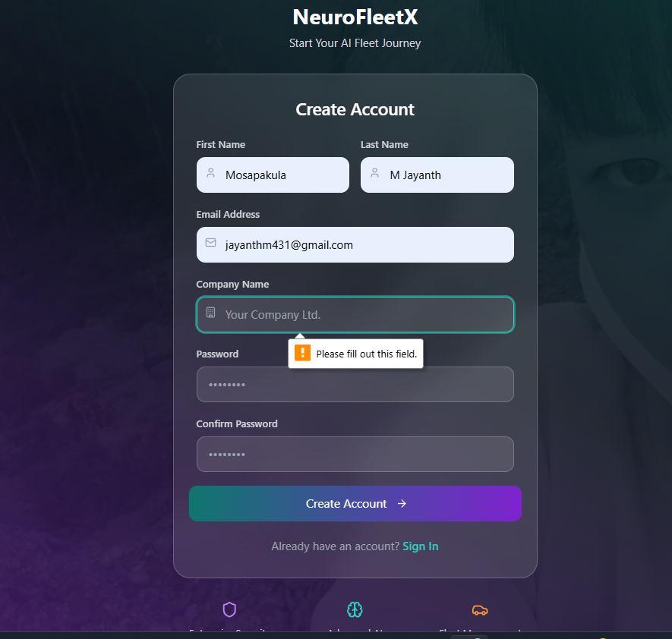
CONCEPT 2
Sign in page
Testing the sign-in by giving some details that work well. and shows a pop-up message, please fill out this field.

Slide 5
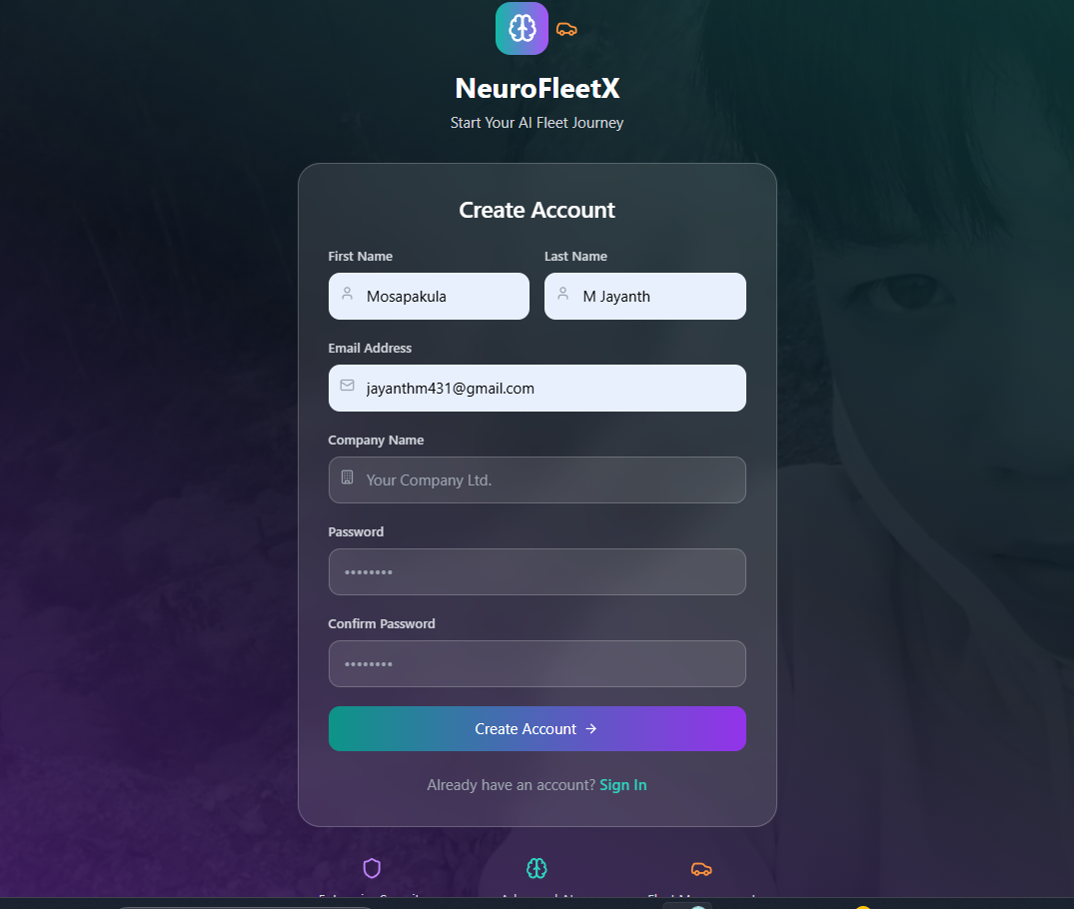
CONCEPT 2.1
Sign in page
After filling in all the details, it will redirect to the login page. after we log in with our email and password, it will redirect us to the dashboard.

Slide 6
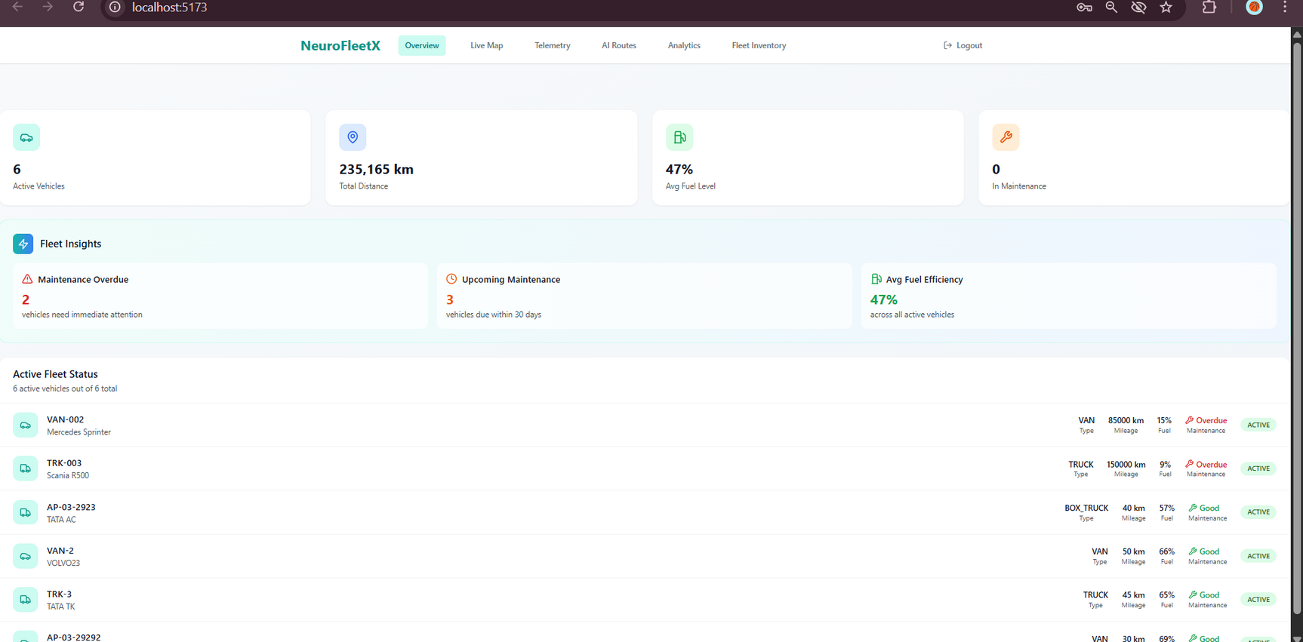
CONCEPT 1.1
Dashboard overview
This is the dashboard that displays the various features of the project NeuroFleetX that are build in the feature.

Slide 7
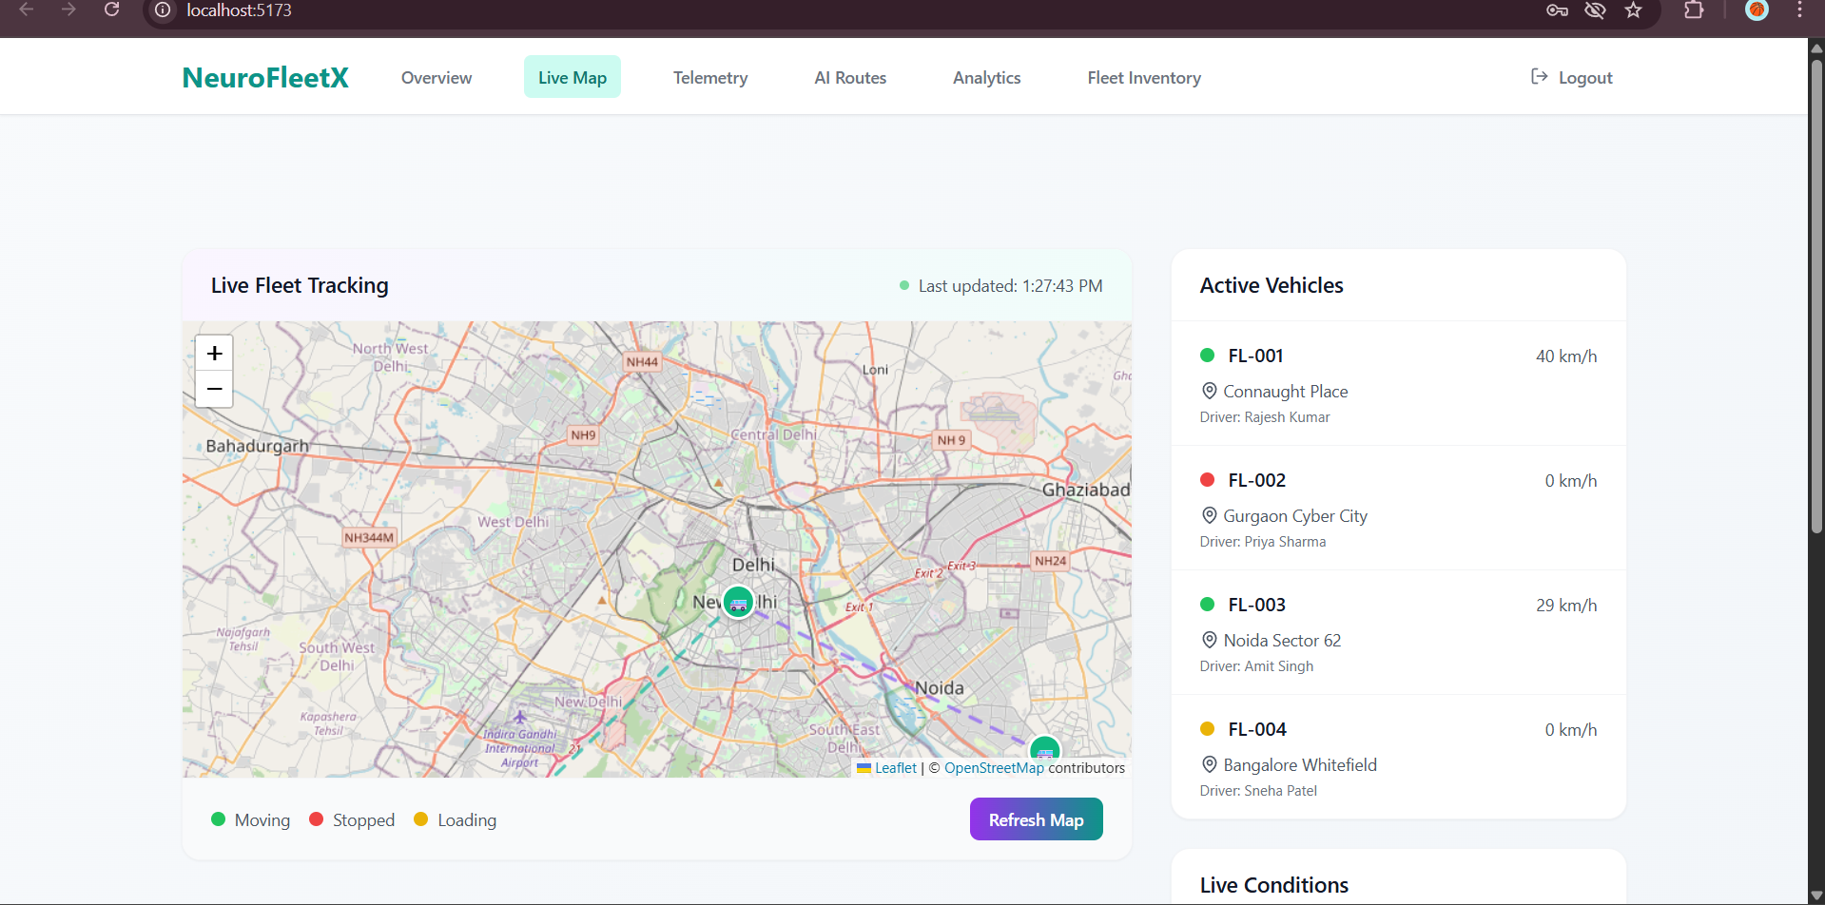
Live map page

Slide 8
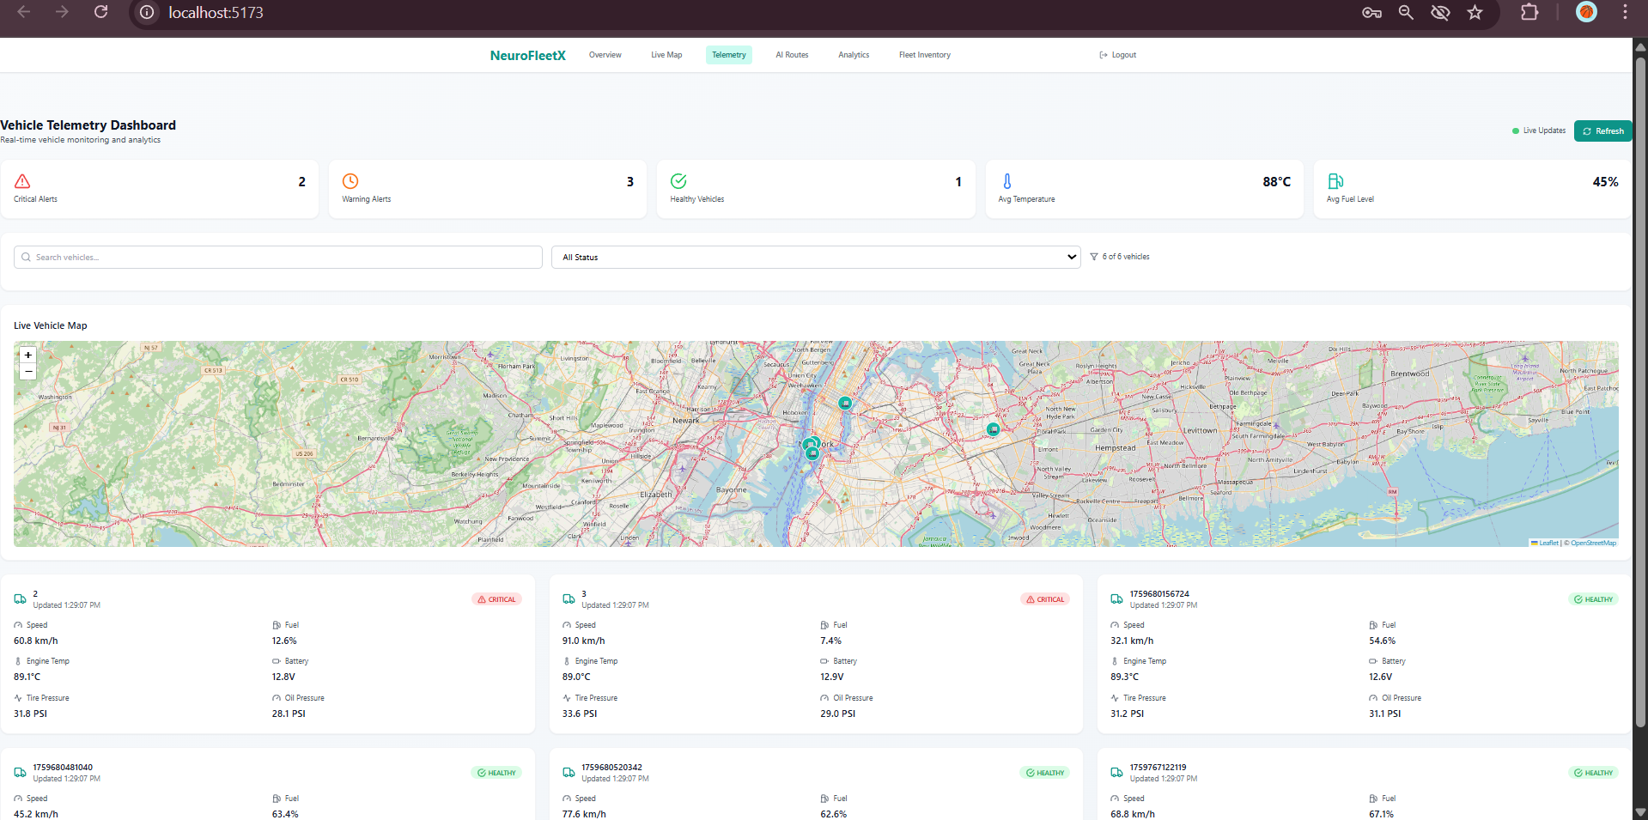
Fleet telemetry page

Slide 9
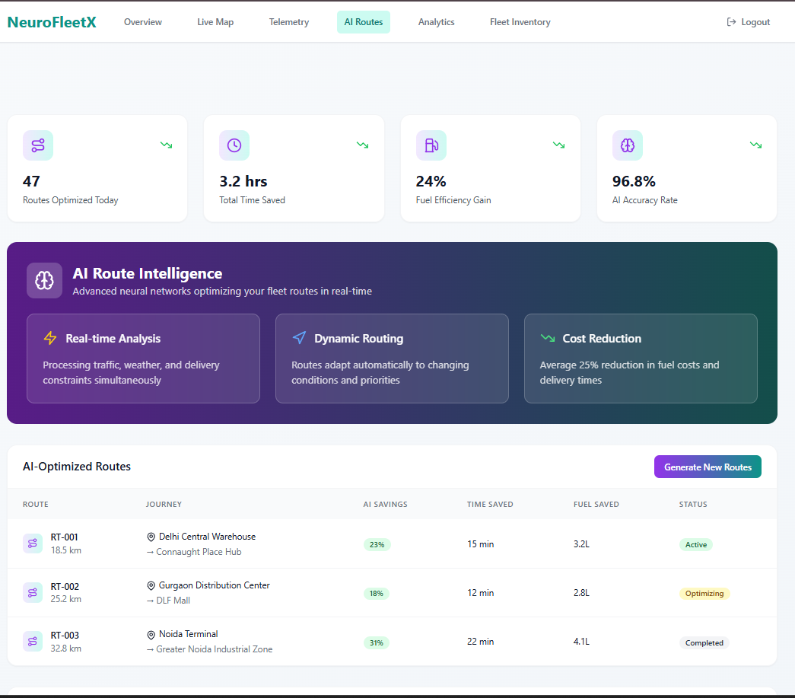
Fleet telemetry page

Slide 10
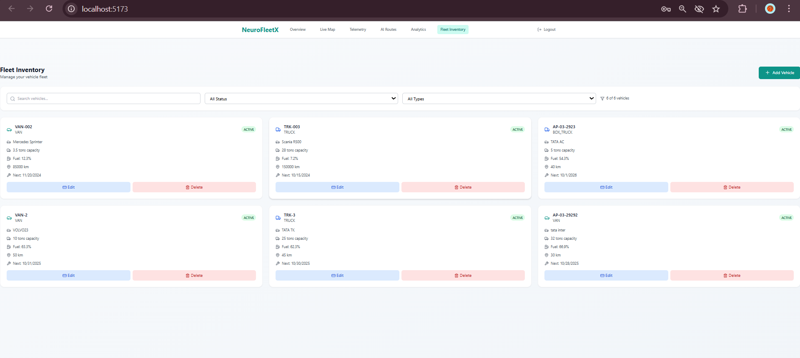
Fleet Inventory page

Slide 11
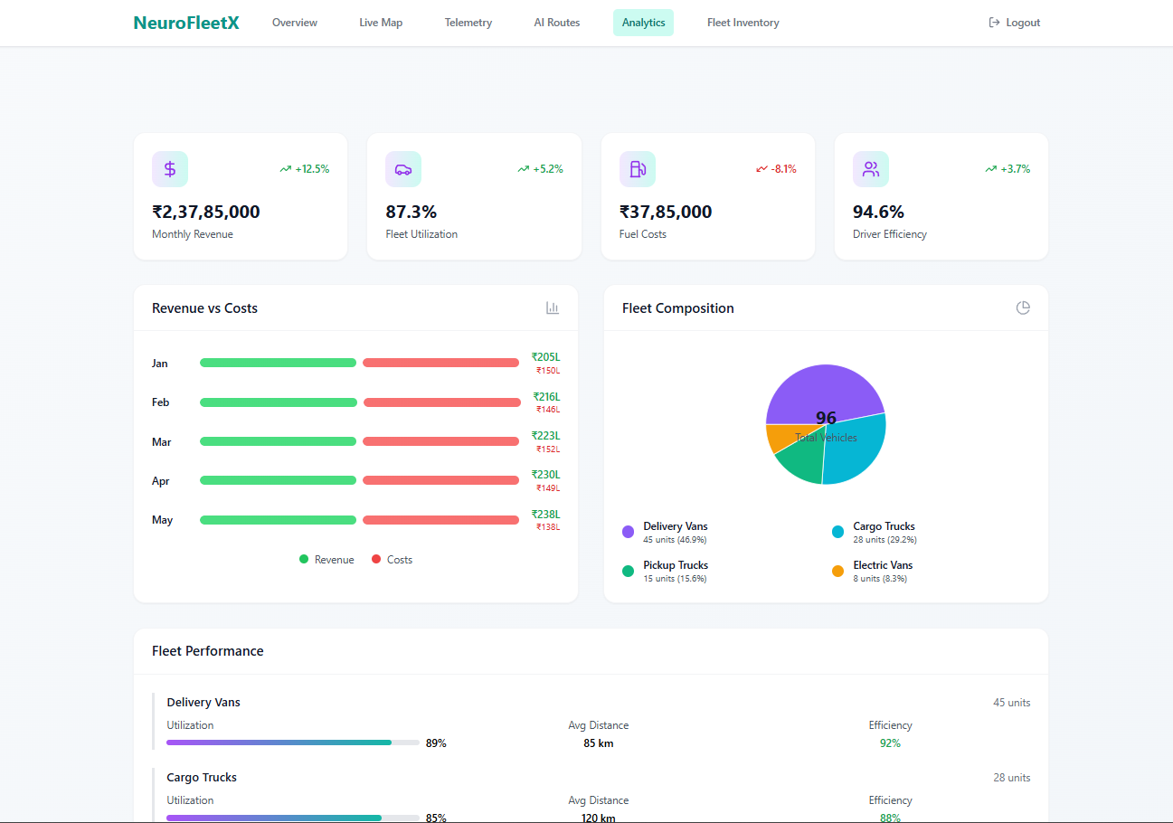
Fleet Analytics page

Slide 12
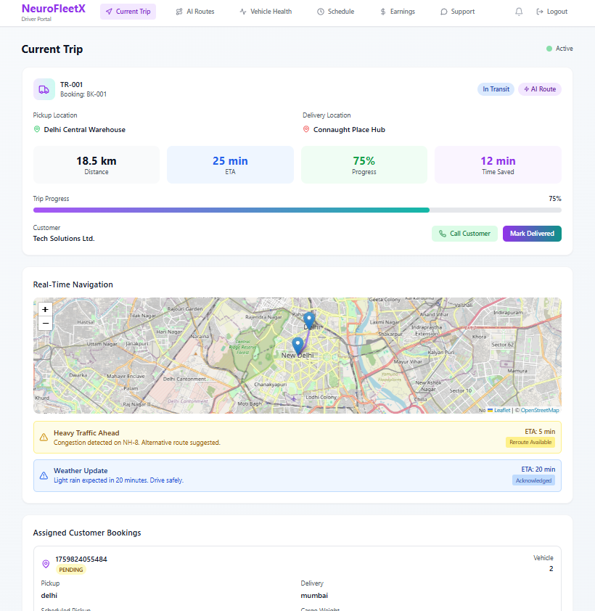
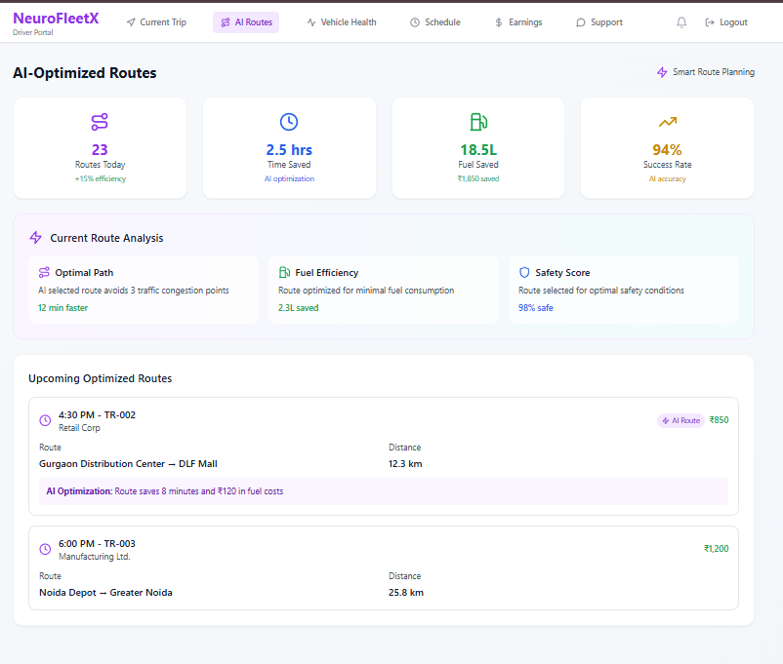
Driver portal pages

Slide 13
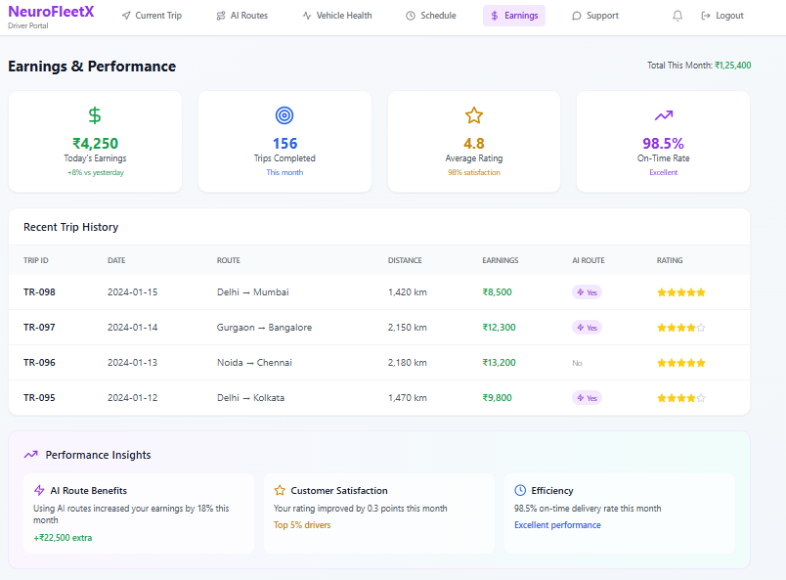
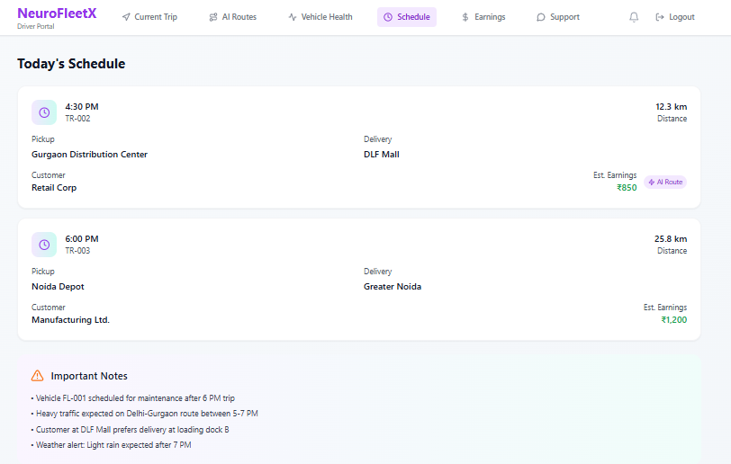
Driver portal pages

Slide 14
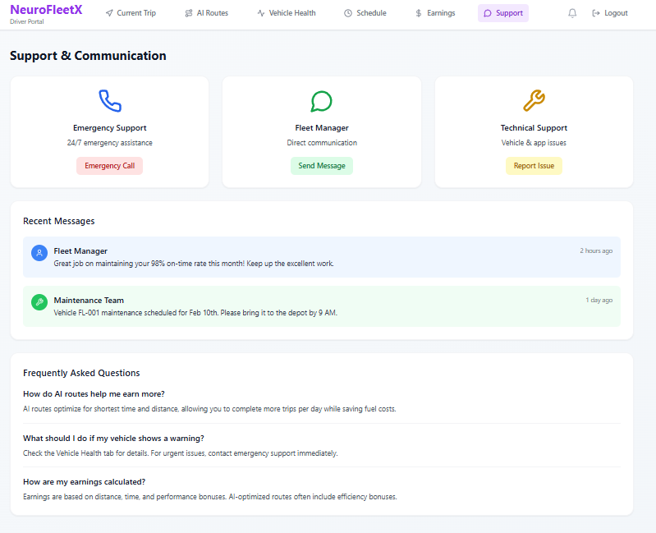
Driver portal pages

Slide 15
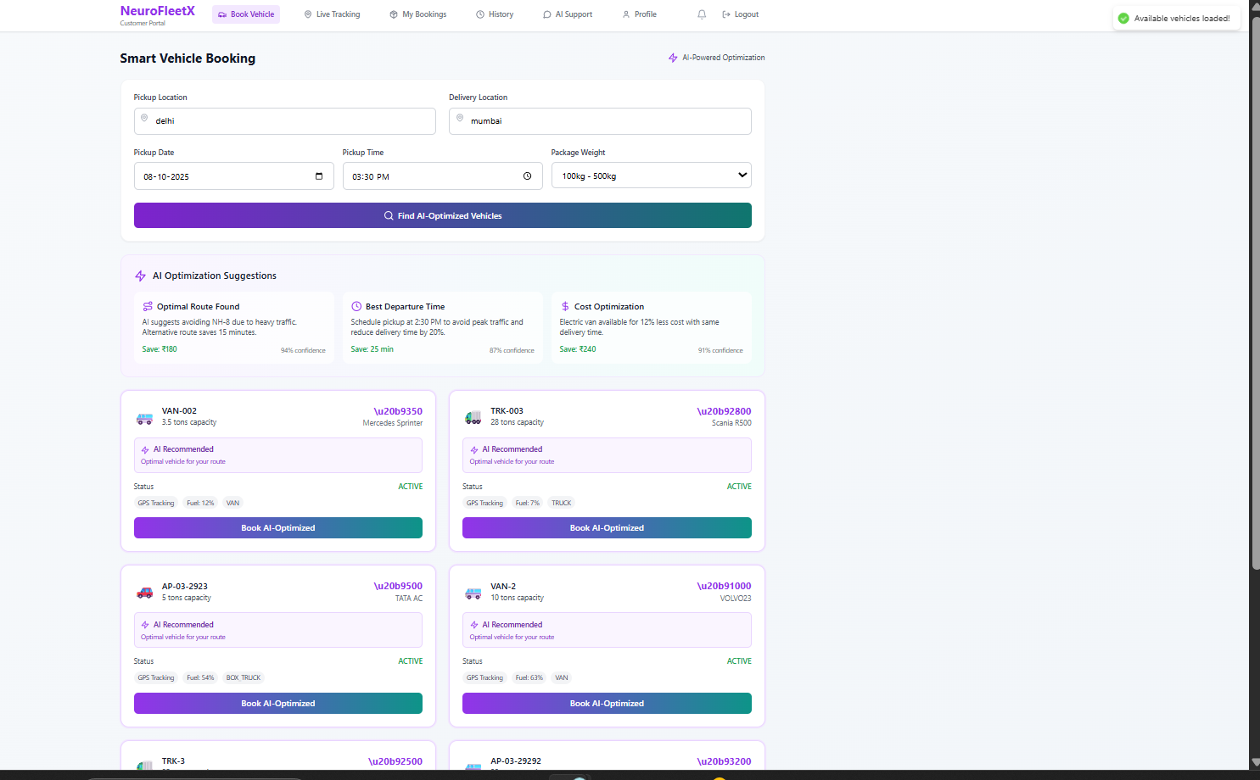
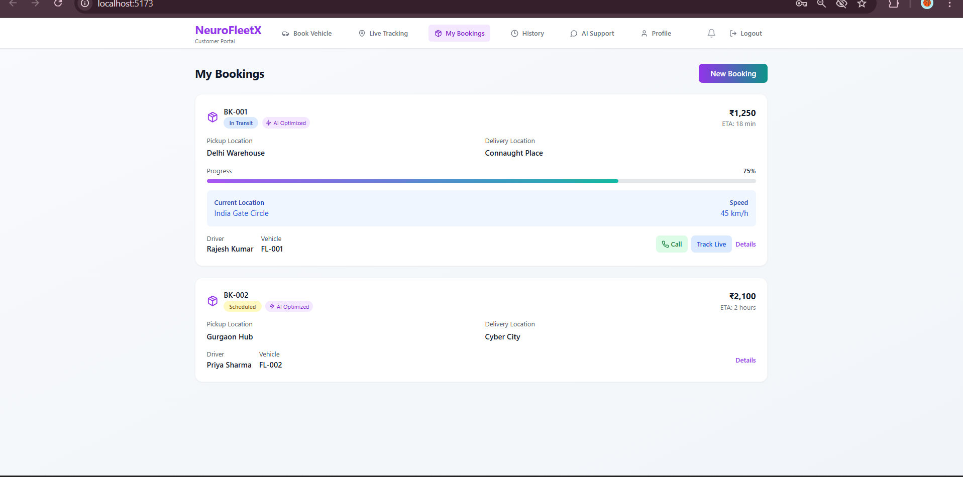
Customer portal pages

Slide 16
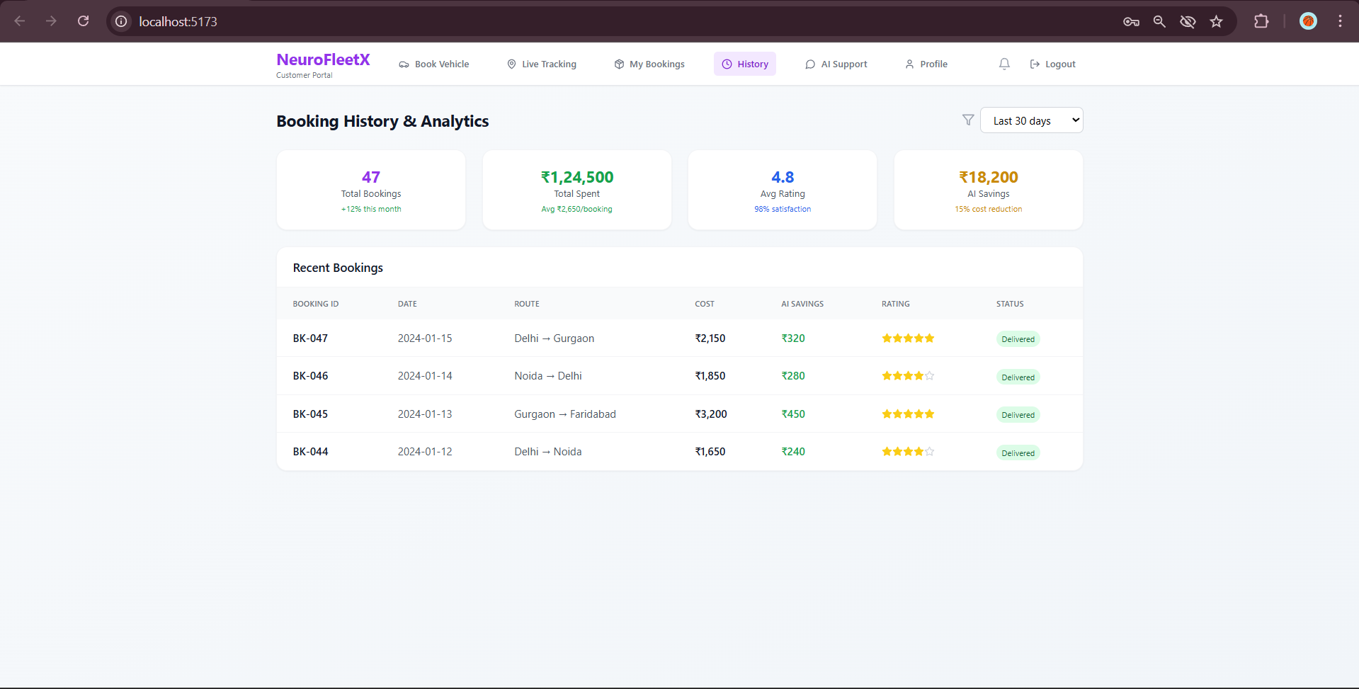
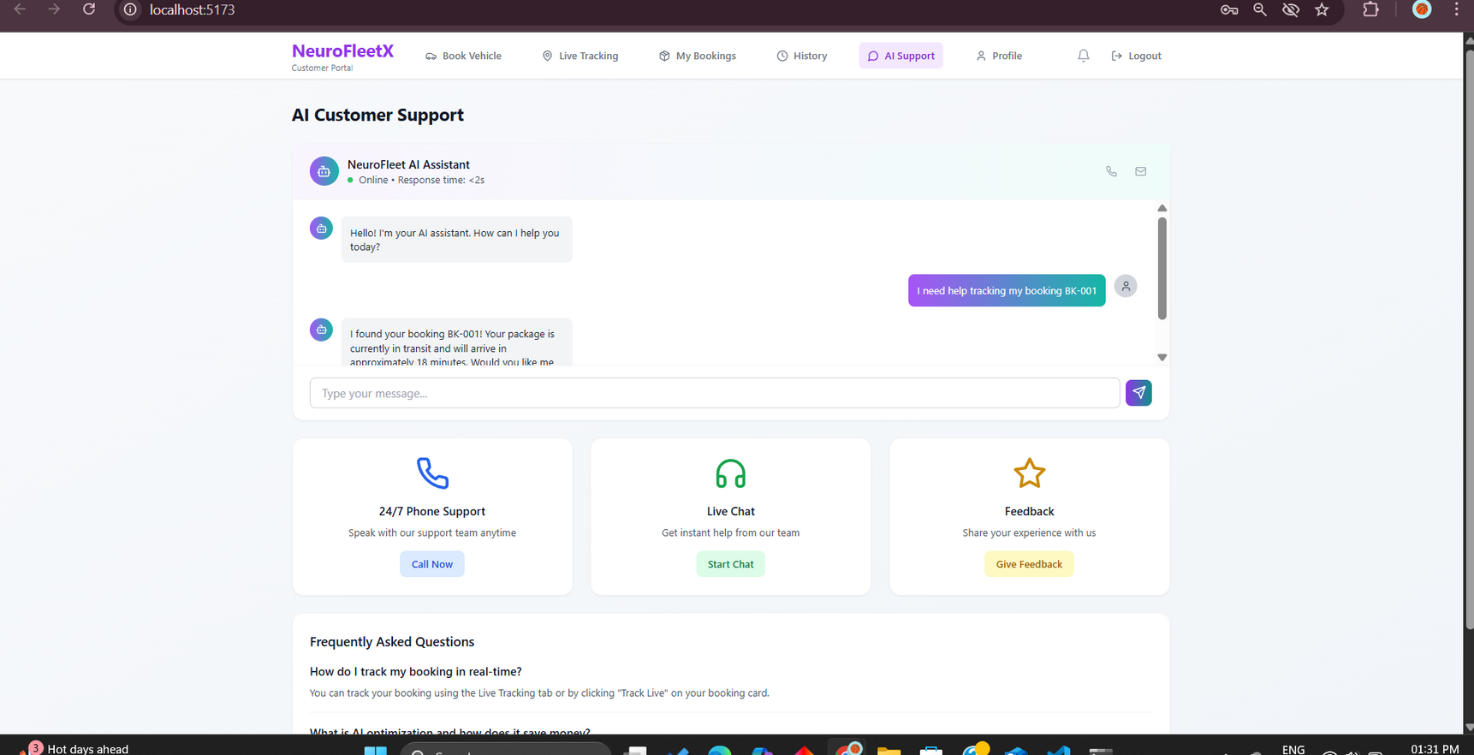
Customer portal pages

Slide 17



THANK YOU
CONNECT WITH US.
m.jayanth431@outlook.com

