Slide 1

Final Presentation
ENT603 Introduction To Entrepreneurship, 2022

Slide 2
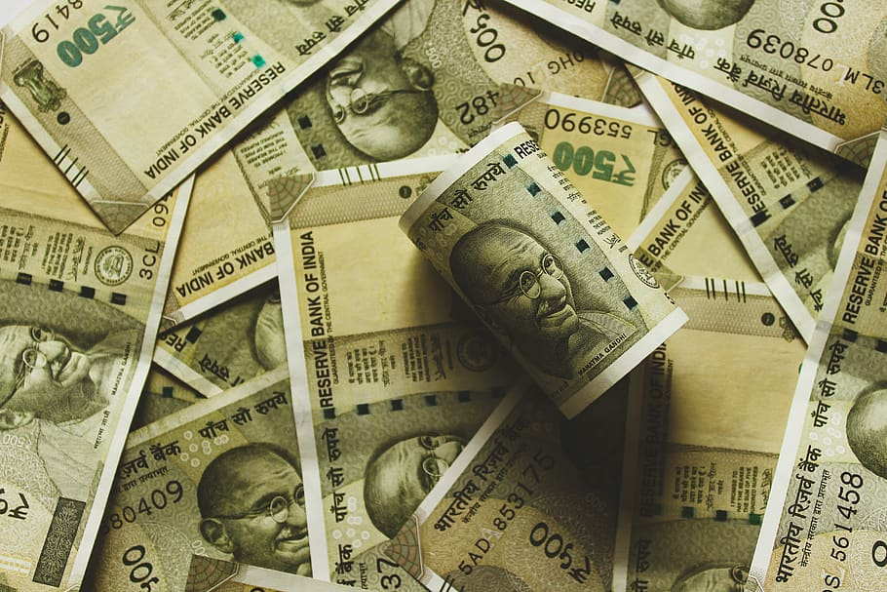
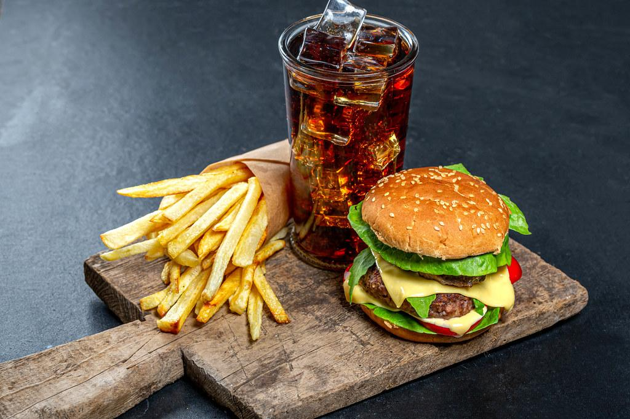
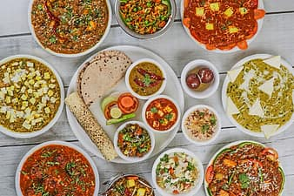
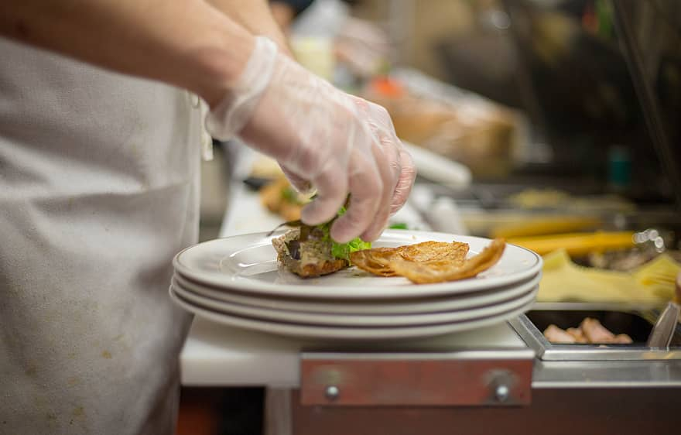
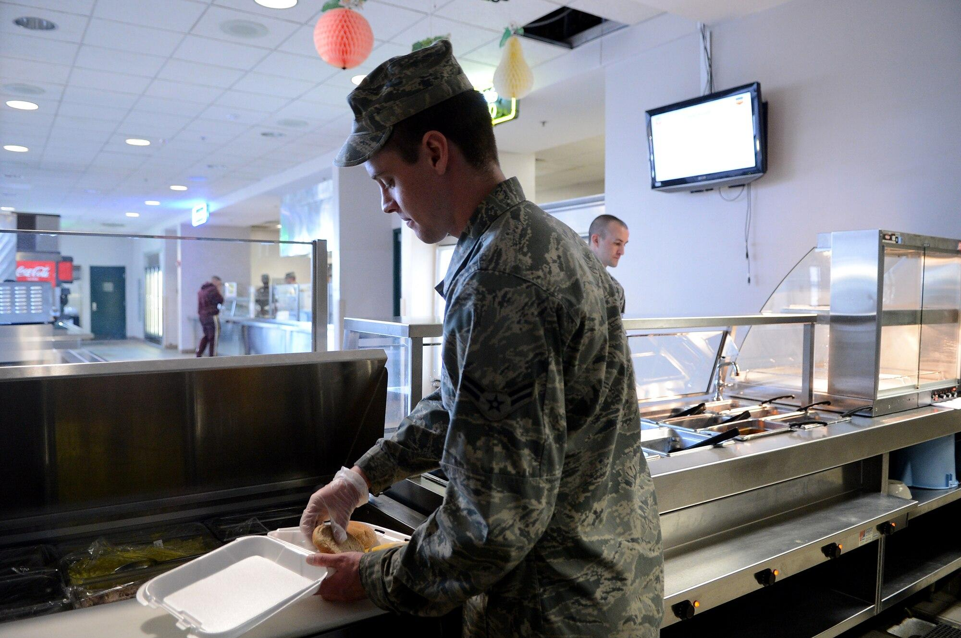
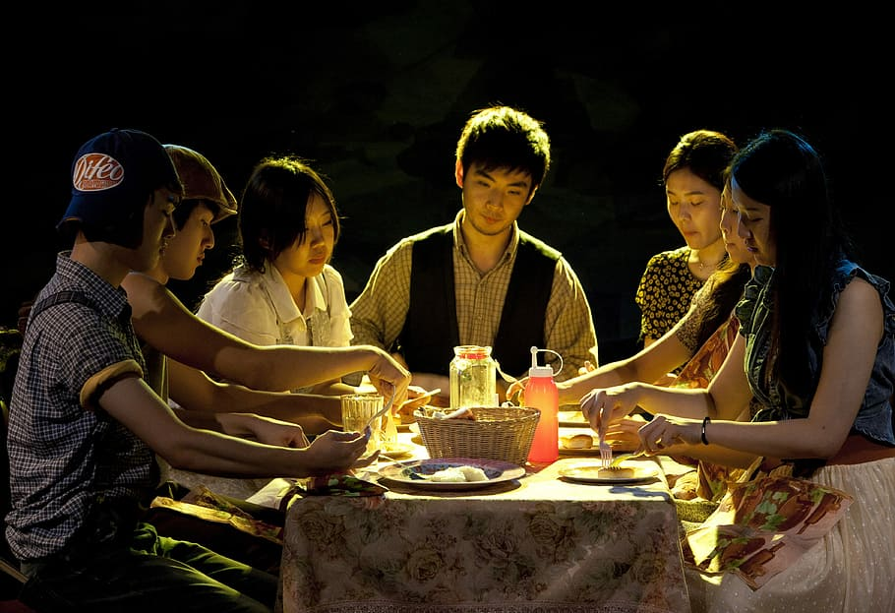
Pain Points
Limited cuisine
for non-natives
Unhealthy food from
restaurants
Expensive Food
No food
customisation
Unreliability/Low
Transparency
Missing home food

Slide 3

Problem Statement
Food delivery in cities like Mumbai are expensive with limited accessibility. They constrain a compromise between taste and health unlike home food. Regular food from restaurants are often unhealthy.
There are 160 million housekeepers in India that are skilled at cooking, but are having no source of income. Many small food businesses are shut with no source of investment.
Can we connect these two problems
to find a solution?

Slide 4
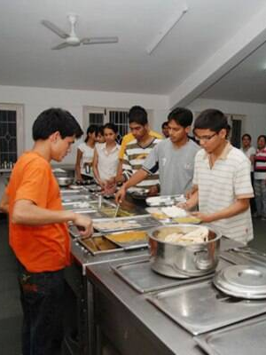
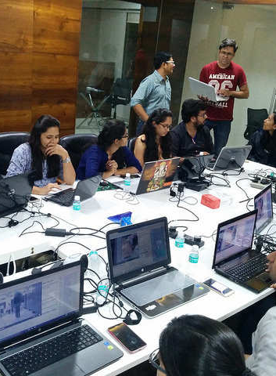
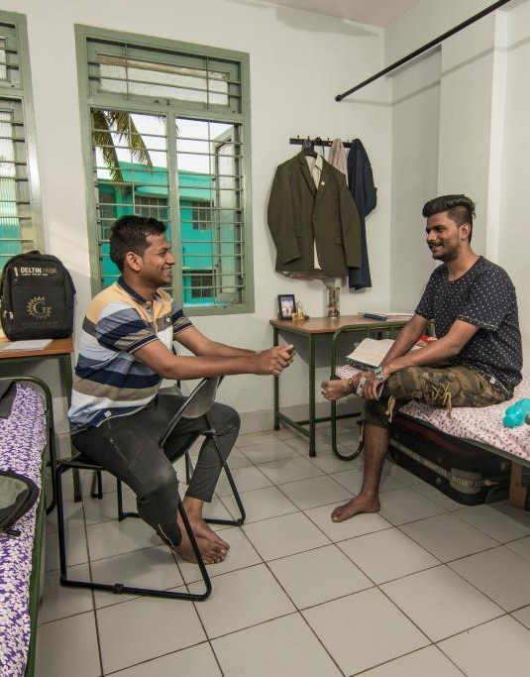
Customer Segments
Hostel Students
Working Professionals
Bachelors

Slide 5
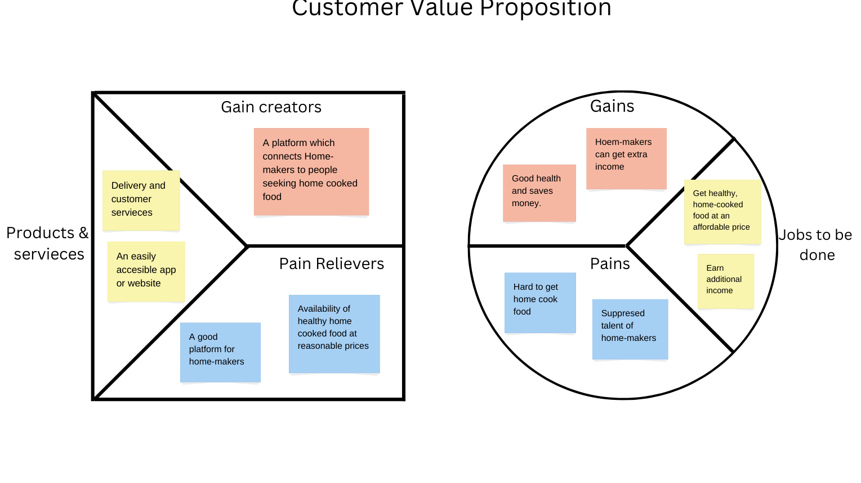
Customer Value Proposition
Customer Value Proposition

Slide 6

Market Size
TAM(Urban Population of major cities): 49 Crore
SAM (Urban Population with internet access and digital advertisement can be reached through) 20 Crore
Target Market (hostel students and bachelors living on their own): 50 Lakhs
TAM
SAM
Target Market

Slide 7
Our Competition
 | Dabba Wala | HomeFoodi | Ghar ki Yaad | Swiggy/Zomato | FoodLive
Platform | On Call | Mobile App, website | Mobile App, website | Mobile App, website | Mobile App, website
Healthy Food | Fixed Pre decided menu | Multiple healthy options | Multiple healthy options | Minimal healthy options | Multiple Healthy options
Price | Affordable Rs300-400 | Expensive Rs-600-1000 | Expensive Rs-600-1000 | Quite Expensive -Rs-600-1000 | Affordable Rs300-400
Customer Segment | Students, Working Professional | Students, Working Professional, Homecooks | Students, Working Professional, Homecooks | Local Restaurants, students, Family,working professions | Students, Working Professional, Homecooks, Chefs
Additional features | Environment Friendly , For daily purposes | Doorstep delivery, all chefs are FSSAI certified | Doorstep delivery | Cloud kitchen , database consulting, ingredients supply | Cloud kitchen , Doorstep delivery, all chefs are FSSAI certified Subscription available , cooked according to customer’s taste and complete transparency

Slide 8

Insights from Customer Discovery
Some of the questions we asked:
From what sources (food delivery, mess, canteen, street shops, cooking at home) do you get your daily meals from?
What would compel you to trust and try a purchase from our service?
How much do you think this solution is worth paying for - say, per order?
Insights
85% of the people we talked to crave homemade food living away from home; so we asked them whether they would prefer ordering homemade food, which would be comparatively healthier and cheaper than restaurants.
People also preferred variety, which is happens to be one of our USPs.
There was also a concern about hygiene, thus we brainstormed ideas such as uploading videos of the cooking areas.

Slide 9
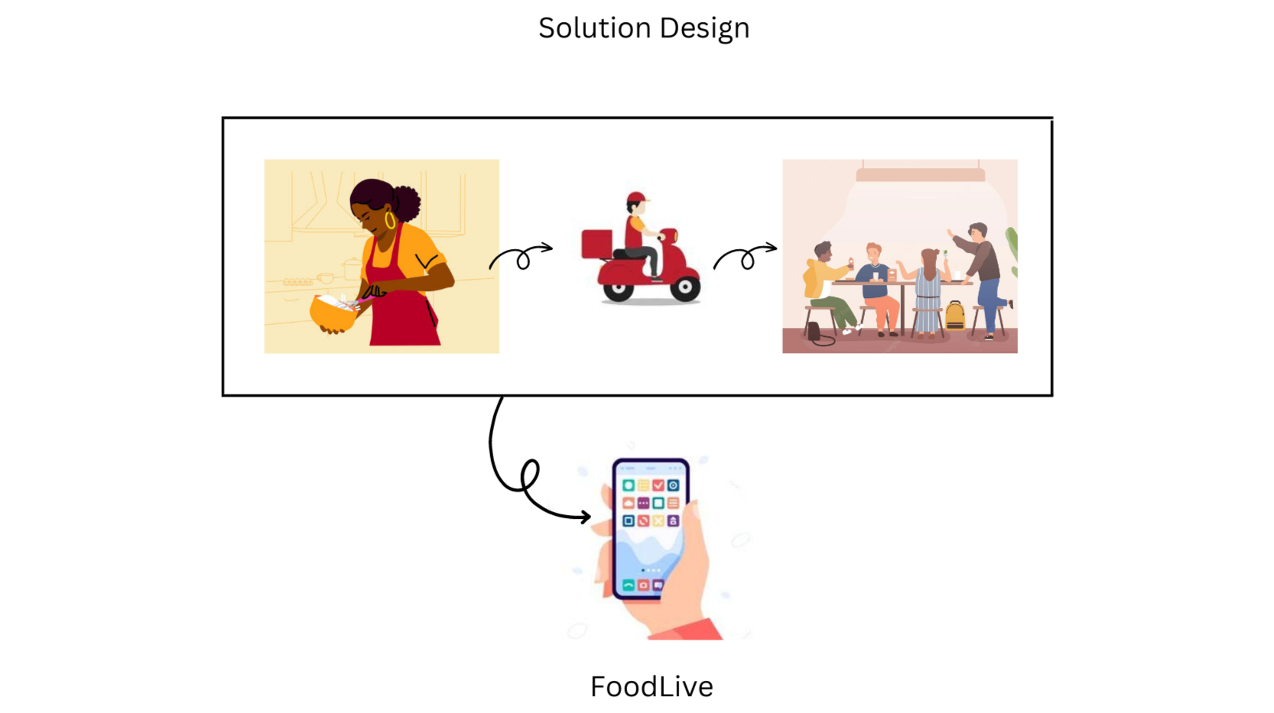
Solution Design
Solution Design

Slide 10
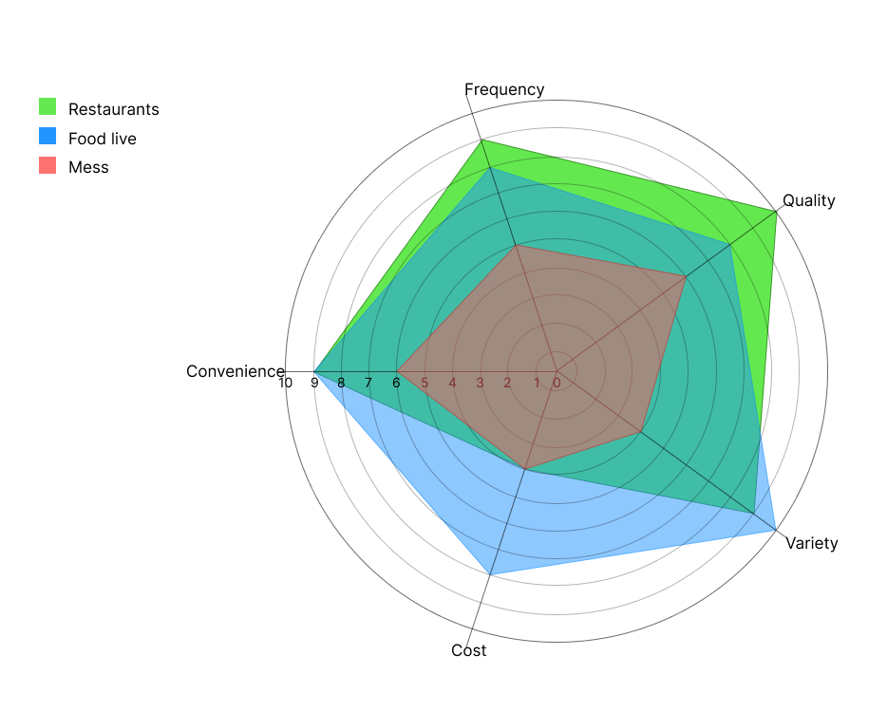
Spiderweb Diagram

Slide 11
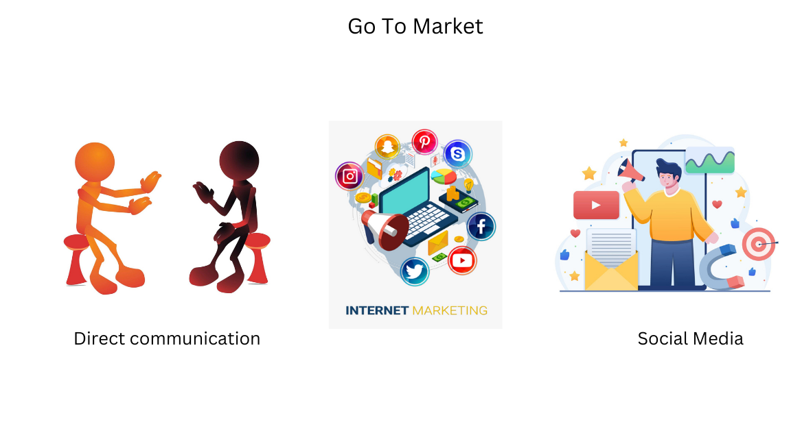
Go To Market
Go To Market

Slide 12
Revenue Planning
 | Year 2 | Year 3 - 4 | Year 5 - 6 | Year 6+
Number of Sellers | 50 | 300 | 1000 | 3000
Average Monthly Orders per Seller | 50 | 80 | 100 | 120
Average Revenue per Order (Including Delivery Charges) | 40 | 50 | 65 | 80
Total Monthly Revenue | 1L | 12L | 65L | 2.8Cr

Slide 13
Project Planning - GANTT Chart
2023
2024
2025
2026
2027
2028
2029
Q1
Q2 Q3 Q4
Q1
Q2
Q3
Q4
S1
S2
S1
S2
S1
S2
Y
Y
Initiation
Development
Launch
Expand
Novel Services
Company
Proof of Concept
Sales Team Recruiting
Team Expansion
Subscriptions, Scheduled Deliveries
Branding & Advertisement
Product
Customer & Seller Survey
Mobile App Development
Investments in Own Delivery Channel
R&D Investments
Partnership with Delivery Service
Market
Adding 80+ Home cooks from Powai & Nearby Regions
First Launch in Selected Regions of Mumbai
Expansion to Entire Mumbai Region
All Major Metropolitan Cities
LOREM

Slide 14
Financial Projection
 | Year 1 | Year 2 | Year 3 | Year 4, 5 | Year 6+
Total Revenue (INR) | 20,000 | 12L | 2.4Cr | 6.8Cr | 33Cr
Cost of delivery partnership | 35,000 | 6L | 30L | 50L | 1Cr
Cost of company-owned delivery channel | 0 | 0 | 30L | 50L | 3Cr
Employee payout | 5,00,000 | 15L | 30L | 1Cr | 5Cr
Capital Investment + R&D cost | 0 | 10L | 50L | 3Cr | 10Cr
Marketing and Advertisement cost | 10,000 | 1L | 20L | 1Cr | 5Cr
Total Profit (Yearly) | -5.25L | -20L | 50L | 1Cr | 9Cr

Slide 15
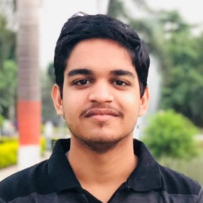
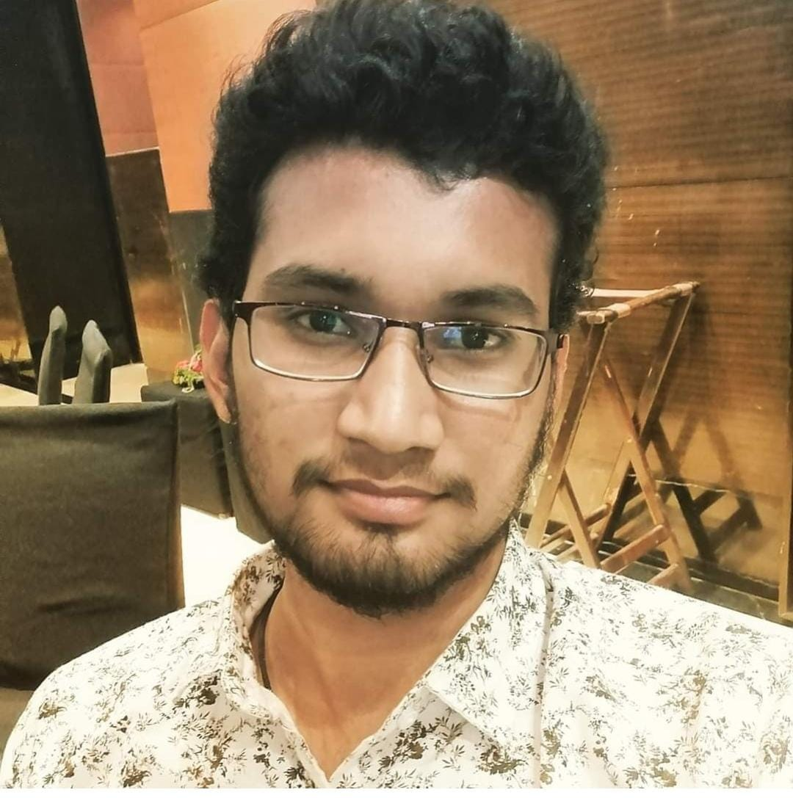
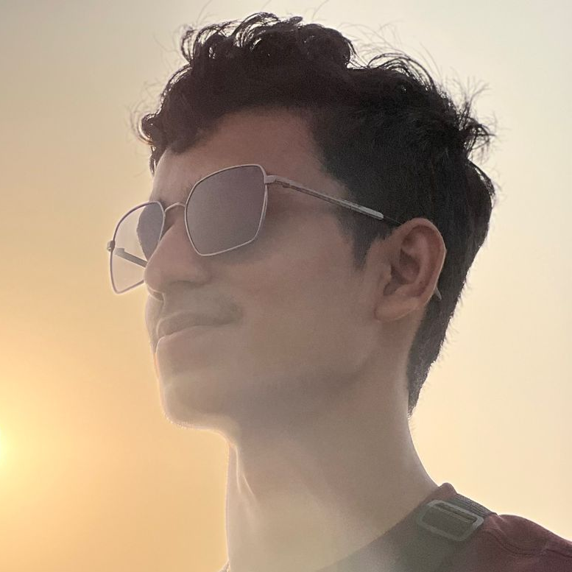
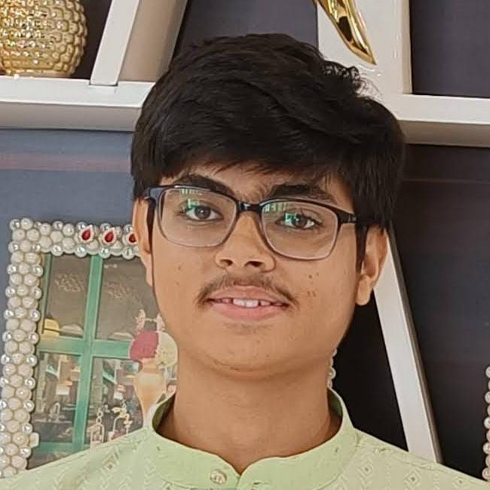
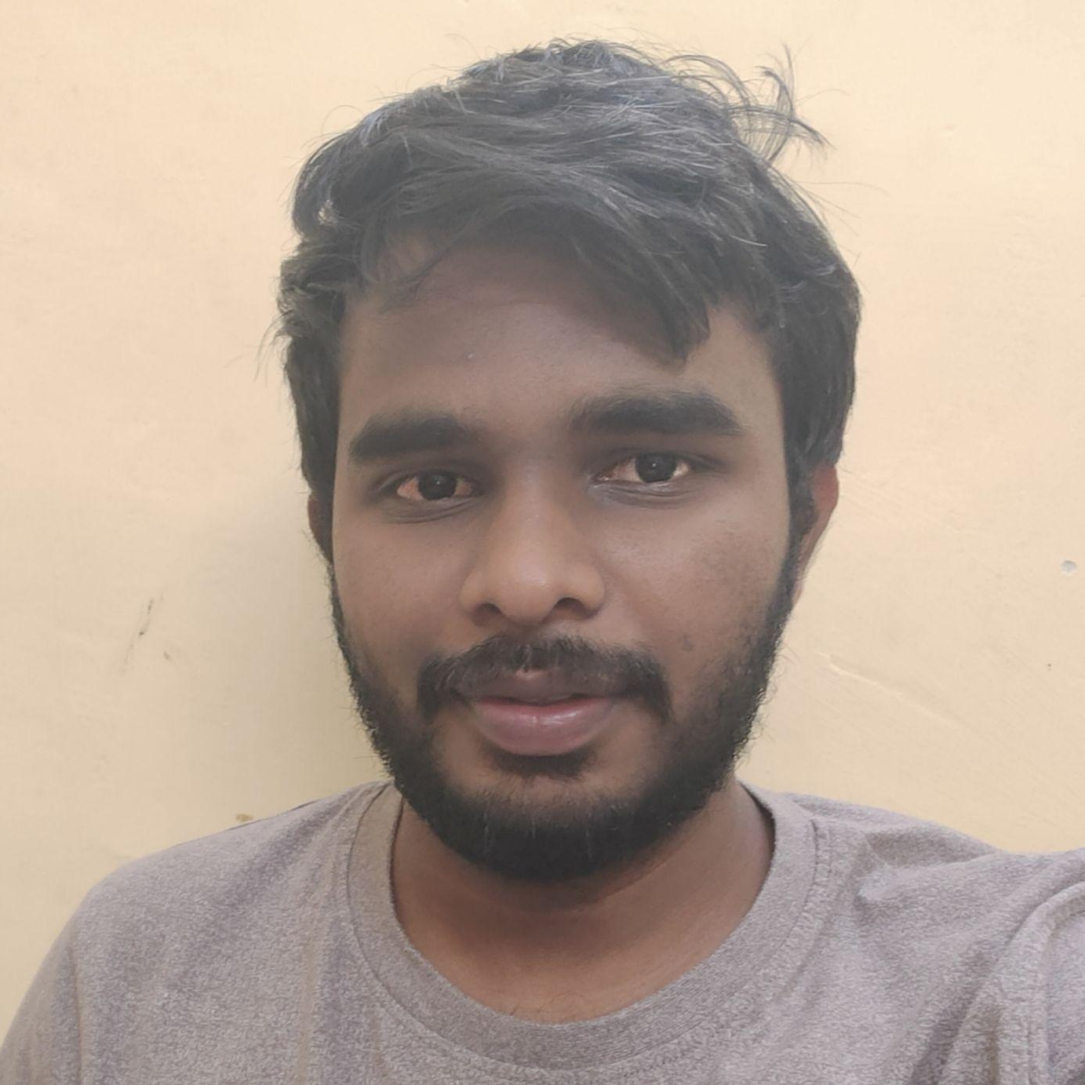
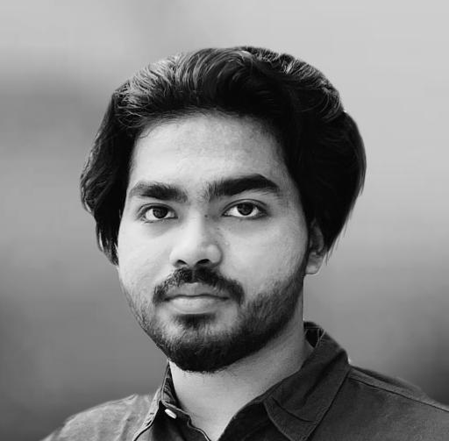
Our Team
Kaustav Prasad
Co-founder & CEO
B.Tech. Engineering Physics
Subbu Srikantam
Co-founder & CFO
B.Tech. Engineering Physics
Aditya Laddha
Co-founder & Chairman
B.Tech. M.E.M.S.
Naman Jain
Co-founder & COO
B.Tech. Civil Engineering
Jayanth Dosapati
Co-founder & CTO
B.Tech. Engineering Physics
Arjun K. Lenin
Co-founder & CMO
B.Des.

