Slide 1
Tan(x)
Jayanth Apagundi
July 28th, Mon

Slide 2
Agenda
Persona for a User of function- Tan(x)
Demo on Implementation from scratch with GUI using JavaFX
Requirements as per D2

Slide 3
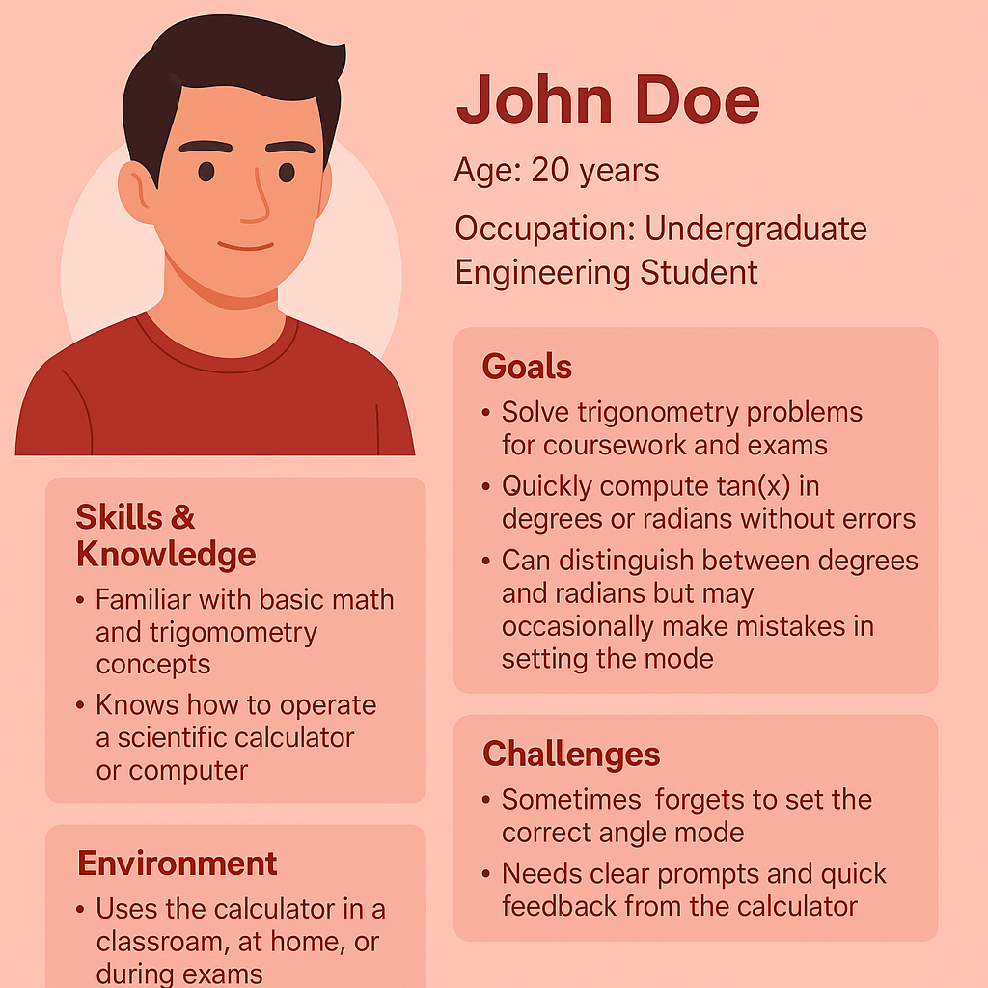
Persona
Represents a typical user of the TAN(x) calculator.
Highlights real challenges like mode selection errors.
Helps design requirements that focus on clarity and usability.
Ensures the solution meets both academic and practical needs.
[1]

Slide 4
Implementation
Implemented sin(x) and cos(x) from scratch using Taylor series, and then computed tan(x) as sin(x)/cos(x).[2]
Program is a JavaFX application -with labels, text fields, combo box, button, and result label, all laid out in a Vbox. [3]
No IDE-specific code, no project files, no dependencies- just a .java file that you can compile with javac and run with java.
Exception Handling with helpful error messages

Slide 5
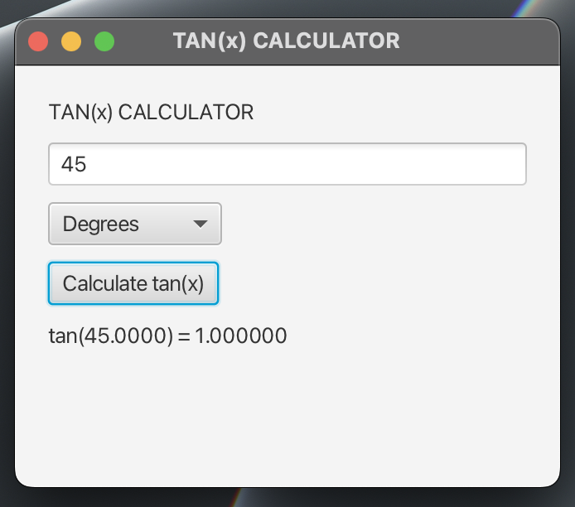
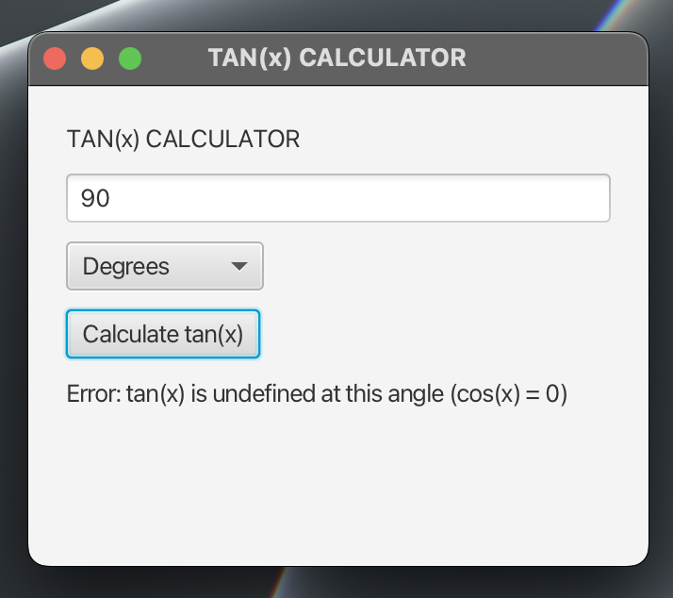
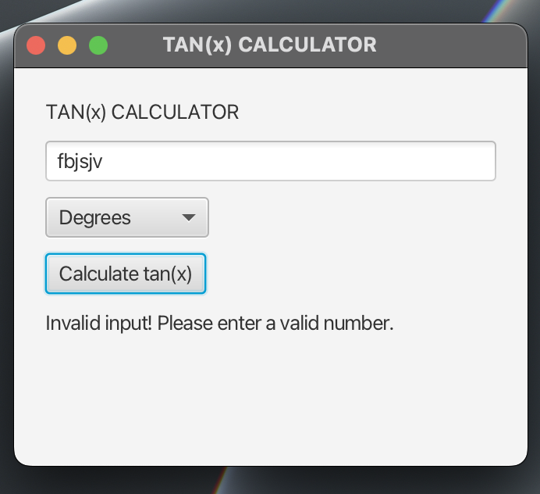
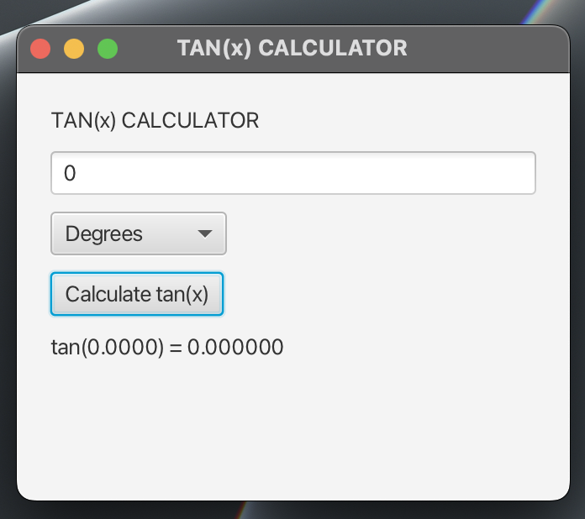
Implementation

Slide 6
Requirements
ID | Risk | Description | Rationale
FR1 | Med | Provide GUI using JavaFX. | Improves usability.
FR2 | Low | Allow angle input via text field. | Capture user input.
FR3 | Med | Dropdown for Degrees/Radians. | Reduce mode errors.
FR4 | Low | Convert Degrees → Radians. | Ensure correctness.
FR5 | High | Compute tan(x) via Taylor series. | Avoid built-in trig.
FR6 | Med | Warn when tan(x) undefined. | Prevent math errors.
FR7 | Low | Handle invalid inputs. | Increase reliability.
NFR1 | Low | Show result within 1 sec. | Maintain performance.
NFR2 | Med | Clear, helpful error messages. | Enhance usability.
NFR3 | Med | Run without IDE dependency. | Ensure portability.

Slide 7
Assumptions
Users have a basic understanding of trigonometry (Degrees vs Radians).
JavaFX runtime is available on the user’s machine.
Inputs are within a practical numeric range (not extremely large or small values).

Slide 8
Conclusion
Created a user persona (John Doe) to align design with real needs.
Implemented tan(x) calculator with JavaFX GUI using Taylor series.
Added robust error handling for invalid inputs and undefined values.
Ensured the program is IDE‑independent, runnable via terminal.
Updated requirements focusing on usability, performance, and portability.

Slide 9
References
[1] Medium, “Four main keys of persona in software development.” [Online]. Available: https://medium.com/inside-ppl-b7/four-main-keys-of-persona-in-software-development-d4df627aeb96.
[2] Stack Overflow, “Implement sine in Java without Math.sin function,” Jul. 26, 2017. [Online]. Available: https://stackoverflow.com/questions/45333694/implement-sine-in-java-without-math-sin-function.
[3] GeeksforGeeks, “JavaFX VBox Class,” [Online]. Available: https://www.geeksforgeeks.org/java/javafx-vbox-class/.

