Slide 1
Title
Jayanth Apagundi
July 14th, Mon

Slide 2
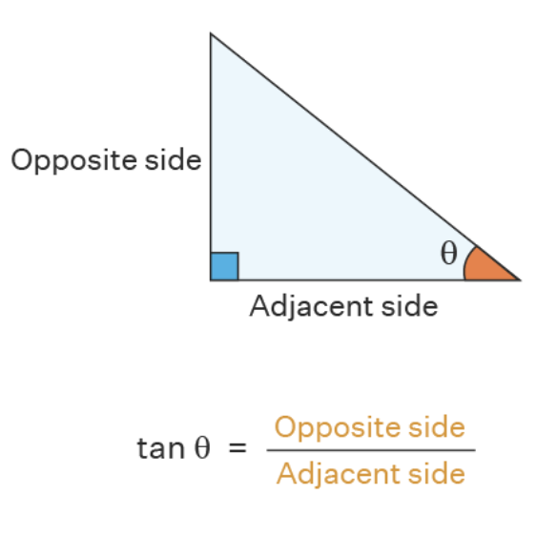
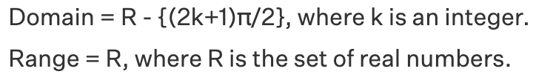
Software Engineering Processes
Tan(x): The Tangent Function is a basic trigonometric function which can be expressed as ratio of sine and cosine functions

Slide 3
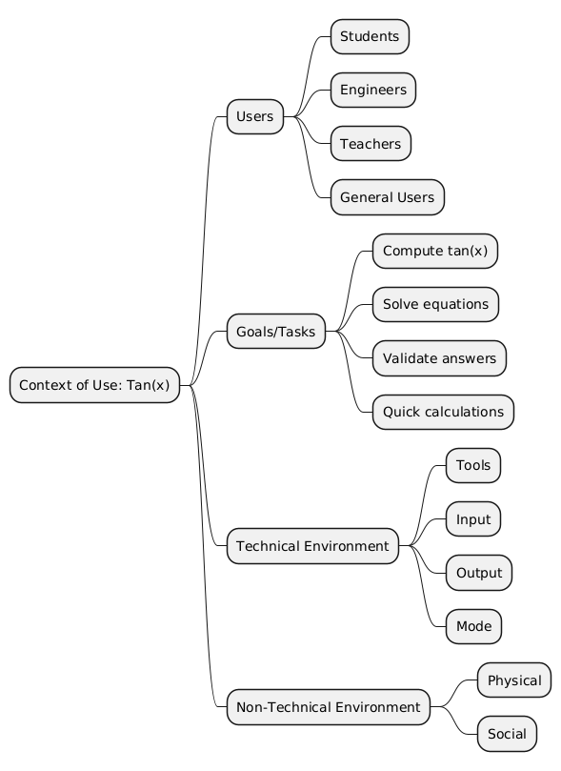
Context of Use Model
Users: Students, engineers, teachers, and general users for various trigonometric calculations.
Tasks: Compute, verify, and solve tangent-related problems quickly and accurately.
Technical Environment: Calculator hardware/software with correct mode, input/output, and reliable power.
Non-Technical Environment: Used individually or collaboratively in classrooms, exams, offices, or at home.

Slide 4
Requirements
ID | Risk | Description | Rationale
FR1 | Low | Accept angle input as a real number | Enable tan(x) calculation
FR2 | Low | Specify unit as ‘d’ (degrees) or ‘r’ (radians) | Handle unit conversion
FR3 | Low | Convert degrees to radians if needed | Java trig functions use radians
FR4 | Medium | Compute and display tan(x) | Provide main functionality
FR5 | Medium | Detect and show message if tan(x) undefined | Avoid invalid/infinite output
FR6 | Low | Show error if unit input is invalid | Guide user input correctness
NFR1 | Low | Display result within 1 second | Ensure timely response
NFR2 | Low | Provide clear prompts and error messages | Improve usability

Slide 5
Assumptions
User inputs a valid real number; no non-numeric validation.
Unit must be ‘d’ (degrees) or ‘r’ (radians); others are invalid.
Program runs in a console with standard input/output.

Slide 6
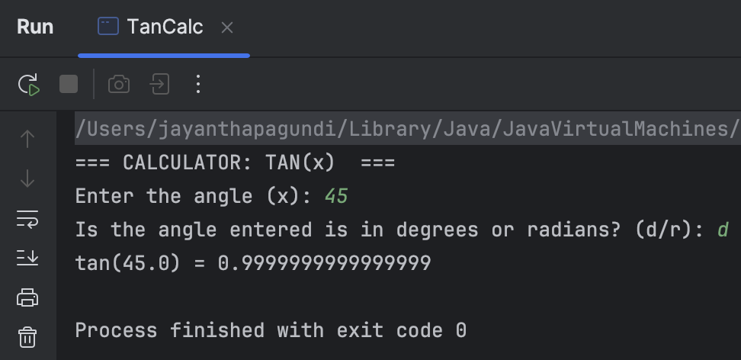
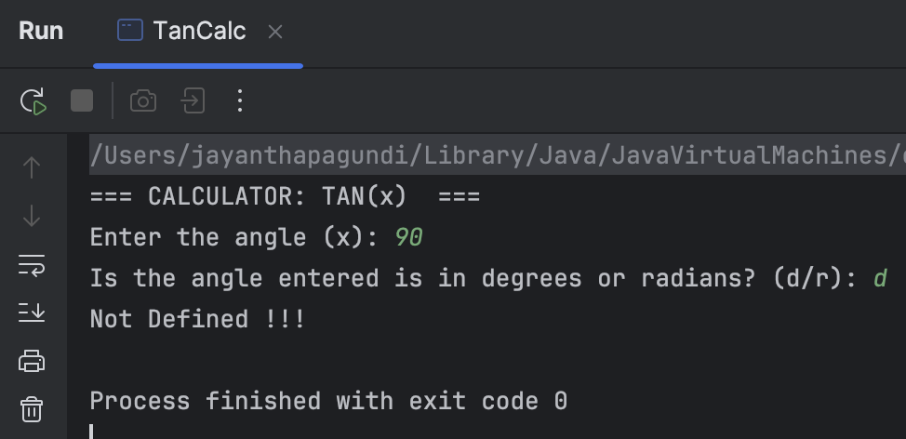
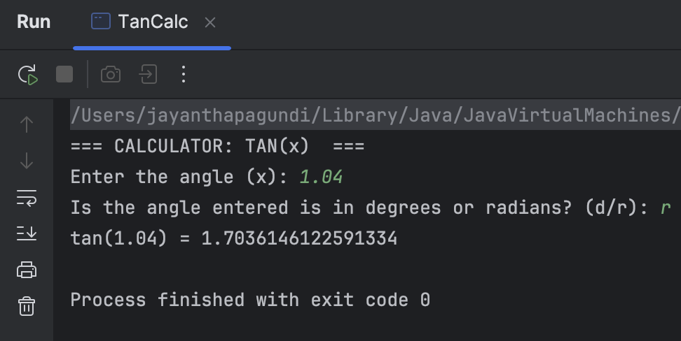
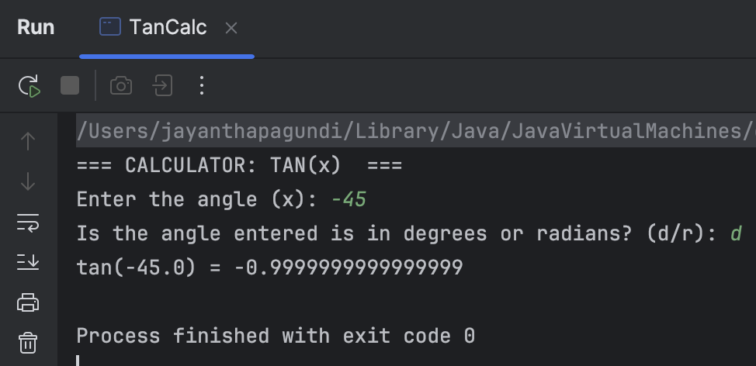
Implementation

Slide 7
Conclusion
Cuemath: Tangent Function - Properties, Graph, and Identities. Available at: https://www.cuemath.com/trigonometry/tangent-function/
Math.cos() method in Java- Available at: https://codegym.cc/groups/posts/mathcos-method-in-java

