Slide 1





8th Edition TECHgium® - Finale
PID No. 2153
Presentation Round
Enhanced Cancer treatment outcome through Simulations
Author 1
Photo
Author 2
Photo
Jayanth SB
Ashish Pujapanda
Lalit R
Akilan K
May 2025
Mentor : Dr. Richards Joe Stanislaus
Vellore Institute of Technology , Chennai

Slide 2

Challenge Statement
To Design and develop a novel catheter system capable of delivering precise electromagnetic energy to target malignant tissues, minimizing thermal damage to surrounding healthy tissue. The system should leverage advanced virtual modeling techniques to visualize the ablation zone in real-time, enabling dynamic adjustments to the energy delivery. Additionally, the design must accommodate various cancer cell shapes and sizes, ensuring optimal energy distribution and ablation efficacy.

Slide 3
Concept / Scope of solution
A novel catheter system leveraging an axial mode helical antenna for precise and minimally invasive liver cancer ablation.
Axial Mode Helical Antenna:
Compact design suitable for catheter applications.
Tunable frequency range for optimal tissue penetration.
Circular polarization for efficient energy deposition.
Real-time Virtual Modeling:
Dynamic visualization of the ablation zone.
Adaptive energy delivery for optimal treatment.

Slide 4
Feedback from Previous Rounds
The mentor suggested us to analyze the radiation pattern for our design, through which we came to know about the precise efficiency of the antenna.

Slide 5
SWOT Analysis
STRENGTH
WEAKNESS
Precise Energy Delivery: Helical antenna for targeted ablation.
Real-time Visualization: Virtual modeling for surgeon control.
Minimally Invasive: Catheter-based approach.
Multiple Organs Treatment: Same antenna design with little change in parameters might be used for other organs too.
Complex Integration: Combining multiple advanced technologies.
High Development Costs: Research and clinical trials.
Regulatory Hurdles: Medical device approvals.
Higher Radiation: Prolong Use might be harmful as more exposure of electromagnetic radiations will occur.
OPPORTUNITIES
THREATS
Growing Cancer Treatment Market: High demand for effective therapies.
Technological Advancements: Continuous innovation in medical tech.
Partnerships: Collaboration for development and distribution.
Expansion to Other Applications: Adaptable technology.
Competition: Existing and emerging ablation technologies.
Regulatory Changes: Stricter healthcare regulations.
Liability Risks: Chance of technical issues with the device.
Reimbursement Challenges: Unsure if the insurance will pay for everything.

Slide 6
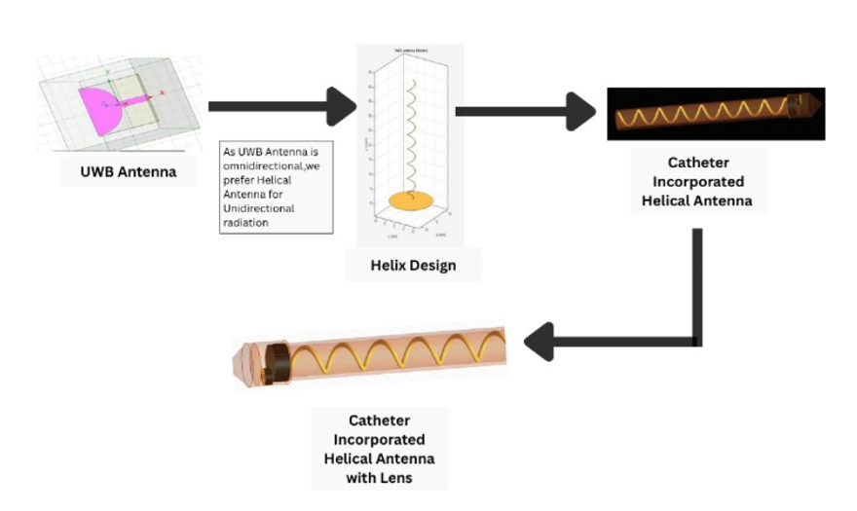
Design Flow:

Slide 7
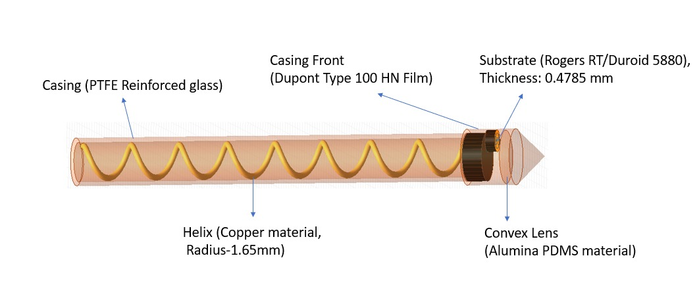
Implementation (1/2)

Slide 8
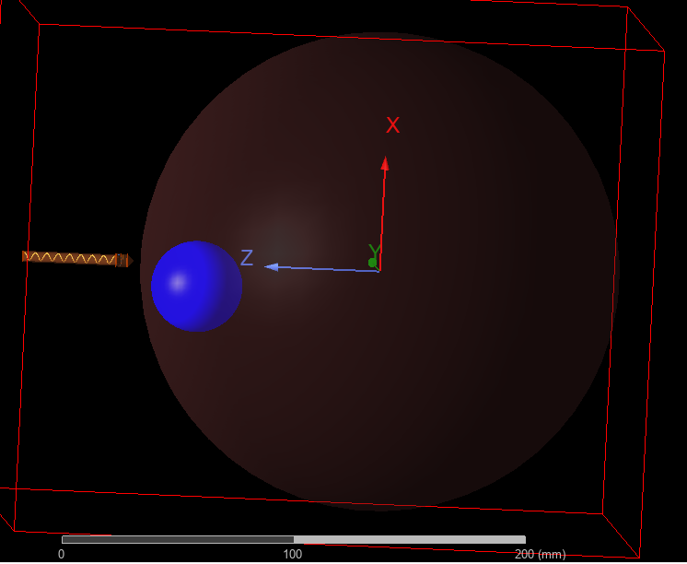
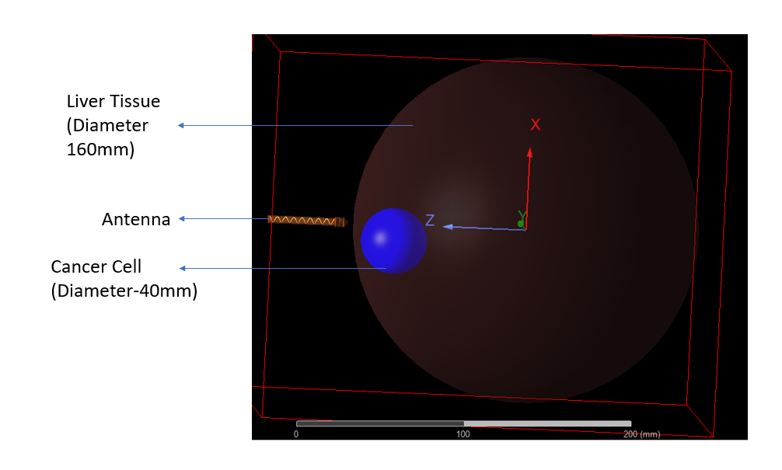
Implementation (2/2)

Slide 9
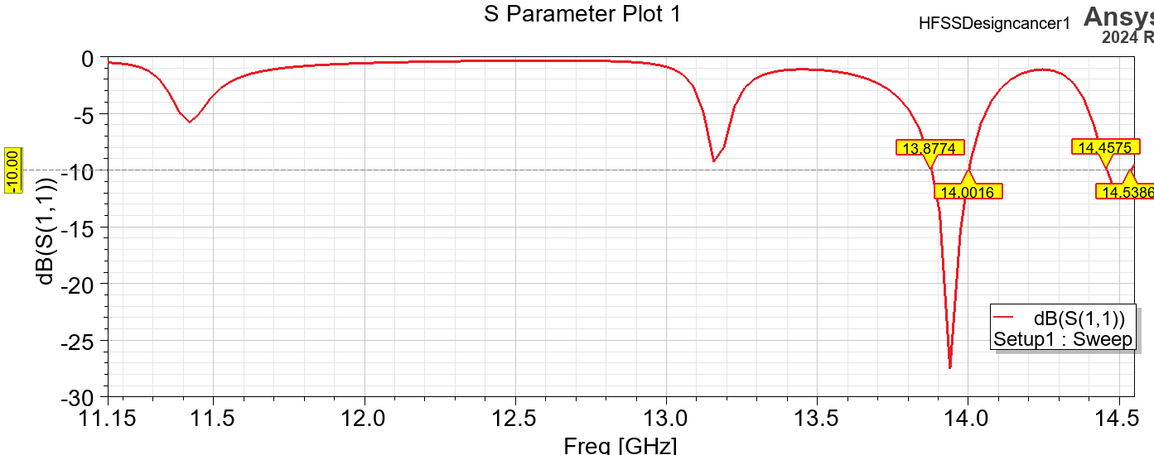
Testing / Analysis (1/7)
Without Lens:
Antenna’s operating frequency : 13.9 GHz

Slide 10
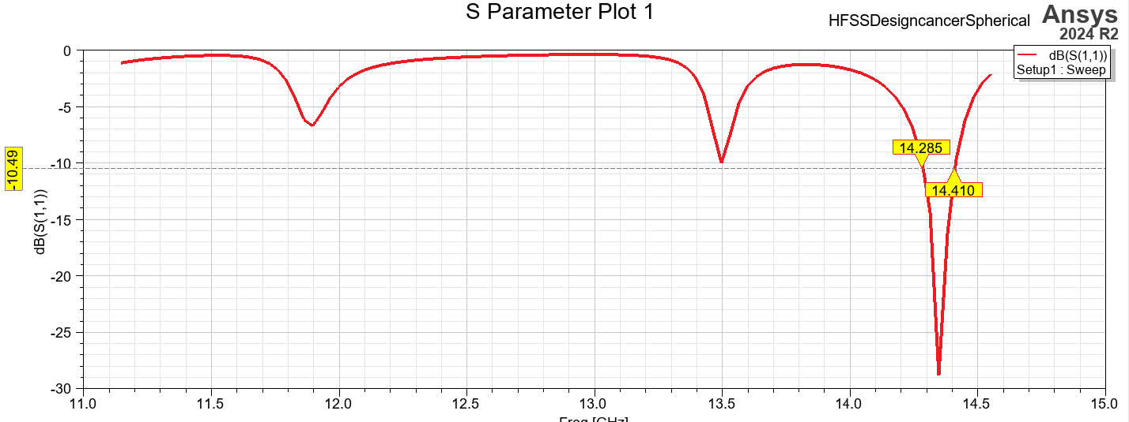
Testing / Analysis (2/7)
With Lens:
The antenna’s operating frequency is shifted to 14.34 GHz

Slide 11
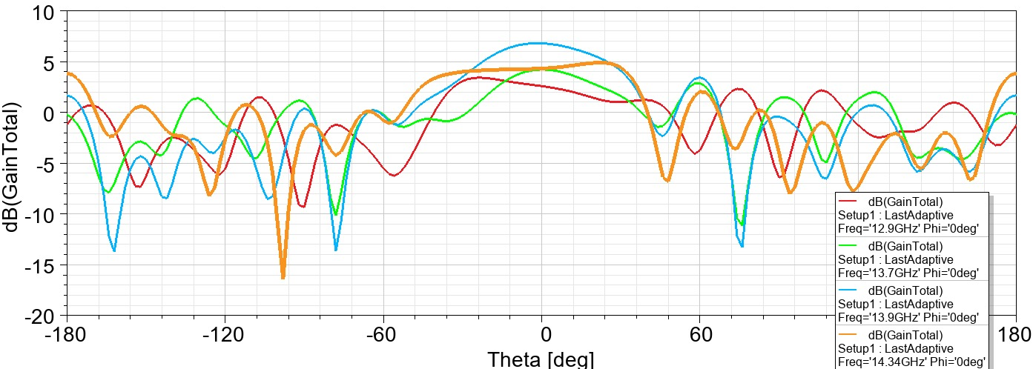
Testing / Analysis (3/7)
This graph showcases the antenna’s gain values in dB for two phi angles – 0 and 90.
A change in the Phi angle doesn’t affect the antenna gain.
At theta =0 degrees, we get the maximum gain as the Antenna operates in the Axial Mode.

Slide 12
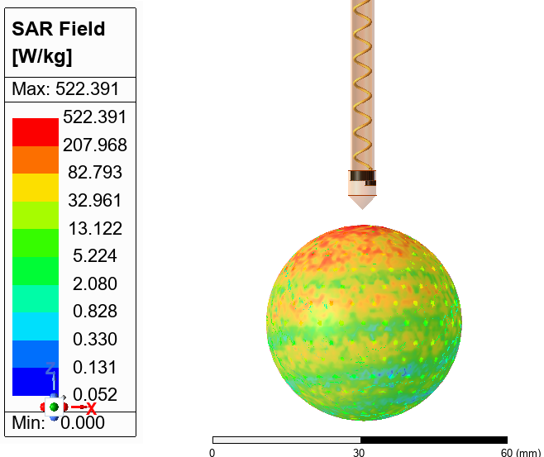
Testing / Analysis (4/7)
Without Lens:
The figure displays the distribution of Specific Absorption Rates (SARs) in liver tissue subjected to electromagnetic radiation at 13.9 GHz in a malignant zone.
SAR is essential for evaluating RF-induced thermal effects since it calculates the rate of energy absorption per unit mass (W/kg).
Directly beneath the antenna, a peak SAR of 522.391 W/kg is seen.
As depth increases, the SAR progressively drops, indicating targeted energy delivery to the cell with the least amount of damage to nearby healthy tissues.

Slide 13
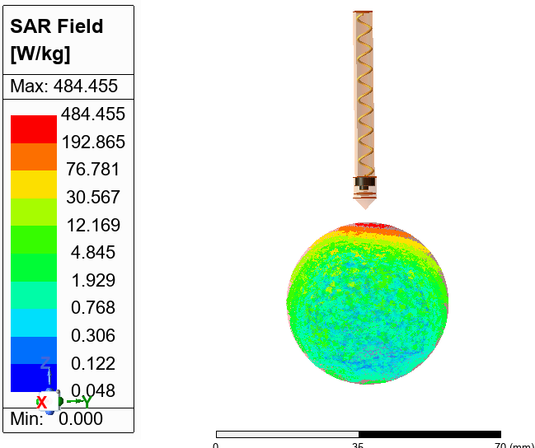
Testing / Analysis (5/7)
With Lens:
This image displays the SAR value for the antenna with lens incorporated in the head part.
The observed SAR value is 484.455 W/kg for 14.34 GHz frequency.
Due to the convex lens, the radiation is highly focused as compared to the previous analysis.
3mm Distance

Slide 14
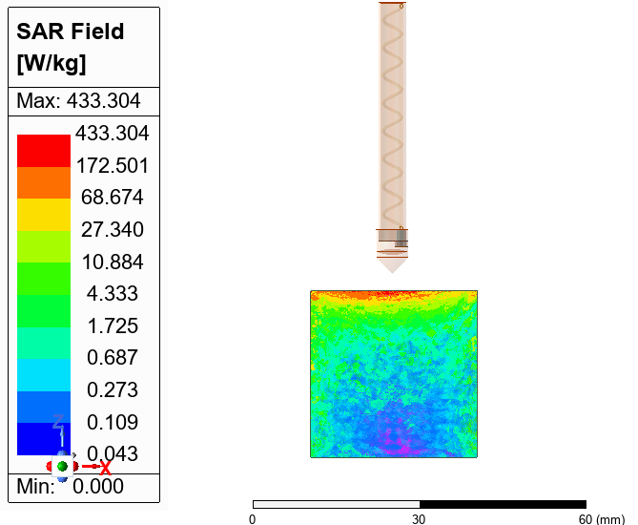
Testing / Analysis (6/7)
Considering a cube-shaped cancer cell:
This image shows the SAR value for the same design, but with a cube-shaped cancer cell.
The observed SAR value is 433.304 W/kg at the top regions of the cancer cell.
Cube-cell was used to reflect the more practical SAR measurement setup.

Slide 15
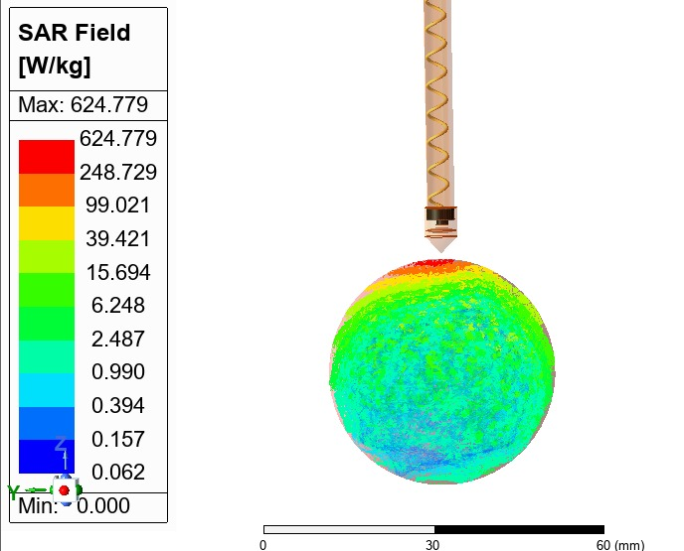
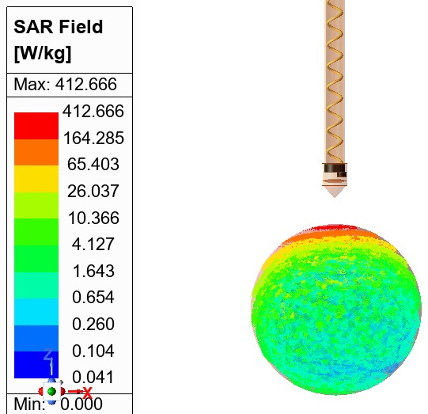
Testing / Analysis (7/7)
SAR for various antenna spacings:
1mm: 6mm:
The SAR value for 1mm antenna spacing is 624.779 W/kg, and that of 6mm is 412.666 W/kg. It is observed that SAR decreases for increase in Antenna-Cell distance.

Slide 16
POC demo
We have created a small video showcasing our antenna design , we are attaching the drive link for your reference .
https://drive.google.com/drive/folders/1n-oJBx1VLWhfNRPJ0JTtnr53-Kc1fYhR

Slide 17
High Level plan for converting POC to MVP
The first step in converting our antenna design into a Minimum Viable Product (MVP) is to fabricate the design.
Next, the fabricated antenna must undergo several tests like functional tests, environmental tests, and mechanical tests.
It should also be tested under some fluids to check for its resistance against them.

Slide 18
Cost for POC vs MVP
Cost for POC
Cost for MVP
The estimated Cost for the Antenna with its Ground Plane and Substrate used will be – Rs.20,000/=
The estimated Cost for the Casing of the Antenna will be – Rs.10000/=
The cost of Minimum Viable Product (MVP) is estimated to be double that of POC, nearly – Rs.40,000/=
Additionally, several tests to evaluate the antenna’s efficiency would cost around – Rs.25,000/=

Slide 19
Result / Conclusion
This is our proposed catheter design which incorporates a helical antenna for precise and minimally invasive liver cancer ablation.
We successfully performed the analysis along with the liver phantom and obtained the gain and radiation pattern of the antenna.

Slide 20
References
Reference papers:
Enhanced Design and Analysis of a Minimally Invasive Antenna for Microwave Ablation in Hepatocellular Carcinoma–
https://ieeexplore.ieee.org/document/10590412
Minimally Invasive Microwave Ablation Antenna Designs at 915 MHz and 2.45 GHz –
https://ieeexplore.ieee.org/document/9806765
A Minimally Invasive Microwave Ablation Antenna With Highly Localized Ablation Zone –
https://ieeexplore.ieee.org/document/9774873
Microwave in the Treatment of Primary Liver Cancers –
https://link.springer.com/referenceworkentry/10.1007/978-1-4419-0751-6_21
Comparative Study of Minimally Invasive Microwave Ablation Applicators
https://www.mdpi.com/2076-3417/15/4/2142
Computer modeling of radiofrequency cardiac ablation: 30 years of bioengineering research –
https://www.sciencedirect.com/science/article/pii/S0169260721006209
Antenna design for microwave hepatic ablation using an axisymmetric electromagnetic model –
https://biomedical-engineering-online.biomedcentral.com/articles/10.1186/1475-925X-5-15

Slide 21
Thank You
May 2025

