Slide 1
Hardware Trojan Detection at RTL Level
-CS203(Digital Logic Design) Project
Group :- 10
Instructor :-Dr. Geeta
(CSE Department)

Slide 2
Team members
Khush Varshney :2025CSB1206
Jayanth Dahire :2025CSB1203(Team Lead)
Jatin Singla :2025CSB1202
Hanzala Zaid :2025CSB1197
Gourav :2025CSB1193

Slide 3
Stage-1
Understanding and Preparing the Plan of the Project
GOAL : Learn UART basics and Trojan concepts
We had to choose two major aspects of our project:
1) System Design: Designing a system that was simple enough to implement using our existing knowledge and the concepts we learned during the project, yet complex enough to incorporate Trojans that would not be directly detectable.
2) Trojan Types and Detection Algorithm: Deciding which types of Trojans to inject into the system and developing an appropriate detection algorithm to identify them.

Slide 4
Understanding and Preparing the Plan of the Project
Upon exploring various systems in which we could implement trojans we ended up on a system which consisted of a transmitter and a receiver following UART protocol. We chose UART because:
Simple and understandable architecture
Contains sequential RTL logic
Easy to insert different Trojan triggers
Supports rare-trigger experiments
Observable outputs make functional testing straightforward
The trojans which were selected for injection:
Sequential Trojans: Trojan activated when certain sequence of inputs were given
FSM Trojans: Trojans whose trigger is determined by its current state and current input

Slide 5
Stage-2
Implementation of UART(Universal Asynchronous Receiver/Transmitter)
GOAL : Build a functional UART system
Activities:
1)Implemented transmitter, receiver , and top modules.
2)Defined FSM states: IDLE, START, DATA, STOP.
3)Added baud-rate counters and synchronizers.
4)Verified functionality using a loopback testbench.
Outcome: Established a working UART baseline (Golden Reference).

Slide 6
Stage-2
Implementation of UART(Universal Asynchronous Receiver/Transmitter)
Difficulties faced:
1)We had to understand the various specific syntax to troubleshoot the code.
2)Meta stability in receiver module: When a signal changes at the wrong time, a flip-flop may temporarily produce an unpredictable output instead of a clear 0 or 1.
3)We had to reset the whole transmitter even when it was not in sync with the clock.
4)We had to be careful about which edge of the clock cycle we were using to ensure synchronisation of parallel components and no race condition of series components.

Slide 7
Stage-2
Resources we used until this stage:
Sources:
1)Class Lectures PPT for Verilog syntax
2)NandLand UART Serial Port Module – Nandland Got ideas to implement the basic UART
3)LLM : Debugging
4)YouTube videos: For understanding syntax in Verilog
https://www.youtube.com/watch?v=YUB-OyGr1oA

Slide 8
Stage-3 (Construction of trojans and their detection)
GOAL : Insert trojans and test detectability
Trojan types :
1)Single byte trigger
2)Two-byte sequence trigger
3)Four-byte sequence trigger
4)Side effect trojan
Payloads :
1)Payload A (Visible-Bit flip in output)
2)Payload B (Stealthy-No change in output. Internal change register change)

Slide 9
Stage-3 (Construction of trojans and their detection)
Testbench &Verification
Four Phases of Testing:
1)Exhaustive sweep(0-255bytes)
2)Pseudo-random stream
3)Near-Trojan sequences
4)Directed Trojan activation
Automatic: Self-checking golden model , timeout counters, per-section summaries
Tools :
1) Verilog/ SystemVerilog
2)Icarus Verilog / Verilator
3)GTKWave / EPWave

Slide 10
Stage-3 (Construction of trojans and their detection)
    Results & Detection Percentages
Exhaustive inputs: 99.61% pass, Trojan detection ~0.39%
Random inputs: 100% pass, Trojan detection 0%
Near‑Trojan sequences: 100% pass, Trojan detection 0%
Directed Trojan activation: 100% detection
Key Insight: Rare triggers evade ordinary testing, but directed tests expose them
Conclusion:
Findings:
  Trigger rarity strongly affects detectability
  Payload A visible → single byte trigger detected ,sequence trigger undetected
  Payload B stealthy → undetected
Final Goal Achieved: Single bit Trojan detected successfully as well as limitations and constraints of current solution determined

Slide 11
Stage-3 (Construction of trojans and their detection)
Limitations:
1) The four testbenches relied on ideal conditions and lacked real-world applicability.
2) The testing approach required excessive computational resources, reducing efficiency.
Observation:
Our test bench was unable to detect any trojans except single-byte trigger trojans.
There was no optimization of testing from our end.
Conclusion:
Upon discussion among ourselves and the TA’s, we understood that EDA playground alone was not a strong enough tool and our solution was very brute-force.

Slide 12
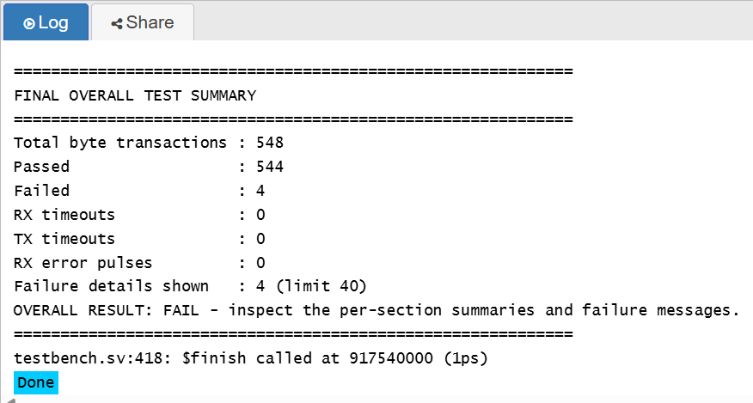
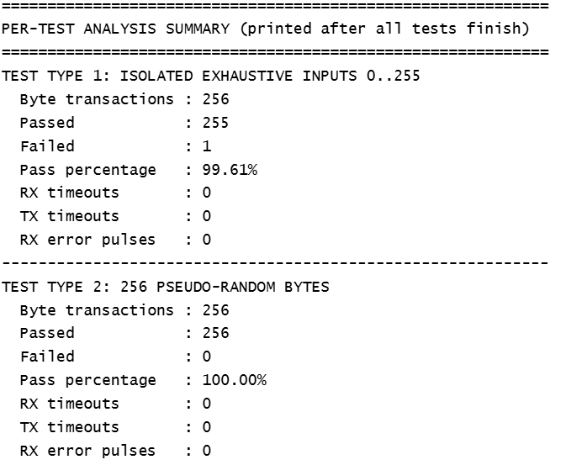
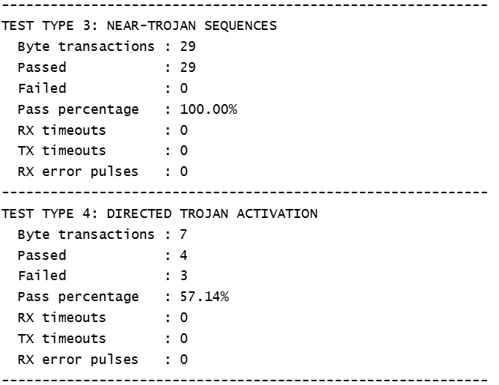
Stage-3 (Construction of trojans and their detection)

Slide 13
Stage-4 (Final implementation)
Solutions discussed
1) Benign clouds-This algorithm suggests to keep a prefix and suffix sequences as reference to detect the trojan sequence.
2)De Bruijn-This algorithm produced a string of input that could repeat all possible sequences.
3) FSM trojans-We wanted to monitor every state change and determine the suspicious states.
Solution implemented
We switched from EDA playground to a Linux-based system so that we don’t encounter any computational restrictions.
We used Python to find the suspicious logic in the source code and generate test cases.
We connected software automation with hardware simulation.

Slide 14
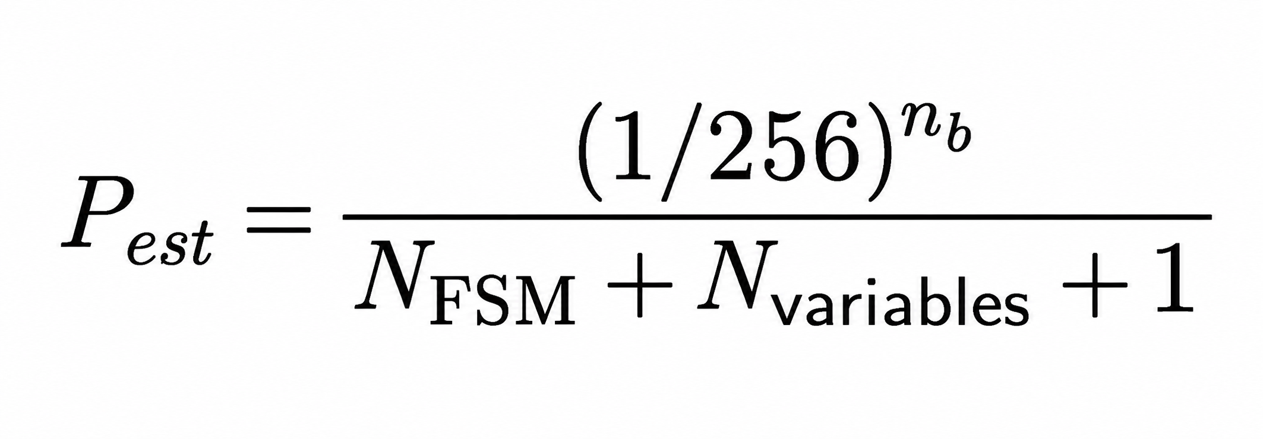
Stage-4 (Final implementation)
How it works?
The python script compares the clean RTL with the suspected RTL and finds out suspicious logic based on difference in codes ignoring whitespace and comments.
The script assigns scores based on comparisons ,conditional-branches, state- variables, counters, data-paths, trigger-related names.
Estimate trigger rarity using byte-sequence length, adjusted by detected FSM-state and variable constraints using formula listed at right side
Filter and rank trigger candidates using the suspiciousness score and the configured rarity threshold of 1/256.
Generate candidate input sequences and a System Verilog test configuration for selected trigger conditions.

Slide 15
Stage-4 (Final implementation)
Results:
We successfully detected trojans in the code using code comparisons as well as statistical analysis.
We were able to optimize the search for trojans to a level which could be industry applicable.
Multiple types of trojans could be detected using a general method without need for special cases.
Constraints:
This method requires complete access to both golden reference as well as the suspect code.
The probability threshold is quite high for complex systems which have multiple logics embedded.
The sequence score and probability formulas are generic and not absolute.
Trojans hidden under broad conditions cannot be accessed.
The trojan conditions must be quite descriptive.

Slide 16
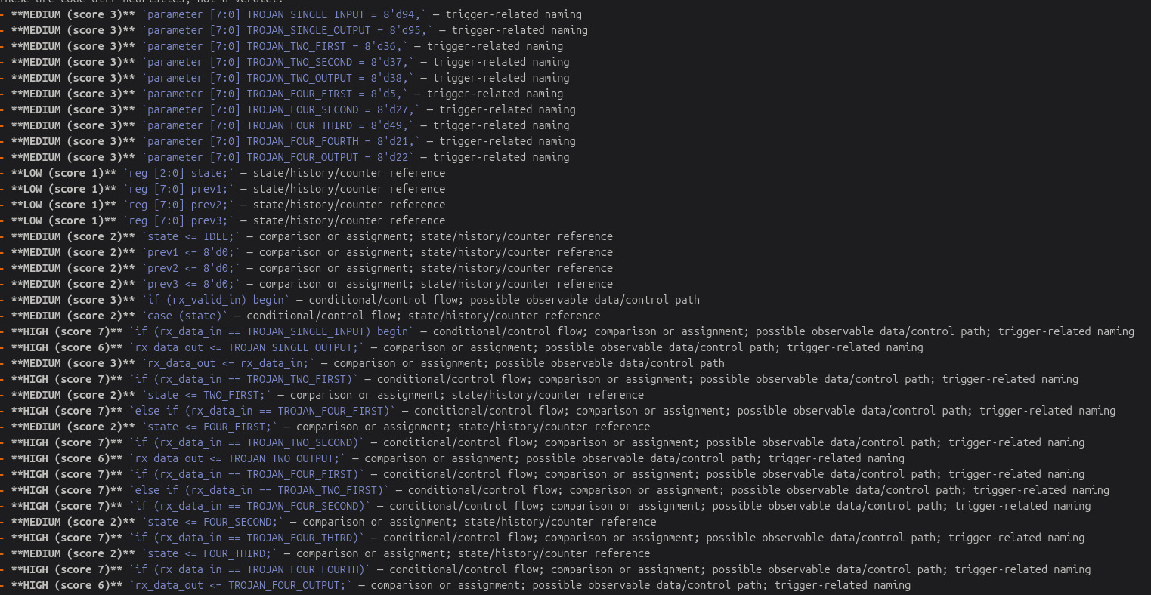
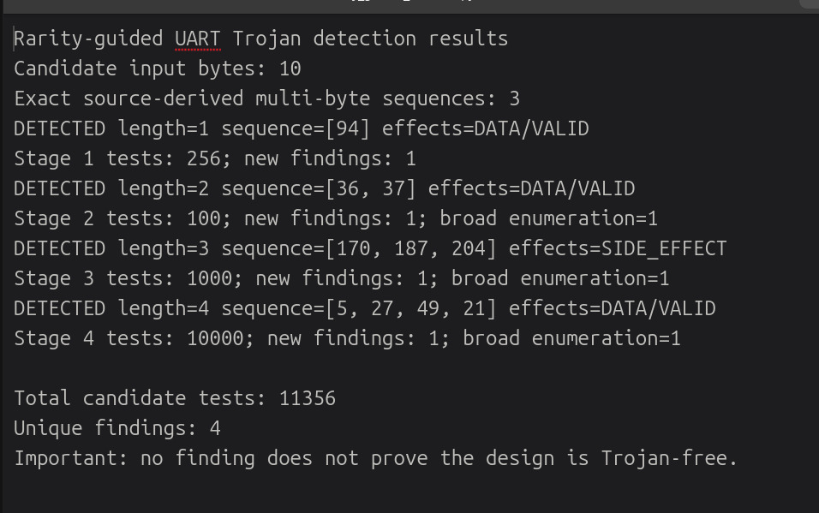
Stage-4 (Final implementation)

Slide 17
References:
1)https://github.com/BarakBinyamin/Trojan-Detection
B. Binyamin, “Trojan-Detection: Some Generic Probabilistic Methodologies to Identify Hardware Trojans in Arbitrary Hardware Designs,” GitHub repository. This project describes probabilistic hardware-Trojan detection using pseudorandom input/output comparisons which inspired implementation and methodology.
2)https://ieeexplore.ieee.org/document/10942366
J. Cruz and J. Hamlet, “A Survey on the Design, Detection, and Prevention of Pre-Silicon Hardware Trojans,” IEEE Access, vol. 13, pp. 58509–58547, 2025. It surveys pre-silicon Trojan detection approaches, prevention methods, benchmarks, and limitations.
3)https://ieeexplore.ieee.org/document/7086012
J. Zhang, F. Yuan, L. Wei, Y. Liu, and Q. Xu, “VeriTrust: Verification for Hardware Trust,” IEEE Transactions on Computer-Aided Design of Integrated Circuits and Systems, vol. 34, no. 7, pp. 1148–1161, 2015. Useful for: identifying potential Trojan trigger inputs through verification and analysing suspicious hardware behaviour.
4)https://dl.acm.org/doi/10.1145/2228360.2228378
S. Wei, K. Li, F. Koushanfar, and M. Potkonjak, “Hardware Trojan Horse Benchmark via Optimal Creation and Placement of Malicious Circuitry,” in Proceedings of the 49th Annual Design Automation Conference (DAC), 2012, pp. 90–95. It provides useful research context for evaluating Trojan-detection methods

Slide 18
Individual Roles:
1)Gourav :-Target system(UART) ,trojans ,debugging
2)Khush Varshney:-Target system(UART) , trojans ,final analysis
3)Hanzala Zaid:-Python integration ,trojans
4)Jatin Singla :-Python integration , rarity calculation
5)Jayanth Kumar Dahire :-Python integration ,test vector creation
GitHub Link : https://github.com/JayanthDahire/HTD

Slide 19
THANK YOU

