Slide 1
Earthquake prediction model
By-Jayanth Gowda B R

Slide 2
Introduction
Earthquakes are something which almost everyone has heard about or experienced at some point or the other. Under the surface of the earth, there are large sections called tectonic plates which make up the outer layer of earth. These sections are frequently moving and interact with each other. As a result of this interaction and movement, these plates can get locked due to friction, which in turn causes stress to build up.
Over time, as the stress keeps getting accumulated, at one point it reaches a point at which the rocks along the boundaries of the plates rupture, releasing the vast amount of stored energy. This energy which is released, propagates as Seismic waves through the earth’s crust and thus causing the ground to shake and tremble. The strength as well and intensity of an earthquake is measured using a standard scale known as Richter scale.

Slide 3
Requirements
Hardware
RAM: 4 GB +
ROM: 256 GB+
OS: Windows 10 and above
Software
Python IDLE 3.12
Jupyter Notebook

Slide 4
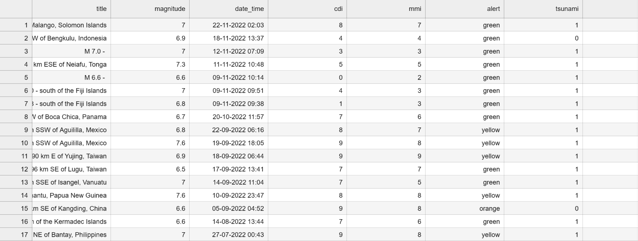
Data set

Slide 5
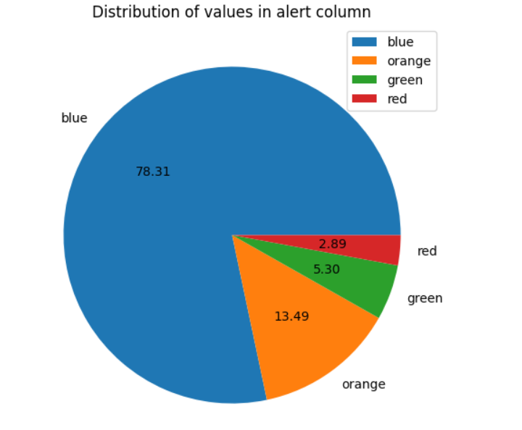
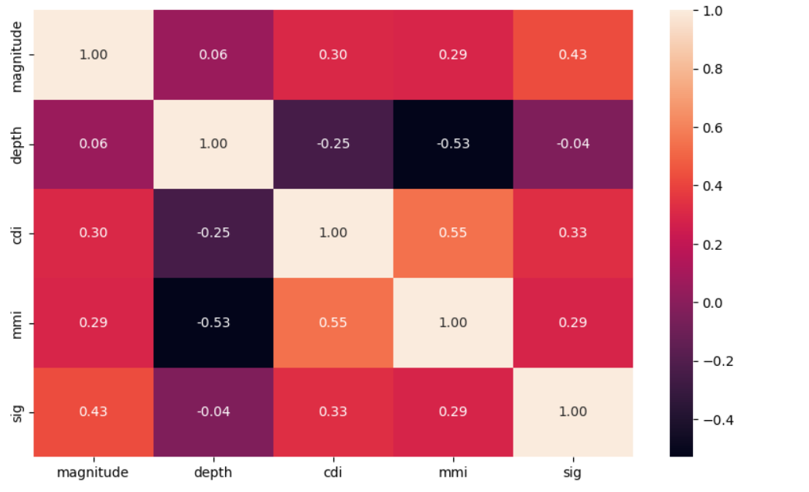
Graphical output

Slide 6
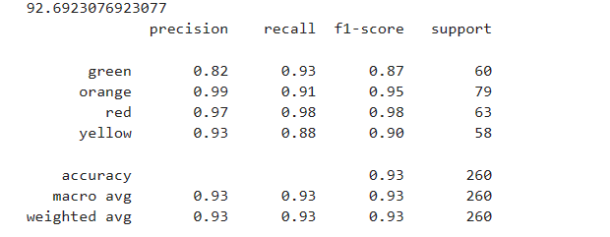

Slide 7
Conclusion
In conclusion, machine learning techniques have shown promising results in the prediction of earthquakes. By analysing various data sources like seismic recordings, geospatial information etc, machine learning models can learn patterns, trends, relationships which can help in identifying potential earthquake occurrences.

