Slide 1

VI Semester MCA Internship Work Presentation on “-----------------SPAM HAM CLASSIFIER-------------------”
JAYANTH L
1RN19MCA20
External Guide:
Name: Mr Aazeeb Hasan
Subject Matter Expert
NASTECH
Internal Guide:
Dr. Rajani Narayan
Associate Professor,
Dept. of MCA, RNSIT

Slide 2
CONTENTS
 | INTRODUCTION
 | 1.1. Aim
 | 1.2. Project description
 | 1.3. Scope
 | COMPANY PROFILE
 | 2.1. Organization structure
 | 2.2. Different departments and functions
 | 2.3. Job process / Services / Facilities
 | TOOLS AND TECHNOLOGY
 | 3.1. Tools/technology used by company
 | 3.2. Tools learned in training
 | INTERNSHIP WORK
 | 4.1. Task assigned
 | 4.2. Application developed using modern tools
 | 4.3. Professional learning (Discipline, attitude, planning, groupwork, self-assessment, etc)
 | IMPLEMENTATION
 | 5.1. Screen shots
 | SOFTWARE TESTING
 | 6.1. Sorts of investigations / Test cases
 | CONCLUSION AND FUTURE WORK
REFERENCES

Slide 3
1.1 Aim
INTRODUCTION
The goal of this project is to construct an email spam filter using machine learning techniques.
1.2 Project Description
The objective is to implement a Naïve Bayesian anti-spam filter to segregate spam from ham and measure its efficiency using various cost effective measures.
A supervised learning approach is used to enable the filter to differentiate between spam and ham. The filter is trained on 70% off spam & ham corpus that requires Feature Extraction and calculation of spam probability of the extracted feature, fi, using a naïve Bayes.

Slide 4
INTRODUCTION
1.3 Scope
Description of the feature extracted
Feature extraction module extract the spam text and the ham text, then produce feature dictionary and feature vectors as input of the selected algorithm, the function of feature extraction is to train and test the classifier.
For the train part, this module account frequency of words in the email text, we take words which the time of appearance is more than three times as the feature word of this class. And denote every email in training as a feature vector.

Slide 5
INTRODUCTION
Spam classification
Through the steps above, we take standard classification email documents as training document, pretreatment of email, extract useful information, save into text documents according to fix format, split the whole document to words, extract the feature vector of spam document and translate into the form of vector of fix format. We look for the optimal classification using the selected algorithm which is constructed using the feature vector of spam documents.

Slide 6
COMPANY PROFILE
2.1 Organization structure
NASTECH is formed with the purpose of bridging the gap between Academia and Industry.
NASTECH is one of the leading Global Certification and Training service providers for technical and management programs for educational institutions. We collaborate with educational institutes to understand their requirements and form a strategy in consultation with all stakeholders to fulfill those by skilling, reskilling and upskilling the students and faculties on new age skills and technologies.
We offer industry and project oriented training programs which not only expose students to hands-on training experience but also make them practical oriented towards the industry-readiness expected in today's time.
We take pride that all our programs are mapped to a certain Global Certification Exams i.e. after the students are done with their training, they will prove themselves on a global level via a global certification exam.
We lead from the front in terms of costing of our overall global certification and training programs.
Highly Qualified Educators

Slide 7
2.2. Different departments and functions
Different Courses
Data Science using python
Our Data Science programs starts from basic and takes students to the level where they develop relevant programming abilities. Demonstrate statistical analysis of data and assess data based models. Mapped to Global Certification Exam from Microsoft.
Machine Learning using Python
Machine learning is touted as one of most in- demand concept in todays' world. After undergoing our course students will good understand of machine learning concepts with hands-on experience on different datasets thereby knowing challenges in machine learning, data, model selection, model complexity, etc. Mapped to Global Certification Exam from Microsoft.
Ethical Hacking

Slide 8
COMPANY PROFILE
Apart from the courses mentioned above we execute different technical programs as per the interest of students and requirement of colleges.
Course Names:
- IOT with AWS Cloud (Online)
- Cloud Computing using Azure
- Cloud Security
- Python Programming with advance concepts
- Business Analytics
- Power BI (Business Intelligence)
- Advance Excel
- Digital Marketing and many more.

Slide 9
COMPANY PROFILE
2.3. Job process / Services / Facilities
Industry Oriented trainings mapped to Global Certification Exams
NASTECH has taken pledge to skill maximum students pan India on the new age skills to make them industry ready. We are scaling this through our Global Certification Programs which are mapped to different departments of universities/colleges. Depending on the interest and capabilities, participants can choose the program and get trained with best of the trainers and peers.

Slide 10
COMPANY PROFILE
Placement Trainings
Placement training has become a norm in majority of educational institutions who offer campus placement to their students. Placement training helps students to take the last stride before the campus recruitment/ placement drives and they also understand how they can apply the learning they imbibed during their academics in real life situations in their care.

Slide 11
TOOLS AND TECHNOLOGY
3.1. Tools/technology used by company
Exploratory Data Analytics
Titanic Dataset
Matplotlib
Numpy
Pandas
Multi Linear Regression
Logistic Regression
Clustering
KNN Classification

Slide 12
TOOLS AND TECHNOLOGY
3.2. Tools learned in training
Matplotlib
Numpy
Pandas
Multi Linear Regression
Logistic Regression
Clustering
KNN Classification

Slide 13
INTERNSHIP WORK
4.1. Task assigned
We learnt about Python basics, Exploratory Data Analytics, Matplotlib, Numpy, Pandas, Computer Vision, Multi Linear Regression, Sentiment Analysis.
Based on the topics which have been covered in Internship by using those technologies develop a simple project and demonstrate it and also prepare a project report on it.
4.2. Application developed using modern tools
Spamdrain- email spam filter
SpamHound SMS Spam Filter

Slide 14
INTERNSHIP WORK
4.3. Professional learning (Discipline, attitude, planning, groupwork, self-assessment, etc)
Professional dialogue with colleagues, other professionals, parents, and learners.
Focused professional reading and research.
Leading or engaging in practitioner enquiry/action research.
Experiential, action or enquiry-based learning.

Slide 15
INTERNSHIP WORK
Discipline involves time management, self-control and dedication.
An attitude is a negative or positive evaluation of an object which influence human's behaviour towards that object.
Planning is the process of thinking regarding the activities required to achieve a desired goal.
Group work refers to a collaborative learning environment where students work through problems and assessments together
Self-assessment is the process of looking at oneself in order to assess aspects that are important to one's identity.

Slide 16
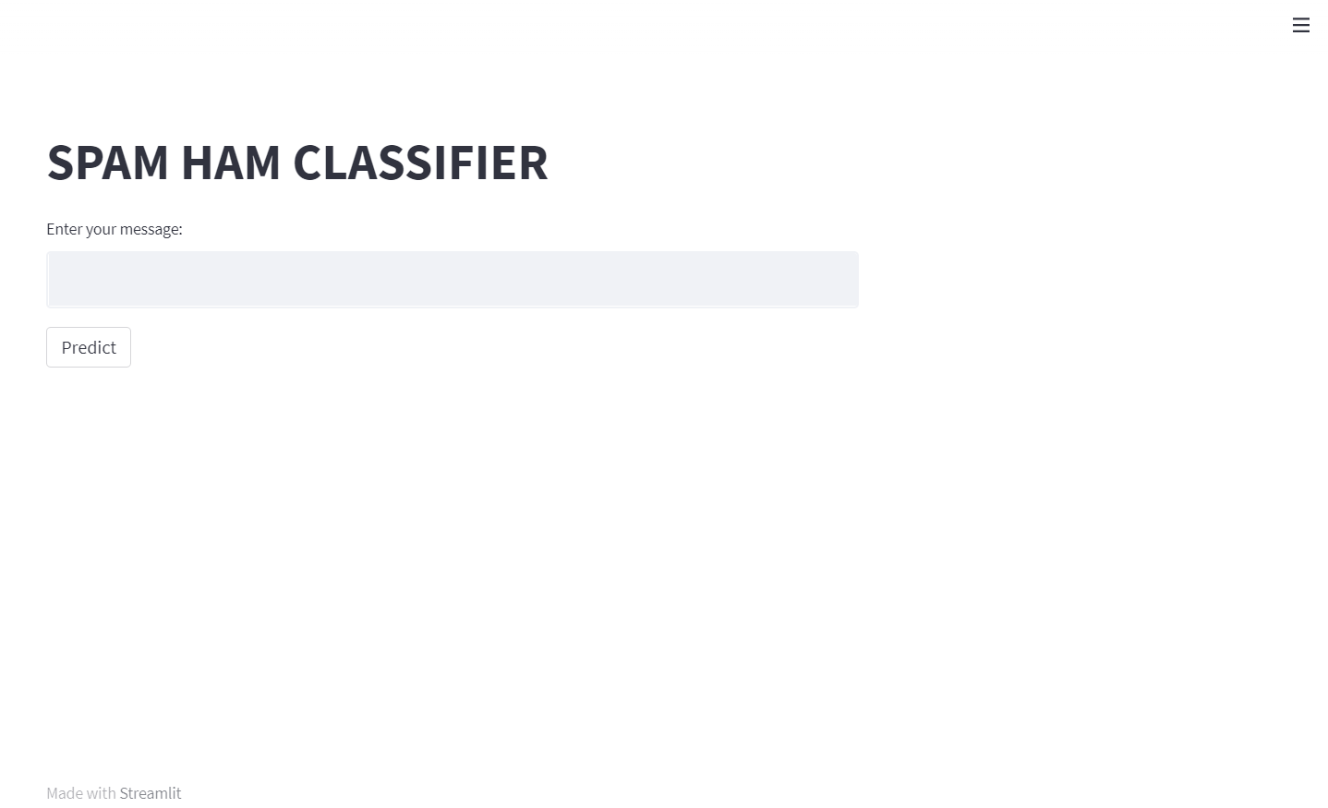
5.1 Screen shots
IMPLEMENTATION

Slide 17
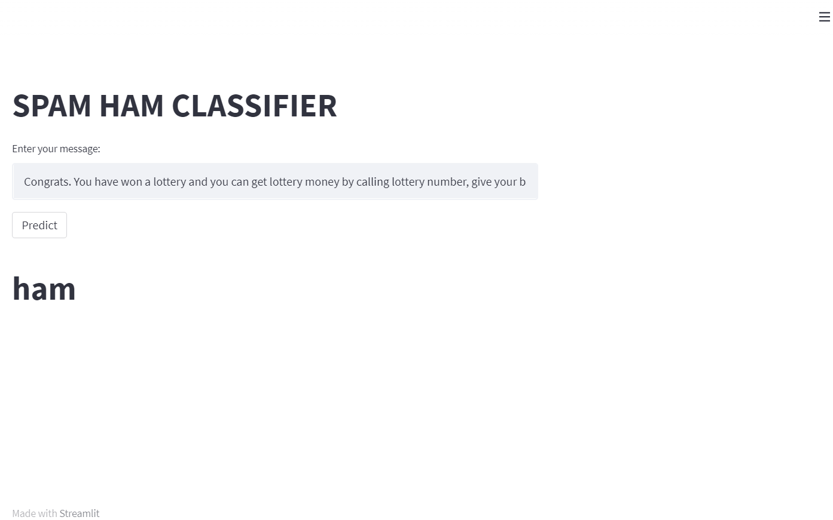
IMPLEMENTATION
5.1 Screen shots

Slide 18
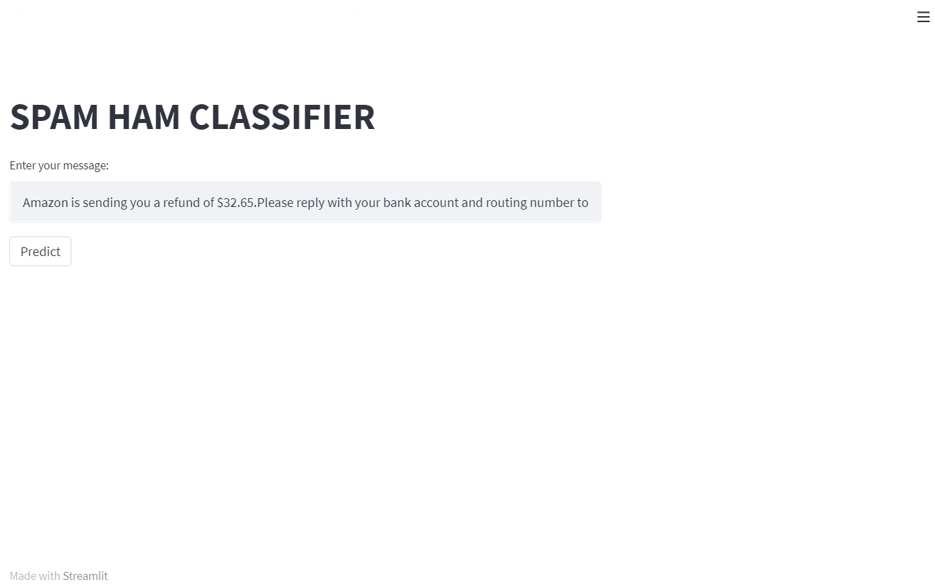
IMPLEMENTATION
5.1 Screen shots

Slide 19
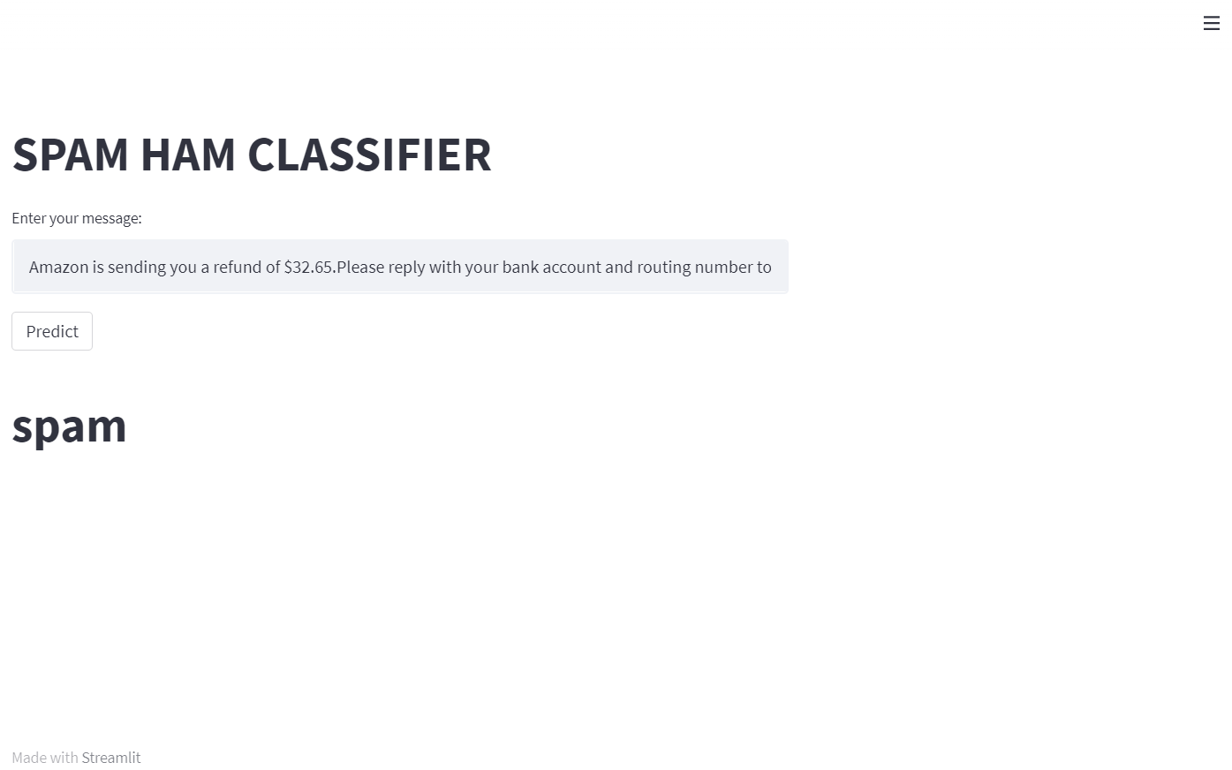
IMPLEMENTATION
5.1 Screen shots

Slide 20
6.1. Sorts of investigations / Test cases
SOFTWARE TESTING
s[0].split()
['Congrats.','You', 'have','won', 'a', 'lottery','and', 'you', 'can','get', 'lottery','money','by','calling','lottery','number’]
s[1].split()
['Give', 'your', 'bank', 'details', 'for', 'lottery']
s[2].split()
['lottery', 'for', 'sure', 'if', 'bank', 'details', 'are', 'verified']

Slide 21
CONCLUSION AND FUTUREWORK
In this study, we reviewed machine learning approaches and their application to the field of spam filtering. A review of the state of the art algorithms been applied for classification of messages as either spam or ham is provided. The attempts made by different researchers to solving the problem of spam through the use of machine learning classifiers was discussed. The evolution of spam messages over the years to evade filters was examined. The basic architecture of email spam filter and the processes involved in filtering spam emails were looked into. The paper surveyed some of the publicly available datasets and performance metrics that can be used to measure the effectiveness of any spam filter.

Slide 22
CONCLUSION AND FUTUREWORK
Given a set of words, we used feature selection to obtain words which allow us to distinguish between spam and ham emails. We also compared the accuracy of various classifiers in predicting the class attribute. We see that k-NN method gives the highest classification accuracy no matter how many attributes are used and which method is used. We also see that on average the accuracy improves as the number of attributes increase. It is possible that the accuracy may increase more than 94.5 % if we further increase the number of attributes.
By using spam classifier easily we can easily detect the spam messages which are present in the spam folder and also it is very much helpful so that misleading of data or personal details would not be done easily.

Slide 23
REFERENCES
https://colab.research.google.com/drive/1X5r80Ib1kjQOhMUcfvn13hi3wBFIIa-_
https://www.sciencedirect.com/science/article/pii/S2405844018353404
https://myblindbird.com/spam-email-detection-using-machine-learning-projects-beginners-python

Slide 24
Suggestions ….!

Slide 25
Thank You !!!

