Slide 1
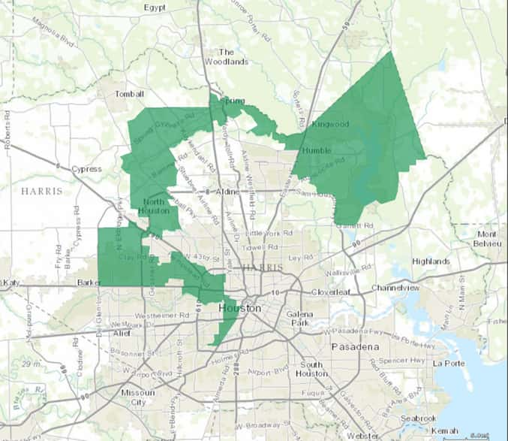
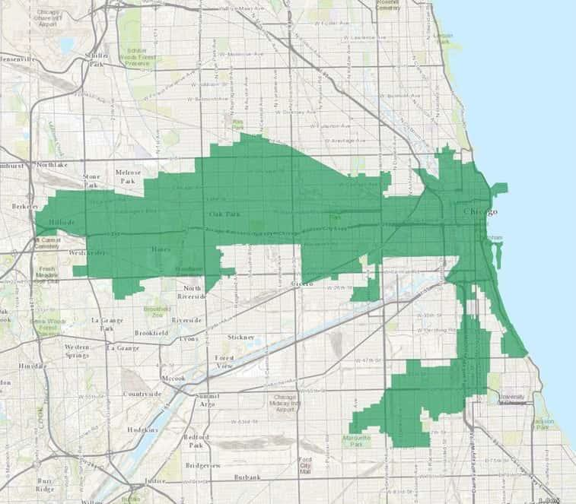
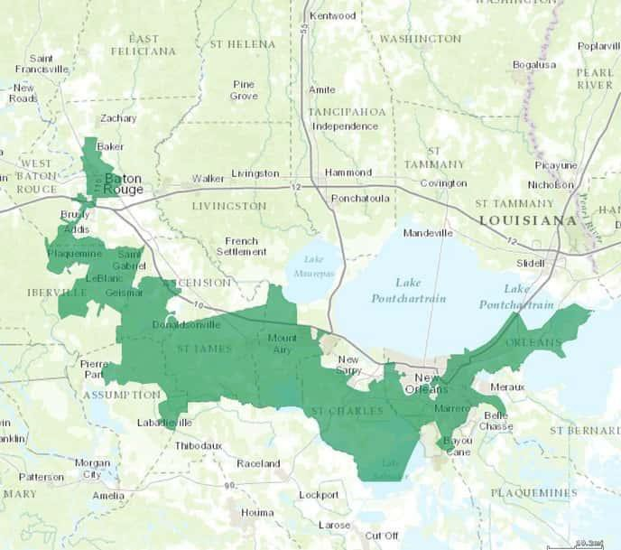
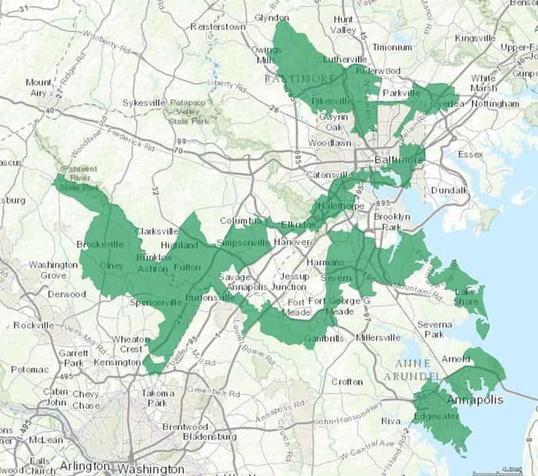
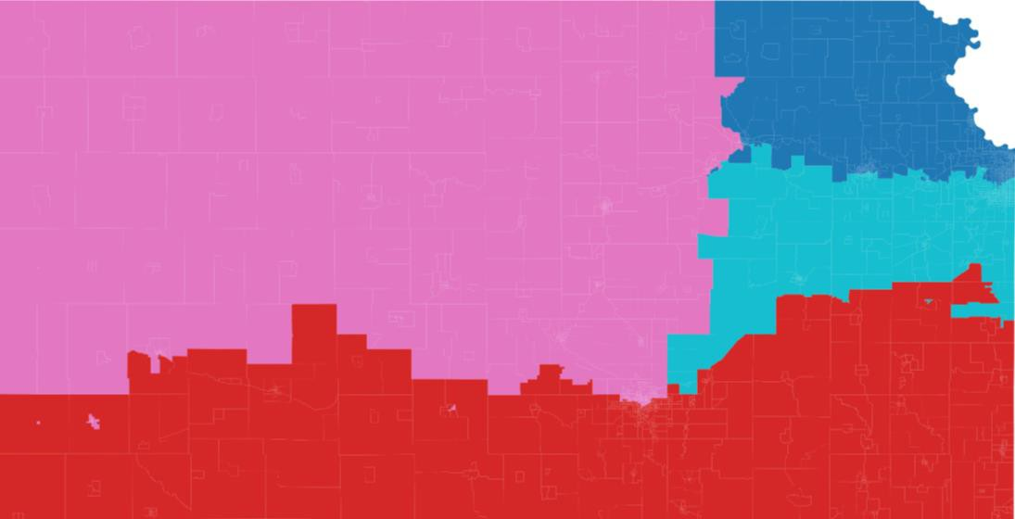
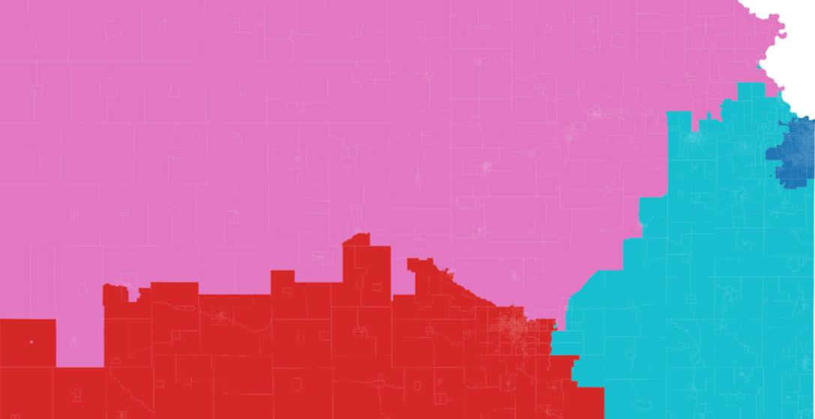
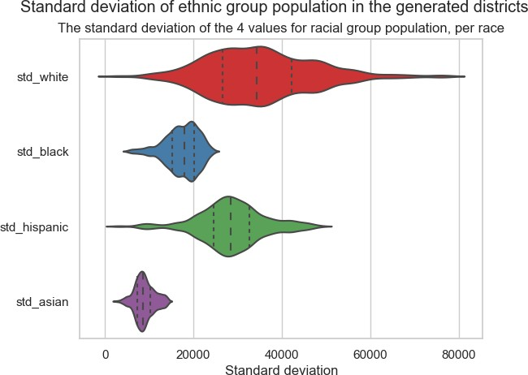
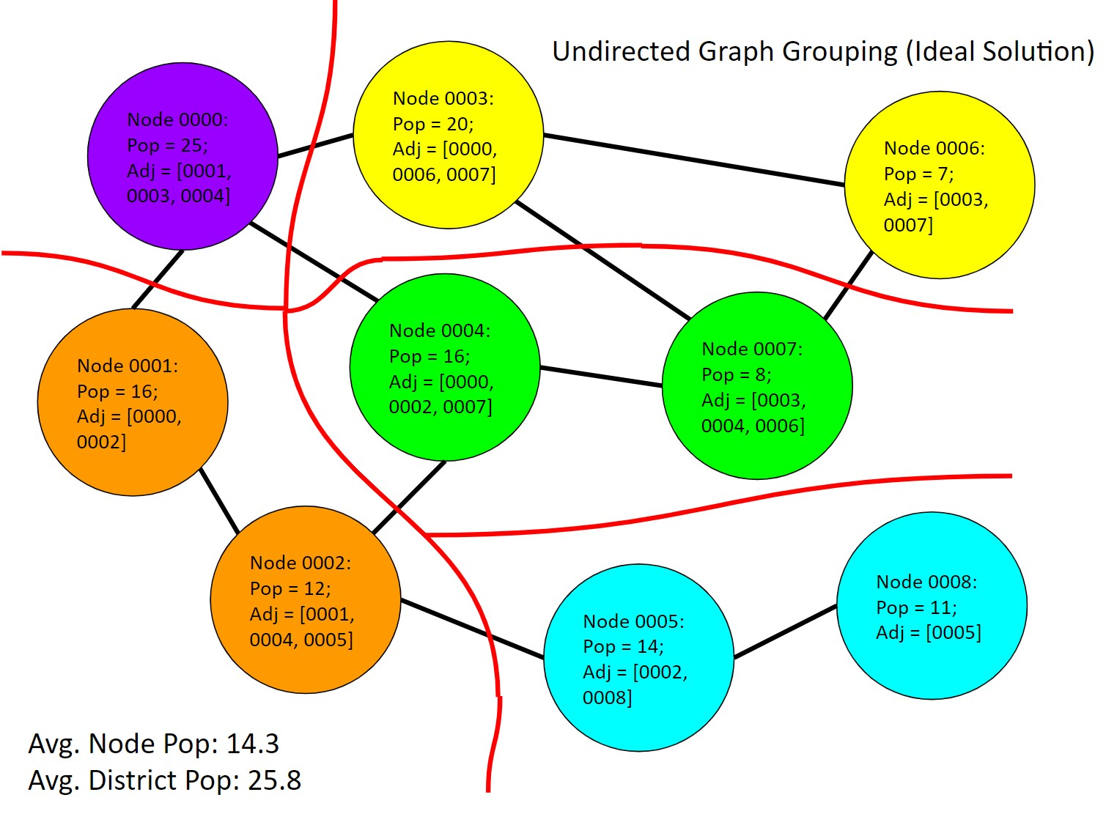
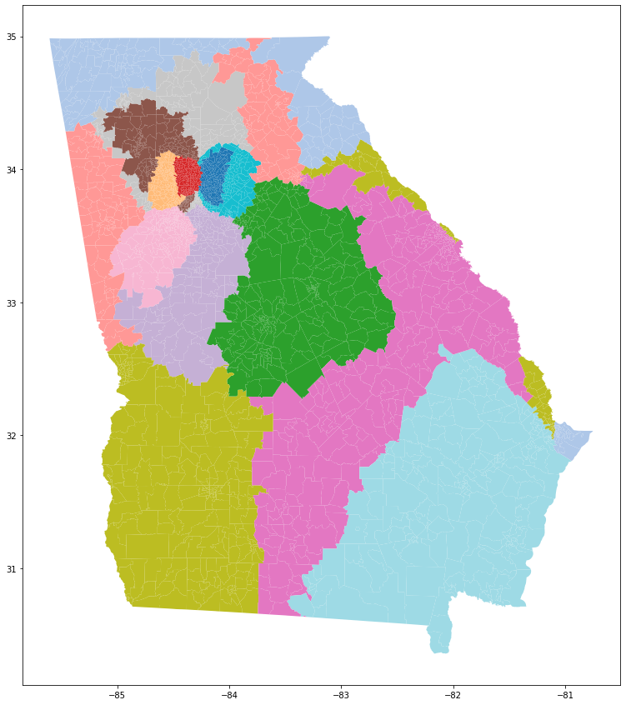
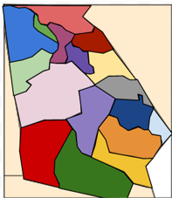
Using Mathematical Modeling to create Non-Gerrymandered Congressional Voting Maps
FWRSEF Scienteer Project #220351
$$SNPD\left(c_{1},c_{2}\right)=shortest traversable path between 2 nodes$$
BACKGROUND
METHODS AND SETUP
DISCUSSION
Gerrymandering is one of the biggest problems in American democracy. Political parties have used redistricting as a method of maintaining political control. Often, they create safe districts and expand their reach far beyond the will of the voters. A mathematical solution to political gerrymandering could help create a more vibrant and fair democracy. Without any settled solution to political gerrymandering, our democracy continues to be unrepresentative.
We propose three distinct algorithms to create non-gerrymandered voting maps:
Ideal Partition
The state map must be re-represented as an undirected graph, where the nodes are precincts and edges are drawn between adjacent precincts.
We pick 2 random precincts separated by at least a given parameter d edges when traversing the shortest path between those districts, and then we assign every precinct in the map to a batch depending on which of the two random precincts it is closer to (leaving equidistant precincts unassigned).
If the population within the smaller of the two batches can form a district with an acceptable population when some unassigned areas is added, we gradually add adjacent areas from the unassigned batch until we reach our optimal population.
We save the district and remove the final precincts from consideration in the next iteration, going back to step II.
After n-1 iterations of steps II through IV, we will have n-1 districts, and a remaining unassigned area of appropriate population that will become the final, nth district.
[8]
Texas’ 2nd Louisiana's 2nd Maryland's 3rd
FUTURE WORK
We used undirected graph representations of precincts for the Ideal Partition and LRPG models, as the geographic shape of the state is irrelevant to their performance. Only the precinct data and the adjacency is maintained. We define adjacency as 2 precincts must share a finite edge to be considered neighbors. In other words, point or corner adjacency is not 'rook' adjacent.
Most of our future work will rely on applying our algorithms to all US states and determining if our results hold true for the rest of the United States. Once that is accomplished, we will be able to simulate a nationwide election and compare the composition of our theoretically elected Congress to the current one. Another possible avenue for future work is to address edge cases, including adjacency for islands (i.e., Galveston, Long Island, Hawaii, etc.) and irregularly shaped states (i.e., Florida or Maryland) that may cause issues for our algorithms.
Square Engulfment
We randomly select n precincts located at (x0,y0) and increase a value a by some small value b, adding all precincts that fulfill the condition:
$$\sqrt{{(x−x_{0})}^{2}+{(y−y_{0})}^{2}} ≤a$$
Also, the Ideal Partition method currently has some caveats for its use. It doesn't work well on large states, as the random nature of picking two points will simply never generate a partition of the appropriate size. Theoretically, the Ideal Partition method could be applied to split the state into mega-districts, which could then be split into final districts, an idea we will call Iterative Ideal Partition.
The value a is increased until all precincts are assigned to a district. Districts above a population threshold no longer have precincts added to their total.
OBJECTIVE
There are two distinct but related purposes for this project:
REFERENCES
Create representative districts using geographical data and iterative mathematical techniques
Determine whether existing districts are gerrymandered based on various demographic trends
Least Required Population Grouping (LRPG)
I. Local population divisions, such as zip codes, are used as
Gerrymandering on graphs: Computational complexity and parameterized Algorithms. In International Symposium on Algorithmic Game Theory (pp. 140-155). Springer, Cham. Gupta, S., Jain, P., Panolan, F., Roy, S., & Saurabh, S. (2021, September).
MGGG Redistricting Lab. (n.d.). Districtr. Districtr. https://districtr.org/
Redistricting Data Hub. (2021, December 1). Election Results and Precinct Boundaries. https://redistrictingdatahub.org/data/about-our-data/election-results-and-precinct-boundaries/
Science Quarterly, 76(1), 105-110.
US Census Bureau (2022, September 27). US Zip Codes Database. https://simplemaps.com/data/us-zips
Civil Rights in America: Racial Voting Rights. U.S. National Park Service, U.S. Department of the Interior, 2009. Accessed 23 January 2023
We aim to create a future in which representatives embody the constituents of a state. When representatives fail to accurately relay their constituents' views and beliefs, the core tenet of representative democracy is shattered. By addressing the problem of gerrymandering mathematically, rather than by a subjective method, we can potentially create a system that returns power to citizens rather than state legislatures.
individual nodes in an undirected graph with each node maintaining a population and geographical coordinates. The graph only contains nodes within a specific state
II. An origin node is chosen. Functionally, this is the node at index 0 in the adjacency list. Geographically, it is random.
III. While iterating through every node at index i+1 from origin node, a min_population variable is updated with the population of node i, and node i, is added to a predefined district_nodes list
IV. This iteration continues until min_population exceeds the
population needed for a congressional district,
and district_nodes is consolidated into a district with a list of nodes that represent its respective precincts
V. Steps II through IV are repeated until we reach node n for some state in which case all nodes of state have been grouped
into d districts. The value d obviously varies from state to state
Variance b/w runs: ~5%
Average run time: 3 sec
All images, other than those marked otherwise, were created by student researchers

Slide 2
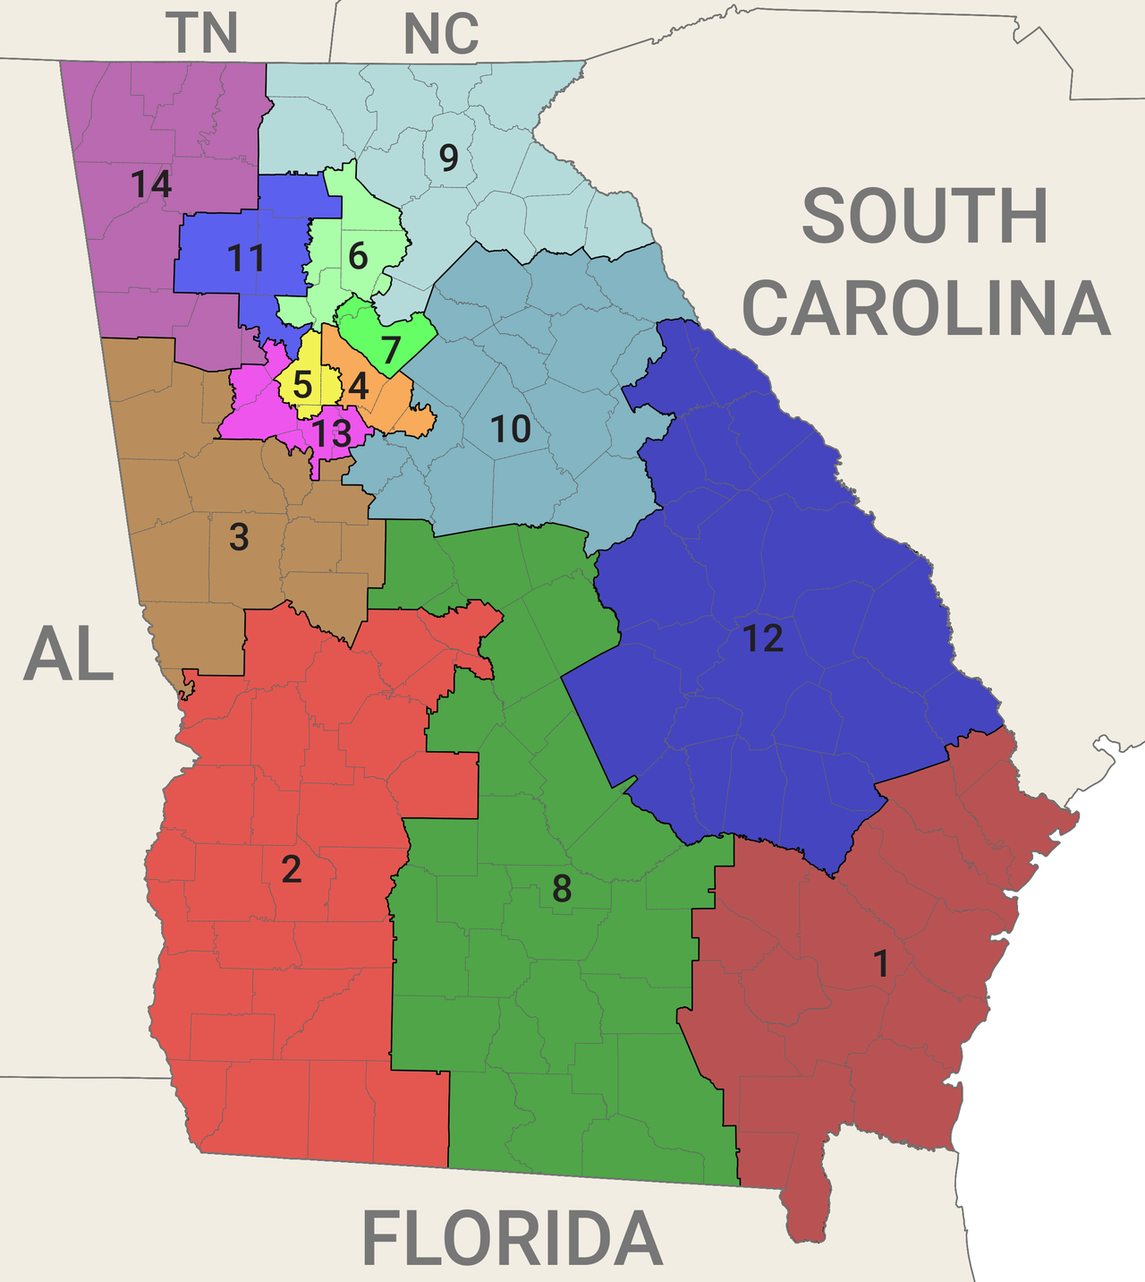
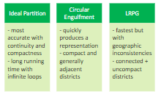

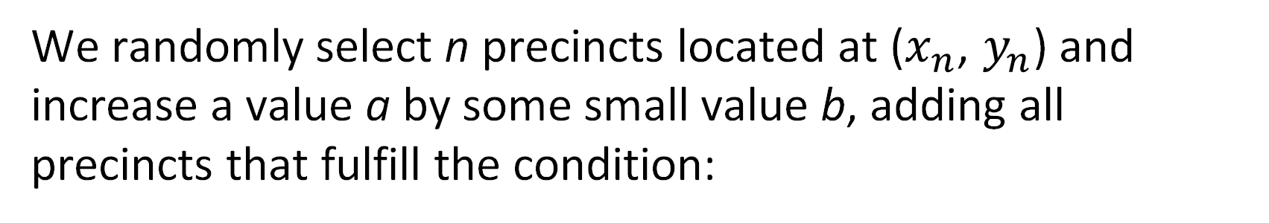
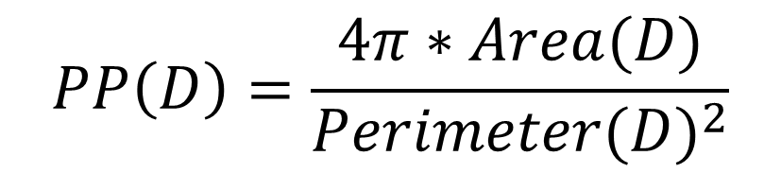
Using Mathematical Modeling to create Non-Gerrymandered Congressional Voting Maps
FWRSEF Scienteer Project #220351
BACKGROUND
STATE OF CHOICE
LEAST REQUIRED POPULATION GROUPING
DISCUSSION
Gerrymandering is one of the biggest problems in American democracy.
We chose to use Georgia to compare our algorithms, for the following reasons.
Georgia has a large racial diversity
Georgia is contiguous.
Georgia has existing gerrymandering.
Local population divisions are used as individual nodes in an undirected graph.
An origin node is chosen randomly and becomes node at index 0 in the adjacency list.
We iterate through every node in order of node distance from the origin (using physical distance as a tie breaker), by adding the node to a district, and tracking the total population.
This iteration continues until the minimum population is exceeded
Steps II through IV are repeated until we reach the end of the list of nodes.
Texas D2 – (2013 – 2023)
Louisiana D2 – (2013+)
Maryland D3 – (2013 – 2023)
GENERATIONAL METHODS
Political parties have used redistricting as a method of maintaining political control. Often, they create safe districts and expand their reach far beyond the will of the voters.
A mathematical solution to political gerrymandering could help create a more vibrant and fair democracy. Without any settled solution to political gerrymandering, our democracy continues to be unrepresentative.
We propose three distinct algorithms to create non-gerrymandered voting maps.
IDEAL PARTITION
FUTURE WORK
We pick 2 random precincts separated by at least a given parameter d edges when traversing the shortest path between those districts, and then we assign every precinct in the map to a batch depending on which of the two random precincts it is closer to (leaving equidistant precincts unassigned).
If the population within the smaller of the two batches can form a district when some unassigned areas is added, we gradually add adjacent areas from the unassigned batch until we reach our optimal population.
We save the district and remove the precincts from consideration in the next iteration.
After n-1 iterations of steps I through III, we will have n-1 districts, and all remaining area forms one last district
This algorithm can be iterated, first breaking the state into sub-states, and then into final districts.
Variance b/w runs: ~5%
Average run time: 3 sec
Most of our future work will rely on applying our algorithms to all US states and determining if our results hold true for the rest of the United States. Once that is accomplished, we will be able to simulate a nationwide election and compare the composition of our theoretically elected Congress to the current one. Another possible avenue for future work is to address edge cases, including adjacency for islands (i.e., Galveston, Long Island, Hawaii, etc.) and irregularly shaped states (i.e., Florida or Maryland) that may cause issues for our algorithms.
Iterative Ideal Partition has some caveats about how iteration works – based on population density, it may be faster to split states into 2-5 groups, or it may be faster to split into 8-10. Splitting small groups into 2-3 districts is harder than splitting large groups into sixths. Further study of the algorithm is needed.
We used undirected graph representations of precincts for the Ideal Partition and LRPG models, as the geographic shape of the state is irrelevant to their performance. Only the precinct data and the adjacency is maintained. We define adjacency as 2 precincts must share a finite edge to be considered neighbors. In other words, point or corner adjacency is not 'rook' adjacent.
REFRENCES
CIRCULAR ENGULFMENT
METRICS AND STATISTICS
Gupta, S., Jain, P., Panolan, F., Roy, S., & Saurabh, S. (2021). Gerrymandering on graphs: Computational complexity and parameterized algorithms. In International Symposium on Algorithmic Game Theory, 140-155. Springer, Cham.
MGGG Redistricting Lab. (n.d.). Districtr [Website]. Retrieved from https://districtr.org/
Redistricting Data Hub. (2021, December 1). Election Results and Precinct Boundaries [Website]. Retrieved from https://redistrictingdatahub.org/data/about-our-data/election-results-and-precinct-boundaries/
US Census Bureau. (2022, September 27). US Zip Codes Database [Website]. Retrieved from https://simplemaps.com/data/us-zips
Civil Rights in America: Racial Voting Rights [Website]. (2009). U.S. National Park Service, U.S. Department of the Interior. Retrieved 23 January 2023.
Polsby, D. D., & Popper, R. D. (1991). The Third Criterion: Compactness as a procedural safeguard against partisan gerrymandering. Yale Law & Policy Review, 9(2), 301-353.
Ansolabehere, S., & Palmer, M. (n.d.). A Two Hundred-Year Statistical History of the Gerrymander, pp. 6-7.
We randomly select n precincts located at ($x_{n}$, $y_{n}$) and increase a value a by some small value b, adding all precincts that fulfill the condition:
One existing measure of Compactness in relation to gerrymandering is the Polsby-Popper test.
OBJECTIVES
$$\sqrt{{(x−x_{n})}^{2}+{(y−y_{n})}^{2}} ≤a$$
$$PP\left(D\right)=\frac{4π∗Area(D)}{{Perimeter(D)}^{2}}$$
Create representative districts using geographical data and iterative mathematical techniques
Determine whether existing districts are gerrymandered based on various demographic trends
The value a is increased until all precincts are assigned to a district. Districts above a population threshold no longer have precincts added to their total.
The value sits between 0 and 1, with 1 being the most compact (a circle), and 0 being the least compact. The test has some notable issues, being susceptible to physical geography and borders, but it can provide a metric for analysis of district compactness
We aim to create a future in which representatives embody the constituents of a state. When representatives fail to accurately relay their constituents’ beliefs, the core tenet of representative democracy is shattered. By addressing the problem of gerrymandering mathematically, rather than by a subjective method, we can potentially create a system that returns power to citizens rather than state legislatures.

Slide 3

Extra Slide
This slide is permitted for any additional, relevant data.
Credit all your sources.
Remember, DO NOT include any animations, videos, or hyperlinks.
Results
Works Cited
Results based on experiments
Result 2
Result 3
Include print and electronic sources in alphabetical order
Conclusion
Photo Credit
Brief summary of discoveries based on results
Indicate and explain whether or not the data supports the hypothesis
All photos, images, and graphics were done by the researcher or parent unless otherwise stated.
MANY IMAGES FOUND ON THE WEB ARE COPYRIGHTED. ONLY USE IMAGES FOR WHICH YOU HAVE THE EXPRESS PERMISSION OF THE PHOTOGRAPHER/STOCK IMAGE COMPANY, AND CREDIT THE IMAGE AS REQUIRED BY COPYRIGHT.

Slide 4

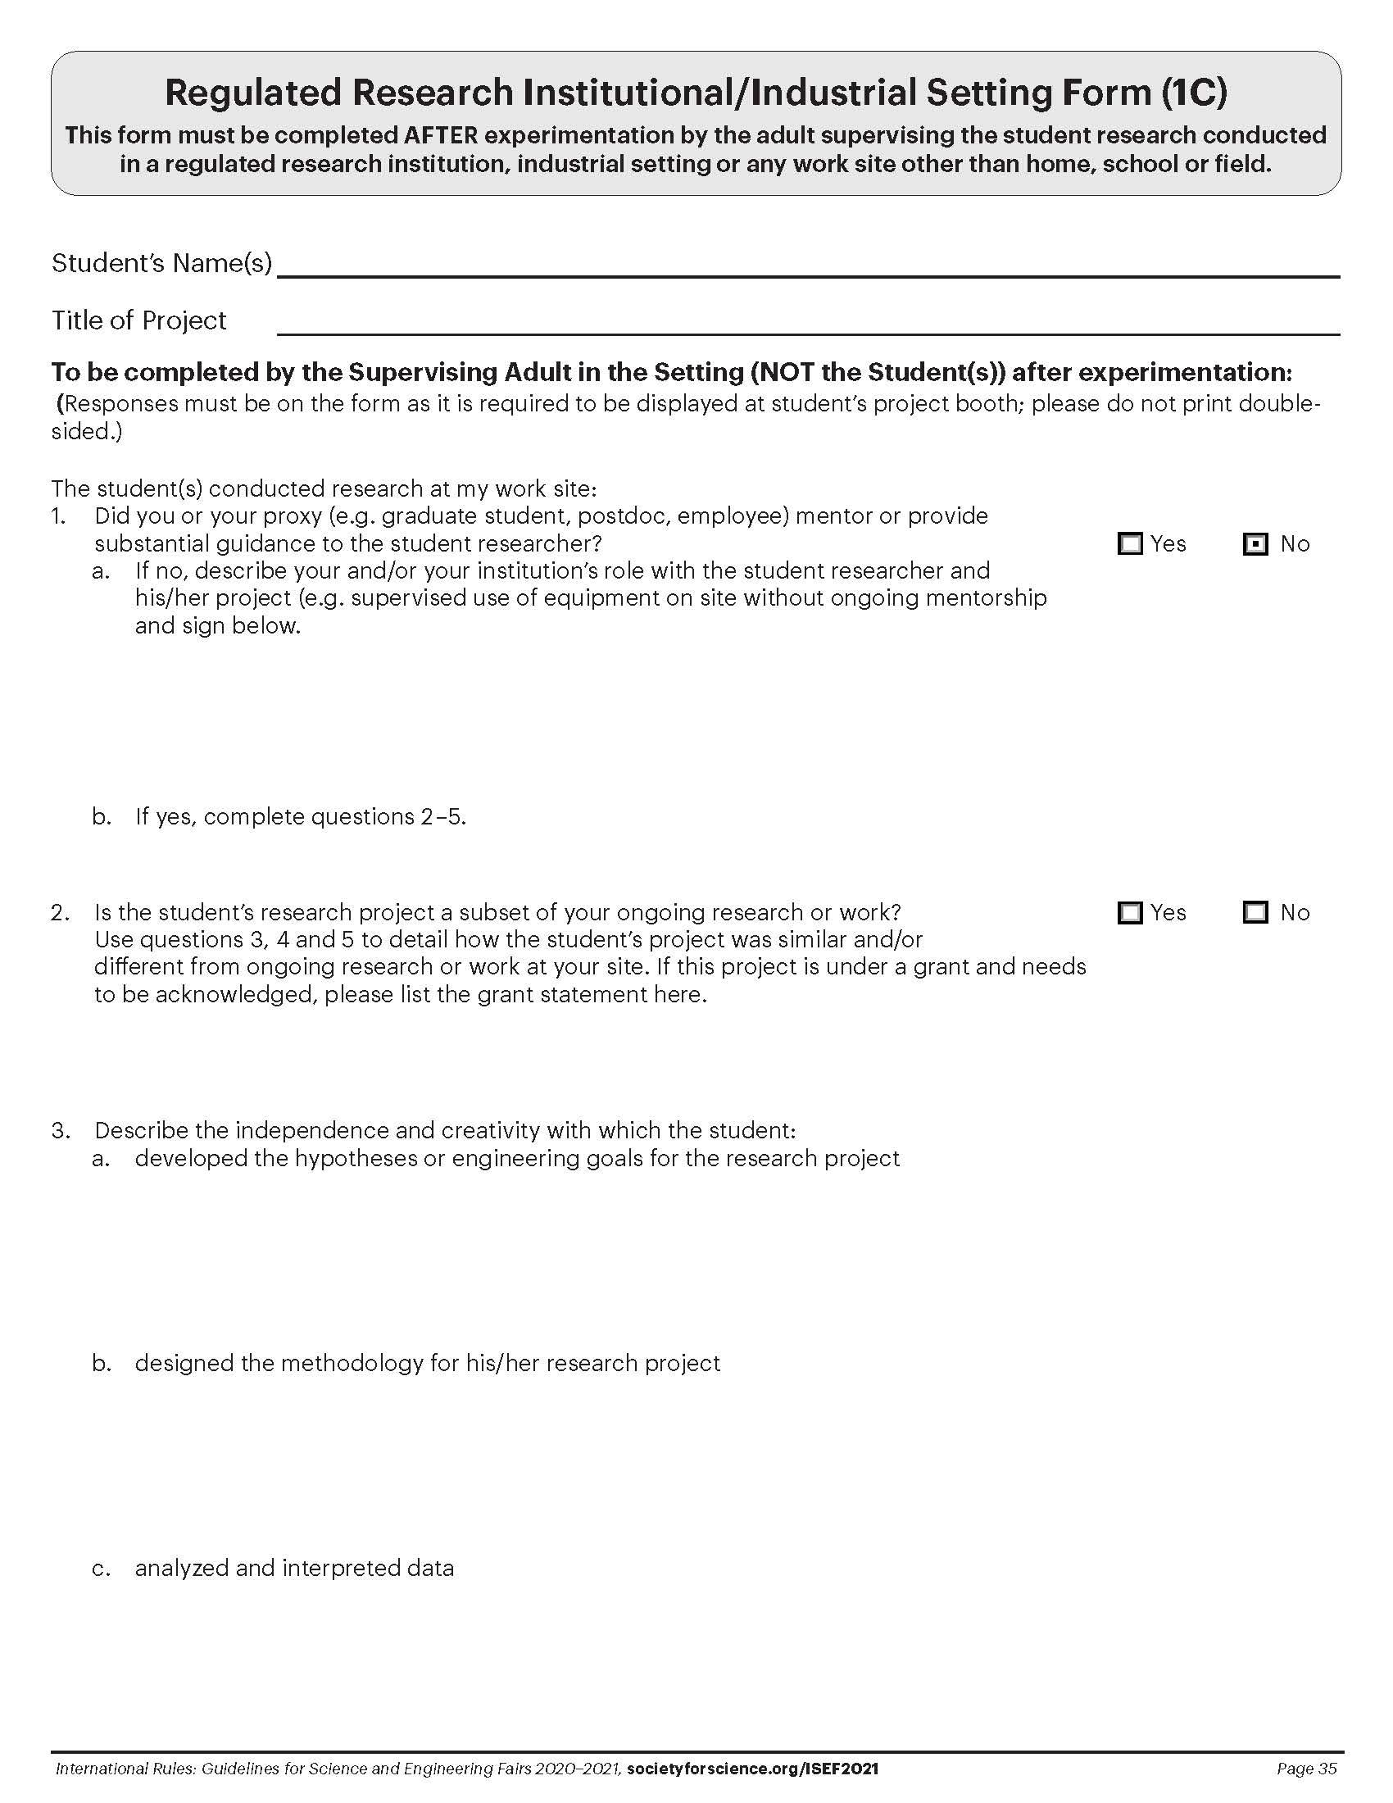


Project Forms
Instructions
Abstract
Form 1C (If Required)
Form 7 (If Required)
ALL Projects must display the Official SRC Approved Abstract from Scienteer and Form 1C (Regulated Research Institutional/ Industrial Setting Form) and/or Form 7 (Continuation/ Research Progression Projects Form) if required for your project.
These forms are found on the Scienteer Dashboard (left side of screen).
Download the documents as pdfs.
Ensure all forms are clear enough for judges to read.
Example
Replace with Your Abstract from Scienteer
with the Official Seal
Example
Replace with Your Form 1C
from Scienteer (If Required)
Example
Replace with Your Form 7
from Scienteer (If Required)
Example
Replace with Your Form 1C
from Scienteer (If Required)

