Slide 1

Fake News Detection Using Multi Model Ensemble Learners
Rukmini Sai Mohan Jayanth Srikantam - 50298996
Notes:
1

Slide 2
Outline
Introduction/Background
Problem Statement
Data Collection
Methods
Results
Conclusion
References

Slide 3
Introduction/Background
The world is undergoing rapid change and advancement in the digital era.
One of the major issues in the digital world is the spread of fake news, which can harm individuals or organizations.
Social media platforms such as Facebook, Twitter, Instagram, and WhatsApp can be used to spread fake news.
Fake news can have a significant impact on people, organizations, and political parties.
AI is a part of artificial intelligence that assists in the development of computers that can learn and perform various tasks.

Slide 4
AI algorithms can be trained on a dataset to perform various tasks such as predicting or identifying fake news.
AI is useful in detecting fake news and researchers are working to improve the accuracy of detection.
The proposed solution in this work is a machine learning ensemble approach to detecting fake news.
The work involves the use of various types of datasets and vectorization using TF-IDF Vectorizer.
The work includes a manual testing block to make the system more useful for fact-checking, using COVID-19 news Chinese dataset and machine learning ensemble learners like Linear SVM, Gradient Boosting, Random Forest, and Logistic Regression.

Slide 5
Problem Statement
In the present era, when the internet is everywhere, everyone relies on a variety of online sources for news.
News has spread swiftly among millions of users in a short amount of time as the use of social media platforms like Facebook, Twitter, and others has increased.
Biased opinions are produced as a result of the dissemination of fake news. Moreover, spammers use captivating news headlines to generate revenue from click-bait advertisements.
Hence, in order to prevent this, we must eliminate fake news, and in order to do so, we must develop certain techniques for identifying fake news.

Slide 6
Data Collection
In total, we are taking two datasets, one is for real news and another is for fake news.
The data in these datasets was taken from Kaggle website. These datasets contain the raw data of Chinese COVID 19 news data.
Fake news dataset has 345 news and the real news dataset has more than 1000 news.
The parameters present in these datasets are: Label, id, date, user_id, text, pic_url, video_url, comment_num, repost_num, like_num.

Slide 7
Methods
The Machine Learning methods used in this project are:
Linear Regression: Under the Supervised Learning approach, one of the most unmistakable Machine Learning calculations is strategic relapse.
Decision Tree: A regulated learning procedure might be utilized to take care of both order and relapse issues, but it is most normally utilized to address characterization issues.

Slide 8
Random Forest: It is a striking ML estimation that uses the oversaw learning procedure.
K-Nearest Neighbors: It is a supervised learning technique which assumes that the new case/data and existing cases are similar and places the new case in the category that is most similar to the existing categories.
Gradient Boosting: It is a machine learning algorithm that uses an ensemble of decision trees to improve prediction accuracy.

Slide 9
Support Vector Machine or SVM: It is conceivably the most well known Supervised Learning calculation, which is used for Classification similarly as Regression issues.
The goal of the SVM computation is to settle on the best line or decision limit that can separate n-dimensional space into classes so we can without a doubt place the new component in the right arrangement later on. This most ideal decision limit is known as a hyperplane.

Slide 10
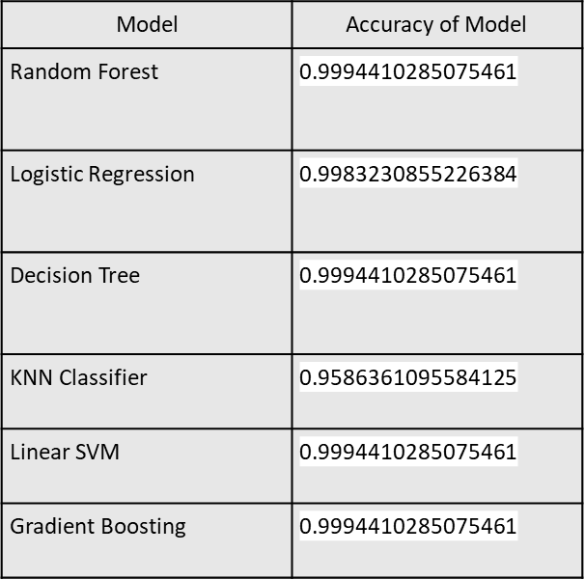
Results
The final result of our project is finding the news whether it is fake or not which is given by the user. The accuracies of each model is given below:

Slide 11
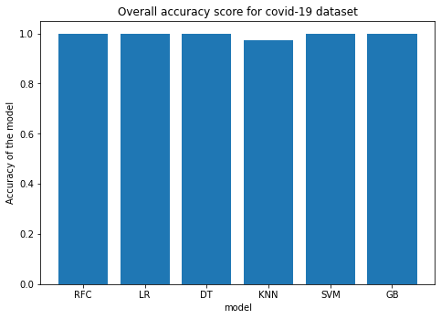
Graph of Accuracies vs Models

Slide 12
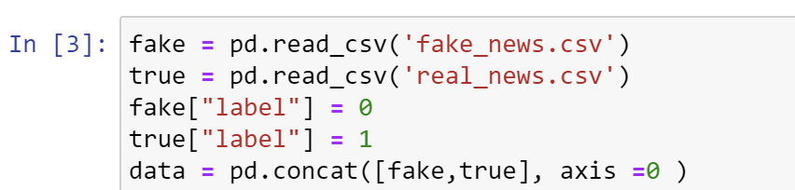
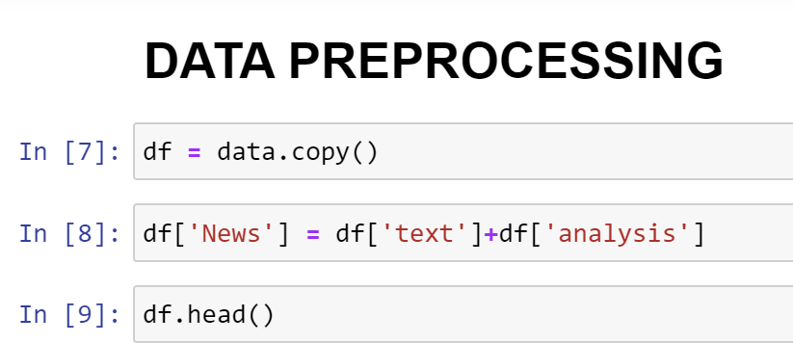
Screenshots of the project

Slide 13
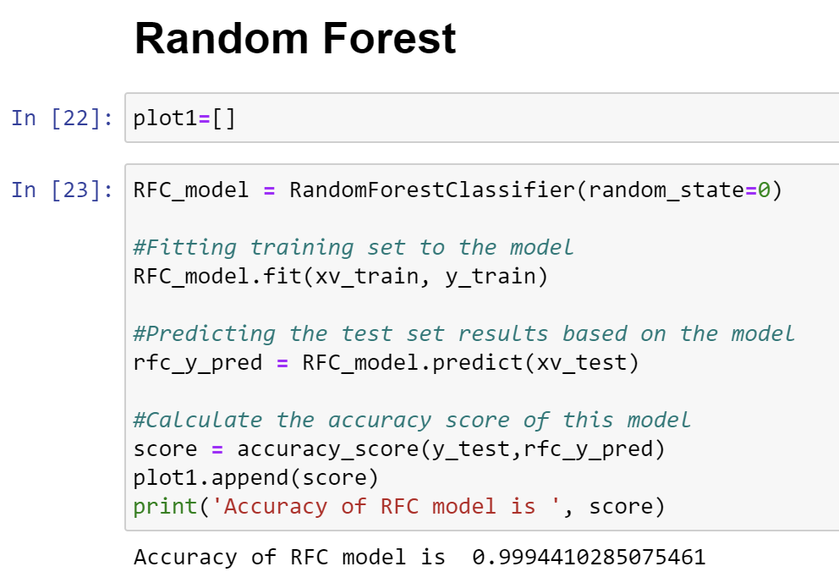

Slide 14
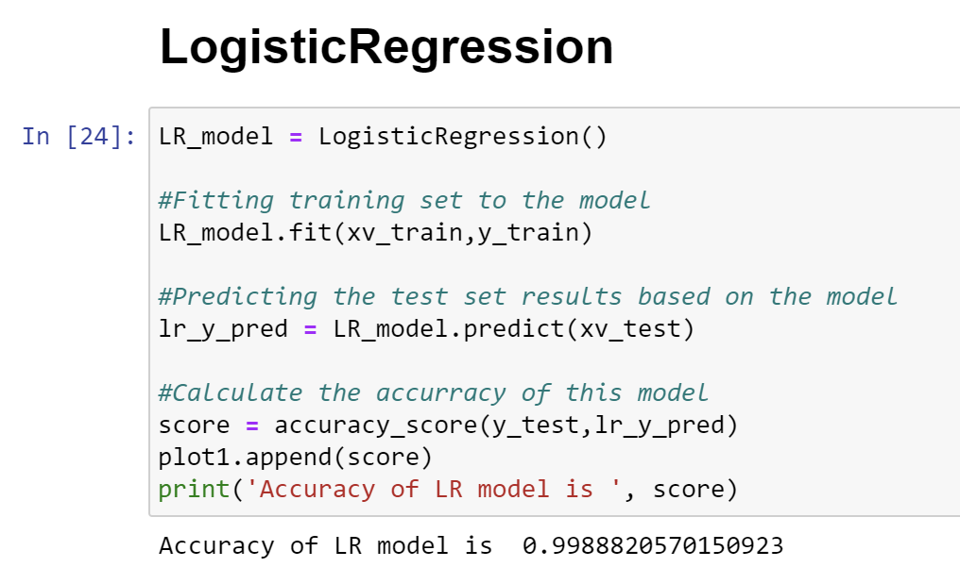

Slide 15
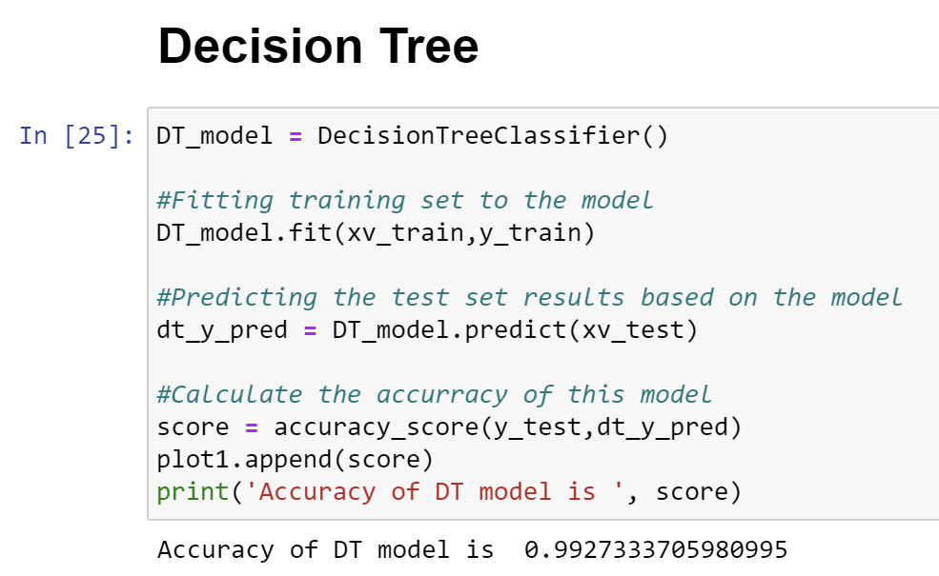

Slide 16
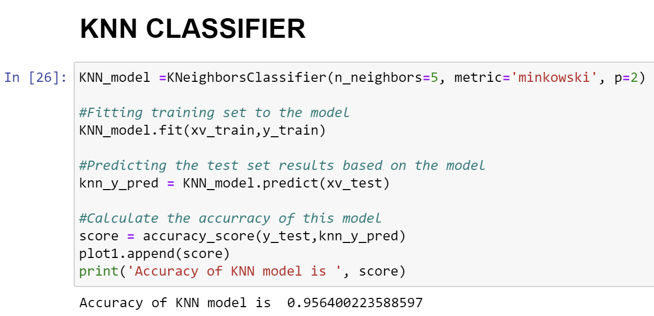

Slide 17
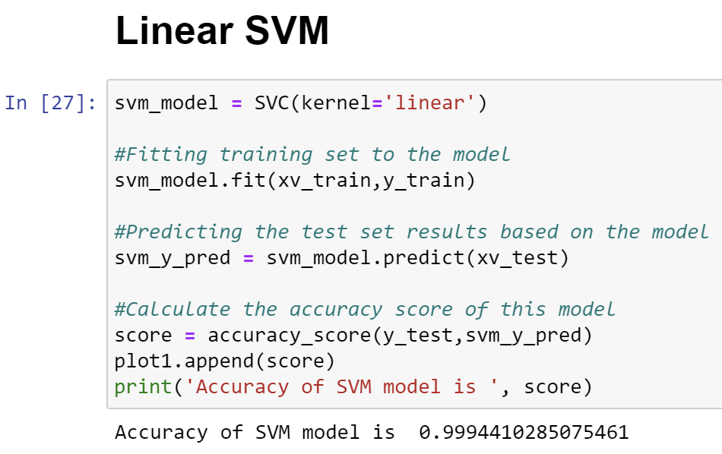

Slide 18
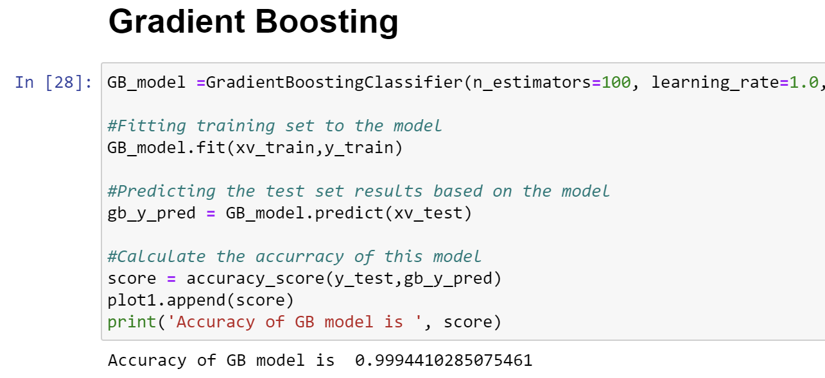

Slide 19
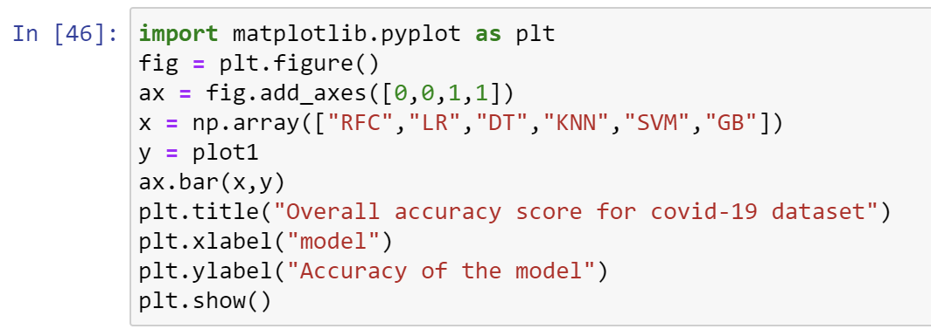

Slide 20
Can We Improve?
Yes, we can improve by taking a larger dataset having the various type of features.
Also, we can use WebCrawler method and we can import the news to the dataset from the website directly and use it for the classification.

Slide 21
Conclusion (Summary)
This Fake News detection system makes more change in the society as it was used as more as possible.
We did it for the COVID 19 news data set as nowadays the fake news about the covid is spreading rapidly to make people know about the truth about the news.
We used these algorithms and found the accuracy of the data and we had created a manual testing block where pc asks user to give an input (Any news) and verify the user given news with respect to dataset and gives output as “Real News” if the news is real and “Fake News” if the news is fake.

Slide 22
References
[1] Shu, Kai, et al. "Fake news detection on social media: A data mining perspective." ACM SIGKDD explorations newsletter 19.1 (2017): 22-36.
[2] Reis, Julio CS, et al. "Supervised learning for fake news detection." IEEE Intelligent Systems 34.2 (2019): 76-81.
[3] Pérez-Rosas, Verónica, et al. "Automatic detection of fake news." arXiv preprint arXiv:1708.07104 (2017).
[4] Palacio Marín, Ignacio, and David Arroyo. "Fake news detection." Computational Intelligence in Security for Information Systems Conference. Springer, Cham, 2019.
[5] Karimi, Hamid, et al. "Multi-source multi-class fake news detection." Proceedings of the 27th international conference on computational linguistics. 2018.

Slide 23
[6] R. V. L, C. Yimin, and C. N. J, “Deception detection for news: Three types of fakes,” Proc. Assoc. Inf. Sci. Technol., vol. 52, no. 1, pp. 1–4, 2016
[7] V. Rubin, N. Conroy, Y. Chen, and S. Cornwell, “Fake News or Truth? Using Satirical Cues to Detect Potentially Misleading News,” pp. 7–17, 2016.
[8] Z. Jin, J. Cao, Y. Zhang, J. Zhou, and Q. Tian, “Novel Visual and Statistical Image Features for Microblogs News Verification,” IEEE Trans. Multimed., vol. 19, no. 3, pp. 598–608, 2017.
[9] S. Gilda, “Evaluating machine learning algorithms for fake news detection,” IEEE Student Conf. Res. Dev. Inspiring Technol. Humanit. SCOReD 2017 - Proc., vol. 2018– January, pp. 110–115, 2018.
[10] Y. Seo, D. Seo, and C. S. Jeong, “FaNDeR: Fake News Detection Model Using Media Reliability,” IEEE Reg. 10 Annu. Int. Conf. Proceedings/TENCON, vol. 2018–October, no. October, pp. 1834–1838, 2019.

