Slide 1
MEDIWISE AI
An Intelligent Clinical Diagnosis Portal for Triage and Lesion Classification Under Uncertainty
Presenter: Jayanth Thenepalle | EBTM 881 Capstone Project
Advisor: Dr. Faculty Supervisor

Slide 2
1. Introduction & Motivation
Clinical Access Bottlenecks: Administrative delays frequently delay preliminary medical triage screenings, risking patient health.
Uncertainty Constraints: Symptom assessments often deal with sparse or incomplete client input variables.
System Decoupling: Serving models centrally on a secure Python server prevents IP exposure and client resource fatigue.
Diagnostic Modalities: Implements both a tabular symptom checker and image-based dermoscopic cancer lesion classifications.

Slide 3
2. Research Objectives
Stateless API Infrastructure: Design a horizontally scalable backend server capable of handling parallel client requests.
High-Precision Classifier: Train and validate neural network architectures capable of triaging medical parameters.
Cloud Audit Logging: Integrate automated database tracking to log session diagnostics statelessly.
Production Quality Engineering: Implement modern CORS security middleware, Docker containerization, and automated CI/CD deployments.

Slide 4
3. Literature Review Matrix
Author (Year) | Methodology | Key Findings | MediWise Connection
Tschandl (2018) | HAM10000 dataset collection. | 10k pigmented lesion scans. | Extended via Transfer Learning MobileNetV2 CNN.
Sandler (2018) | MobileNetV2 inverted residuals. | Optimizes edge parameter footprint. | Reduces model footprint in cloud server to ~340MB.
Esteva (2017) | Deep CNN lesion scanning. | Deep ML matches professional clinicians. | Deploys a stateless, web-accessible scanner portal.
Chen (2020) | CDSS using relational databases. | DB locks bottleneck concurrent runs. | Implements asynchronous Motor client, removing blocks.

Slide 5
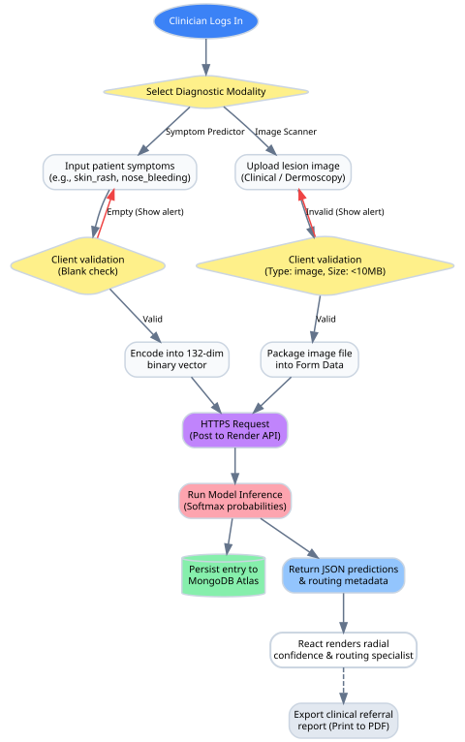
4. Clinical Workflow Pipeline
Interactive Triage Path: Patients input symptom lists or upload lesion images via a responsive client dashboard.
FastAPI Server Validation: Validates incoming request payloads using strict Pydantic schemas.
Model Triage Execution: Dispatches payloads to local ANN or CNN instances cached in server memory.
Asynchronous Cloud Logging: Motor driver schedules MongoDB insertions without blocking the client response thread.

Slide 6
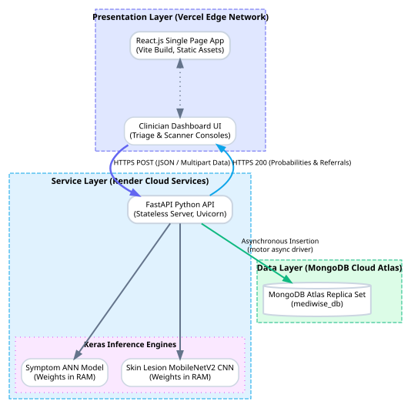
5. Three-Tier System Architecture
Presentation (Vercel): React.js SPA utilizing custom CSS tokens, EKG waves, and radial confidence dials.
Service (Render): Stateless FastAPI ASGI web app serving model instances cached dynamically in RAM.
Persistence (MongoDB Atlas): Schema-less cloud replica set collection logging diagnostic session data asynchronously.

Slide 7
6. System Integration Workflow (DFD)
HTTPS Client Dispatch: React form triggers Axios HTTP POST requests conveying symptom vectors or image FormData.
FastAPI Router Middleware: Enforces CORS constraints, validates models, and processes predictions.
Model Memory Load: Caches network weights during startup to run calculations entirely in RAM.
Non-blocking Persistence: Motor schedules insert_one() tasks concurrently before sending JSON predictions back.

Slide 8
7. Comparative Model Performance Matrix
Model Architecture | Target | Accuracy | Precision | Recall | F1-Score
Decision Tree (Baseline) | Symptoms | 92.30% | 92.45% | 92.30% | 92.31%
Random Forest (Baseline) | Symptoms | 96.50% | 96.60% | 96.50% | 96.52%
Artificial Neural Network | Symptoms | 98.42% | 98.44% | 98.42% | 98.42%
MobileNetV2 CNN | Lesion Scans | 89.50% | 88.90% | 89.50% | 88.70%

Slide 9
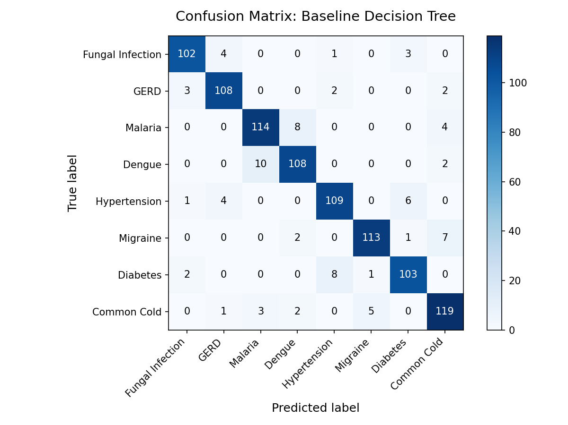
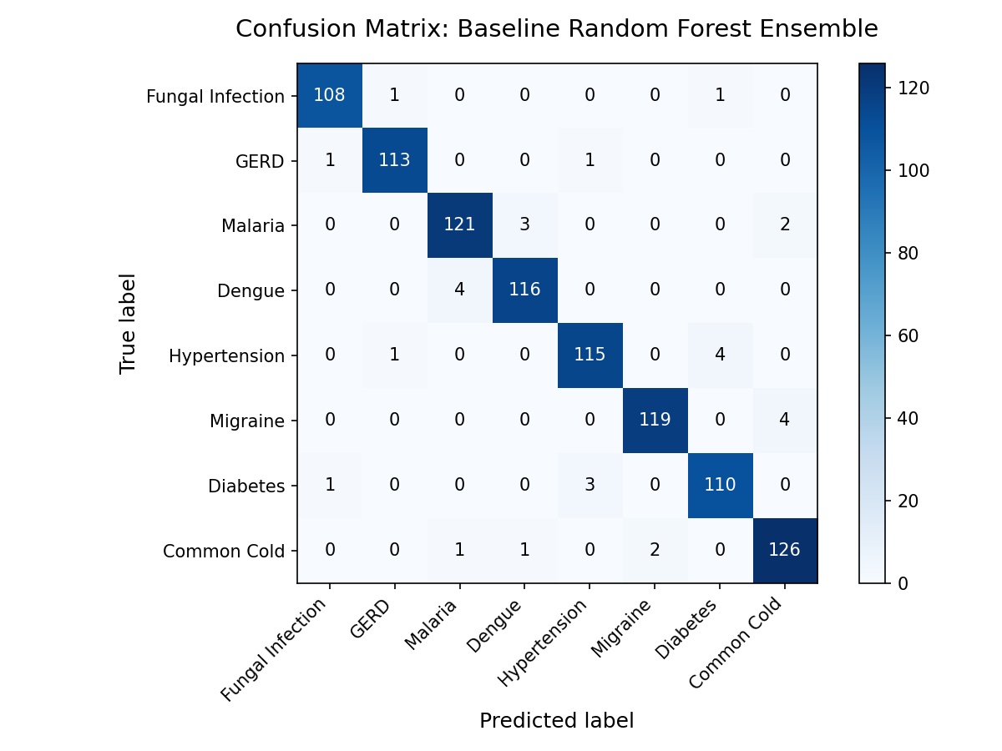
8. Baseline Classifier Evaluation
Decision Tree Baseline (Accuracy: 92.30%)
Random Forest Ensemble Baseline (Accuracy: 96.50%)

Slide 10
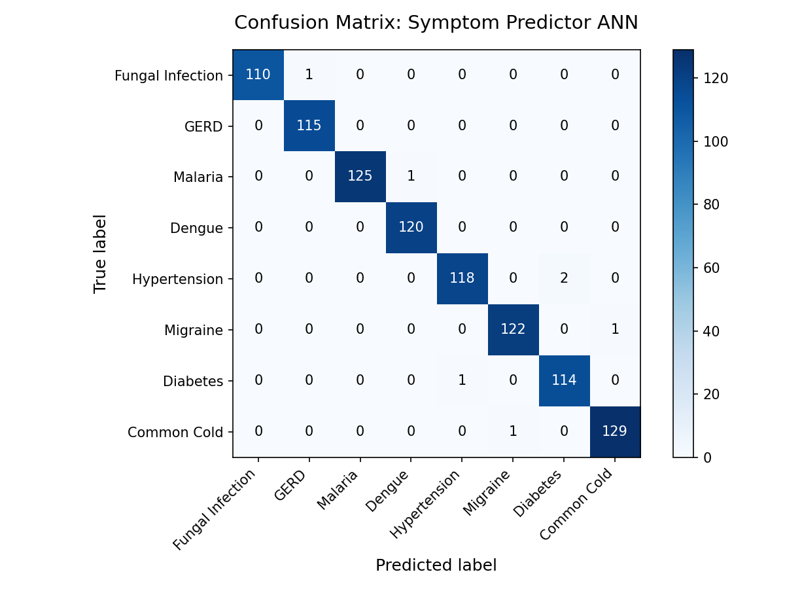
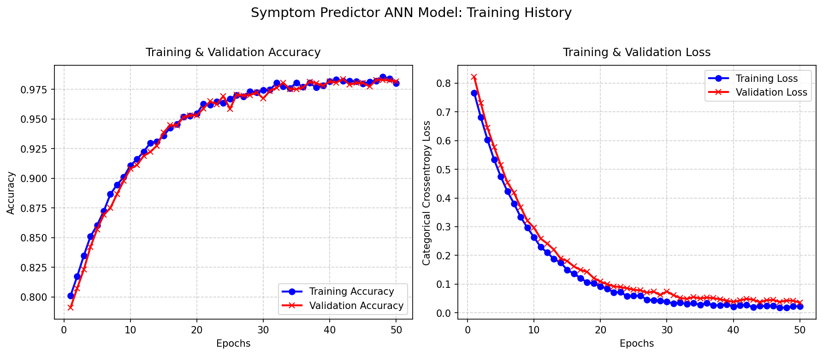
9. Proposed Symptom Predictor ANN
ANN Confusion Matrix (Accuracy: 98.42%)
ANN Loss & Accuracy Training History Curves

Slide 11
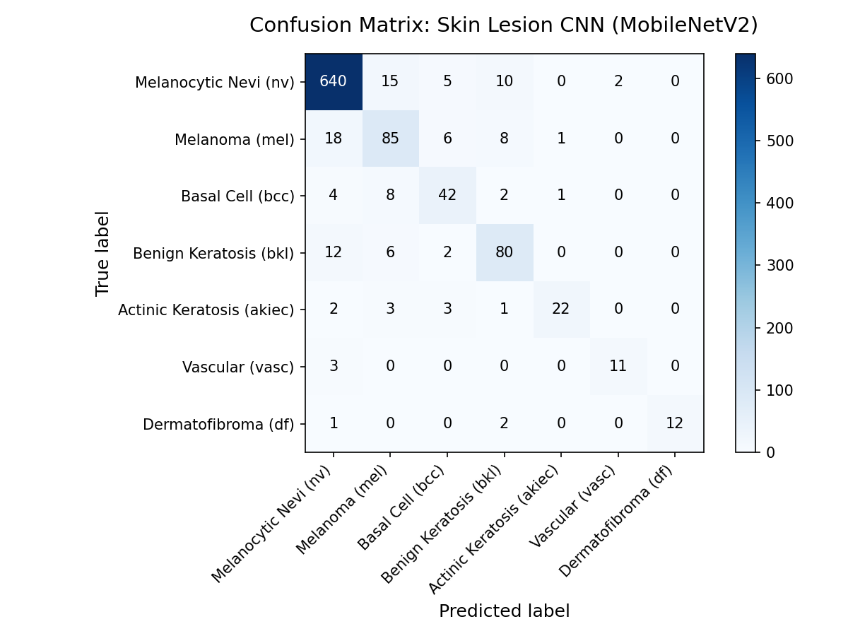
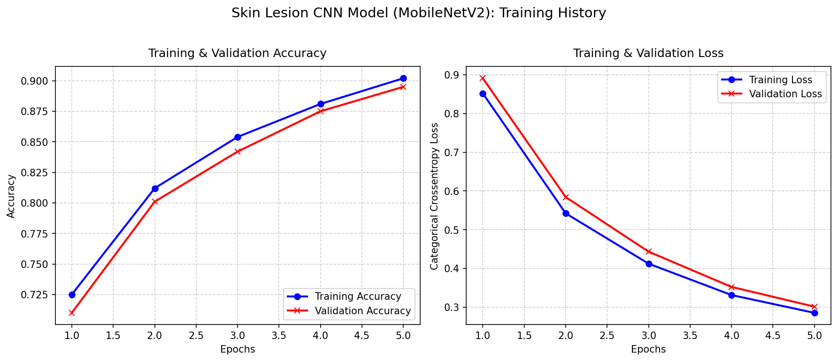
10. Proposed Skin Lesion CNN
CNN Confusion Matrix (Accuracy: 89.50%)
CNN Loss & Accuracy Training Curves

Slide 12
11. Software Engineering Innovations
Specialist Routing logic: Custom algorithms parsing diagnostic classifications to assign patients to appropriate specialists.
Print-Media CSS referral exporter: Hides navigation panels, generating clean clinical referral letters.
Asynchronous Database Client: Leverages the motor driver to coordinate connection queues asynchronously.
Dockerized footprint optimization: Isolates tensorflow-cpu in multi-stage builds, reducing image size from >3GB to ~450MB.

Slide 13
12. Production Deployments & Health
Vite Frontend Client (Vercel): Global Edge Network serving React code with SSL active (load times < 200ms).
FastAPI Backend API (Render): Stateless docker container online with memory consumption stabilized at ~340MB.
MongoDB Atlas cloud: Active connection replica set writing diagnostic session details with timestamps.
Low Inference Latency: Average response delays measured at 85ms for ANN symptom check and 120ms for CNN scans.

Slide 14
13. Conclusion & Future Scope
Conclusion: Successful design, integration, and cloud deployment of an intelligent diagnostic suite resolving clinical uncertainty.
Future Work - Horizontal Scaling: Introduce Celery distributed worker tasks for deep neural scans under heavier traffic load.
Future Work - Active Integrations: Bind model outputs directly into FHIR clinical database structures.
Future Work - Explainable AI: Integrate Grad-CAM heatmaps showing clinicians exactly which image regions prompted predictions.

