Slide 1
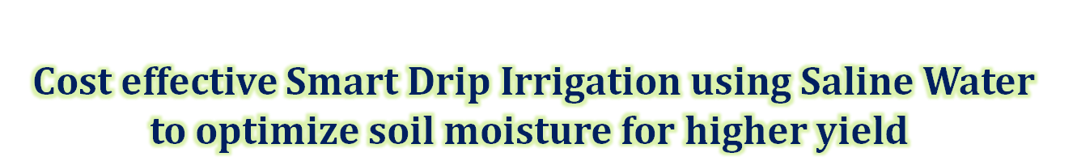
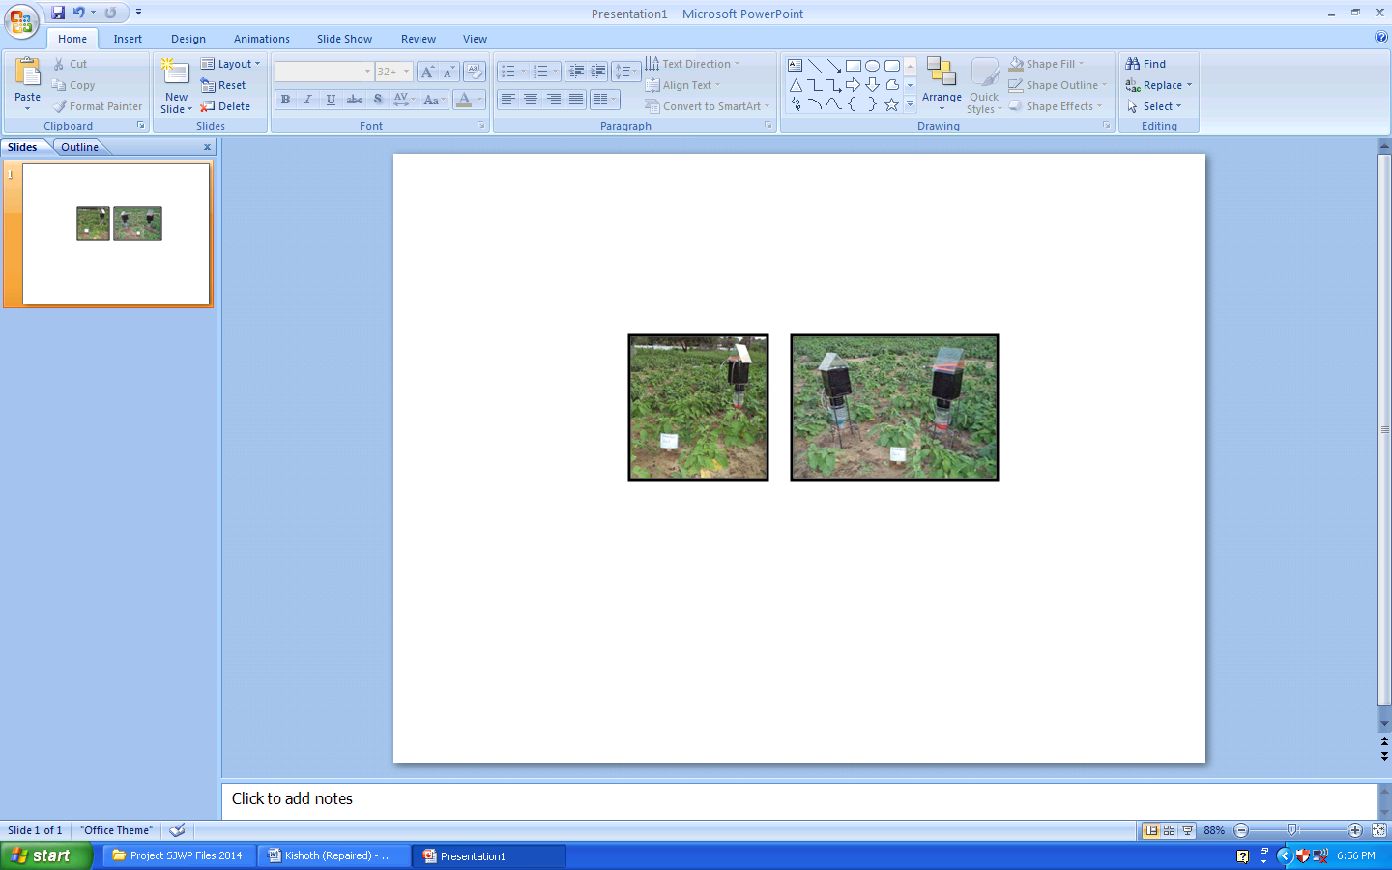
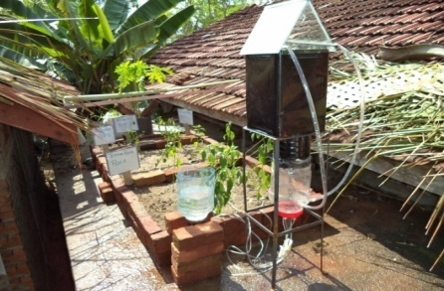
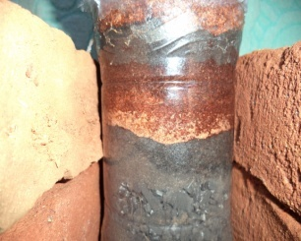
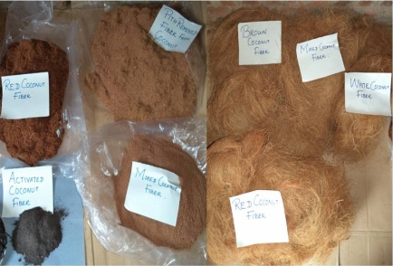

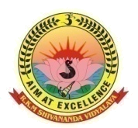
Shivananda Vidyalaya National School, Batticaloa
Entry to Stockholm Junior Water Prize 214

Slide 2

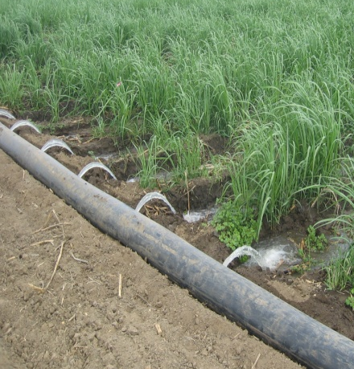
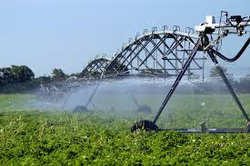
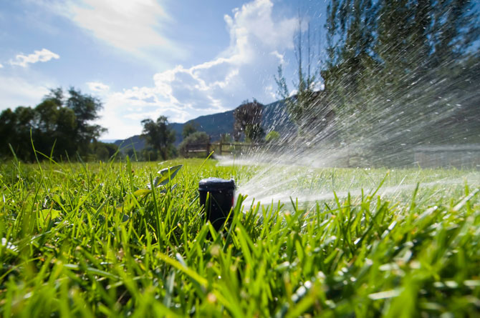
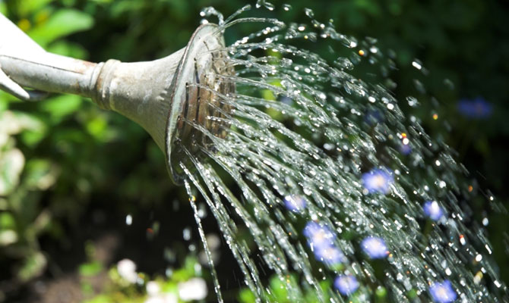
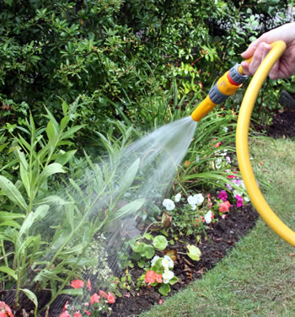
Our Problem
Convectional Irrigation Techniques
Irrigation methods commonly used today require water in large amounts to achieve the moisture level desired at the root zone.
Proper Soil moisture is neglected.
Improved soil moisture management is essential for sustainable improvement of food production and water supply.
Quality water is required for irrigation. [Saline Water Cannot be used]

Slide 3
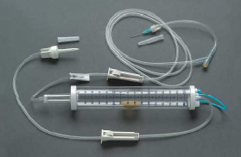
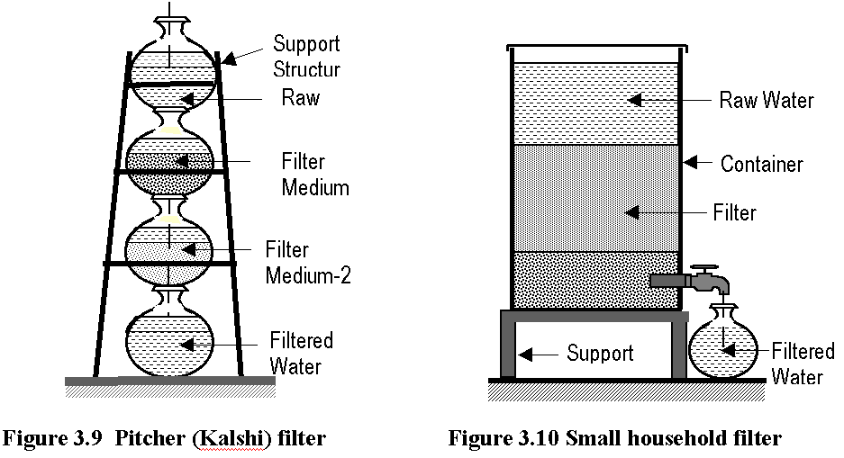
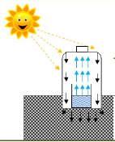

Our Hypothesis
Drippers
Filters purify water
Evaporation using Sunlight
Salt water usage for Irrigation using fiber materials capable of removing Sodium Ions.
Water Evaporation due to sunlight.
Drippers are used to supply accurate level of water for Irrigation.

Slide 4
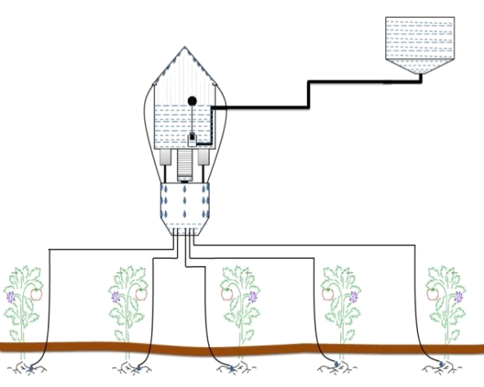
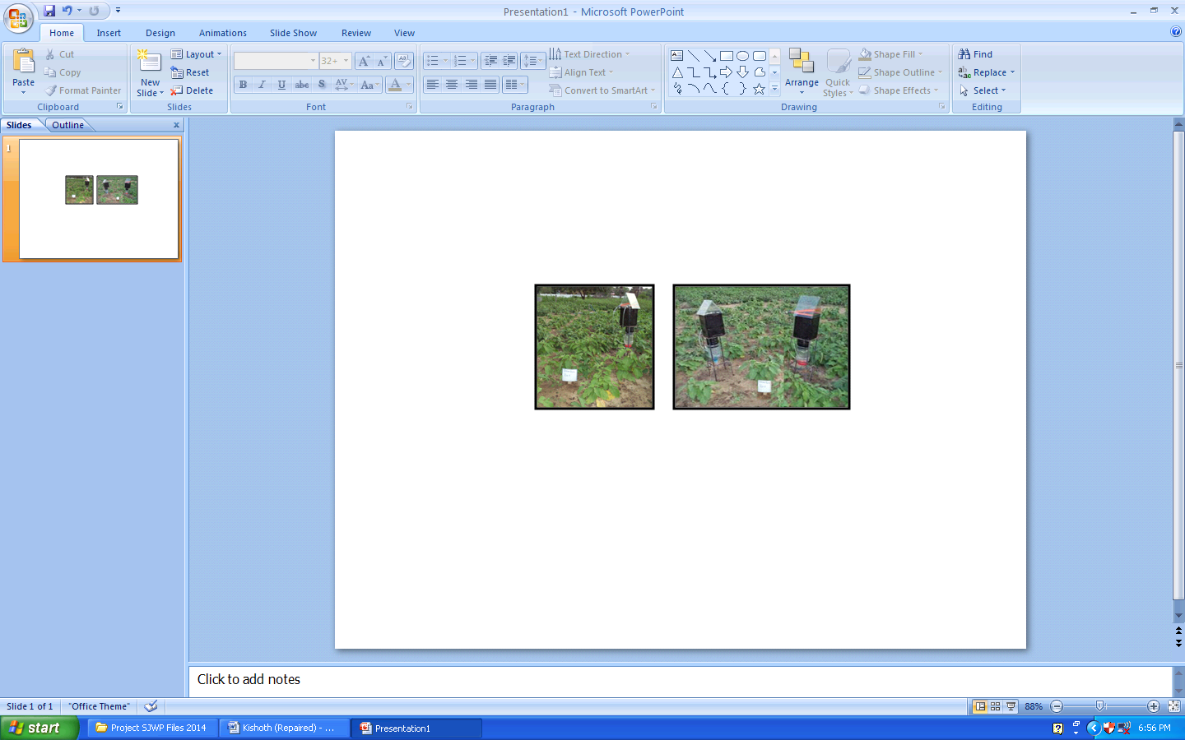
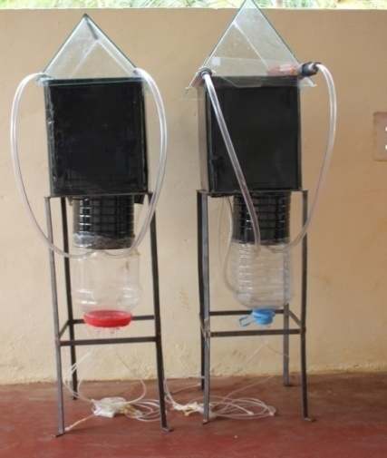
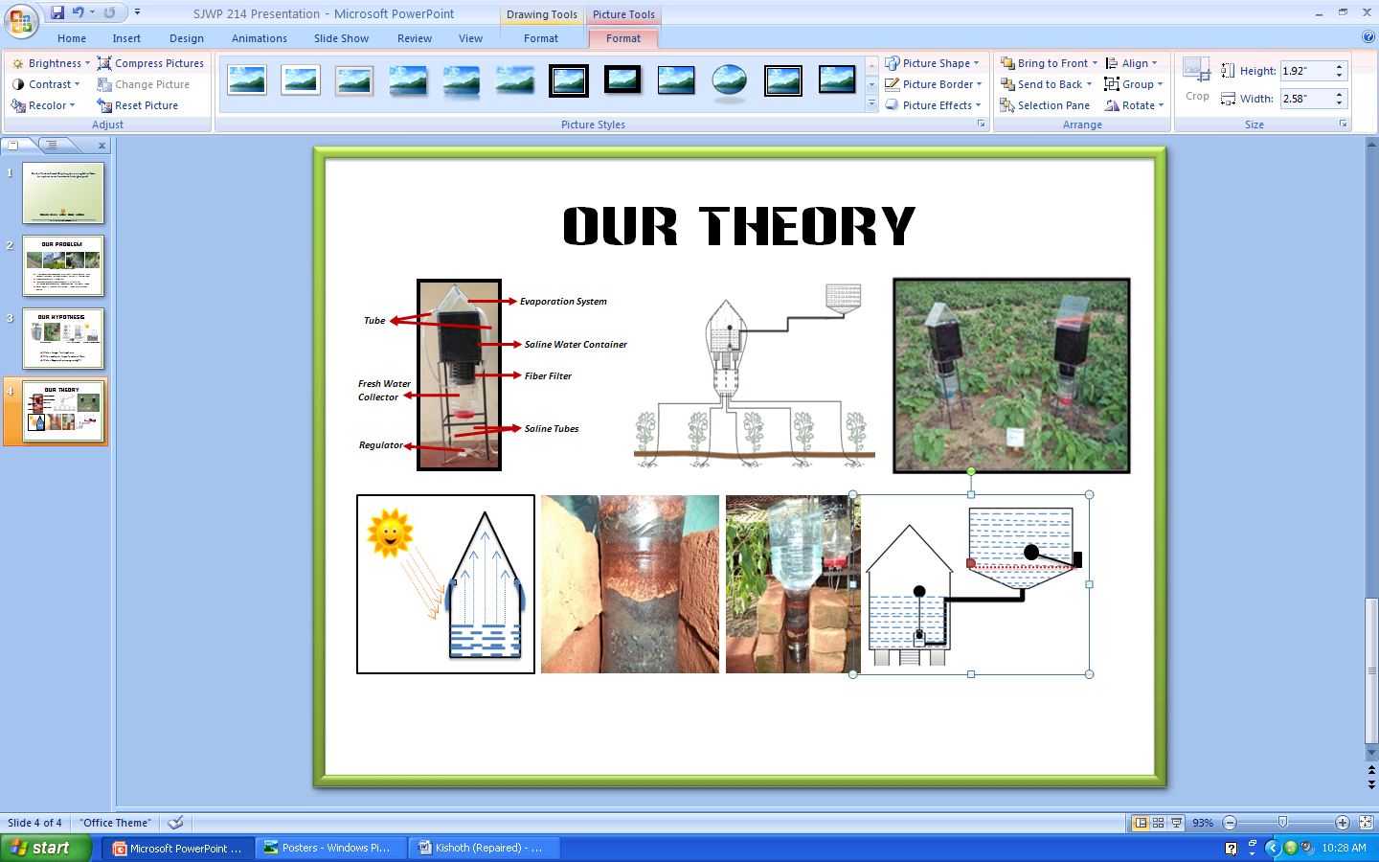

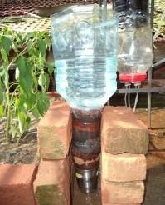

Our Theory
Evaporation System
Tube
Saline Water Container
Fresh Water Collector
Fiber Filter
Saline Tubes
Regulator
The fibers ability to remove Na ions and activated carbon’s(coconut shell) ability to remove other ions is investigated to use them in agriculture as the amount of removal of Na ions is not efficient for drinking purposes. Also with the incorporation of using evaporation system provides efficient water for the plants using drippers.

Slide 5
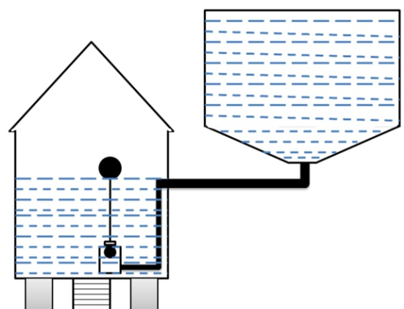
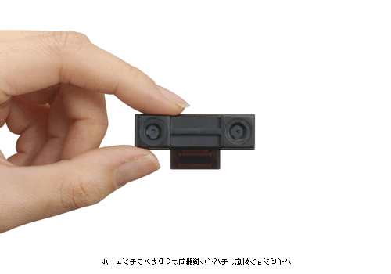
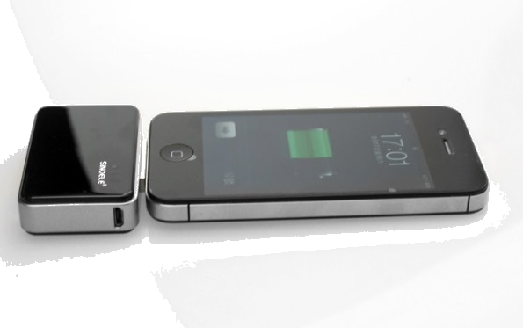
Our Theory
Automatic Saline Water Filler
The automatic filler mechanical part) connected to the black container to automatically fill the saline water once its get empty through the system which is connected to the main tank supplier.
Also, the main tank supplier is connected with a mechanical system to alert the farmer that the saline water is empty and it should be filled by making an alarm system but as mentioned in the suggestion we are developing it to the Phone SMS system.
Saline Water
Fiber Filter
Auto Fill

Slide 6
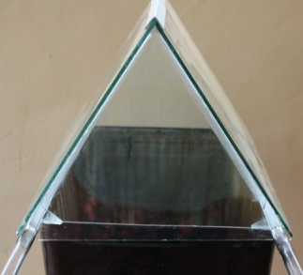
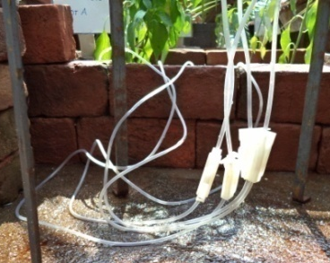
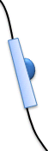
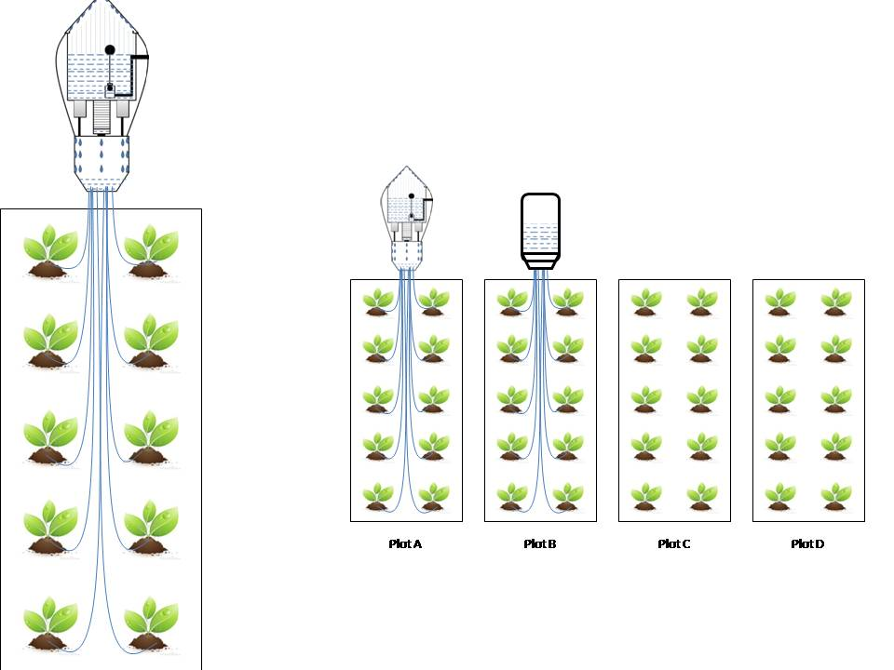
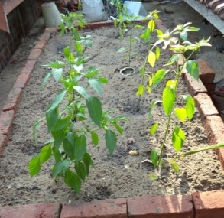
Our Experiment
Preparation of the water feeding System.
Preparation of Experimental Plots.
Experimental Plots &
Large Scale Testing
Plot A : Plants with the gadget using saline water.
……
Plot B : Plants with regular traditional dripping irrigation system using normal water.
Plot C : Plants with surface watering technique using normal water.
Plot D : Plants with surface watering technique using high saline water

Slide 7
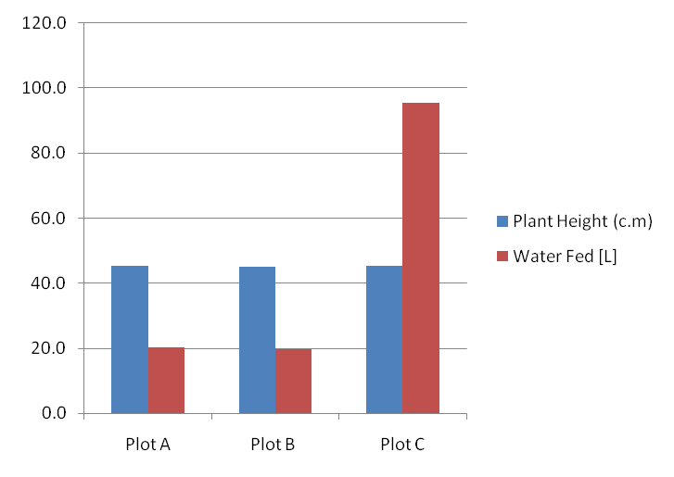
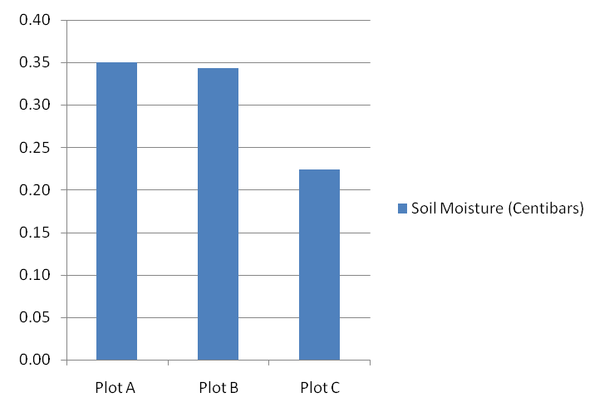
Our Results
Plant height and water fed for 12 weeks duration in three Plots
  Average soil moisture at 8 cm depth in three Plots
*Note: Plants in Plot D died after two weeks thus it has not been watered.

Slide 8
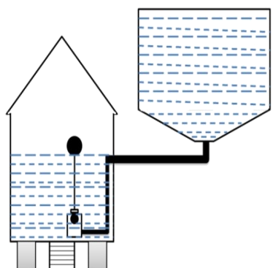


Our Conclusions
This device uses saline water for irrigation.
The Coconut fiber has the capacity to remove Na (Sodium) ions in Salt water.
Using the coconut fibers filter significant amount of water filtered as fresh water and low cost than compared to other filtering devices.
Application of this device to the farming area to optimize the soil moisture level could successfully prevent the water waste by feeding water to the surface soil layer using any watering techniques.
By supplying only the required amount of water at the roots with this controlling device, significant amount of water can be saved during the period in which heavy quantity of water is used in any cultivation.
Using the regulators control the filtered water not to flow during the rain time.
This device is being as a companion to the farmers not to be with the farming plot as this automation of irrigation and gives warning to the farmer once the saline water tank empty.
This efficient and novel device could achieve following environmental and social benefits;
  Improvement of productivity of farmers due to less involvement of watering plants in regular intervals.
  Prevention of Soil erosion.
  Increase of yield due to prevention of flushing off the fertilizer from plots.
  Reduced water pollution due to not allowing water to flow to the environment.

Slide 9


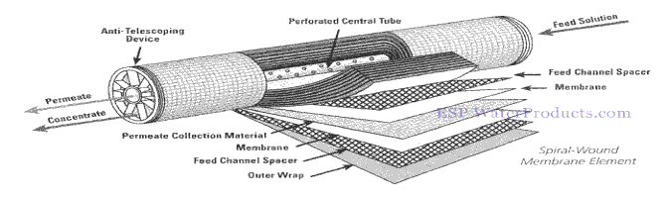
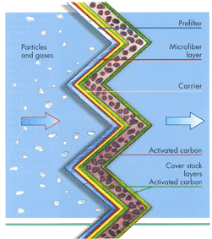
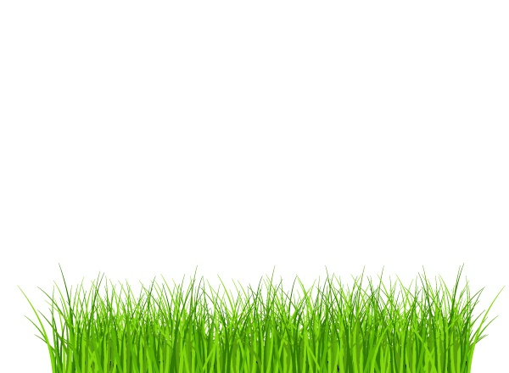
Our Suggestions
  The Fiber filter should be modifying to achieve the maximum removal of Na ions and other ions to use it for the drinking purposes.
  If a system that scan the field and notify the farmer by sending thermal photographs to the farmers phone can be ensure which area of the field needs water.
  Using Semi permeable membrane should be considered for the filtration.
  A device to sense the soil moisture and to control the flow of water using thermo meter should be investigated through electronic circuit.
  The anti fungal effect and the life time of the fiber should be investigated.
  Further improvements to increase the efficiency and effectiveness of the proposed device

Slide 10


