Slide 1

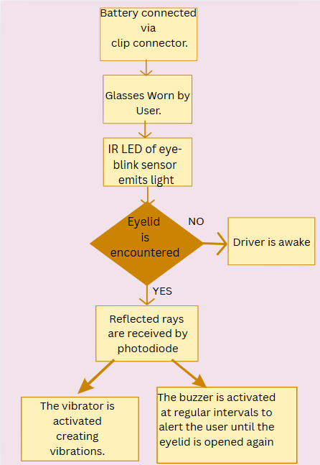
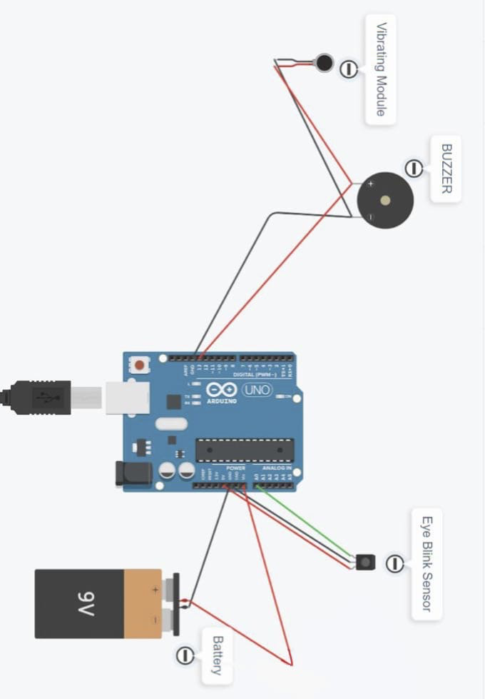

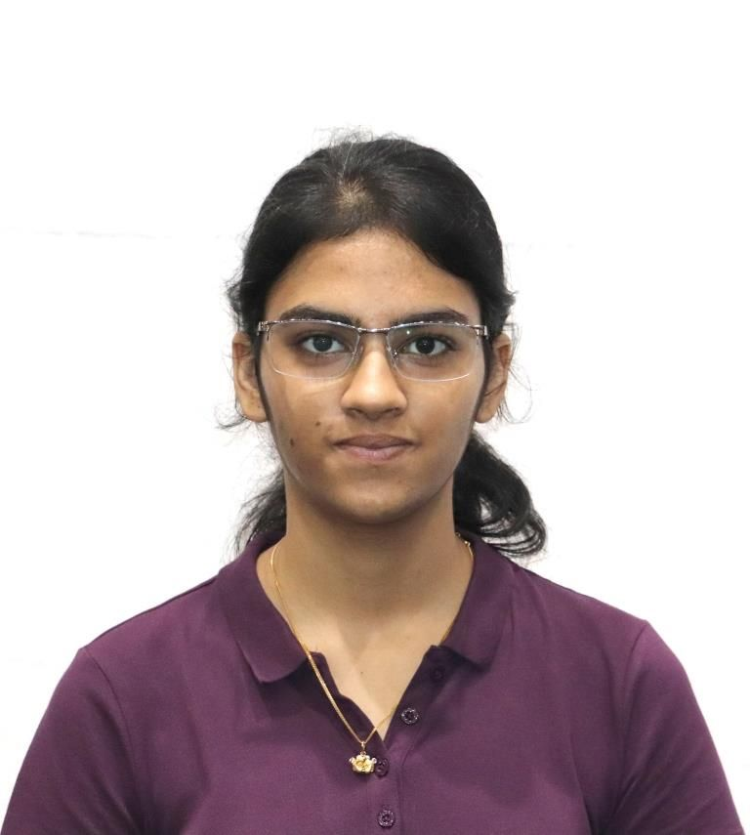
ANTI – SLEEP GLASSES
SDG 11
Promote sustainable cities and communities
Jayanthi Sharma - 22BCE1758 Kashish Mahendra - 22BCE1720
Faculty: Dr J Deepika Roselind
School of Computer Science and Engineering
INTRODUCTION
Drowsiness among night shift workers and vehicle drivers is a critical safety concern that leads to numerous workplace and road accidents. This project introduces a lightweight, wearable device that detects prolonged eye closure—a key sign of fatigue—and alerts the user using sound and vibration. Built using an Arduino Nano, the system aims to reduce sleep-related incidents by providing timely, real-time feedback.
OBJECTIVES-
SDG Goal 11: Promote sustainable cities and communities
SDG 11.2 – Provide access to safe, affordable, accessible and sustainable transport systems for all by enhancing road and industrial safety for night shift workers and drivers through the use of real-time drowsiness detection wearables.
Design and implement a compact, wearable system using Arduino Nano, eye blink sensor, piezo buzzer, and vibration motor to detect and alert users during fatigue episodes.
- Detect early signs of drowsiness by monitoring eye closure duration using a non-invasive blink sensor.
Provide dual alerts (sound and vibration) to awaken
drowsy users in real time, preventing micro-sleep
incidents.
- Ensure comfort and affordability through lightweight
design and use of open-source components for
widespread deployment.
- Improve safety in industrial and transport sectors by
enabling continuous alertness during night shifts and
long-distance driving.
SCOPE OF THE PROJECT
This project presents an affordable, user-friendly wearable system designed to detect drowsiness and alert users in real time. Aimed at night shift industrial workers and vehicle drivers, the system helps reduce fatigue-related accidents by monitoring eye activity and issuing immediate alerts. By enhancing safety and well-being in transport and manufacturing sectors, it directly supports SDG 11.2—promoting safer, more sustainable mobility and work environments.
METHODOLOGY
1. Component Setup: Assemble the primary components, including the Arduino Uno, eye blink sensor, piezo buzzer, vibrating module, and battery, on a breadboard to test the core functionality.
2. Programming: Develop a basic Arduino sketch to monitor eye blink data, triggering alerts when the user’s eyelids remain closed for more than 3-5 seconds.
3. Testing: Test the system on the breadboard to ensure reliable detection of drowsiness and proper functioning of the buzzer and vibrating module.
4. Hardware Migration: After testing, migrate to the Arduino Nano for a more compact, portable design.
5. Assembly: Attach the components to glasses for comfortable wear and to ensure stability.
ARCHITECTURE
MODULES
1. Eye Monitoring Module - Detects eye movements and prolonged eye closure, which are key signs of drowsiness. - Provides data to the Arduino Nano for processing.
2. Processing Module - The Arduino Nano processes the input from the eye blink sensor and determines if the user is showing signs of fatigue (eyes closed for 3-5 seconds). - Triggers the alert system when drowsiness is detected.
3. Alert Module
Piezo Buzzer: Issues an audible sound to alert the user.
Vibrating Module: Provides physical feedback (vibration) to further ensure the user is alerted to their drowsiness
4. Power Module - Uses a rechargeable battery to power the system, optimized for long hours of use. - The power module is designed for low energy consumption to ensure the system can be used continuously during night shifts or long drives.
RESULTS
The system accurately detected prolonged eyelid closure and triggered timely alerts. Both the buzzer and vibration module effectively warned the user in real time. The lightweight glasses were comfortable for extended use.
CONCLUSION
The Anti-Sleep Alarm Glasses offer a low-cost, effective solution for night shift workers and drivers at risk of fatigue-related accidents. By monitoring eye movements and delivering real-time alerts, the system enhances safety in high-risk environments.
Aligned with SDG 11.2—providing access to safe, affordable, and sustainable transport—this project promotes safer roads and workplaces through drowsiness detection technology. Built using Arduino Nano, an eye blink sensor, piezo buzzer, and vibration motor, the compact wearable device demonstrates the impact of simple technology on urban safety.
MEMBERS
Sensor Value: 626
Sensor Value: 626
Sensor Value: 626
Eye has been closed for more than 2 seconds! Alert ON.
Sensor Value: 623
Sensor Value: 4
Eye opened.
Sensor Value: 4
Jayanthi Sharma
Kashish Mahendra

