Slide 1
Deep Neural Network
The model we use for churn prediction is a Deep Neural Network model .A deep neural network (DNN) is an ANN with multiple hidden layers between the input and output layers.

Slide 2
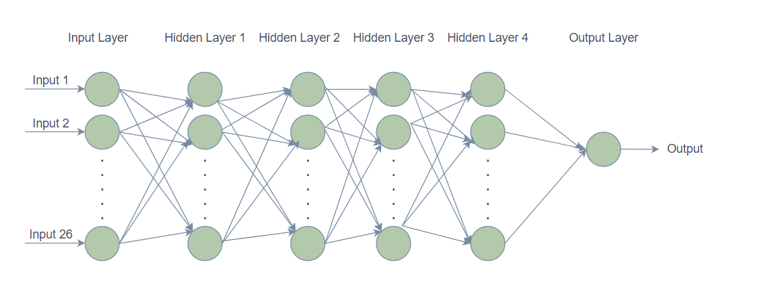
Model Architecture

Slide 3
Input layer
The input layer of deep neural network brings the initial data into the model for further processing by subsequent layers.
Each of the nodes in the input layer represents an individual feature from each sample within the dataset that will pass through the model.
Every node is a feature vector, where each element represents different pieces of information.
The 26 columns from the finally processed dataset like tenure, payment method, Monthly charges, contract, etc., together make up the input layer of the model.

Slide 4
Hidden layer
Hidden Layers are intermediate layers between the input and output layer and process the data by applying complex non-linear functions to them
Each of the input neurons are connected to every single unit of the hidden layer which is next to input layer.
Each connection from input layer to the hidden layer will have its own assigned weight which range from 0 to 1. These weights are multiplied with the input and passed to ReLu activation function.
Here the model has 4 hidden layers. These layers are the key component that enables a neural network to learn complex tasks.

Slide 5
ReLu activation function
The rectified linear activation function, or ReLU activation function, is the most common function used for hidden layers. It is common because it is both simple to implement and effective at overcoming the limitations of other previously popular activation functions, such as Sigmoid and Tanh.
Mathematically, it is defined as y = max(0, x)
We chose ReLu as the activation function for hidden layers because other activation functions like sigmoid, tanh causes vanishing gradient problem.

Slide 6
Output Layer
An Output Layer takes the processed data from the previous hidden layer as input and produces the final results.
The Deep Neural Network model has one neuron in the output layer – churn(0) or non-churn(1). The model uses sigmoid activation function in the output layer.

Slide 7

Sigmoid activation function
Sigmoid transforms the values between the range 0 and 1.
Mathematical expression for sigmoid :
$S\left(x\right)=\frac{1}{1+e^{−x}}$ where S(x) is Sigmoid Function , e is Euler’s number.
Usually used in output layer of a binary classification, where result is either 0 or 1, as value for sigmoid function lies between 0 and 1 only so, result can be predicted easily to be 1 if value is greater than 0.5 and 0 otherwise.

Slide 8
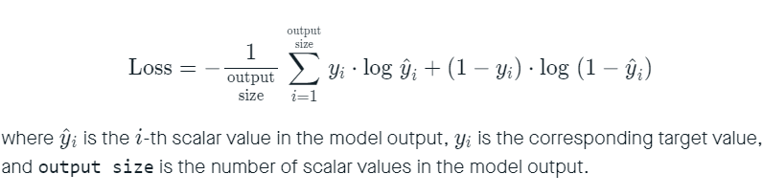
Loss Function
Binary Cross Entropy is the negative average of the log of corrected predicted probabilities.
The binary cross entropy loss function calculates the loss of an example by computing the following average:

Slide 9
Optimizer
Adam is an optimization algorithm that can be used instead of the classical stochastic gradient descent procedure to update network weights iterative based on training data.
The results of the Adam optimizer are better than every other optimization algorithms, have faster computation time, and require fewer parameters for tuning.

