Slide 1
Employee Data Analysis using Excel
STUDENT NAME: R.Jayanthi
REGISTER NO: 312208493
DEPARTMENT: B.com (commerce)
COLLEGE: Chellammal women's college

Slide 2

Employee Performance Analysis
using Excel

Slide 3


Problem Statement
Project Overview
End Users
Our Solution and Proposition
Dataset Description
Modelling Approach
Results and Discussion
Conclusion

Slide 4

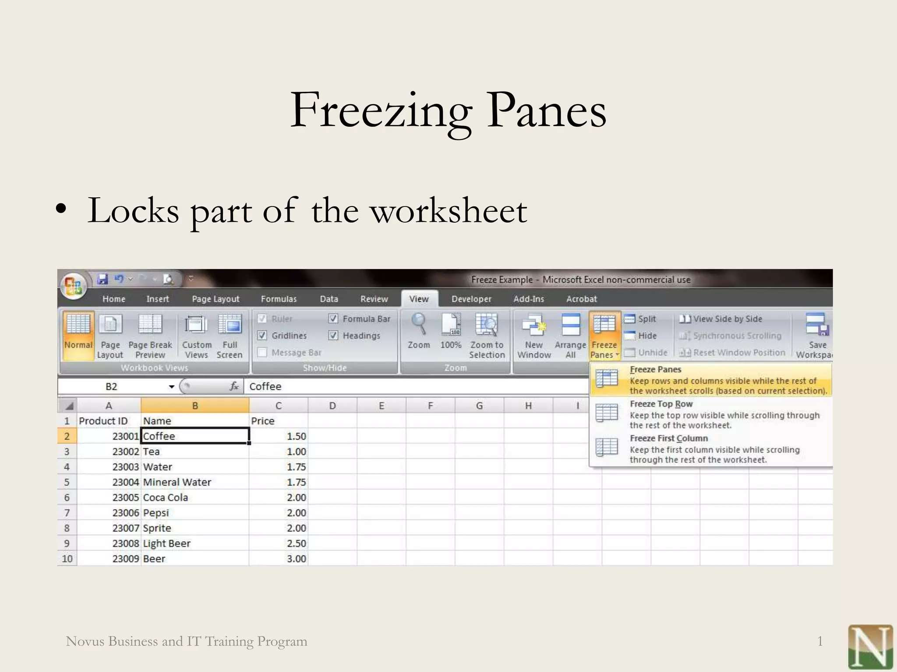

Slide 5

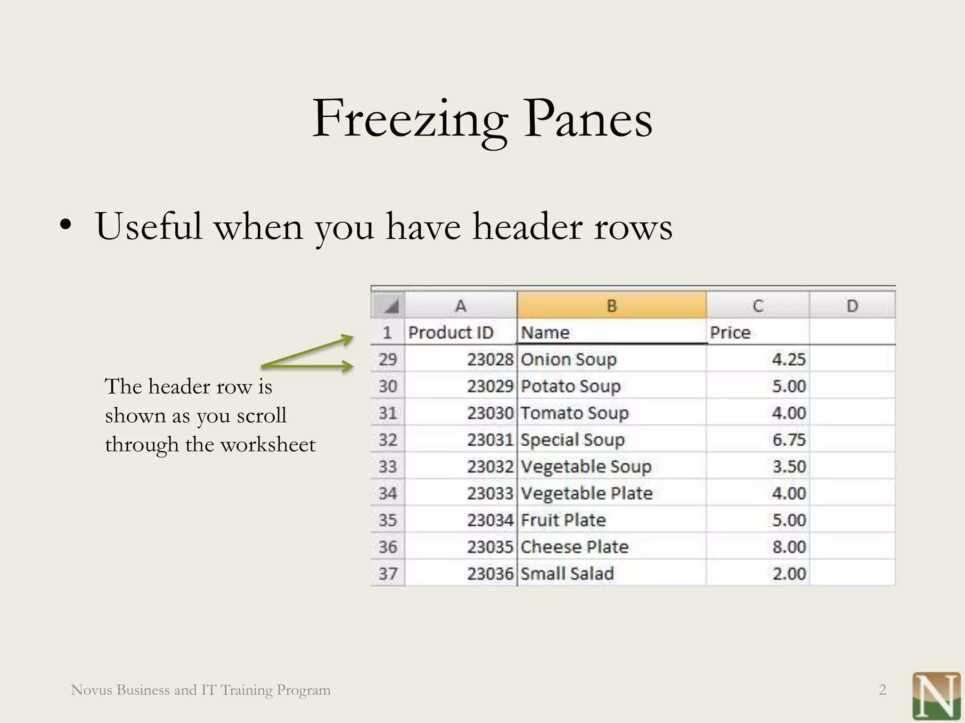

Slide 6

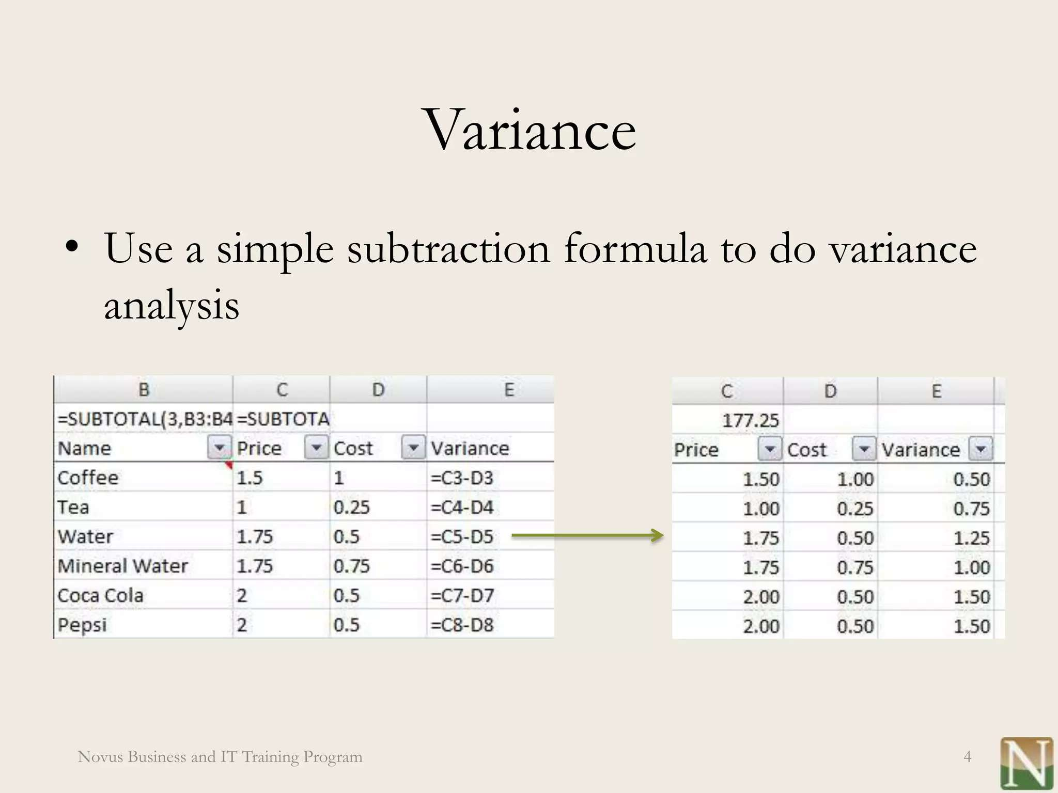


Slide 7
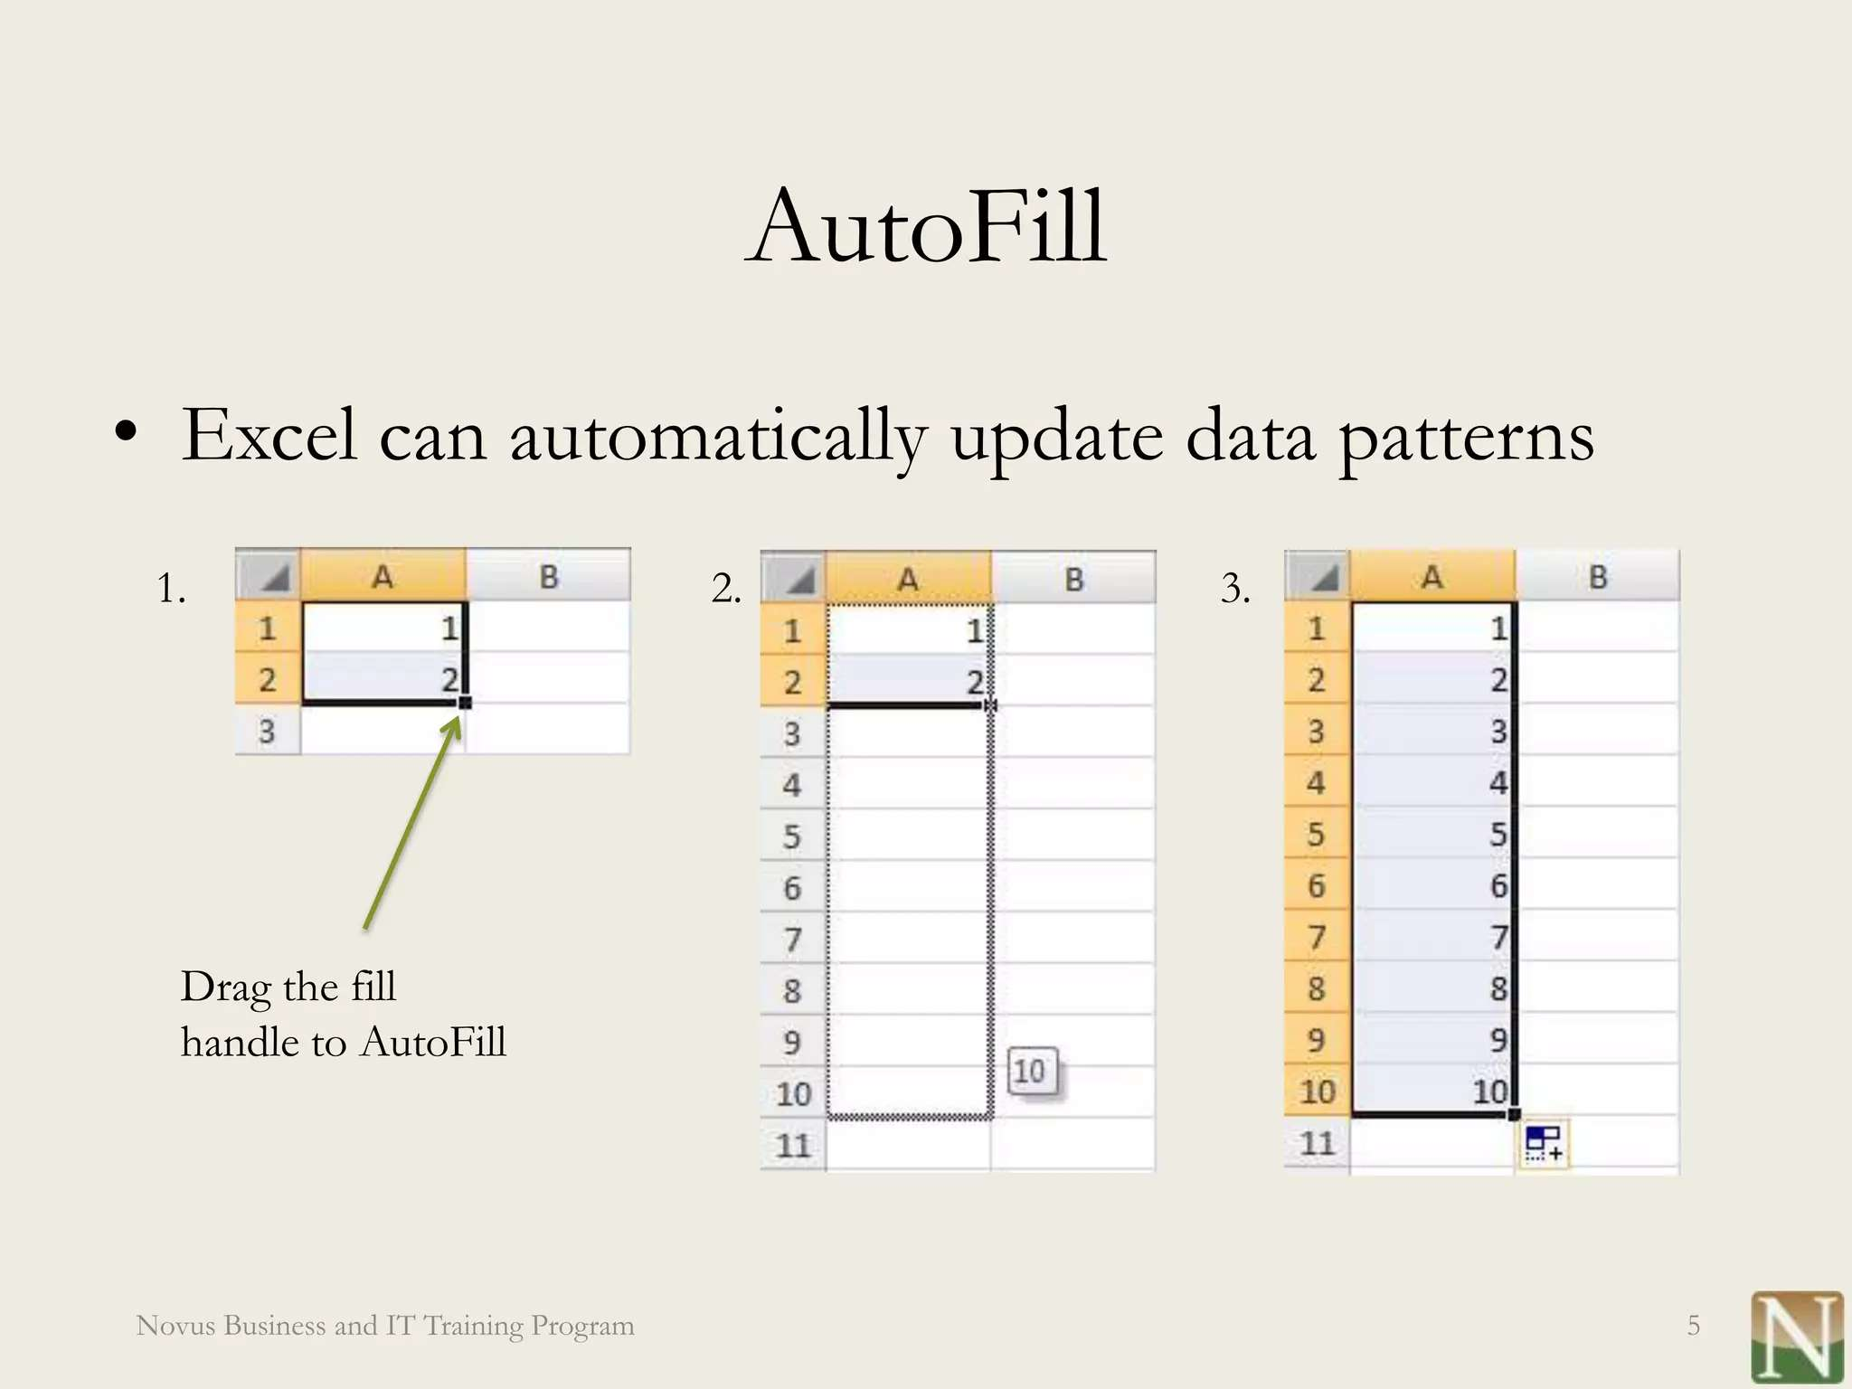
MODELLING

Slide 8
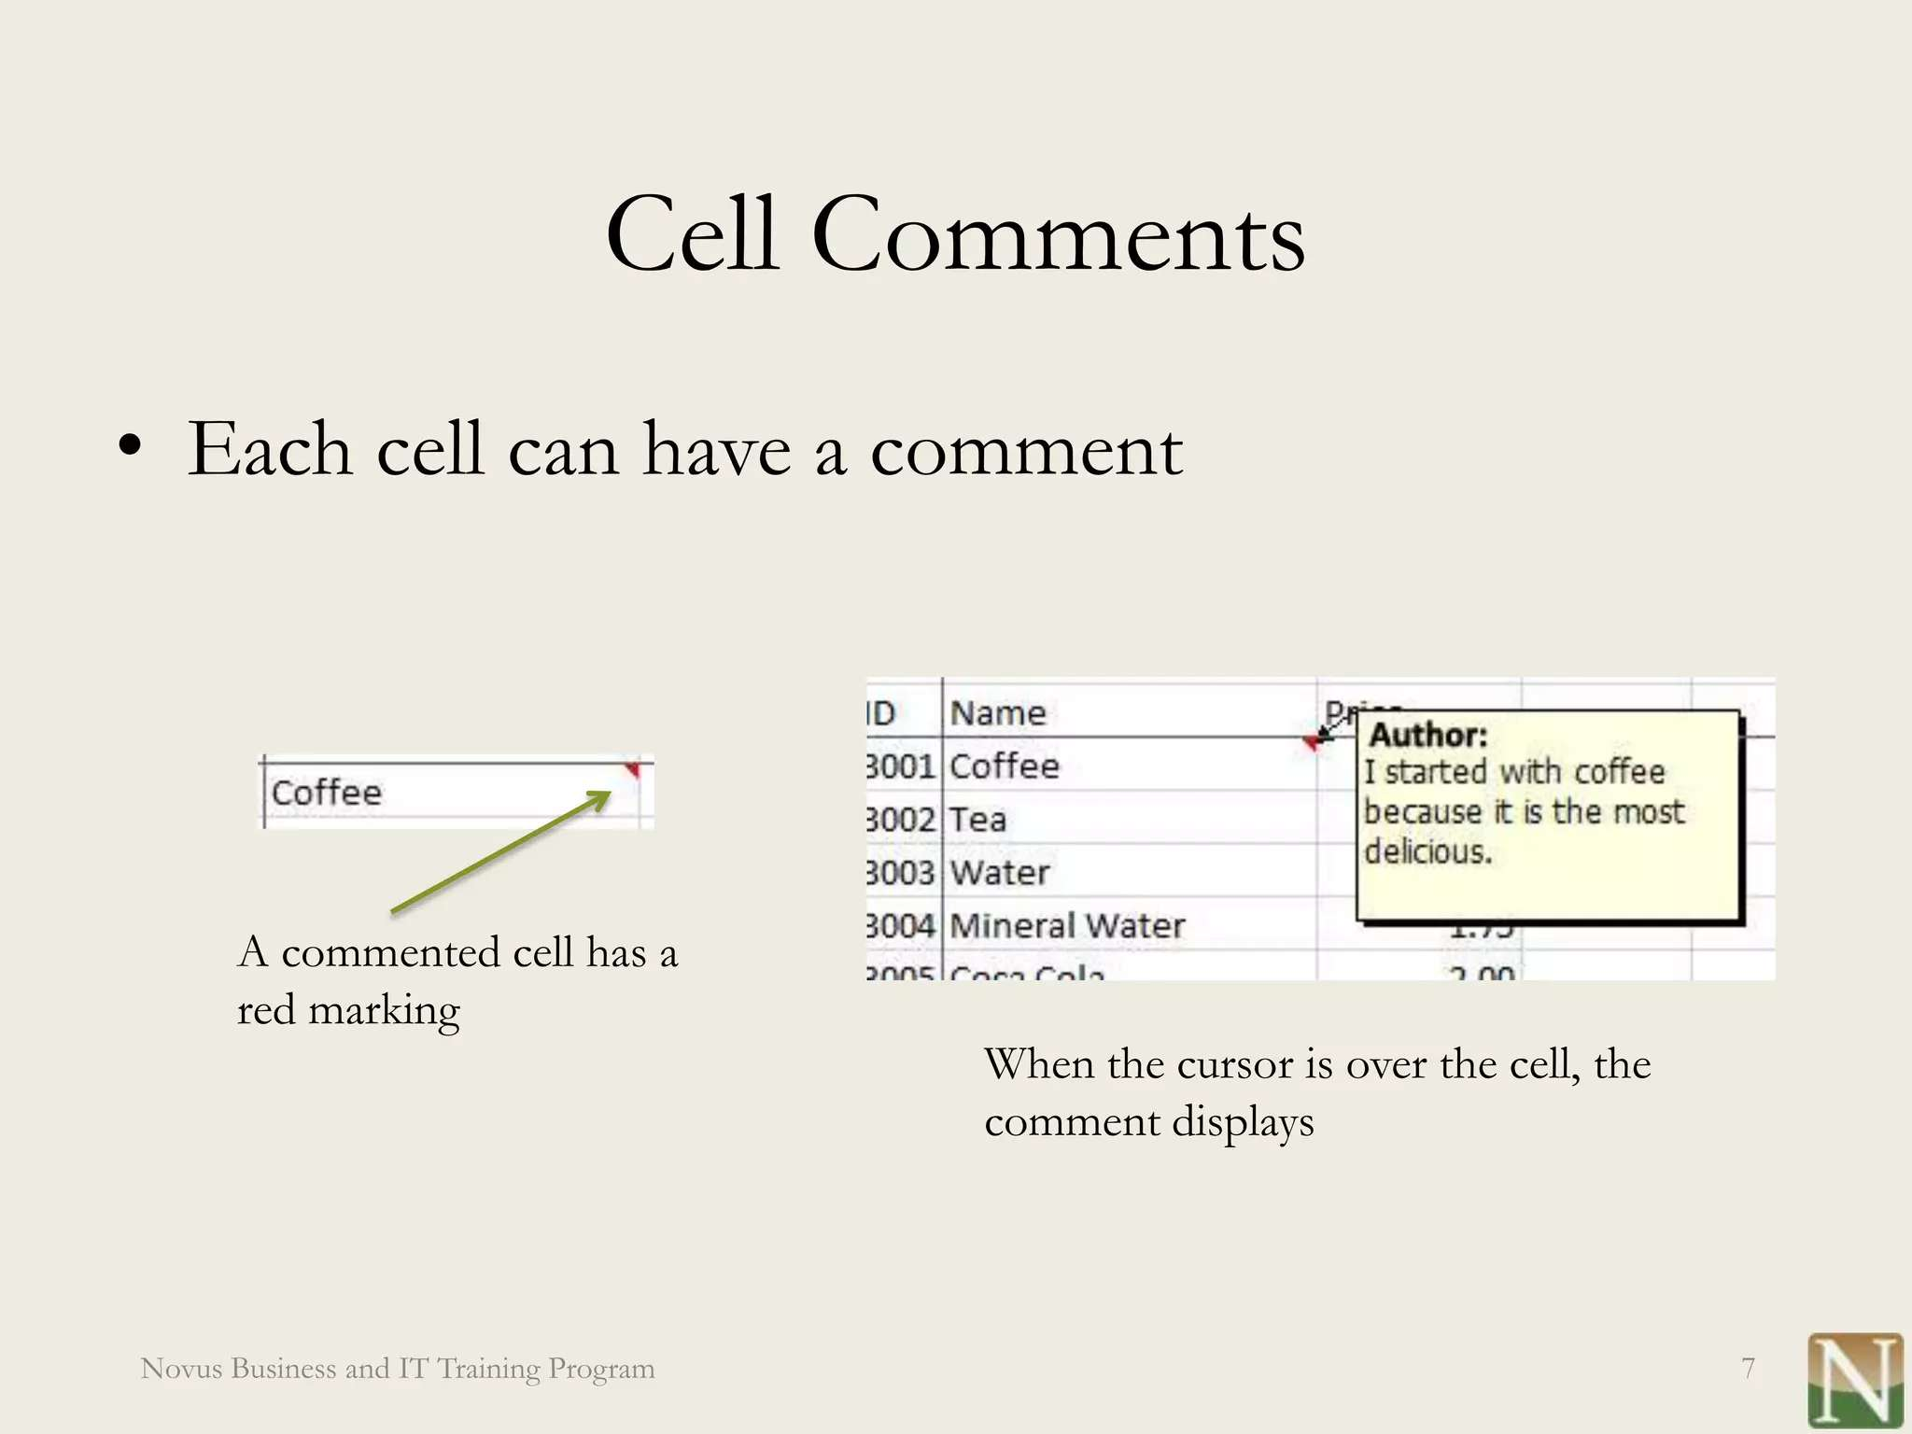

Slide 9
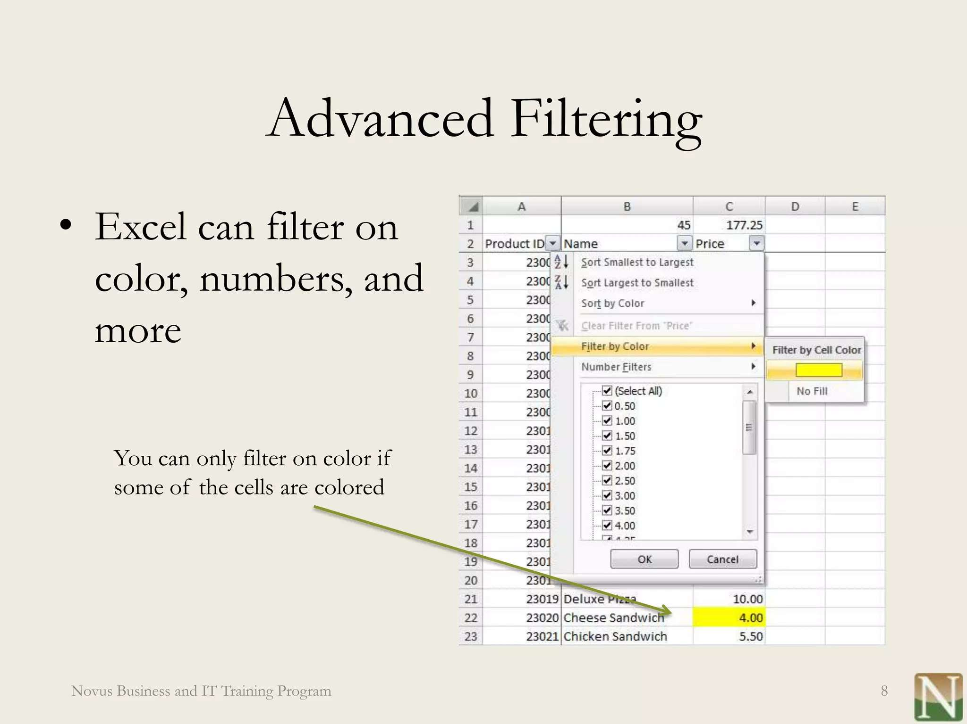

Slide 10

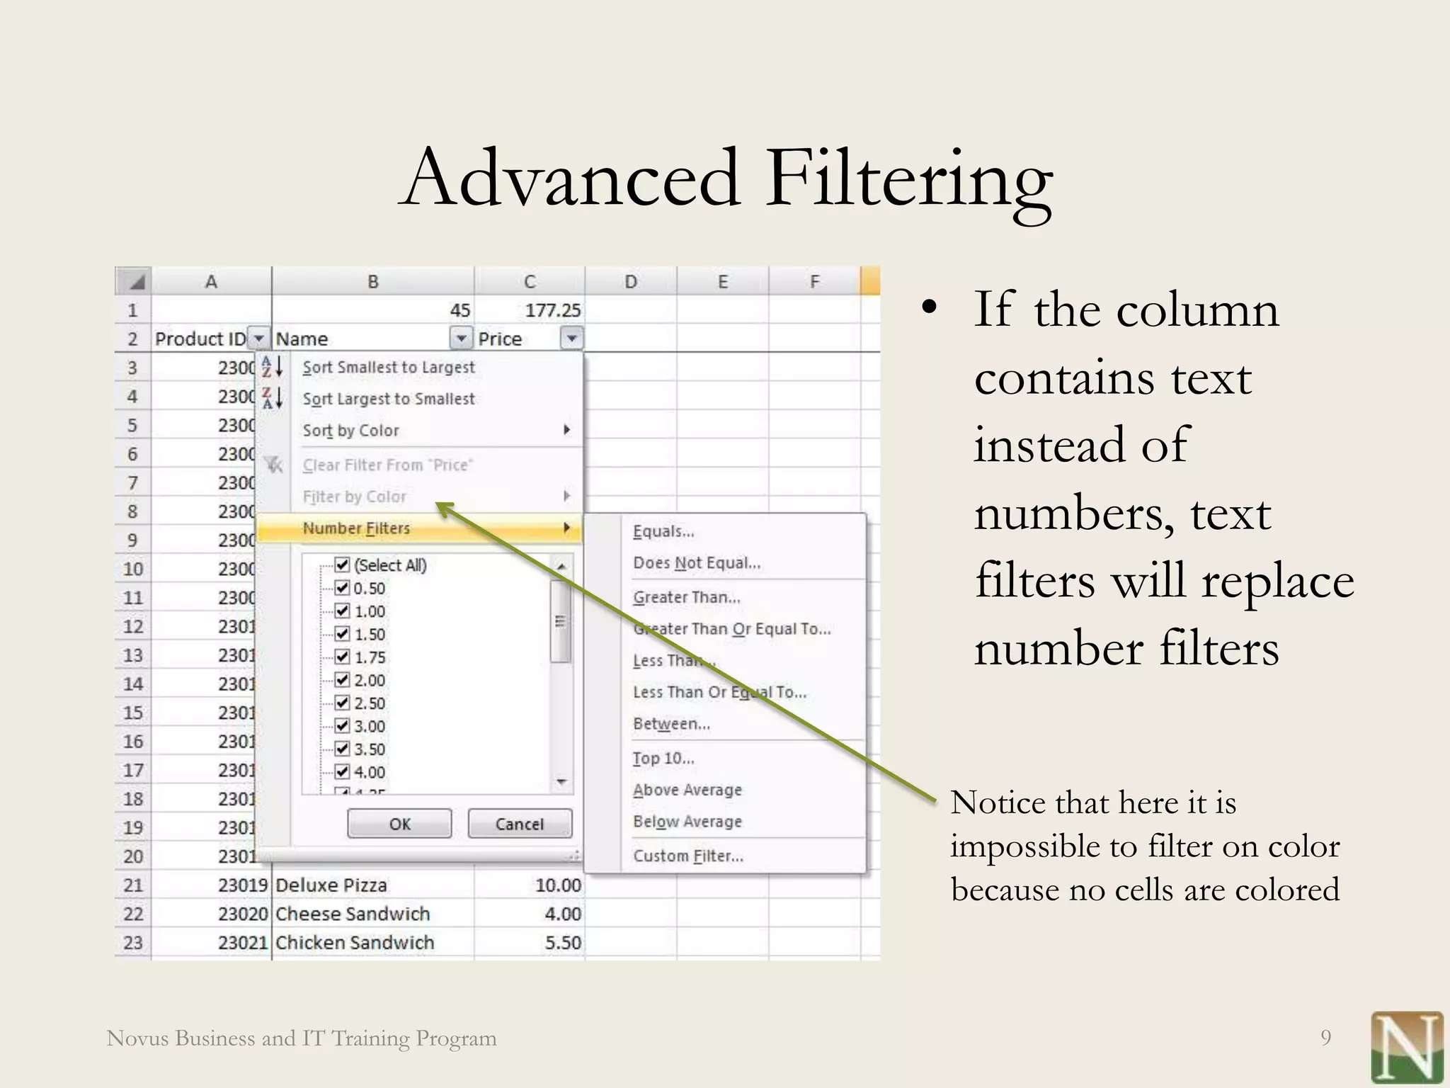

Slide 11
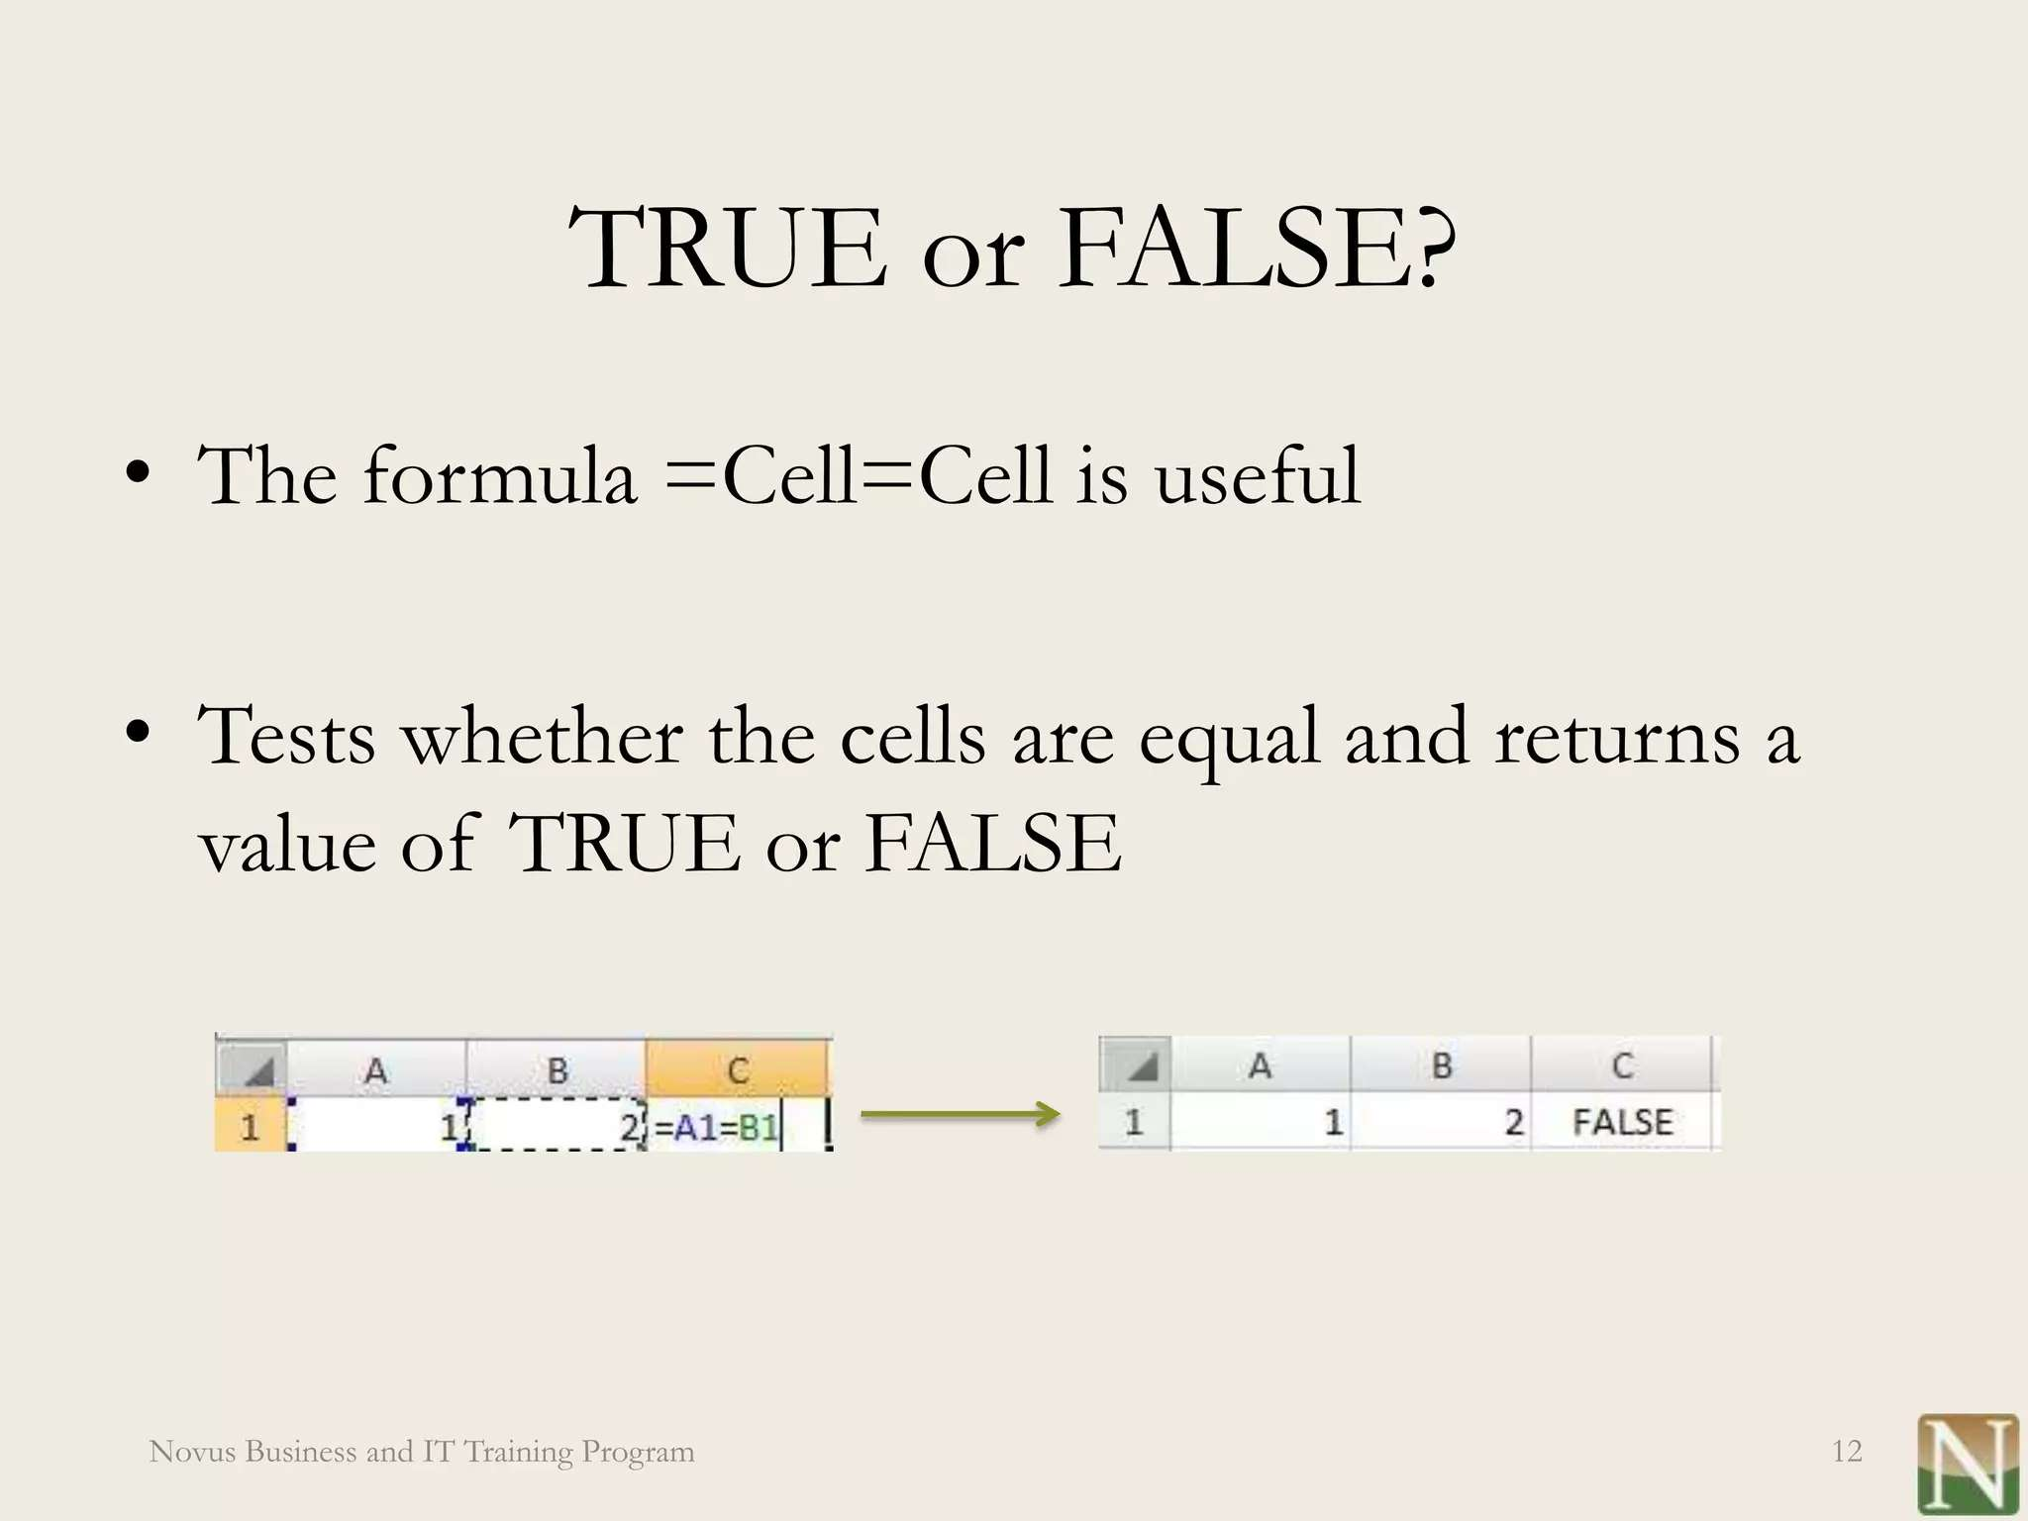

Slide 12
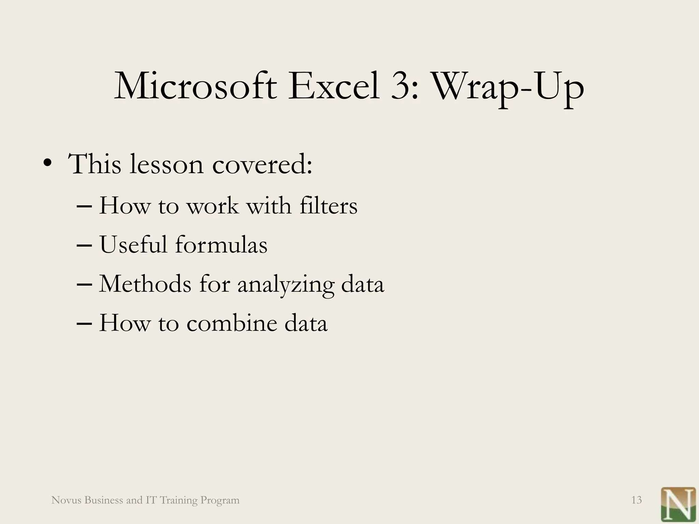

Slide 13


