Slide 1
Version control with Git

Slide 2
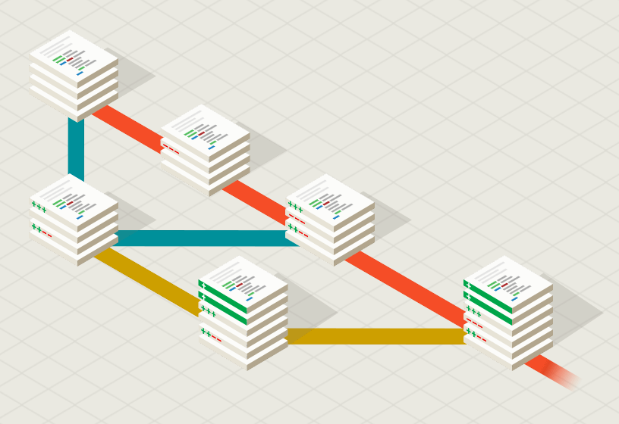
Git
Git is a free and open source distributed version control system designed to handle everything from small to very large projects with speed and efficiency.

Slide 3
Git Resources
At the command line: (where verb = config, add, commit, etc.)
$ git help <verb>
$ git <verb> --help
$ man git-<verb>
Free on-line book: http://git-scm.com/book
Git tutorial: http://schacon.github.com/git/gittutorial.html
Reference page for Git: http://gitref.org/index.html
Git website: http://git-scm.com/
Git for Computer Scientists (http://eagain.net/articles/git-for-computer-scientists/)

Slide 4

Git History
Came out of Linux development community
Linus Torvalds, 2005
Initial goals:
  Speed
  Support for non-linear development (thousands of parallel branches)
  Fully distributed
  Able to handle large projects like Linux efficiently
Notes:
Initial goals were to support development of Linux

Slide 5
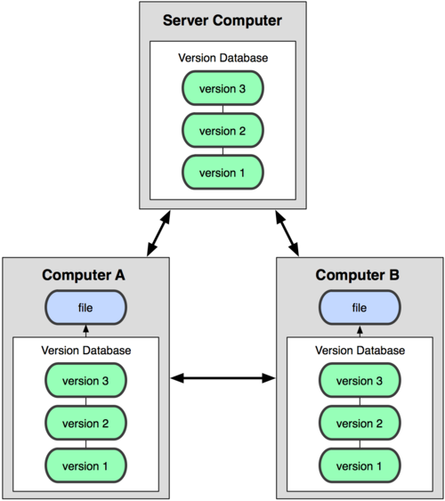
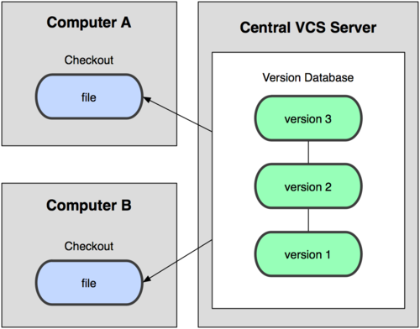
Git uses a distributed model
(CVS, Subversion, Perforce)
(Git, Mercurial)
Centralized Model
Distributed Model
Notes:
http://git-scm.com/book/en/Getting-Started-About-Version-Control

Slide 6
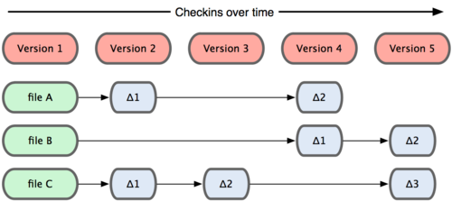
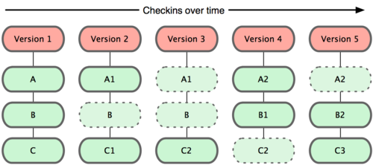
Git takes snapshots
Subversion
Git
Notes:
Every time we do COMMIT, git will save snapshots to disk instead of the delta between the new version to old version of the same file. Even if we just changed one letter of one file, git will save whole file as a snapshot.
It is the replacement term for "Revision". In other version control systems, changes to individual files are tracked and refered to as revisions, but git tracks the entire workspace.
git will cost more disk space than the other vcs (such as subversion) which save delta between the new version to old version of the same file. But the benefits of using snapshot is shorten the time at commit stage.

Slide 7

Git uses checksums
In Subversion each modification to the central repo incremented
the version # of the overall repo.
Instead, Git generates a unique SHA-1 hash – 40 character string
of hex digits, for every commit. Refer to commits by this ID rather
than a version number. Often we only see the first 7 characters:
  1677b2d Edited first line of readme
  258efa7 Added line to readme
  0e52da7 Initial commit

Slide 8

A Local Git project has three areas
Unmodified/modified
Files
Staged
Files
Committed
Files
Note: working directory sometimes called the “working tree”, staging area sometimes called the “index”.
Notes:
Staging is a step before the commit process in git. That is, a commit in git is performed in two steps: staging and actual commit. As long as a changeset is in the staging area, git allows you to edit it as you like (replace staged files with other versions of staged files, remove changes from staging, etc.).

Slide 9
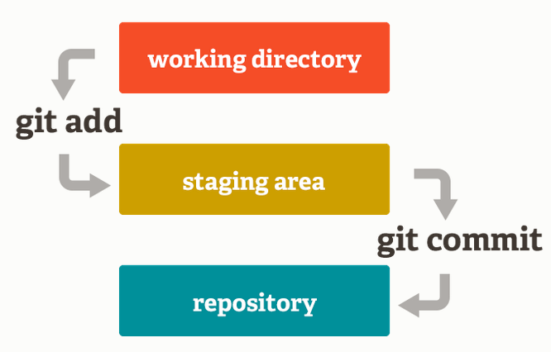
Staging Area
Unlike the other systems, Git has something called the "staging area" or "index". This is an intermediate area where commits can be formatted and reviewed before completing the commit.

Slide 10
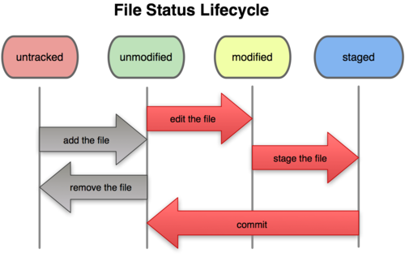
Git file lifecycle
Notes:
”add the file” means to add a file to the directory of Git.
“Git add” means to add a file to staging area.

Slide 11

Basic Workflow
Basic Git workflow:
Modify files in your working directory.
Stage files, adding snapshots of them to your staging area.
Do a commit, which takes the files as they are in the staging area and stores that snapshot permanently to your Git directory.
Notes:
  If it was changed since it was checked out but has not been staged, it is modified.
  If it’s modified but has been added to the staging area, it is staged.
  If a particular version of a file is in the .git directory, it’s considered committed.

Slide 12

Get ready to use Git!
Set the name and email for Git to use when you commit:
$ git config --global user.name “Bugs Bunny”
$ git config --global user.email bugs@gmail.com
You can call git config –list to verify these are set.
These will be set globally for all Git projects you work with.
You can also set variables on a project-only basis by not using the
--global flag.
You can also set the editor that is used for writing commit messages:
$ git config --global core.editor emacs (it is vim by default)

Slide 13

Create a local copy of a repo
Two common scenarios: (only do one of these)
  To clone an already existing repo to your current directory:
$ git clone <url> [local dir name]
This will create a directory named local dir name, containing a working copy of the files from the repo, and a .git directory (used to hold the staging area and your actual repo)
  To create a Git repo in your current directory:
    $ git init
    This will create a .git directory in your current directory.
    Then you can commit files in that directory into the repo:
    $ git add file1.java
    $ git commit –m “initial project version”

Slide 14
Git commands
command | description
git clone url [dir] | copy a git repository so you can add to it
git add files | adds file contents to the staging area
git commit | records a snapshot of the staging area
git status | view the status of your files in the working directory and staging area
git diff | Show changes between commits, commit and working tree, etc
git help [command] | get help info about a particular command
git pull | fetch from a remote repo and try to merge into the current branch
git push | push your new branches and data to a remote repository
others: init, reset, branch, checkout, merge, log, tag
Notes:
git-diff - Show changes between commits, commit and working tree, etc

Slide 15

Committing files
The first time we ask a file to be tracked, and every time before we commit a file we must add it to the staging area:
$ git add README.txt hello.java
This takes a snapshot of these files at this point in time and adds it to the staging area.
To move staged changes into the repo we commit:
$ git commit –m “Fixing bug #22”
  Note: To unstage a change on a file before you have committed it:
  $ git reset HEAD -- filename
  Note: To unmodify a modified file:
  $ git checkout -- filename
Note: These commands are just acting on your local version of repo.

Slide 16

Status and Diff
To view the status of your files in the working directory and staging area:
$ git status or
$ git status –s
(-s shows a short one line version similar to svn)
To see what is modified in the working
directory:
$ git diff
To see staged changes:
$ git diff --cached

Slide 17

After editing a file…
[rea@attu1 superstar]$ emacs rea.txt
[rea@attu1 superstar]$ git status
# On branch master
# Changes not staged for commit:
# (use "git add <file>..." to update what will be committed)
# (use "git checkout -- <file>..." to discard changes in working directory)
#
# modified: rea.txt
#
no changes added to commit (use "git add" and/or "git commit -a")
[rea@attu1 superstar]$ git status -s
M rea.txt ← Note: M is in second column = “working tree”
[rea@attu1 superstar]$ git diff ← Shows modifications that have not been staged.
diff --git a/rea.txt b/rea.txt
index 66b293d..90b65fd 100644
--- a/rea.txt
+++ b/rea.txt
@@ -1,2 +1,4 @@
Here is rea's file.
+
+One new line added.
[rea@attu1 superstar]$ git diff --cached ← Shows nothing, no modifications have been staged yet.
[rea@attu1 superstar]$

Slide 18

After adding file to staging area…
[rea@attu1 superstar]$ git add rea.txt
[rea@attu1 superstar]$ git status
# On branch master
# Changes to be committed:
# (use "git reset HEAD <file>..." to unstage)
#
# modified: rea.txt
#
[rea@attu1 superstar]$ git status -s
M rea.txt ← Note: M is in first column = “staging area”
[rea@attu1 superstar]$ git diff ← Note: Shows nothing, no modifications that have not been staged.
[rea@attu1 superstar]$ git diff --cached ← Note: Shows staged modifications.
diff --git a/rea.txt b/rea.txt
index 66b293d..90b65fd 100644
--- a/rea.txt
+++ b/rea.txt
@@ -1,2 +1,4 @@
Here is rea's file.
+
+One new line added.

Slide 19

Viewing logs
To see a log of all changes in your local repo:
$ git log or
$ git log --oneline (to show a shorter version)
  1677b2d Edited first line of readme
  258efa7 Added line to readme
  0e52da7 Initial commit
git log -5 (to show only the 5 most recent updates, etc.)
Note: changes will be listed by commitID #, (SHA-1 hash)
Note: changes made to the remote repo before the last time you cloned/pulled from it will also be included here

Slide 20

Pulling and Pushing
Good practice:
Add and Commit your changes to your local repo
Pull from remote repo to get most recent changes (fix conflicts if necessary, add and commit them to your local repo)
Push your changes to the remote repo
To fetch the most recent updates from the remote repo into your local repo, and put them into your working directory:
$ git pull origin master
To push your changes from your local repo to the remote repo:
$ git push origin master
Notes: origin = an alias for the URL you cloned from
master = the remote branch you are pulling from/pushing to,
(the local branch you are pulling to/pushing from is your current branch)
Notes:
$ git remote -v
origin https://github.com/rea2000/santalist.git (fetch)
origin https://github.com/rea2000/santalist.git (push)

Slide 21
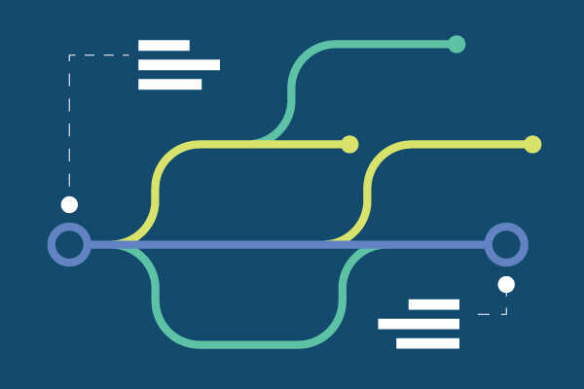
Branching
To create a branch called experimental:
$ git branch experimental
To list all branches: (* shows which one you are currently on)
$ git branch
To switch to the experimental branch:
$ git checkout experimental
Later on, changes between the two branches differ, to merge changes from experimental into the master:
$ git checkout master
$ git merge experimental
Note: git log --graph can be useful for showing branches.
Note: These branches are in your local repo!

Slide 22

Aside: So what is github?
GitHub.com is a site for online storage of Git repositories.
Many open source projects use it, such as the Linux kernel.
You can get free space for open source projects or you can pay for private projects.
Question: Do I have to use github to use Git?
Answer: No!
you can use Git completely locally for your own purposes, or
you or someone else could set up a server to share files, or
you could share a repo with users on the same file system.

Slide 23

Assignment 2
Please finish and take a snapshot for each of the following steps and paste it into the report.
Download and install Git
Set user name and email
Clone or create a Git repository
Create a file
Add the file
Commit the file
Check status and log
Delete and commit the file
Push to repo
Pull from repo

Slide 24
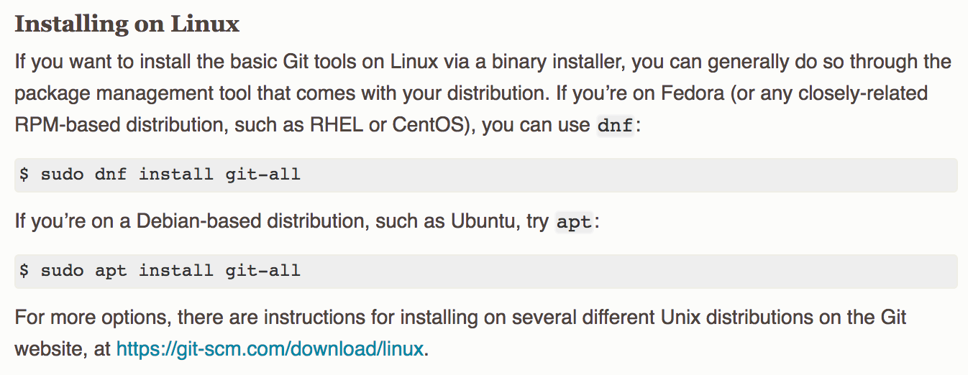

Download & Install Git

Slide 25
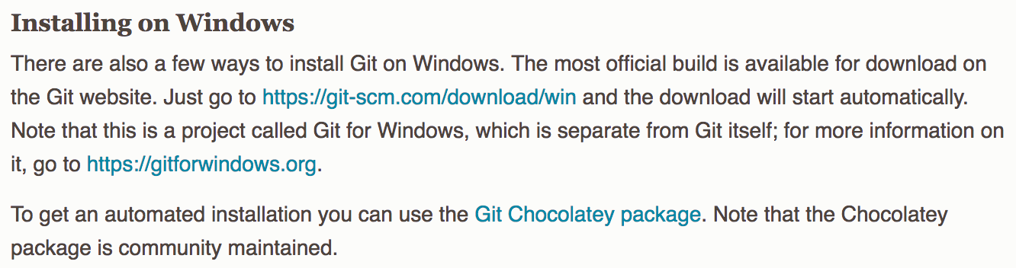

Download & Install Git

Slide 26
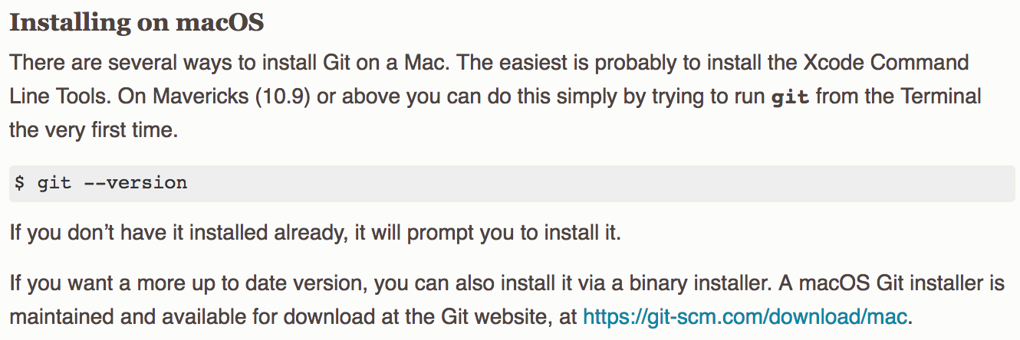

Download & Install Git

