Slide 1
AI-Powered ChatGPT Clone with Intelligent Tool & MCP Integration
Conversational AI
Integrated Tools
Multi-session chat with persistent memory and context awareness
Web search, weather, time, calculator — all in one interface
MCP Architecture
Full-Stack
Standardized, extensible tool integration via Model Context Protocol
React + FastAPI + LangGraph — production-ready deployment
Project Evaluation Presentation

Slide 2
Problem & Use Case
The Challenge
Target Users
Users switch between multiple applications for different tasks — search, weather, calculations, and chat are all siloed
Students & Professionals
Businesses & Support Teams
Traditional chatbots lack real-time information and external tool access, limiting their practical utility
Research, calculations, and real-time lookups in a single session
Automated responses with live data and integrated knowledge
Context and information must be repeatedly provided across sessions, creating friction and inefficiency
Organizations & General Users
No unified conversational interface exists that integrates live data, tools, and persistent memory
Accessible AI assistant with extensible, role-aware capabilities
Our Solution
A single AI assistant combining conversational AI with web search, weather, time, calculations, and personalized memory — all accessible through a natural language interface for seamless task execution.

Slide 3
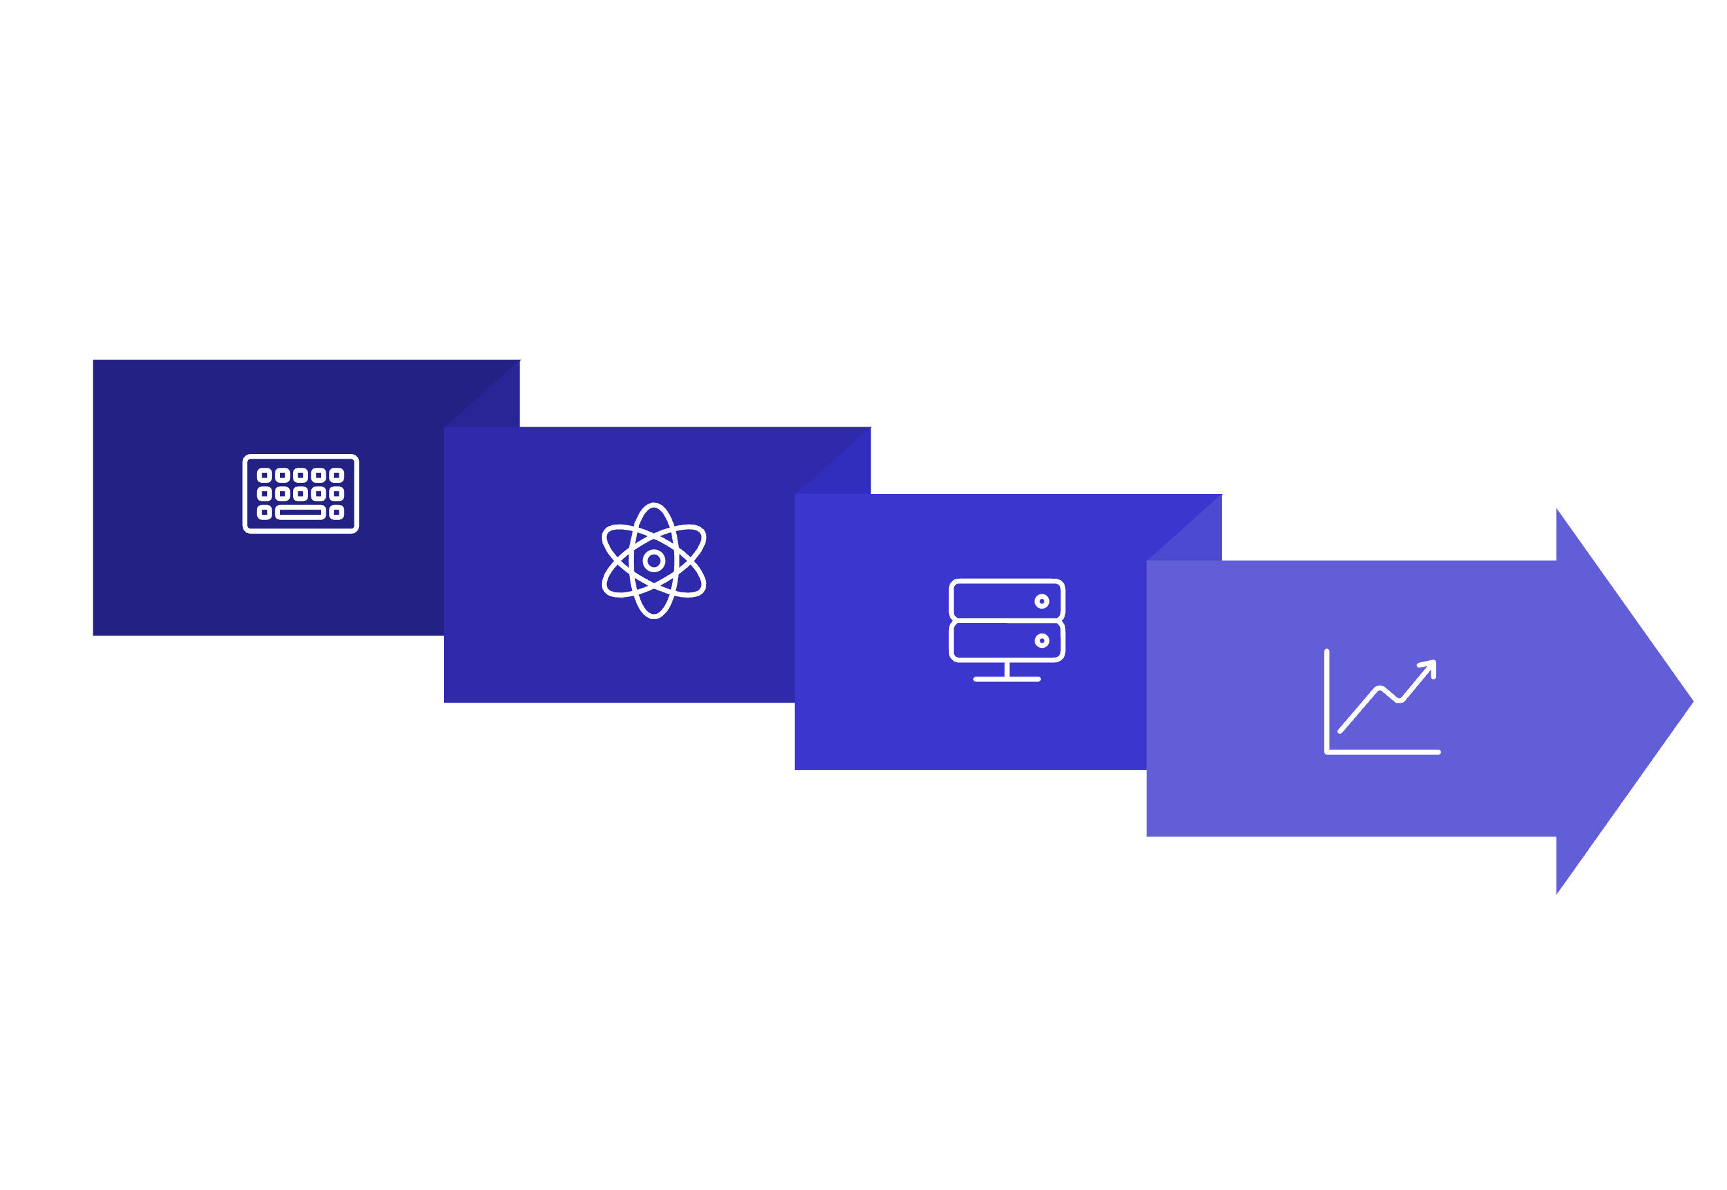
Our Solution
End-to-End Request Flow
React Frontend
LangGraph Workflow
User Input
FastAPI Backend
Full-Stack Architecture
Core Capabilities
Frontend
Backend
React + Vite for a responsive, fast-loading conversational UI
FastAPI for high-performance, async API serving
Multi-Session Chat
Web Search
Orchestration
Integration
Persistent conversation history across sessions
Real-time results via SerpAPI integration
LangGraph for intelligent, stateful workflow management
MCP server for standardized, extensible tool integration
User Memory
Tool Suite
Personalized context retained across conversations
Weather, time, calculator — extensible via MCP

Slide 4
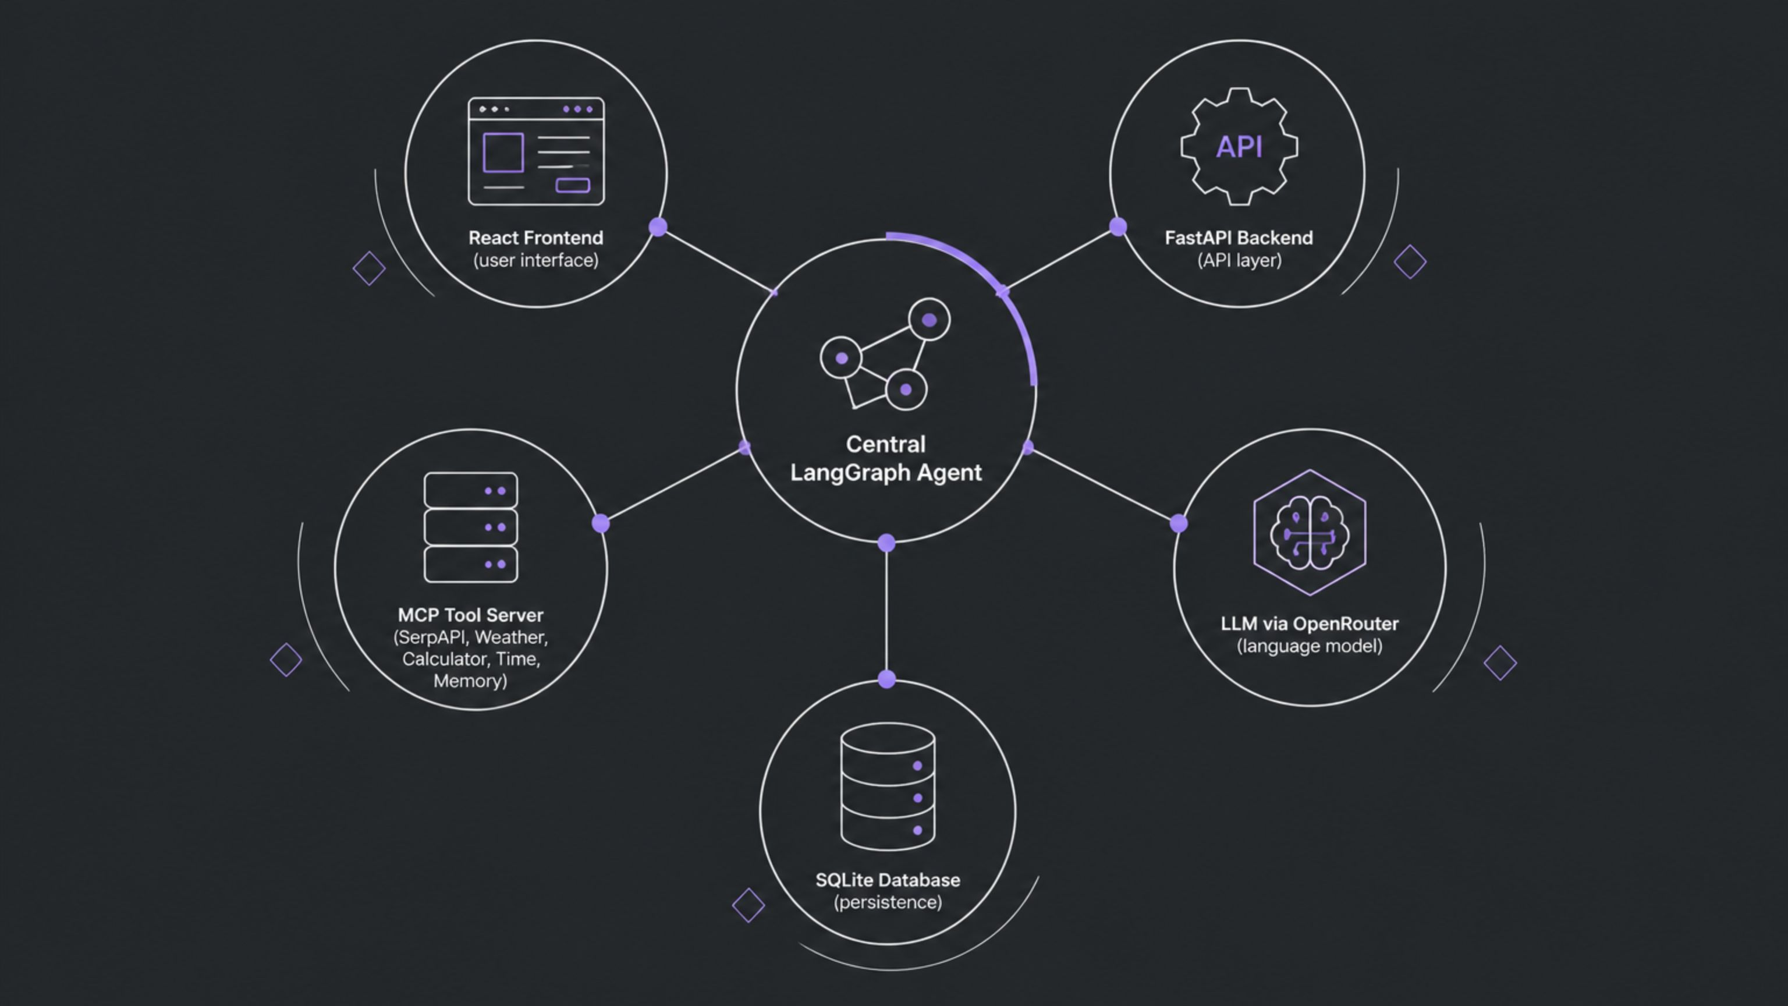
System Architecture & Components
Technology Stack
Key Architectural Components
Layer
1
LangGraph Agent Workflow
Technologies
Frontend
React.js, Vite, JavaScript, CSS, Axios
Stateful, graph-based orchestration for intelligent routing of user requests to the appropriate tool or LLM response path
Backend
Python, FastAPI, Uvicorn, SQLAlchemy, SQLite
2
MCP Client ↔ MCP Server
AI / Agent
LLM, LangGraph, OpenRouter
Standardized Model Context Protocol bridge enabling modular, plug-and-play tool integration without core system changes
Tools
SerpAPI, Weather, Calculator, Time, Memory, MCP
Deployment
3
Database Layer
Docker, Git, GitHub, Render
SQLAlchemy-managed schema covering users, chat sessions, messages, and feedback for full data persistence
4
Dynamic Tool Router
Runtime capability selection — the agent identifies and invokes the correct tool based on natural language intent

Slide 5
Expected Value & Future Scope
Immediate Benefits
Future Enhancements
One interface for multiple tasks — search, weather, time, calculations, and conversation unified in a single session
Additional MCP Integrations
Reduced context switching between applications, lowering cognitive load and improving productivity
Expand the tool ecosystem with new MCP server connections for broader capability coverage
Faster information retrieval with integrated real-time tools responding within the conversational flow
Enterprise Knowledge Base
Integrate organizational documents and internal data sources for domain-specific intelligence
Personalized conversations through persistent user memory that retains preferences and prior context
Extensible architecture — new AI tools can be added via MCP without restructuring the core system
Voice-Based Interaction
Speech-to-text and text-to-speech for hands-free, accessible conversational AI
Advanced Personalization & RBAC
Role-based access control and user-specific AI behavior for enterprise deployments
Analytics & Enterprise Scale
Usage dashboards, monitoring, and infrastructure scaling for organizational adoption
Vision: From a simple chatbot to an extensible AI assistant platform.

