Slide 1

MySQL
What is SQL?
SQL is Structured Query Language, which is a computer language for storing, manipulating and retrieving data stored in a relational database.
What is RDBMS?
RDBMS stands for Relational Database Management System. RDBMS is the basis for SQL, and for all modern database systems like MS SQL Server, IBM DB2, Oracle, MySQL, and Microsoft Access.

Slide 2
MySQL
SQL Sub Languages
DDL - Data Definition Language
1. Create 2. Alter 3. Drop
DML - Data Manipulation Language
1. Select 2. Insert 3. Delete 4. Update
DCL - Data Control Language
1. Grant 2. Revoke
TCL - Transaction Control Language
1. Commit 2. Rollback 3. Savepoint
Notes:
Ref Note : 1 to 233

Slide 3
MySQL
Database Normalization
Database normalization is the process of efficiently organizing data in a database. There are two reasons of this normalization process −
Eliminating redundant data, for example, storing the same data in more than one table.
Ensuring data dependencies make sense.
First Normal Form (1NF)
Second Normal Form (2NF)
Third Normal Form (3NF)

Slide 4
MySQL
SQL – Datatypes
Datatype | Use
INT | used for columns which will store integer values.
FLOAT | used for columns which will store float values.
DOUBLE | used for columns which will store float values.
VARCHAR | used for columns which will be used to store any characters and integers, basically a string.
CHAR | used for columns which will store char values(single character).
DATE | used for columns which will store date values.
TEXT | used for columns which will store text which is generally long in length. For example, paragraph’s.

Slide 5
MySQL
SQL – Datatypes
Operator | Description
= | Equal to
!= | Not Equal to
< | Less than
> | Greater than
<= | Less than or Equal to
>= | Greater than or Equal to
BETWEEN | Between a specified range of values
LIKE | This is used to search for a pattern in value.
IN | In a given set of values
Union, Union All | used to combine the result-set of two or more SELECT statements.
Notes:
Ref notes : 705 to 715 & 301(like) to 330(between) & 360 to 412 (Union)

Slide 6
MySQL
SQL Constraints
Constraints are the rules enforced on data columns on a table.
NOT NULL Constraint − Ensures that a column cannot have a NULL value.
DEFAULT Constraint − Provides a default value for a column when none is specified.
UNIQUE Constraint − Ensures that all the values in a column are different.
PRIMARY Key − Uniquely identifies each row/record in a database table.
FOREIGN Key − Uniquely identifies a row/record in any another database table.
CHECK Constraint − The CHECK constraint ensures that all values in a column satisfy certain conditions.
INDEX − Used to create and retrieve data from the database very quickly.
Notes:
Ref Notes : 445 to 697

Slide 7
MySQL
Difference Between Drop, Delete and Truncate
Delete | Truncate | Drop
Delete is a DML command | Delete is a DDL command | Delete is a DDL command
Delete is used to delete the particular records in the table | Truncate is used to delete the entire table data and keep the table structure as it is | Drop is used to drop the entire table data with structure
Delete statement use the where clause to delete particular records | Truncate can’t use with where clause | Drop can’t use with where clause
Delete statement can be rollback before the commit | Can’t rollback | Can’t rollback
Notes:
Ref notes : 89 to 113

Slide 8
MySQL
SQL Aggregate Functions
COUNT - counts how many rows are in a particular column.
SUM - adds together all the values in a particular column.
MIN, MAX - return the lowest and highest values in a particular column, respectively.
AVG calculates the average of a group of selected values.
Notes:
Ref notes : 339 to 357

Slide 9
MySQL
The SQL SELECT DISTINCT Statement
The SELECT DISTINCT statement is used to return only distinct (different) values.
Example
SELECT DISTINCT Country FROM Customers;
SQL Aliases
SQL aliases are used to give a table, or a column in a table, a temporary name.
Example
SELECT CustomerID AS ID
FROM Customers;
Notes:
Ref notes : 748 to 750 & 699 to 701

Slide 10
MySQL
SQL CREATE VIEW Examples
Generally it creates temporary shorthand name for particular whole query.
The following SQL creates a view that shows all customers from Brazil:
Example
CREATE VIEW [Brazil Customers] AS
SELECT CustomerName, ContactName
FROM Customers
WHERE Country = 'Brazil';
Notes:
Ref notes : 716 to 737

Slide 11
MySQL
SQL CASE Statement
The CASE statement goes through conditions and returns a value when the first condition is met (like an IF-THEN-ELSE statement). So, once a condition is true, it will stop reading and return the result. If no conditions are true, it returns the value in the ELSE clause.
If there is no ELSE part and no conditions are true, it returns NULL.
CASE Syntax
SELECT OrderID, Quantity, CASE WHEN Quantity > 30 THEN 'The quantity is greater than 30' WHEN Quantity = 30 THEN 'The quantity is 30' ELSE 'The quantity is under 30' END
AS QuantityResult FROM OrderDetails;
Notes:
Ref notes : 413 to 422

Slide 12
MySQL
SQL ORDER BY
The ORDER BY keyword is used to sort the result-set in ascending or descending order.
Syntax
SELECT column1, column2, ...
FROM table_name
ORDER BY column1, column2, ... ASC|DESC;
Notes:
Ref notes : 425 to 443

Slide 13
MySQL
The SQL HAVING Clause
The HAVING clause was added to SQL because the WHERE keyword cannot be used with aggregate functions.
Syntax
SELECT column_name(s)
FROM table_name
WHERE condition
GROUP BY column_name(s)
HAVING condition
ORDER BY column_name(s);
Notes:
Ref notes : 767 to 782

Slide 14
MySQL
SQL GROUP BY
The GROUP BY statement is often used with aggregate functions (COUNT(), MAX(), MIN(), SUM(), AVG()) to group the result-set by one or more columns.
Syntax
SELECT column_name(s)
FROM table_name
WHERE condition
GROUP BY column_name(s)
ORDER BY column_name(s);
Notes:
Ref notes : 753 to 765

Slide 15
MySQL
MySQL Subqueries Statement
You can write a query with in a query in MySQL this is known as a subquery.
Usually, a sub query is embedded within the where clause.
A subquery is used to return data that will be used in the main query as a condition to further restrict the data to be retrieved.
Following are the rules to be followed while writing subqueries −
The subqueries must be enclosed within parentheses.
An ORDER BY command cannot be used in a subquery, we can use the GROUP BY clause instead.
A subquery cannot be immediately enclosed in a set function.
Notes:
Ref notes : 784 to 794

Slide 16
MySQL
SQL JOIN
A JOIN clause is used to combine rows from two or more tables, based on a related column between them.
Different Types of SQL JOINs
CROSS JOIN: combines each row from the first table with each row of the second table.
NATURAL JOIN: which is based on column having same name and same datatype present in both the tables to be joined.
INNER(Equi) JOIN: Returns records that have matching values in both tables
LEFT (OUTER) JOIN: Returns all records from the left table, and the matched records from the right table
RIGHT (OUTER) JOIN: Returns all records from the right table, and the matched records from the left table
FULL (OUTER) JOIN: Returns all records when there is a match in either left or right table
Notes:
Ref notes : 797 to 835

Slide 17
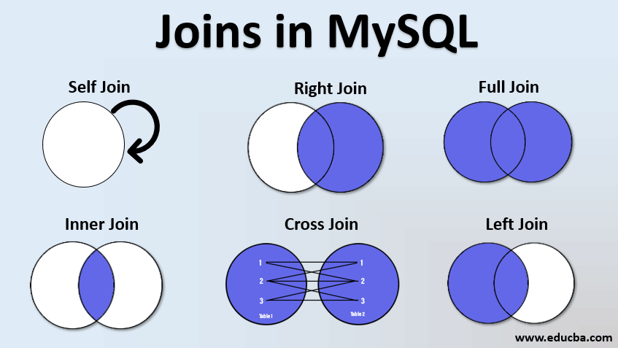
MySQL
SQL JOIN

Slide 18
MySQL
Thank You
MySQL

