Slide 1
BIOMETRIC
ATTENDANCE
SYSTEM
JAYAPPRATHA N
PYTHON FULLSTACK DEVELOPMENT

Slide 2
OBJECTIVES
• Automate student attendance tracking
• Record intime of each student
• Mark attendances as Present or Absent
based on cutoff time
• Display daily attendance reports

Slide 3
INTRODUCTION
• The Biometric Attendance System is a Python-based application that helps record and manage student attendance using biometric IDs. It automatically marks attendance based on the time of biometric scan.

Slide 4
SYSTEM FEATURES
• User-friendly console interface
• Real-time attendance marking
• Cutoff time-based attendance status
• Automatic absent marking after cutoff
• Daily attendance report generation

Slide 5
TECHNOLOGIES USED
• Python 3
• Datetime module
• Dictionary data structures for student record
• Console input/output for interaction

Slide 6
SYSTEM FLOW
• Display Main Menu
• Scan Biometric ID
• Record Intime and Status
• Automatically mark absentees after cutoff
• View attendance report

Slide 7
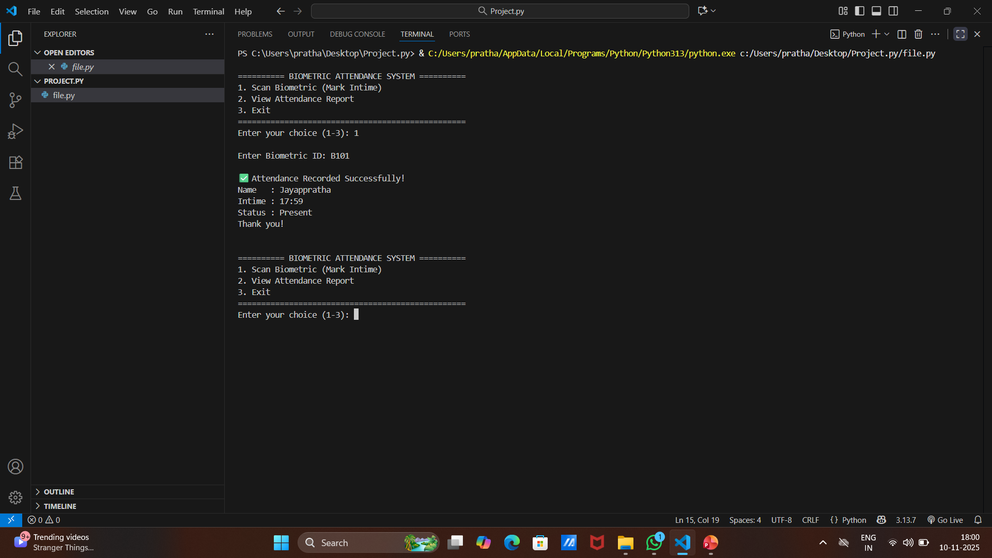
SAMPLE OUTPUT

Slide 8
FUTURE IMPROVEMENTS
• Integrate fingerprint scanner hardware for real biometric input
• Add database (e.g., MySQL or SQLite) for data storage
• Enable attendance export to Excel or PDF
• Implement face recognition for contactless attendance
• Add notification system for absent students
• Provide admin dashboard for attendance analytics

Slide 9
CONCLUSION
• The Biometric Attendance System automates attendance management, reducing manual effort and errors. It can be expanded with database integration, GUI support, and hardware connectivity for real-world deployment.

Slide 10
--- THANK YOU ---

