Slide 1
Mass-storage structure-overview of mass storage structure
Magnetic disks-the bulk of secondary storage, platter, disk arm, tracks, sectors, cylinder.
The transfer rate is the rate at which data flow between the drive and the computer
The positioning time, or random-access time, consists of two parts:
the time necessary to move the disk arm to the desired cylinder, called the seek time, and
the time necessary for the desired sector to rotate to the disk head, called the rotational latency.
head crash- the head will sometimes damage the magnetic surface.

Slide 2
Solid state disks
an SSD is nonvolatile memory that is used like a hard drive.
The new solid-state drives work completely differently. They use a simple memory chip called NAND flash memory, which has no moving parts and near-instant access times.
SSDs have the same characteristics as traditional hard disks but can be more reliable because they have no moving parts and faster because they have no seek time or latency

Slide 3
Magnetic Tapes
its access time is slow compared with that of main memory and magnetic disk.
In addition, random access to magnetic tape is about a thousand times slower than random access to magnetic disk, so tapes are not very useful for secondary storage.
Tapes are used mainly for backup, for storage of infrequently used information, and as a medium for transferring information from one system to another.

Slide 4
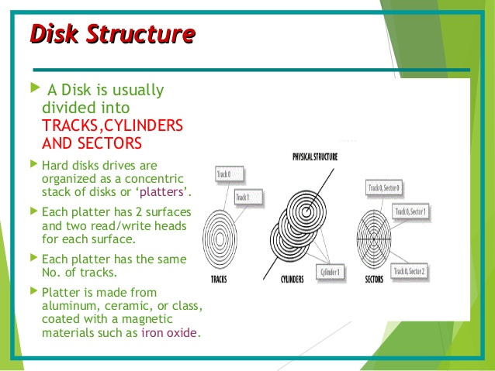
Disk structure
Constant linear velocity (CLV), the density of bits per track is uniform.

Slide 5
The drive increases its rotation speed as the head moves from the outer to the inner tracks to keep the same rate of data moving under the head
Alternatively, the disk rotation speed can stay constant;
in this case, the density of bits decreases from inner tracks to outer tracks to
keep the data rate constant. This method is used in hard disks and is known as
constant angular velocity (CAV).

Slide 6
Disk attachment
Computers access disk storage
I/O ports (or
host-attached storage),common on small systems
network-attached
Storage,a remote host in a distributed file system

Slide 7
Host-Attached Storage
accessed through local I/O ports.
The typical desktop PC uses an I/O bus architecture called IDE or ATA.
similar protocol that has simplified cabling is SATA.
High-end workstations and servers generally use more sophisticated I/O architectures such as fibre channel (FC), a high-speed serial architecture that can operate over optical fiber or over a four-conductor copper cable.
hard disk drives, RAID arrays, and CD, DVD, and tape drives.
The Serial ATA or SATA connector is used as an interface for
connecting a host bus adapter to a mass storage device or optical drive.

Slide 8
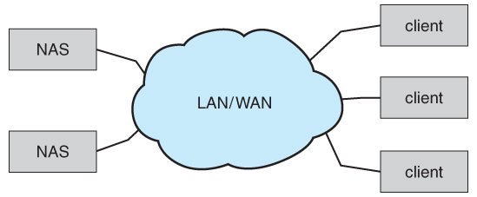
Network –Attached storage
A network-attached storage (NAS) device is a special-purpose storage system that is accessed remotely over a data network
The remote procedure calls (RPCs) are carried via TCP or UDP over an IP network—usually the same localarea network (LAN) that carries all data traffic to the clients.

Slide 9
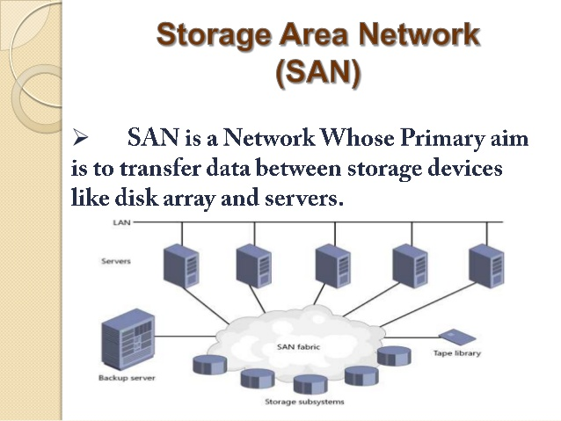
Storage Area Network

Slide 10
One drawback of network-attached storage systems is that the storage I/O operations consume bandwidth on the data network, thereby increasing the latency of network communication.
the communication between servers and clients competes for bandwidth with the communication among servers and storage devices.
Astorage-area network (SAN) is a private network (using storage protocols rather than networking protocols) connecting servers and storage units,
Multiple hosts and multiple storage arrays can attach to the same SAN, and storage can be dynamically allocated to hosts.

Slide 11
Disk Scheduling
Disk scheduling is done by operating systems to schedule I/O requests arriving for the disk. Disk scheduling is also known as I/O scheduling.
Disk scheduling is important because:
Multiple I/O requests may arrive by different processes and only one I/O request can be served at a time by the disk controller. Thus other I/O requests need to wait in the waiting queue and need to be scheduled.
Two or more request may be far from each other so can result in greater disk arm movement.
Hard drives are one of the slowest parts of the computer system and thus need to be accessed in an efficient manner.

Slide 12
Seek Time:Seek time is the time taken to locate the disk arm to a specified track where the data is to be read or write. So the disk scheduling algorithm that gives minimum average seek time is better.
Rotational Latency: Rotational Latency is the time taken by the desired sector of disk to rotate into a position so that it can access the read/write heads. So the disk scheduling algorithm that gives minimum rotational latency is better.
Transfer Time: Transfer time is the time to transfer the data. It depends on the rotating speed of the disk and number of bytes to be transferred.
Disk Access Time: Disk Access Time is:
Disk Access Time = Seek Time + Rotational Latency + Transfer Time
Disk Response Time: Response Time is the average of time spent by a request waiting to perform its I/O operation. Average Response time is the response time of the all requests. Variance Response Time is measure of how individual request are serviced with respect to average response time. So the disk scheduling algorithm that gives minimum variance response time is better.

Slide 13
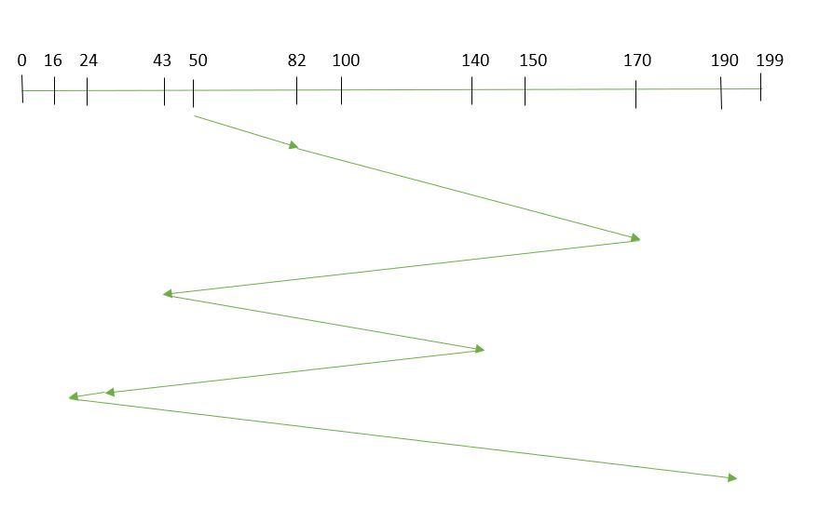
FCFS Scheduling
the requests are addressed in the order they arrive in the disk Example: Suppose the order of request is- (82,170,43,140,24,16,190).And current position of Read/Write head is : 50
So, total seek time: =(82-50)+(170-82)+(170-43)+(140-43)+(140-24)+(24-16)+(190-16) =642

Slide 14
FCFS Scheduling
Advantages:
Every request gets a fair chance
No indefinite postponement
Disadvantages:
Does not try to optimize seek time
May not provide the best possible service

Slide 15
shortest-seek-time-first (SSTF) algorithm.
SSTF: In SSTF (Shortest Seek Time First), requests having shortest seek time are executed first. So, the seek time of every request is calculated in advance in the queue and then they are scheduled according to their calculated seek time. As a result, the request near the disk arm will get executed first. SSTF is certainly an improvement over FCFS as it decreases the average response time and increases the throughput of system. Example:
Suppose the order of request is- (82,170,43,140,24,16,190) And current position of Read/Write head is : 50
Advantages:
Average Response Time decreases
Throughput increases
Disadvantages:
Overhead to calculate seek time in advance
Can cause Starvation for a request if it has higher seek time as compared to incoming requests
High variance of response time as SSTF favours only some requests

Slide 16
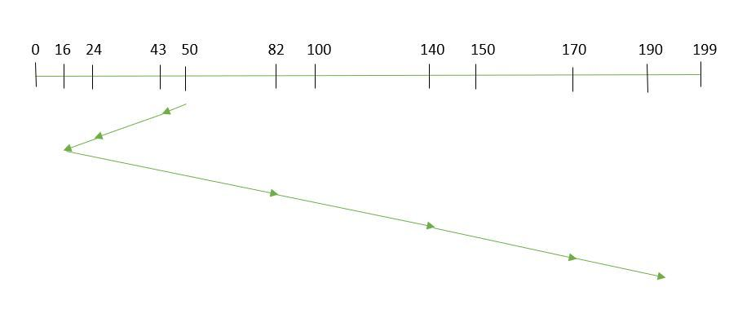
next closest request is selected to previous position.
So, total seek time:
=(50-43)+(43-24)+(24-16)+(82-16)+(140-82)+(170-40)+(190-170) =208

Slide 17
SCAN
In SCAN algorithm the disk arm moves into a particular direction and services the requests coming in its path and after reaching the end of disk, it reverses its direction and again services the request arriving in its path. So, this algorithm works as an elevator and hence also known as elevator algorithm. As a result, the requests at the midrange are serviced more and those arriving behind the disk arm will have to wait. Example:
Suppose the requests to be addressed are-82,170,43,140,24,16,190. And the Read/Write arm is at 50, and it is also given that the disk arm should move “towards the larger value”.
Advantages:
High throughput
Low variance of response time
Average response time
Disadvantages:
Long waiting time for requests for locations just visited by disk arm

Slide 18
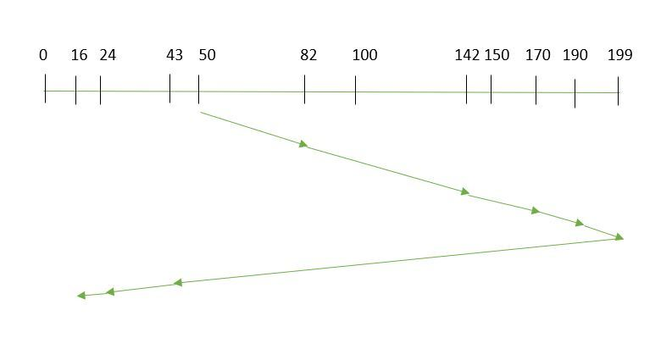
Therefore, the seek time is calculated as:
=(199-50)+(199-16) =332

Slide 19
CSCAN
In SCAN algorithm, the disk arm again scans the path that has been scanned, after reversing its direction. So, it may be possible that too many requests are waiting at the other end or there may be zero or few requests pending at the scanned area.
These situations are avoided in CSCAN algorithm in which the disk arm instead of reversing its direction goes to the other end of the disk and starts servicing the requests from there. So, the disk arm moves in a circular fashion and this algorithm is also similar to SCAN algorithm and hence it is known as C-SCAN (Circular SCAN).
Example:
Suppose the requests to be addressed are-82,170,43,140,24,16,190. And the Read/Write arm is at 50, and it is also given that the disk arm should move “towards the larger value”.
Advantages:
Provides more uniform wait time compared to SCAN

Slide 20
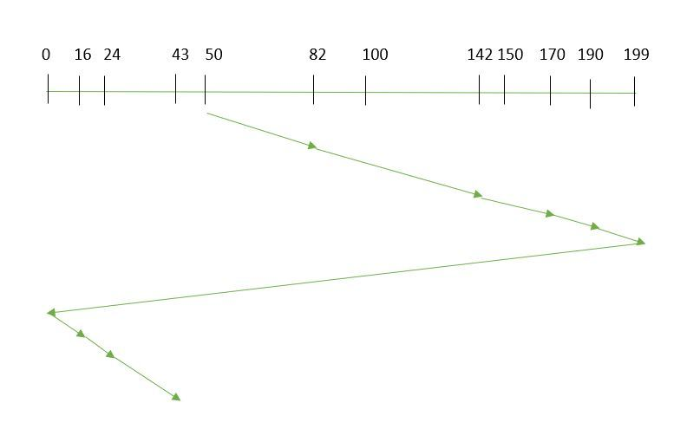
Seek time is calculated as:
=(199-50)+(199-0)+(43-0) =391

Slide 21
LOOK: It is similar to the SCAN disk scheduling algorithm except for the difference that the disk arm in spite of going to the end of the disk goes only to the last request to be serviced in front of the head and then reverses its direction from there only. Thus it prevents the extra delay which occurred due to unnecessary traversal to the end of the disk.
Example:
Suppose the requests to be addressed are-82,170,43,140,24,16,190. And the Read/Write arm is at 50, and it is also given that the disk arm should move “towards the larger value”.
C-LOOK scheduling:similar to CSCAN

Slide 22
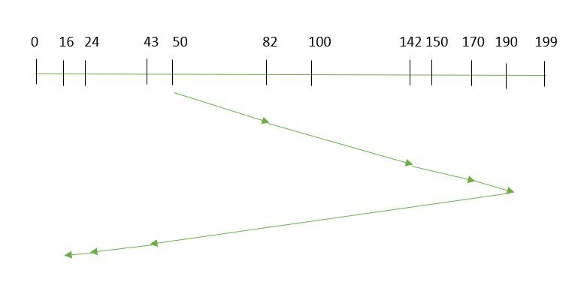
So, the seek time is calculated as:
=(190-50)+(190-16) =314

Slide 24
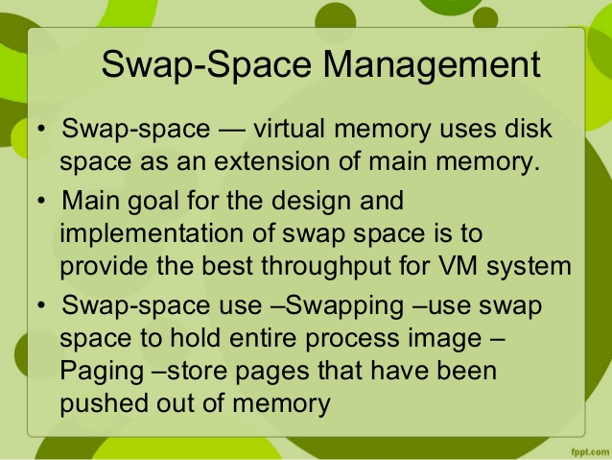
Swap-Space Management

Slide 25
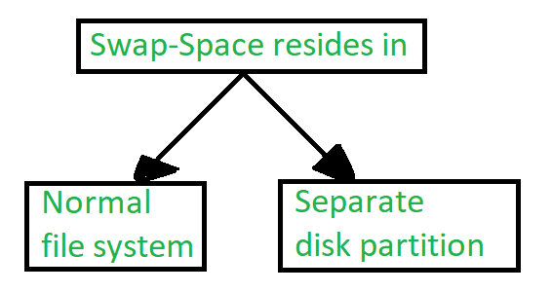
If the swap space is simply a large file within the file system, normal file-system routines can be used to create it, name it, and allocate its space.
2)a separate swap-space storage manager is used to allocate and deallocate the blocks from the raw partition(Disk partition)

Slide 26
Swap-Space Management: An Example
The traditional UNIX kernel started with an implementation of swapping that copied entire process between contiguous disk regions and memory. UNIX later evolve to a combination of swapping and paging as paging hardware became available. In Solaris, the designers changed standard UNIX methods to improve efficiency. More changes were made in later versions of Solaris, to improve the efficiency.
Linux is almost similar to Solaris system. In both the systems the swap space is used only for anonymous memory, it is that kind of memory which is not backed by any file. In the Linux system, one or more swap areas are allowed to be established. A swap area may be in either in a swap file on a regular file system or a dedicated file partition.

Slide 27
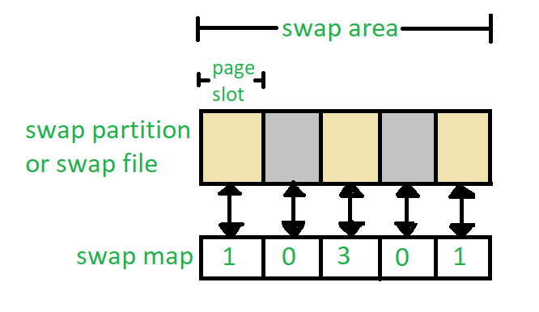
Each swap area consists of 4-KB page slots, which are used to hold the swapped pages. Associated with each swap area is a swap-map- an array of integers counters, each corresponding to a page slot in the swap area. If the value of the counter is 0 it means page slot is occupied by swapped page. The value of counter indicates the number of mappings to the swapped page. For example, a value 3 indicates that the swapped page is mapped to the 3 different processes.

Slide 28
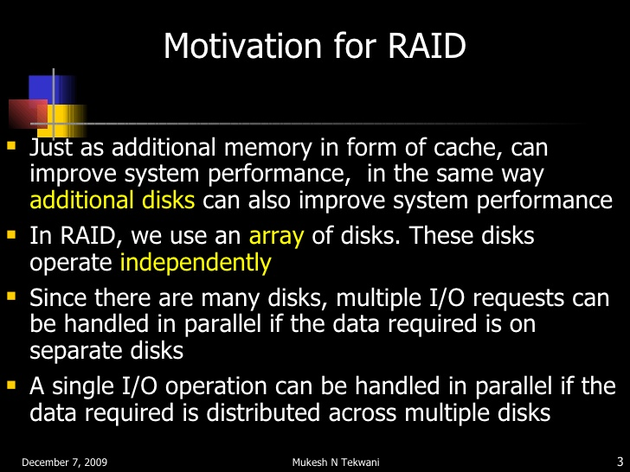
RAID Structure
redundant arrays of independent disks (RAID)

Slide 29
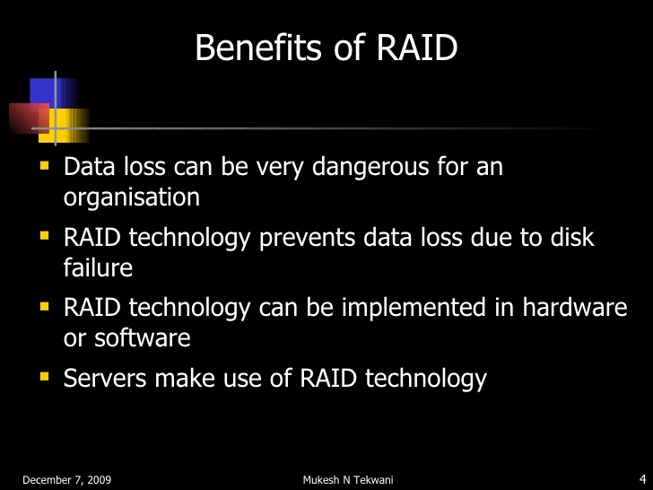

Slide 30
The simplest (but most expensive) approach to introducing redundancy is to duplicate every disk. This technique is called mirroring
data striping consists of splitting the bits of each byte across multiple disks; such striping is called bit-level striping
In block-level striping, for instance, blocks of a file are striped
across multiple disks; with n disks, block i of a file goes to disk (i mod n) + 1.
Other levels of striping, such as bytes of a sector or sectors of a block, also are possible

Slide 31
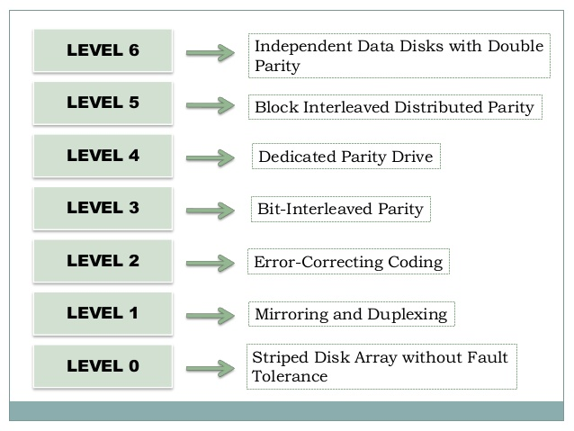

Slide 32
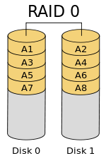

non-redundant striping.
mirrored disks.

Slide 33
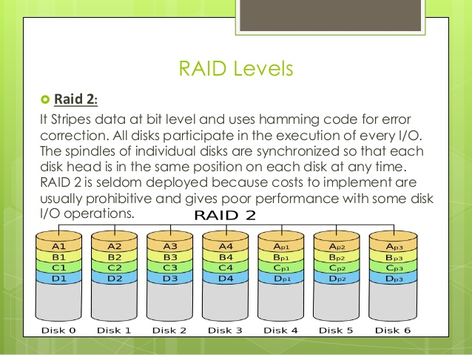

Slide 34
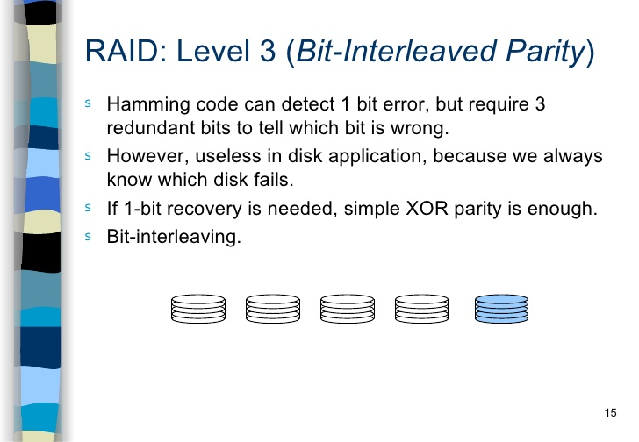

Slide 35
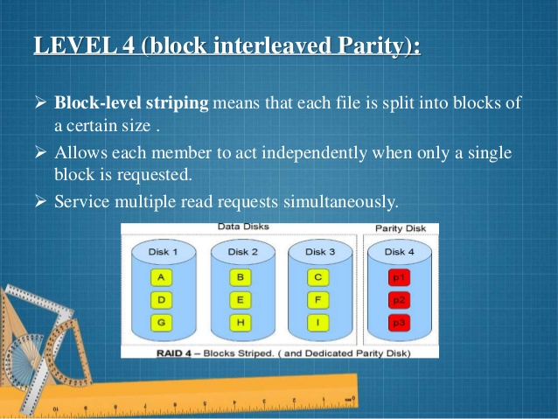

Slide 36
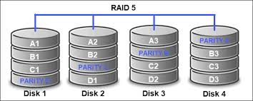

Slide 37
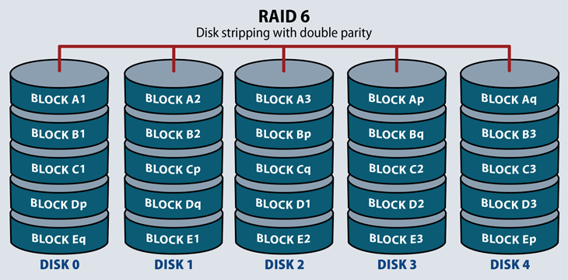

Slide 38
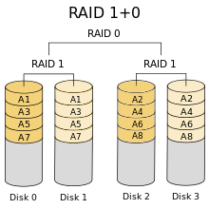

Slide 39
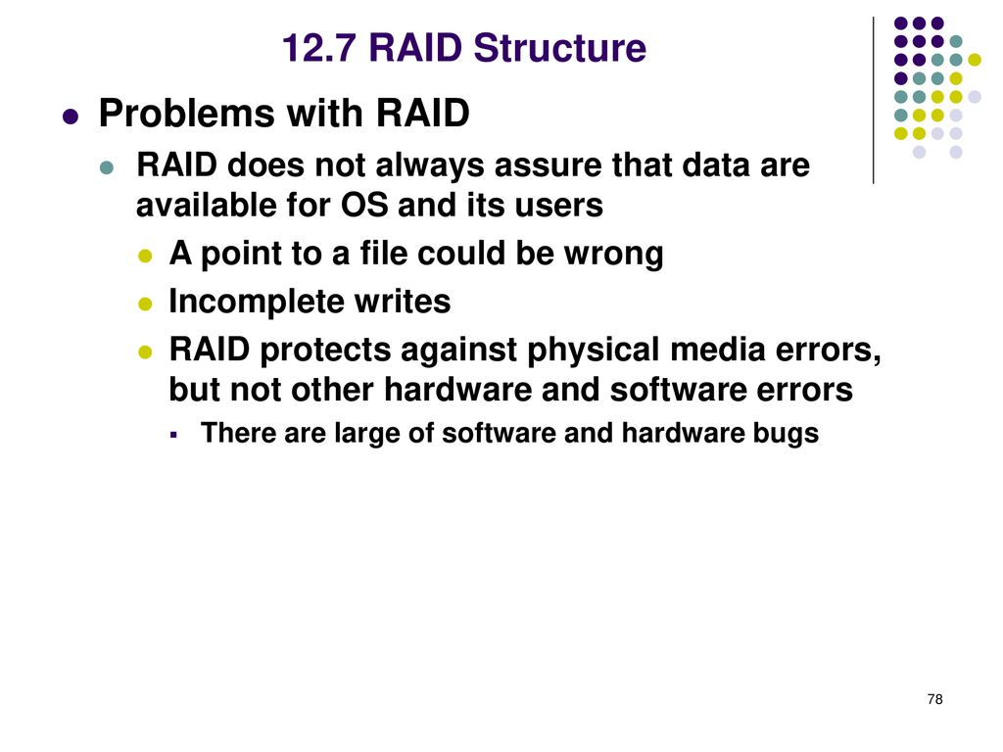

Slide 40
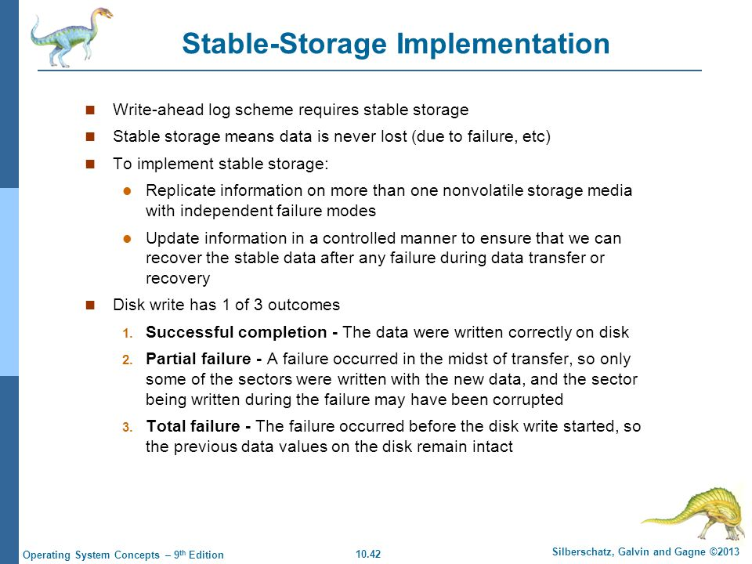

Slide 41
Whenever a failure occurs during writing of a block, the system needs to
detect it and invoke a recovery procedure to restore the block to a consistent
state. To do that, the system must maintain two physical blocks for each logical
block. An output operation is executed as follows:
1. Write the information onto the first physical block.
2. When the first write completes successfully, write the same information
onto the second physical block.
3. Declare the operation complete only after the second write completes
successfully.

