Slide 1
CAPSTONE PROJECT
DOCONNECT
GROUP-6
TRAINER DIMPLE GULATI
TEAM MEMBERS Tammineedi Satya Sai Mani Tejaswini Jayapradha Chinnakann Perarivalan L Rebbas Manoj Kumar

Slide 2
SYNOPSIS
Introduction
Tools /Application Used
Database Structure
Spring Boot Structure
Angular Structure
ScreenShots
Conclusion

Slide 3
INTRODUCTION
Questioning is an art which leads to gaining of exceptional knowledge.
This is the website where you will get your answers for all your queries.
This website helps you to do the art wisely and get queries answered.
In this website one can post their question other when answered by other user to the same ,they can view the answer at any time.
This website allows one to post the question and also post the answer for the question posted by others.

Slide 4
Tools/Application used
FRONT END
Tool : The Angular CLI (Command Line Tool)
Design/Styling : Bootstrap, HTML, CSS
Language : Typescript

Slide 5
Tools/Application used
BACK END
Tool : STS (Spring Tool Site)
Language : JAVA Programming Language
Database : MySQL

Slide 6
Tables in Database
Admin
Hibernate-Sequence
Ques-Ans
User
User-Ques-Ans

Slide 7
Spring boot structure
Packages
Controller
Main
Entity
Repository
Service

Slide 8
Angular Structure
Components
Services
Environment
Routing
Models

Slide 9
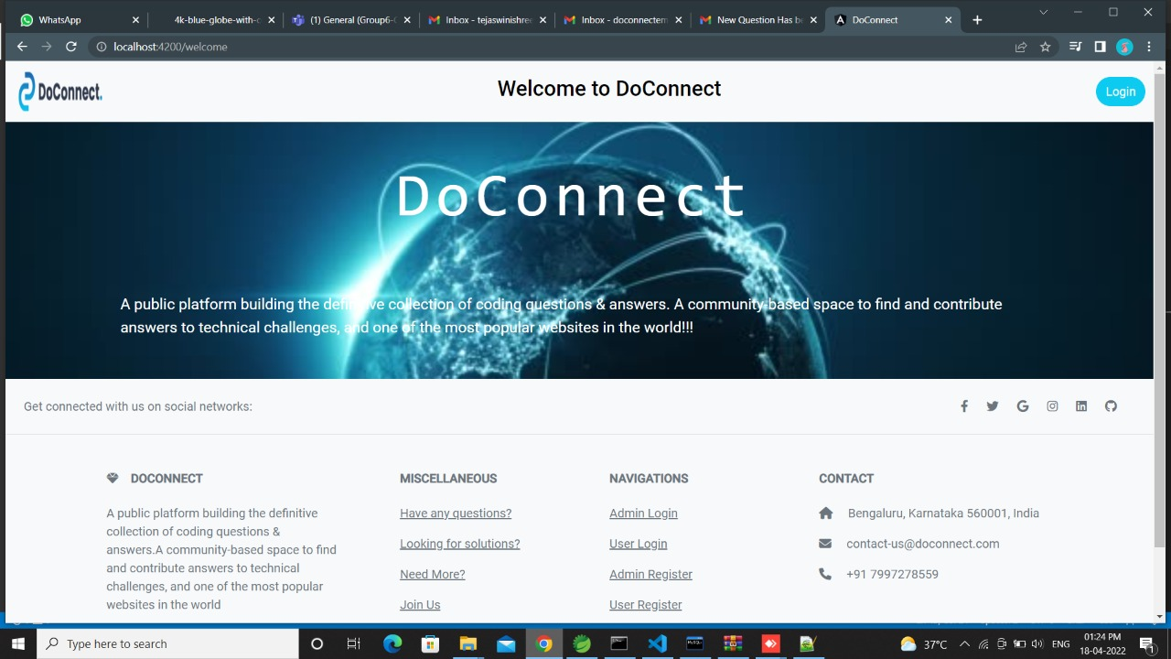
WELCOME PAGE

Slide 10
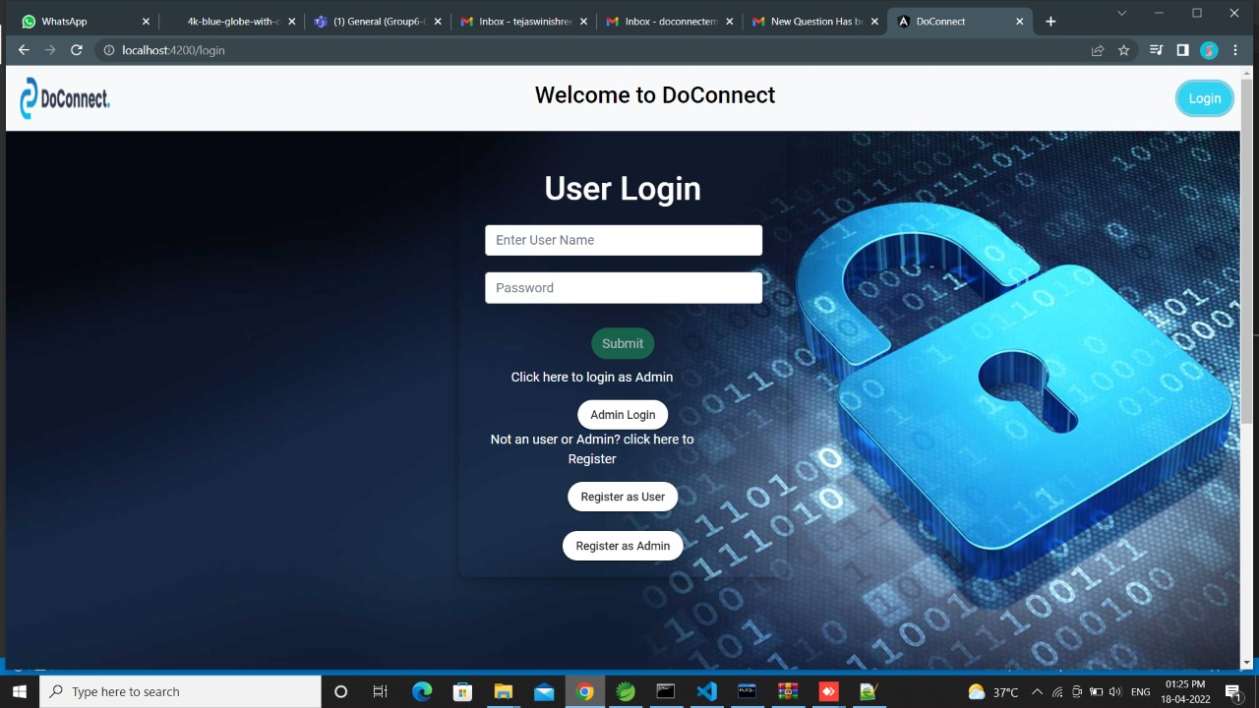
USER LOGIN PAGE

Slide 11
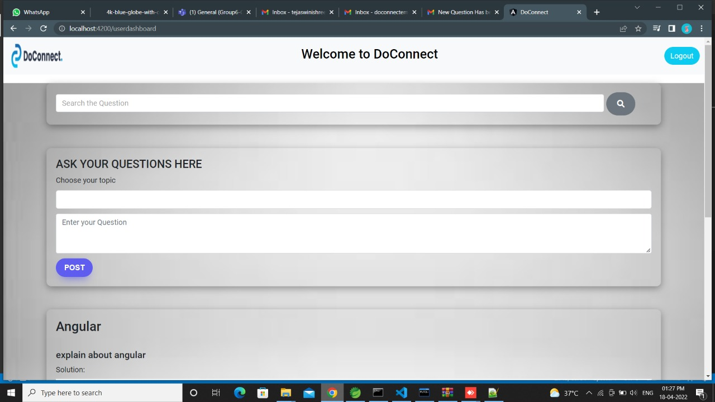
USER DASHBOARD

Slide 12
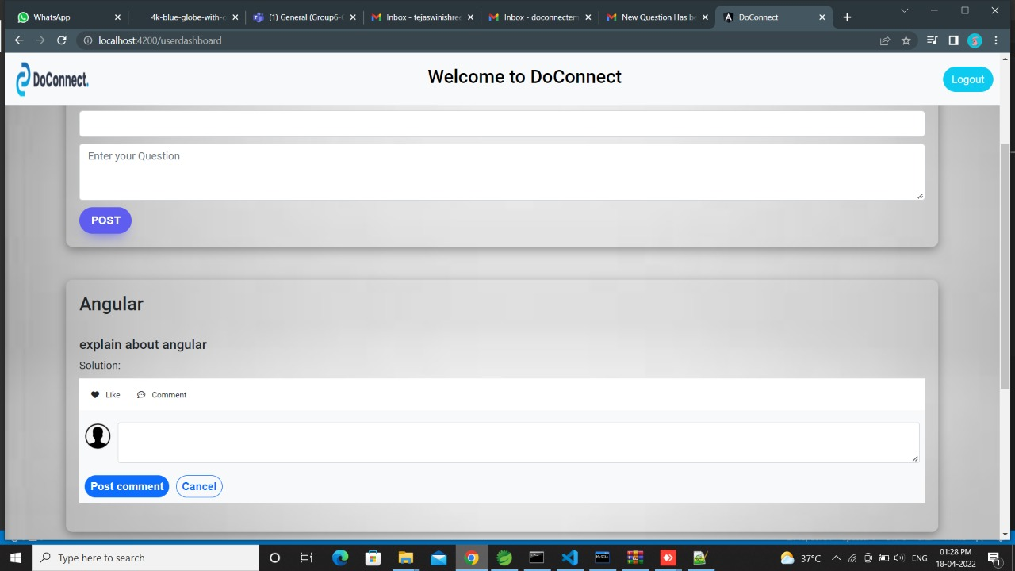
USER DASHBOARD

Slide 13
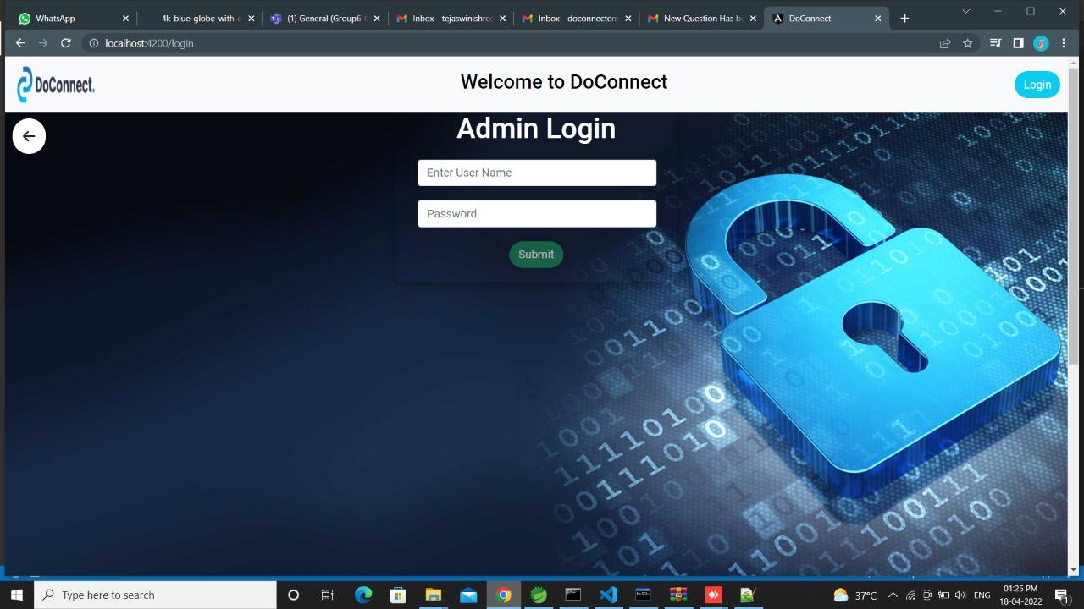
ADMIN LOGIN PAGE

Slide 14
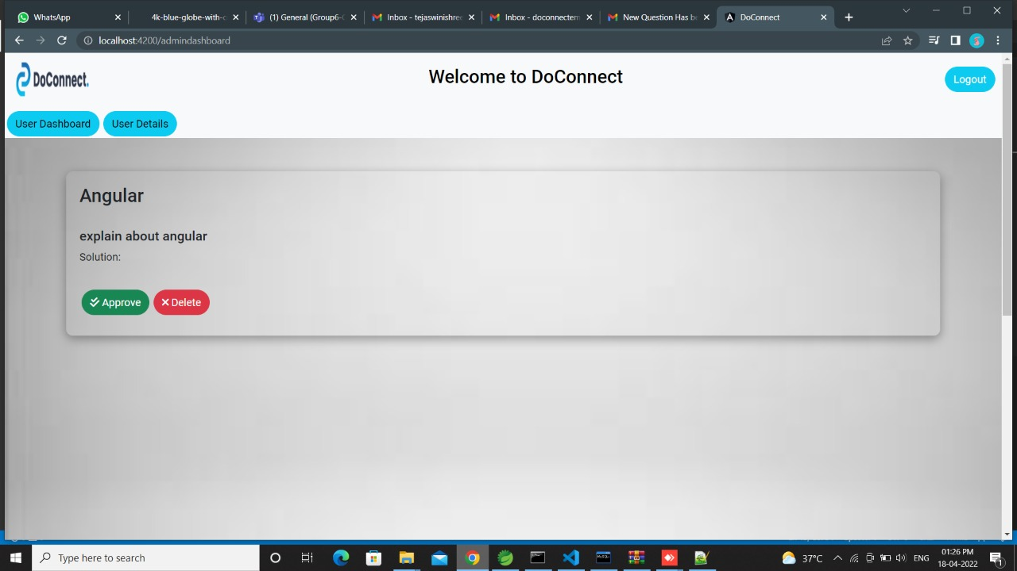
ADMIN DASHBOARD

Slide 15
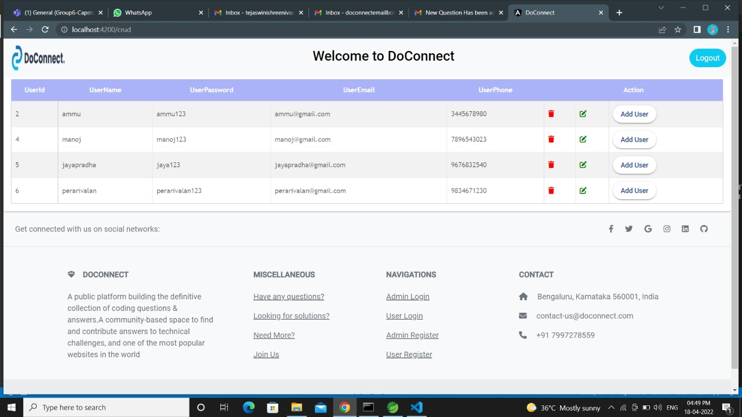
USER DETAILS IN ADMIN DASHBOARD

Slide 16
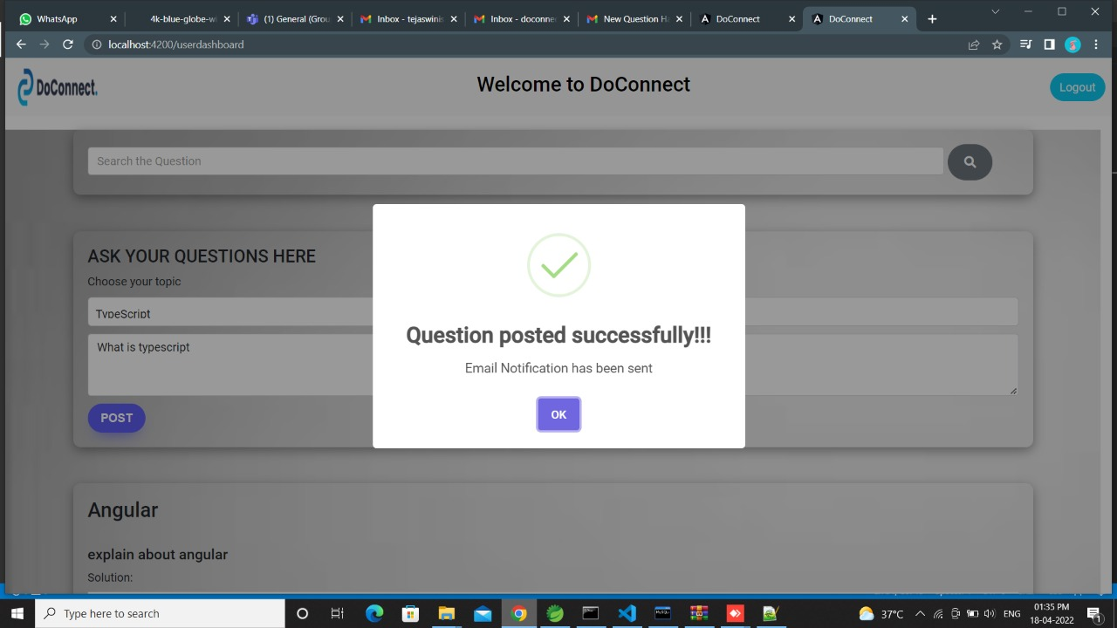
EMAIL NOTIFICATIONS

Slide 17
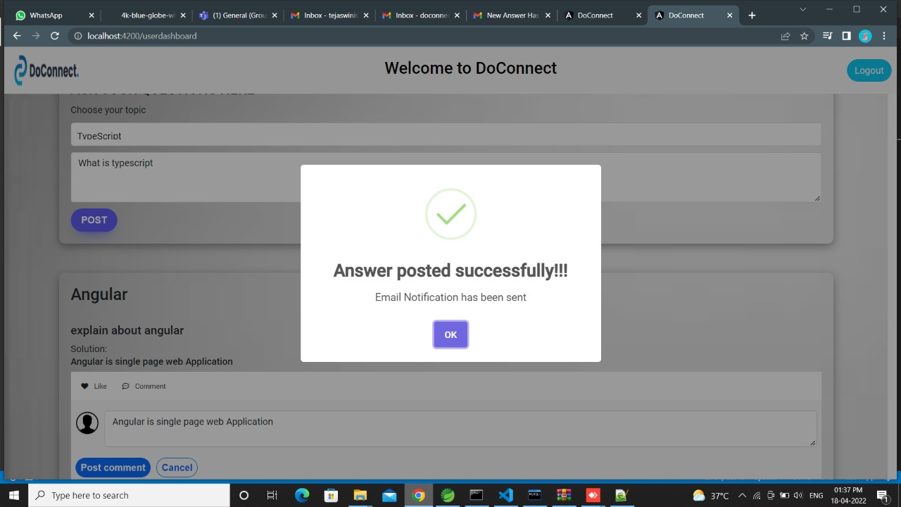
EMAIL NOTIFICATIONS

Slide 18
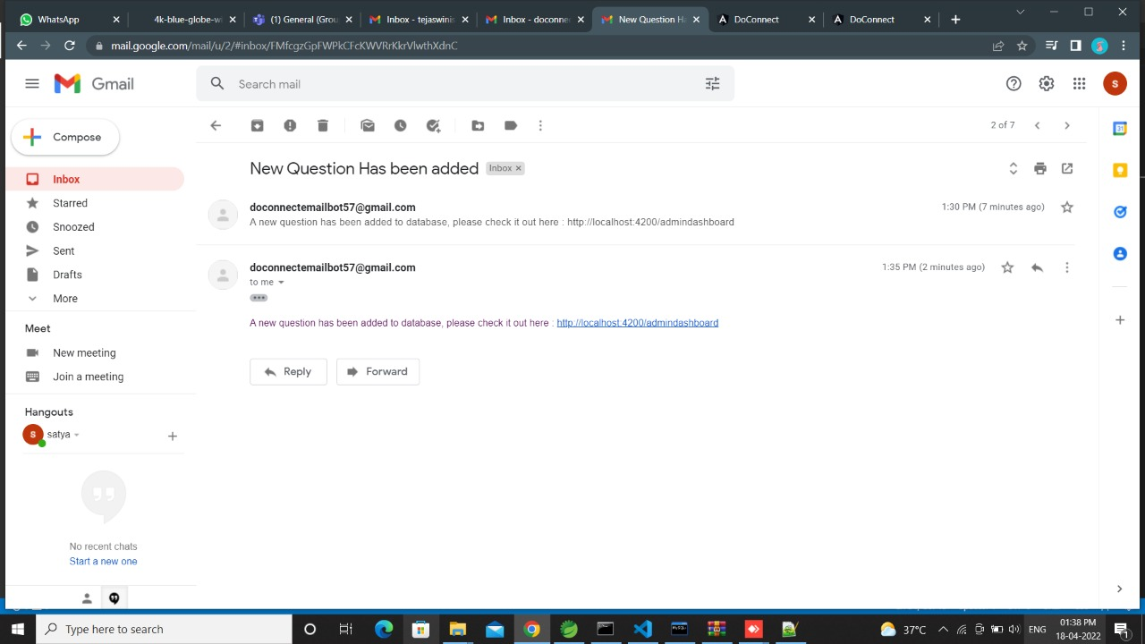

Slide 19
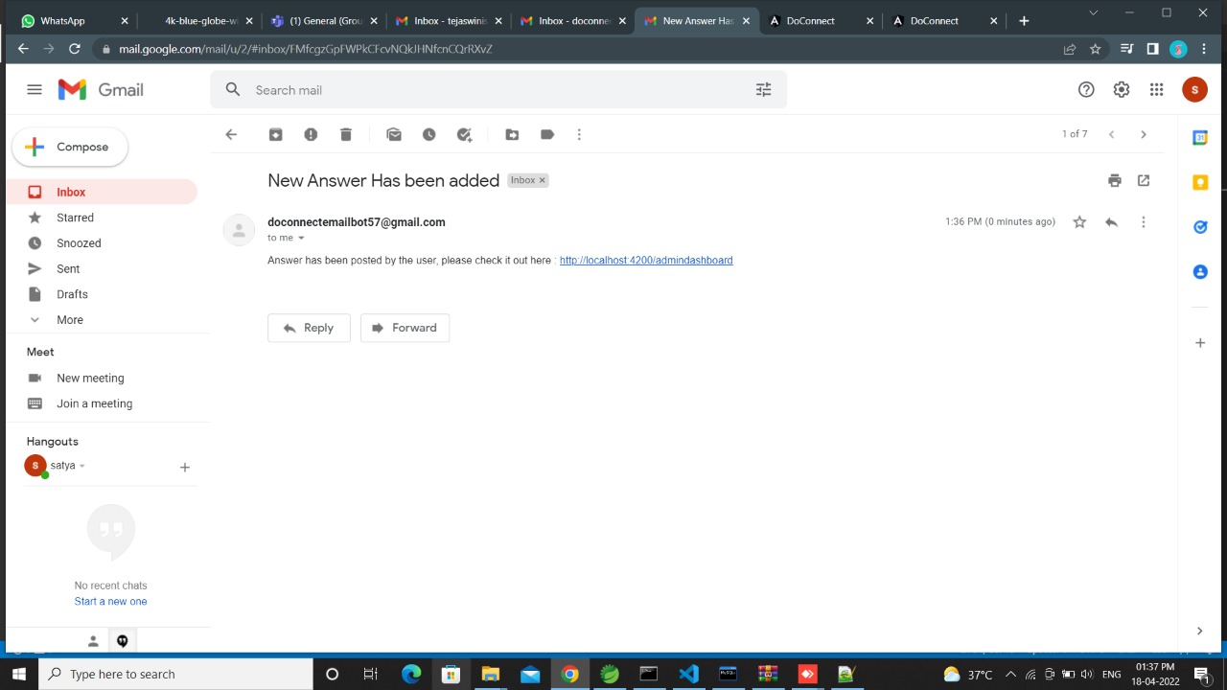

Slide 20
Thank you

