Slide 1
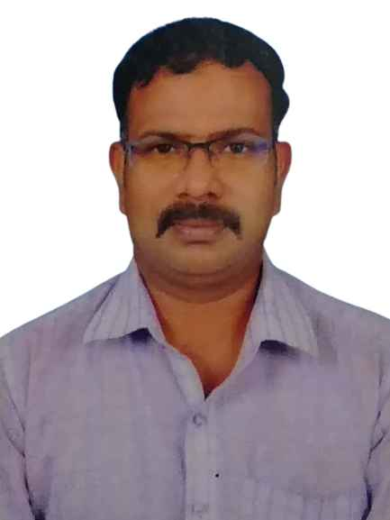


JAYAPRAKASH LOGANATHAN
Director – Data & Analytics
(Program/Project Management)
Highlights:
Solutions:
A Visionary Solutions Director focused on converting Business problems to values through advanced ideation. Started with a small team of trainees, expanded to a 20+ member team which successfully built various Advanced Data and Analytics Solutions/Accelerators/Frameworks/Tools for serving various use cases across multiple domains.
Key Solutions:
Vehicle 360 (Telematics): CAFÉ (Corporate Average Fuel Economy), Customer360 and Fleetmatics.
Analytics solutions being built on vehicle running data which recommends the Auto OEMs to take business decisions on the Vehicle Model manufacturing and decommissioning ultimately increasing the overall revenue.
Fleetmatics Solutions is being implemented in one of the Logistics companies for effective tracking of their Fleets attaining a ~15% overall revenue growth
Cooling System Analytics Solutions (Refeer Analytics): An integrated, robust and scalable analytical platform for effectively managing the Cooling System Operations. By predictive maintenance recommendations improves the quality and consistency coupled with improved efficiency.
Data/Component Migration Solution: Alcazar a Development accelerator mainly utilized in Data Modernization initiatives (Data Platform Assessment, Analysis, Data Migration, Component Migration) of an Organization to cope up with the Overall Business growth and expansion.
Program Management, Governance & Delivery:
A Program Director having a commanding foothold on all the stages of Software Lifecyle (Discovery, Assessment, Program/Project Scoping, Planning (Estimation, Scheduling & Milestones), Quality & KPI Monitoring, Risk management, Communication between project stakeholders, Execution Control and Delivery and responsible for end-to-end smooth implementation) executed critical engagements to reach the Business goals.
Enterprise Datawarehouse Platform for an Electronics parts Manufacturer serving their Reporting needs for Sales/Operations/Executive and Financial Dashboards.
Successfully lead and managed this challenging program (On-Prem SQL Server with Data
migrated to Azure Cloud Platform) for overall Data platform rationalization and a Scalable platform for
accommodating multiple brands and markets
while cutting down the Cost significantly to ~25%
On-Shelf Availability and Assortment Planning Recommendation Engine Implementation with Seasonality factors for a leading Cosmetic Company (Retail).
Report Rationalization for a large Auto manufacturer resulting in almost 20% savings in effort spent on Support & Maintenance of the critical applications
+91 9884821179
pratap.log@gmail.com
Work Experience:
Director – Data and Analytics (Program & Project Management) – LTIMindtree, Chennai - (Nov 2022 – till date)
Senior Solutions/Program/Project Manager – Cognizant Technology Solutions
- (Mar 2014 – Nov 2022)
Technology/Solutions Lead/Manager – Infosys Technologies
- (Jul 2004 – Feb 2014)
Profile Summary:
An IT Professional having around 20 years of experience with specialization in Data Analytics/Business/Artificial Intelligence/Cloud Solutions, Program/Project Governance and Delivery.
Diversified experience in Technical, Functional and Management areas
3 years of Onsite (USA) experience at various clients
Being a Director in LTIMindtree for the past 2 years with deep Solution expertise, embracing the advanced tools and technologies helped Business to deliver values aligning to overall Organizations IT strategy.
Successfully ran challenging engagements through an effective Program/Project Management/Governance and Delivery which helped the customer in faster Go-To Market strategies.
Previously worked in Cognizant and Infosys as Senior Solutions/Project Manager and Lead
Skills:
Data Engineering, Data Analytics, Data Quality, Data Intelligence, Data Governance, DataOps, Observability
Project Execution Methodologies (Waterfall, Agile, Hybrid)
Domain: Retailing, Manufacturing, Life Sciences, Logistics and Energy/Utilities
Technologies and Tools :
Advanced BI and Data Tools (Qlikview, Power BI, Tableau, SQL, ETL, DB, ADF, Azure SQL)
Hyperscalers (Cloud-AWS, Azure)

Slide 2
Recent Deals:
Implementation of a Launchpad Application for Global CPG Company - Provided Azure Databricks and Advanced Visualization Solution for the Data modernization with a cost savings of 20 – 30 % in development through Alcazar’s automation.
Assortment Planning Recommendation Engine for a Global CPG (1.5 M)
Areas of Experience/Knowledge:
Data Engineering: Data Quality, Data Standardization, Data Reconciliation, Transformation
BI Reporting: KPI Enrichment, Business Insights Solutions
Data Quality Framework:
  Data Quality Monitoring, Data Quality Mitigation, Data Quality Issue Resolution
  Discover, Analyze, Define and Implement
Rapid Assessment Methodology:
  An Assessment method tailored for Data programs that focuses on defining the Enterprise Data Management Journey.
  We bring modularized templates, workshop structures and plans
Observability 360:
  Platform Observability – Platform and Infra monitoring
  Pipeline Observability – Jobs Scheduling, Completion
  Consumption Observability – Application Performance Monitoring
  Quality Observability – Anomaly detection
DataOps:
Strategize, Optimize (Orchestrate, CI/CD), Automate (Automate Testing and Platform Monitoring, Observability), Intelligence (Auto Healing, BOTs based Self Service)
Data Governance:
Themis - GRC360 solution for data (Governance, Regulations and Compliance)
Past Experience:
Cognizant Technology Solutions
Role | Client | Systems
Senior BI/Cloud Project Manager BI Solutions Manager | GSK – Life Sciences (UK), Toyota – Auto Sales(USA), Amgen – Pharma (USA), Schneider Electric(USA) BI Solutions Team - Banking and Insurance BI Solutions Team – Manufacturing and Logistics | Marketing Analytics (GSK) Parts and Sales Analytics (Toyota) Research Data Lake (AMGEN) BMS Analytics (Schneider) SPENDWIZ (Spend Analytics) JPMorgan Chase & Co Sales Analytics – Wellsfargo, Metlife Telematics – Vehicle 360, SPENDWIZ (Spend Analytics), RE Energize, Warranty Analytics, OPTILAY (Warehouse Optimization)
Infosys Technologies
Role | Client | Systems
BI Solutions Lead Technology Lead | Starbucks, SEARS, Nordstrom (Solutions Team) Walmart, JC Penney (Onsite –USA) | Loyalty and Campaign Management Analytics, Customer Diagnostics Solution Forecasting Analytics, Item Number Upgrade 2.0
Education:
M.B.A (Technology Management) from Anna University (Distance), Chennai
B.E (Electrical & Electronics) from University of Madras, Chennai

