Slide 1
Excel Re-Assessment

Slide 2
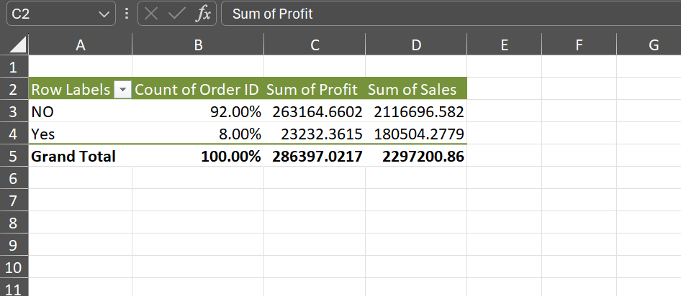
Q1
INFERENCE:
We can see that the “8%” percentage of product is returned and the loss value in profit due to this 23232.36 and in sales is 180504.27
FORMULA:
Used pivot table
INSIGHTS :
Create a row called returned in original data and using xlookup find the product is returned or not using return sheet.
Then using pivot table create the sum of profit and sales for each return catgory.

Slide 3
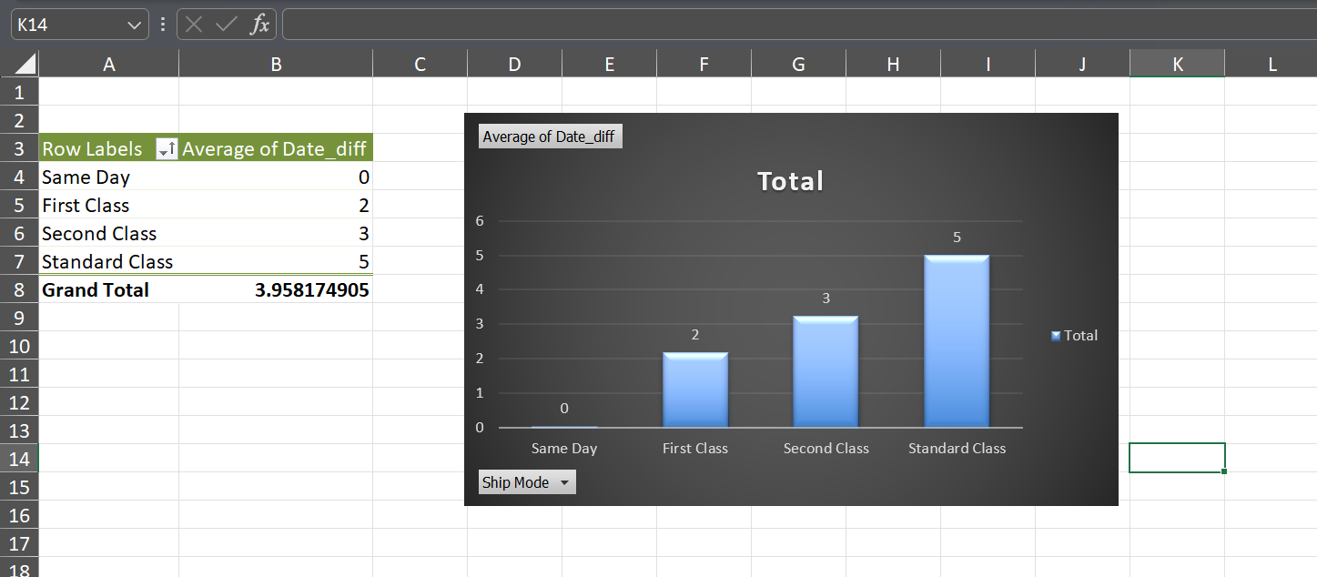
Q2
INFERENCE:
The fastest way of delivery is “Same Day”
The slowest way of delivery is “Standard Class” where it takes an average of 5 days for delivery
FORMULA:
Used pivot table
INSIGHTS :
The steps involved are I created a column called date_diff where I calculated the difference between order and shipped date.
Then using the pivot table calculate the average for each shipping mode.

Slide 4
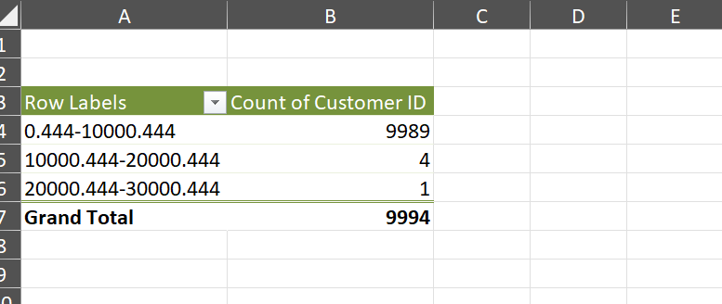
Q3
INFERENCE:
We can see that most of the customer fall under the category of sales between 0 to 10000.
FORMULA:
Used pivot table
INSIGHTS :
Using pivot table group the sales column by 10000 then calculate the count of customer id in each group .

Slide 5
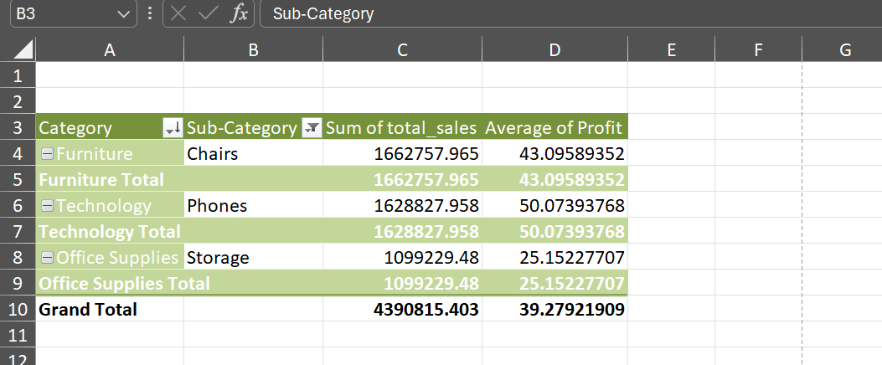
Q4
INFERENCE:
From this we can infer that the overall top selling category is “Furniture”.
Also based on category wise “Chairs”, “Phones”, “Storage” are top selling sub-category on furniture , technology and office supplies respectively.
FORMULA:
Used pivot table
INSIGHTS :
First find the category and subcategory wise “sum of total sales” and filter the top 1 value . Find the average of profit for each sub catgory.

Slide 6
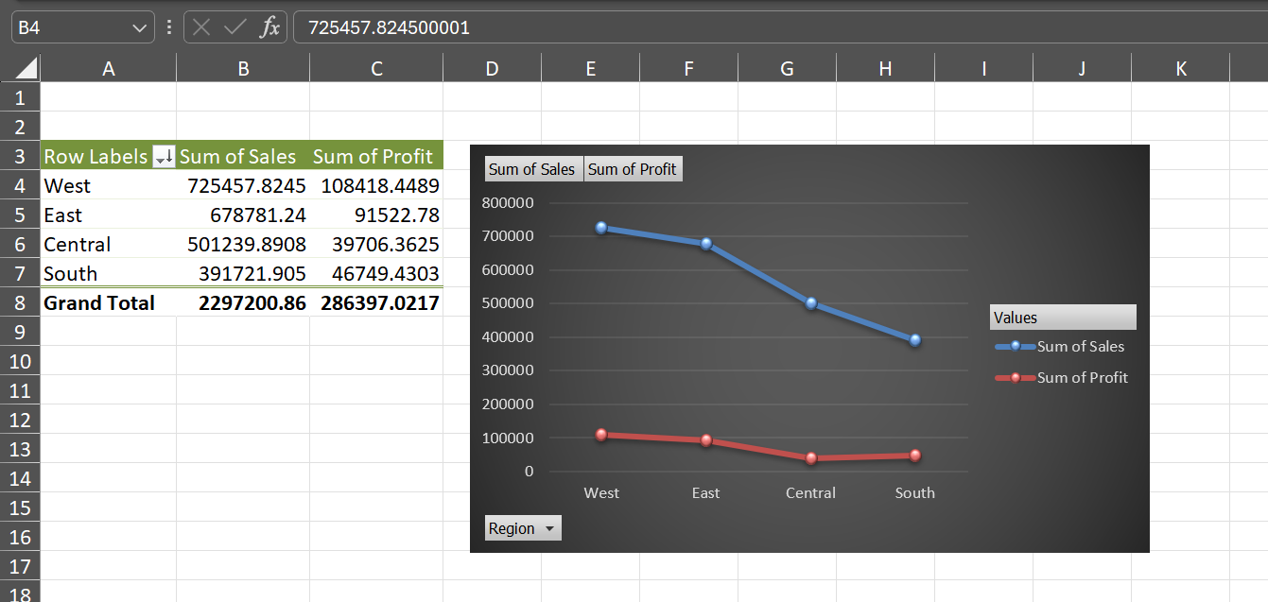
Q5
INFERENCE:
From this we can see that “West” region has the highest amount of sales and the “South” region have the lowest amount of sales.
Also from the chart we can see that the profit is affected in the “south” region and it is high in “West” region.
FORMULA:
Used pivot table.
INSIGHTS :
Calculate the region wise sum of sales for using pivot table fields, then sort them in ascending order based on the sum of sales.
Also calculate the profitability for each region and create a chart to analyse the trends.

Slide 7
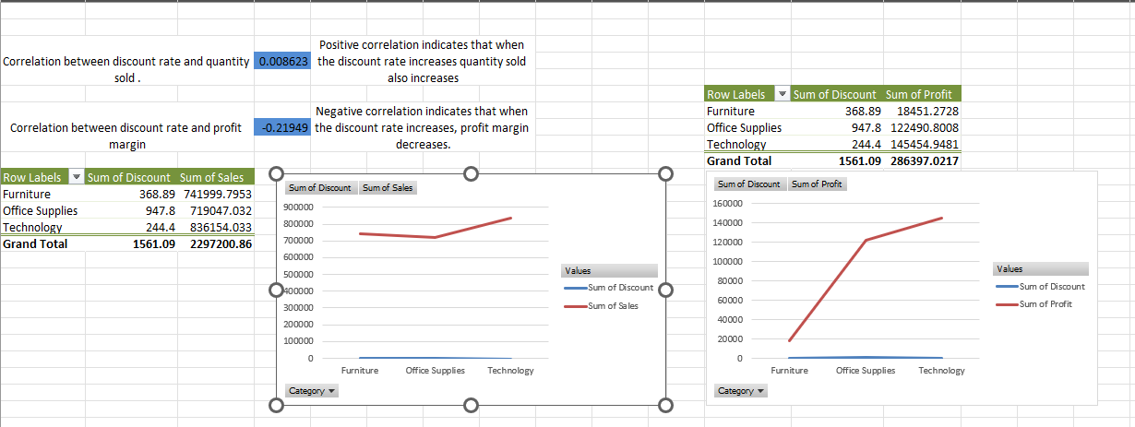
Q6
INFERENCE:
We can see that the correlation between discount rate and quantity sold is “0.008623” which indicates it has a positive correlation and the sales increases when the discount increases.
We can see that the correlation between discount rate and profit is “-0.21949” which indicates it has a negative correlation and the profit decreases when the discount increases.
FORMULA:
CORREL(Orders!T:T,Orders!S:S)
INSIGHTS :
Calculate the correlation for discount and sales and discount and profit using the function “correl”.

Slide 8
Q7
INFERENCE:
From this we can see that “South” region has the lowest market saturation , but also we can see that profit is increasing in the south compared to central so if we tend to improve strategies here it will result in high sales.
FORMULA:
Used pivot table.
INSIGHTS :
Calculate the region wise sum of sales for using pivot table fields, then sort them in ascending order based on the sum of sales.
Also calculate the profitability for each region and create a chart to analyse the trends.

Slide 9
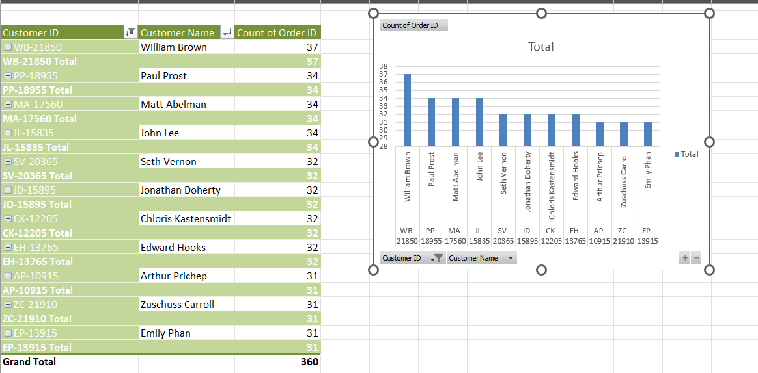
Q8
INFERENCE:
We can see the top 10 customers based on the maximum number of repeated orders to improve the customer retention we can give higher discounts to these customer every year which will automatically improve the customer lifetime value.
FORMULA:
Used pivot table
INSIGHTS :
Calculate the number of repeated orders for each customer id and customer name and filter the top 10 customers.

Slide 10
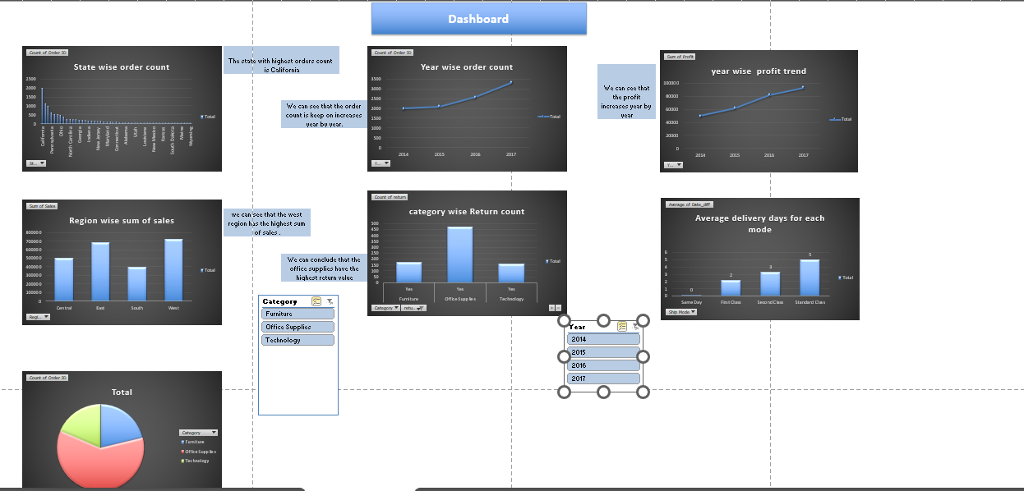
Dashboard

