Slide 1
Employee Data Analysis using Excel
STUDENT NAME : JAYA PRIYA DHARSHINI C P
REGISTER NO : 58EADE3BEF2CC1C8C764AF8FF09F4469,312208686
DEPARTMENT : B.COM (General)
COLLEGE : MEENAKSHI COLLEGE FOR WOMENS

Slide 2
PROJECT TITLE
Employee Performance Analysis based on their Educational Qualification

Slide 3


AGENDA
Problem Statement
Project Overview
End Users
Our Solution and Proposition
Dataset Description
Modelling Approach
Results and Discussion
Conclusion
3/21/2024 Annual Review

Slide 4

PROBLEM STATEMENT
Educational qualifications often serve as a basic filter in the hiring process.
Many positions have minimum educational requirements, and candidates must meet these criteria to be considered for the role.
Higher educational qualifications can enhance a candidate's credibility and perceived competence.
They serve as proof that you have acquired certain skills and knowledge relevant to a field.
For many professions, degrees or certifications are a basic requirement to ensure that candidates have a foundational understanding necessary for the role.

Slide 5

PROJECT OVERVIEW
Employee analysis involves examining various aspects of employees in a work force to gain insights that help in - promotion, demotion, job appointment, selection, improving the efficiency of working and enhancing employee satisfaction.

Slide 6
WHO ARE THE END USERS?
MANAGING DIRECTORS
HUMAN RESOURCE DEPARTMENTS
MANAGEMENT AND LEADERSHIP
TEAM LEADERS AND SUPERVISIORS
EXECUTIVE LEADERSHIP
BUSINESS ANALYSTS
UNION EMPLOYERS
EMPLOYEES
RECRUITERS

Slide 7

OUR SOLUTION AND ITS VALUE PROPOSITION
FILTERING – REMOVES VALUES
PIVOT TABLE – SUMMARY OF EMPLOYEE
PERFORMANCE ANALYSIS
TABLE - TO HIGHLIGHT VALUE
COLUMN DIAGRAM – FINAL RESULT

Slide 8
Dataset Description
EMPLOYMENT DATA SET - KAGGLE
EMPLOYEE ID : ALPHANUMERIC (TEXT)
AGE : NUMERICAL VALUE (TEXT)
GENDER : ALPHABETICAL (TEXT)
YEARS AT COMPANY : NUMERICAL (TEXT)
JOB ROLE: : ALPHABETICAL (TEXT)
NUMBER OF PROMOTIONS : NUMERICAL (TEXT)
DISTANCE FROM HOME : NUMERICAL (TEXT)
JOB LEVEL : ALPHABETICAL (ENTRY, MID, SENIOR)
LEADERSHIP OPPORTUNITIES : ALPHABETICAL (YES, NO)
COMPANY REPUTATION : ALPHABETICAL (VERY POOR, POOR, GOOD, EXCELLENT)
EMPLOYEE RECOGNITION : ALPHABETICAL (VERY LOW,LOW, MEDIUM, HIGH)

Slide 9

THE "WOW" IN OUR SOLUTION
Automate the performance review process, track employee goals, and manage feedback
Assess employee productivity and efficiency using analytics tools integrated into productivity suites or standalone applications.
Enables the creation of more accurate and fair performance evaluations by using quantifiable data
rather than subjective assessments
3/21/2024 Annual Review
9

Slide 10
MODELLING
DOWNLOAD THE EMPLOYMENT DATASET FROM KANGAL AND OPEN IT IN EXCEL.
SELECT THE ENTIRE DATA AND CLICK ON DATA AND CLICK ON SORT OPTION
SORT THE EMPLOYEE ID BASED THE DATE OF JOINING
SELECT THE ENTIRE DATA AND CLICK ON INSERT AND THEN CLICK
PIVOT TABLE OPTION TO CREATE THE VISUALISED PIVOT TABLE DATE
FROM THE TAKEN DATASET.
10

Slide 11
MODELLING
NOW DRAG THE ENTIRE DATA AND CREAT A PIVOT TABLE
ONCE THE PIVOT TABLE IS BEEN CREATED SELECT THE PIVOT TABLE AND CLICK ON INSERT
NOW CLICK ON THE CHART THAT YOU PREFER
(COLUMN CHART)
FINALLY THE CHART IS CREATED FROM THE PIVOT TABLE ANALYSIS.

Slide 12
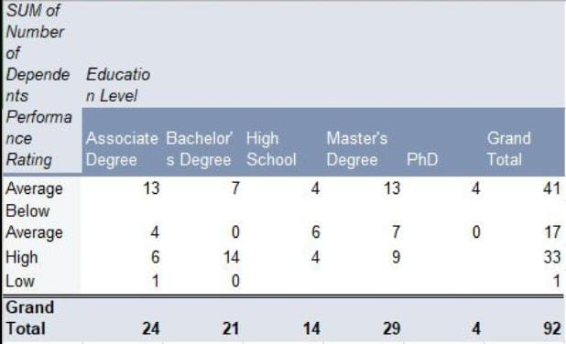
RESULTS
1. TABLE
12

Slide 13
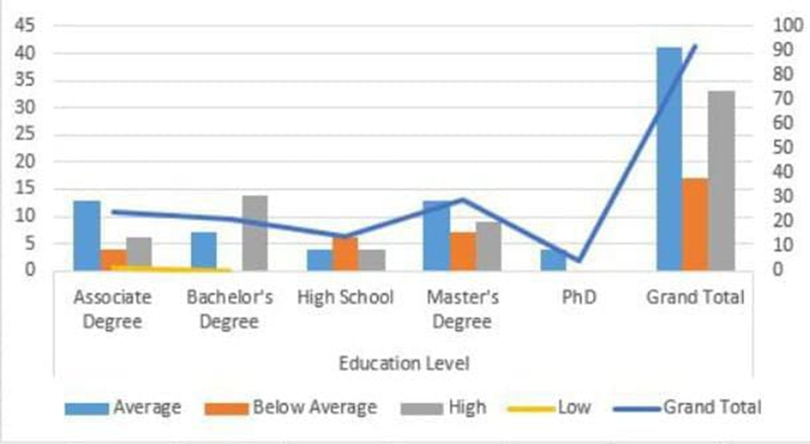
RESULTS
2. COLUMN CHART

Slide 14
Conclusion
Data Overload
Problem: An excess of data can be overwhelming and lead to analysis paralysis.
Solution: Focus on key performance indicators (KPIs) and use data visualization tools to
highlight important insights. Prioritize data that impacts organizational objectives
Data Quality Issues
Problem: Inaccurate, incomplete, or outdated data can lead to misleading conclusions.
Solution: Implement robust data validation processes, regularly update data, and ensure
data consistency across sources.
Lack of Actionable Insights
Problem: Analysis may not provide clear or actionable recommendations.
Solution: Focus on generating insights that are directly applicable to performance
improvement. Provide specific, actionable recommendations based on the data.

