Slide 1
MUSIC MOOD PREDICTION
TNSDC-Generative AI
Presented by :
Jaya Priya.T
au211521104058,
Pre-Final Student,
Computer Science and Engineering,
Panimalar Institute of Technology.

Slide 2
AGENDA
Problem Statement
Project overview
Proposed Solution
Modelling
Wow in the solution
Conclusion
References

Slide 3
PROBLEM STATEMENT
Music is a powerful language to express our feelings and in many cases is used as a therapy to deal with tough moments in our lives. Emotions and moods can be easily reflected in music, when we are doing sports, we tend to listen to energetic music, similarly when we are anxious or tired a nice relaxed song can help us to calm down. That’s why I try to figure out how classification models could help to determinate which is the mood of a specific track.
In this I will expose and explain how I could achieve this idea using a Multi-Class Neural Network for Classification and a cool Dataset provided from Spotify. So with no more talk, let’s start working!!

Slide 4
PROJECT OVERVIEW
Spotify uses a series of different features to classify tracks. I copy/paste the information from the Spotify Webpage.
Acousticness: A confidence measure from 0.0 to 1.0 of whether the track is acoustic. 1.0 represents high confidence the track is acoustic.
Danceability: Danceability describes how suitable a track is for dancing based on a combination of musical elements including tempo, rhythm stability, beat strength, and overall regularity. A value of 0.0 is least danceable and 1.0 is most danceable.
Energy: Energy is a measure from 0.0 to 1.0 and represents a perceptual measure of intensity and activity. Typically, energetic tracks feel fast, loud, and noisy. For example, death metal has high energy, while a Bach prelude scores low on the scale. Perceptual features contributing to this attribute include dynamic range, perceived loudness, timbre, onset rate, and general entropy.
Instrumentalness: Predicts whether a track contains no vocals. “Ooh” and “aah” sounds are treated as instrumental in this context. Rap or spoken word tracks are clearly “vocal”. The closer the instrumentalness value is to 1.0, the greater likelihood the track contains no vocal content. Values above 0.5 are intended to represent instrumental tracks, but confidence is higher as the value approaches 1.0.

Slide 5
Liveness: Detects the presence of an audience in the recording. Higher liveness values represent an increased probability that the track was performed live. A value above 0.8 provides a strong likelihood that the track is live.
Loudness: the overall loudness of a track in decibels (dB). Loudness values are averaged across the entire track and are useful for comparing the relative loudness of tracks. Loudness is the quality of a sound that is the primary psychological correlate of physical strength (amplitude). Values typically range between -60 and 0 db.
Speechiness: Speechiness detects the presence of spoken words in a track. The more exclusively speech-like the recording (e.g. talk show, audiobook, poetry), the closer to 1.0 the attribute value. Values above 0.66 describe tracks that are probably made entirely of spoken words. Values between 0.33 and 0.66 describe tracks that may contain both music and speech, either in sections or layered, including such cases as rap music. Values below 0.33 most likely represent music and other non-speech-like tracks.
Valence: A measure from 0.0 to 1.0 describing the musical positiveness conveyed by a track. Tracks with high valence sound more positive (e.g. happy, cheerful, euphoric), while tracks with low valence sound more negative (e.g. sad, depressed, angry).
Tempo: The overall estimated tempo of a track in beats per minute (BPM). In musical terminology, the tempo is the speed or pace of a given piece and derives directly from the average beat duration.

Slide 6
PROPOSED SOLUTION
1.Explaining and Analysing the Data
To obtain the data I had to create a series of functions using the Spotipy Library. This library helps to automate the Spotify services downloading more technical information (explaining above) about playlists, songs, artist music, etc. For the main purpose of this article, I’ll not mention how I obtained the data, but I’ll explain what the data consists of.
As you may know, Classification problems use labeled data, so I had to create these labels. I decided to create 4 categories to label the tracks, these categories are “Energetic”, ”Calm”, “Happy” and “Sad”. I choose these categories based on the following article, who explains what is the best way of classifying music by mood.
Then I searched on Spotify some playlists with different music tracks based on these 4 labels (200 tracks per label) and finally, I concatenated all these tracks into the main data frame labeled by each mood.

Slide 7
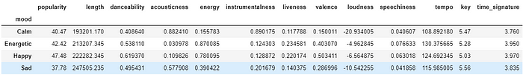
The main data have 800 rows and 18 columns, but for information reduction purposes I decided to use the features of Length, Danceability, Acousticness, Energy, Instrumentalness, Liveness, Valence, Loudness, Speechiness and Tempo because they have more influence to classify the tracks.
I grouped the data frame by labels calculating the mean of the tracks’ features. I obtained the following result:

Slide 8
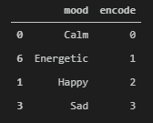
2. Building the Model:
To normalize the features I used MinMaxScaler to scale the values between a range of [0,1] and preserving the shape of the original distribution. I also encoded the 4 labels because Neural Networks uses numerical values to train and test. Finally, I split the data by 80% for training and 20% for testing.
The labels are encoded as follows:

Slide 9
3.Creating the model
To build the model I used the library Keras, this library is designed to enable fast experimentation with Deep Neural Networks, focused on being user-friendly. My main goal is to classify tracks in the 4 categories of moods (Calm, Energetic, Happy and Sad) so my model consists of a Multi-Class Neural Network with an input of 10 Features, 1 Layer with 8 nodes, and 4 outputs with the output Layer.
I also need to use a Classifier as an Estimator, in this case, the Classifier is KerasClassifier, which takes as an argument a function that I created previously with the Neural Network model defined. The activation Function corresponds to a Rectified Linear Unit (Relu), the Loss function is a Logistic Function and Adam Gradient Descent Algorithm is the optimizer.

Slide 10
4.Evaluating the model
Using K-Fold Cross Validation I evaluated the estimator using the train data. The number of splits is K=10 shuffling all the values.
The Accuracy of the model is the average of the accuracy of each fold, in this case, the Accuracy was 72.75%.

Slide 11
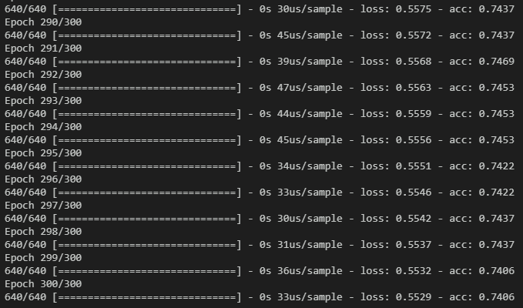
5.Training the Model
the model was trained with 640 samples (80% of the main data).
Some of the output of the last epochs when the model was training.

Slide 12
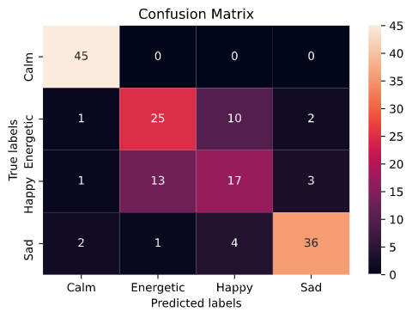
MODELLING Accuracy of the Multi-Class Neural Network
With a Final Accuracy score of 76% and taking a look at the Confusion Matrix, I noticed my model is good classifying Calm and Sad songs, but it’s having some issues dealing with Energetic and Happy songs. I could modify some parameters like the batch size, epochs, or maybe aggregate or delete some track features to train my model and thus help to improve the accuracy of the model.

Slide 13
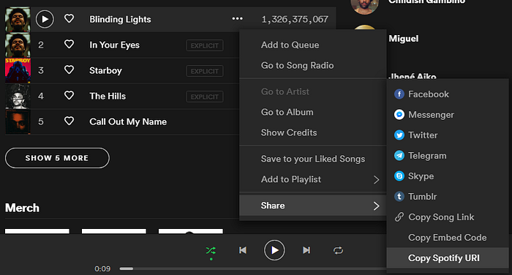
THE WOW IN SOLUTION Having Fun Classifying Music by Mood
I want to show how to predict the mood of a song that may you are lazy to listen completely but you want to know if the song will make you dance or cry.
First, we need to obtain the Spotify URI of any song provided by the Spotify App. For instance, I will like to predict the mood of “Blinding Lights by The Weekend”.
Spotify URI of Blinding Lights : spotify:track:0VjIjW4GlUZAMYd2vXMi3b

Slide 14
Then I will pass the Spotify URI of the song into a function I defined called predict_mood. This function takes the Id of the song as an argument and includes inside the Neural Network model created
Spotify URI of Blinding Lights is “spotify:track:0VjIjW4GlUZAMYd2vXMi3b” but the predict_mood function takes the Id, so I just need to take the code after “spotify:track”: in this case, the Id is 0VjIjW4GlUZAMYd2vXMi3b.
And the result display that Blinding Lights by the Weeknd have an Energetic Mood. Pretty accurate don’t you think so?.

Slide 15
Conclusion
Deep Learning Algorithms are a lot of fun to implement ideas or projects related to things you like. In my case, I like music a lot, so I could use this knowledge to create cool ways helping me to automate a task that can take a long time to perform it.
I also could learn more about this amazing world of Data Science and my tendencies to music tastes.

Slide 16
References
https://towardsdatascience.com/cross-validation-explained-evaluating-estimator-performance-e51e5430ff85
https://towardsdatascience.com/clustering-music-to-create-your-personal-playlists-on-spotify-using-python-and-k-means-a39c4158589a
https://machinelearningmastery.com/multi-class-classification-tutorial-keras-deep-learning-library/
Github reposiotory Demo link - https://github.com/Jayapriyathenraj/TNSDC-Generative-AI-project-Au211521104058.git

