Slide 1

SMART INDIA HACKATHON 2026
TITLE PAGE
Problem Statement ID – SIH26188
Problem Statement Title- AI-Based Fake Identity & Document Screening System
Theme- Blockchain & Cybersecurity
PS Category- Software
Team ID-
Team Name - Codeholics

Slide 2
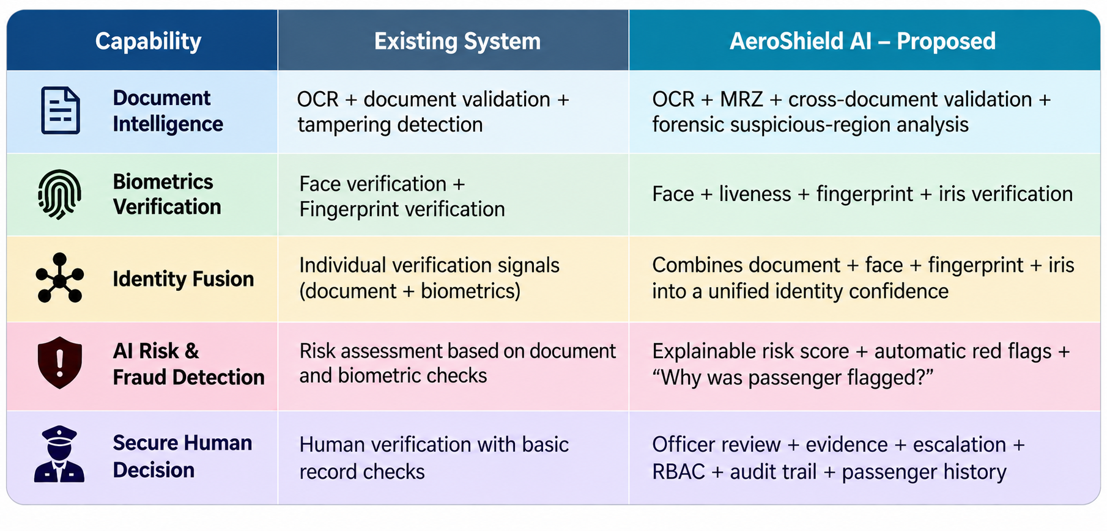
AeroShield-AI
Codeholics
Proposed Solution

Slide 3
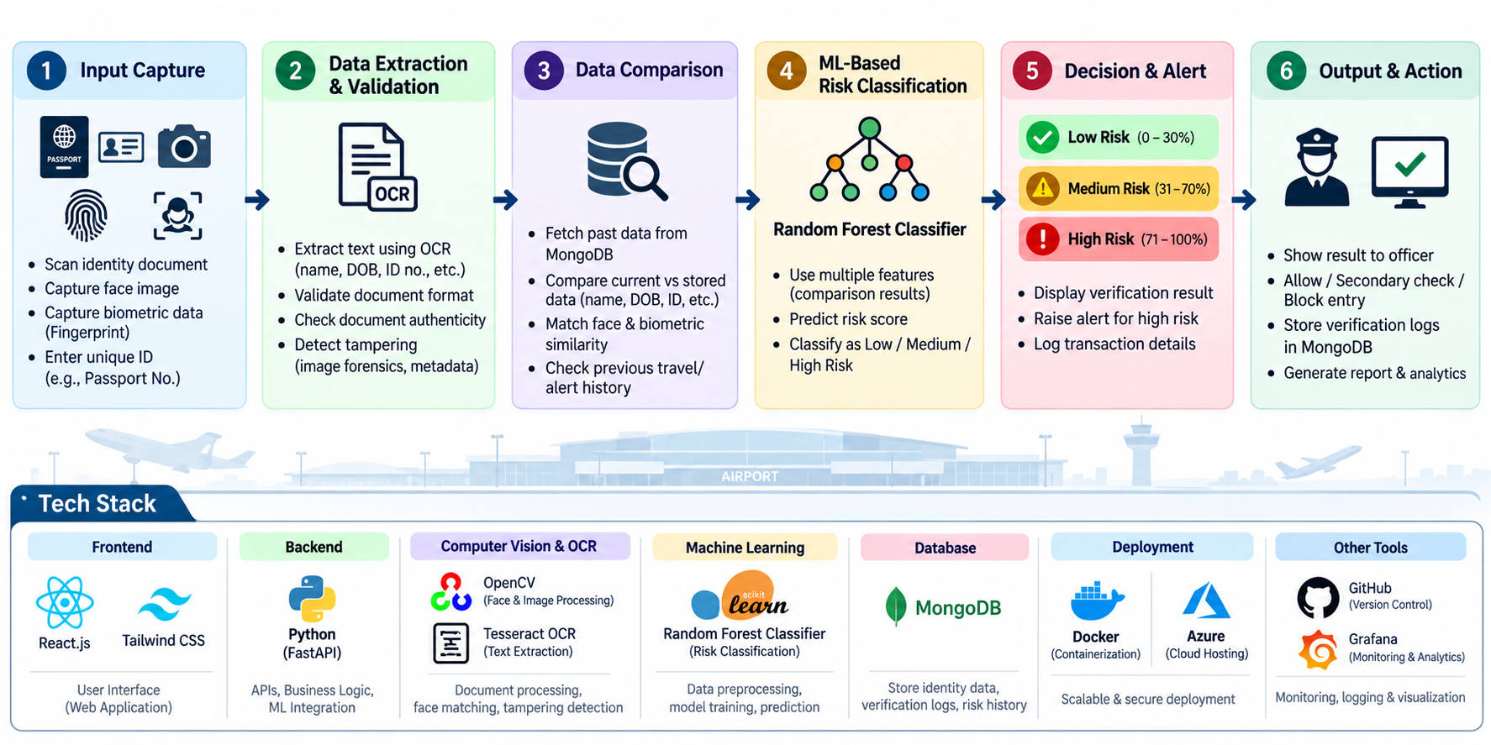
TECHNICAL APPROACH
Codeholics

Slide 4
FEASIBILITY AND VIABILITY
Codeholics
Feasibility – High
Uses existing technologies like OCR, face recognition, biometrics, MongoDB, and Random Forest.
Can be developed using Python, FastAPI, React, and OpenCV.
Can integrate with airport databases through APIs.
Viability – High
Reduces manual identity verification time.
Helps detect identity mismatches, document tampering, and suspicious records.
Provides a risk score to help officers make faster decisions.
Can be scaled to multiple airports and integrated with existing security systems.

Slide 5
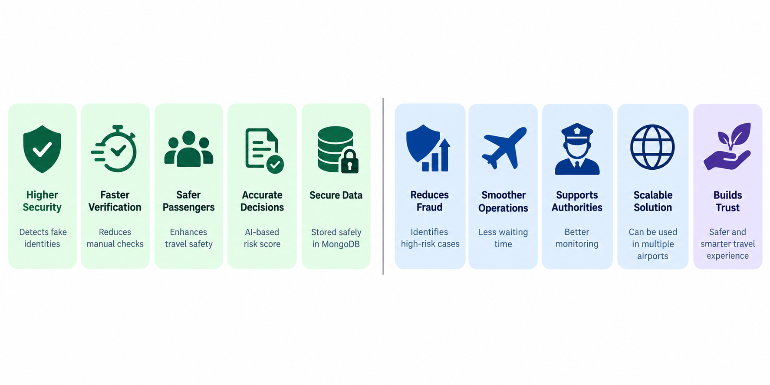
IMPACT AND BENEFITS
Codeholics

Slide 6
RESEARCH AND REFERENCES
Codeholics
ICAO Doc 9303 – Standards for secure machine-readable travel documents.
ICAO TRIP – Biometric-based traveller identification and verification.
Tesseract OCR Research – Automated text extraction from identity documents.
Random Forest (Breiman, 2001) – ML classification for risk prediction.
ICAO PKD – Electronic passport authenticity and digital-signature verification.
Key Technologies: OCR • Face Recognition • Biometrics • Random Forest • MongoDB • Document Validation

Slide 7
IMPORTANT INSTRUCTIONS
Please ensure below pointers are met while submitting the Idea PPT:
Kindly keep the maximum slides limit up to six (6). ( Including the title slide)
Try to avoid paragraphs and post your idea in points /diagrams / Infographics /pictures
Keep your explanation precise and easy to understand
Idea should be unique and novel.
You can only use provided template for making the PPT without changing the idea details pointers (mentioned in previous slides).
You need to save the file in PDF and upload the same on portal. No PPT, Word Doc or any other format will be supported.
Note - You can delete this slide (Important Pointers) when you upload the details of your idea on SIH portal.

