Slide 1
Unagi - Demo
For testing the app in the dev-environment
Lei Wu
Developer

Slide 2
What to Expect
Introduction to Unagi
Database
Studies
How to use the application
Explain the Graphical User Interface (GUI)
Demos on how to use the GUI
With this demo you can start to test/review the Unagi in the dev-environment in Shell’s platform.
Total Duration: 45 min. Demo: 30/35 min. Q&A: 10/15 min.
Not included in this demo.
Explain the Physics and Algorithm behind each study – It needs a dedicated workshop/tutorial

Slide 3
Introduction
Unagi facilitates the design for offshore wind farm network and export connection. It offers:
A database of genres of cable, 2-winding transformer, and 3-winding transformer.
Different studies for various business challenges
Preliminary study
Transfer capacity study
Cable loss study
Cable rating study
Cable temperature study
IAC loss study
Why the name “Unagi”: from electrical eel which lives under water and carries current, just like a subsea cable ☺

Slide 4
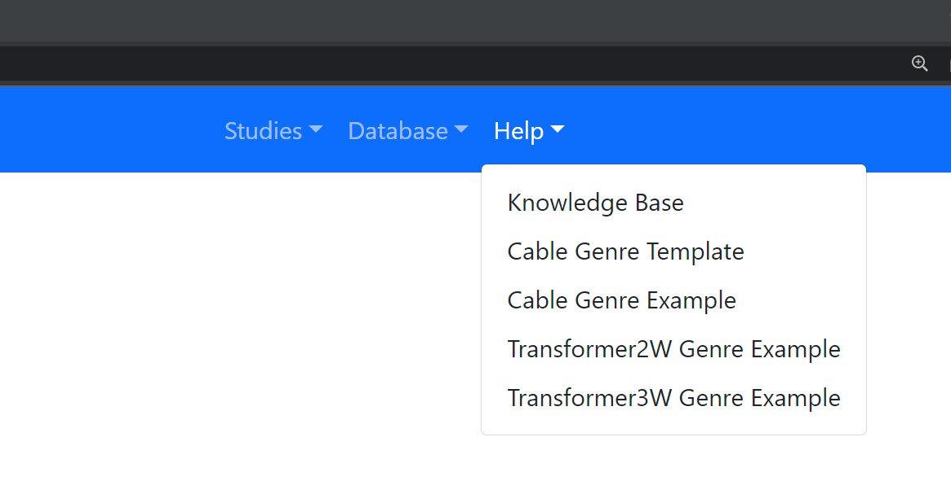
Database
3 tables for genres of cable, 2-winding transformer, and 3-winding transformer.
All parameters are explained in the Knowledge Base: appendix 1. Component Modelling.
Since cable genre has many parameters for different calculations, a template XLSX file to identify the required parameters for different studies is provided.
Demo
Show help files. And Knowledge Base appendix 1.
Notes:
Let’s start with Database. Because we need data to perform studies.

Slide 5
Web GUI Database
Import new data to database
Demo:
Error message when save to a wrong table name.
Save and Not Overwrite
Save and Overwrite
Database management
Demo:
Export All
Export Selected
Clear Selected
Filter and Clear Filter
Reset Database (reset one table, the other tables are not changed)
After the demo, import all 3 genres for the demo of studies.

Slide 6
Database User Access Management
Now, in the dev-environment, the database engine is inside the Unagi application.
The CRUD actions (Create, Read, Update, and Delete) are via the Unagi GUI. And users can freely CRUD.
For the test/review of the application in the dev-environment, if you import new data to the database, please keep the CSV file on your laptop just for backup purpose.
Later it will be replaced by an external database engine in the cloud with User Access Management. Because the external database in the production-environment will be persistent, you do not need to keep a local backup anymore.

Slide 7
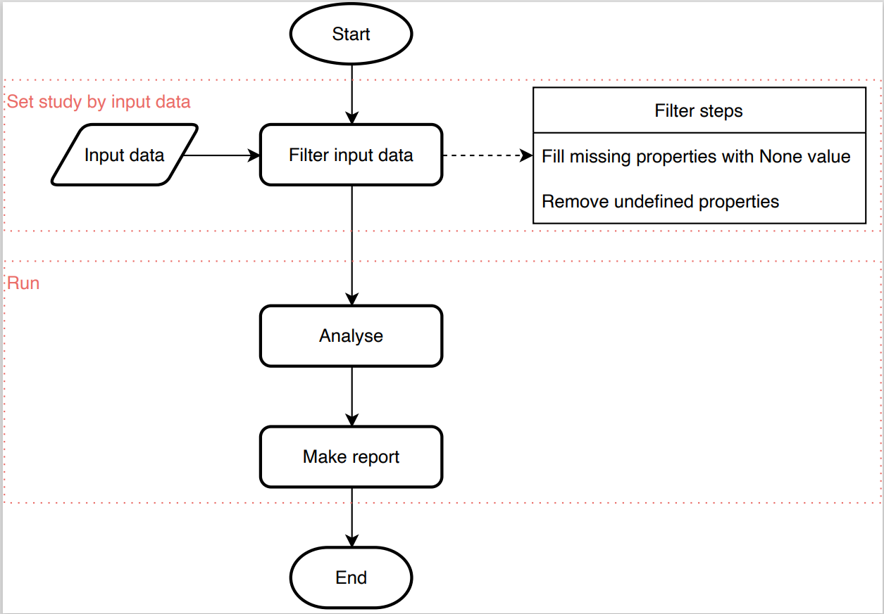
Studies
User provide input via the Web GUI.
Input data is collected and passed on to the backend model and perform calculations.
The main results will be reported in a LATEX file, and the raw results will be saved in CSV file(s).
If a study is finished successfully, all the results will be downloaded as one ZIP file to the user’s local computer.

Slide 8
Study Input Data Actions
Input form: entry, table, uploading CSV file, etc.
Input method:
fill in each input field, one by one;
or use “Load An Example”;
or use “Import Input”.
Save Input by “Export Input” to a JSON file and exchange it with other colleagues for collaboration.
Note: if “Load An Example” or “Import Input” is used, all input fields are automatically filled, including CSV files (if needed).
Demo:
Show different input form:
Entry, button, switch in Preliminary Study
Show hint message in Preliminary Study
Cable Genre Table in Preliminary Study
Tabs in Cable Genre Table in Cable Loss Study
Uploading a File: CAPEX OPEX Study.
Show “Load An Example” in CAPEX OPEX Study
Show “Export Input” in CAPEX OPEX Study.
Change one value and use “Import Input” in CAPEX OPEX Study
Notes:
For the “Load” button of the Cable Genre Table:
User can use the button to select one or more cable genres from the database. The selected ones will be shown in this table.
Since different studies use different parameters of a cable genre, and the cable genres stored in the database do not need to have values for all the parameters. This means, in the database, some cable genres may be values only for the parameters that needed by a power-flow calculation, and some cable genres may have values for cable loss calculations, and some may have values for all the parameters. The load button from one study page will only show the cable genres that have values for the parameters required by this specific study.
For the “Add” button:
It allows user to manually add a cable genre directly to the Cable Genre Table of that study on the go.

Slide 9
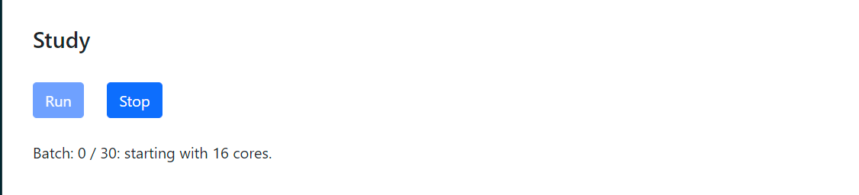
Study The Run Process
A Run button has a companion Stop button.
The Stop button is disabled before and after a run. And the Run button is disabled during a run.
During a run, the process is displayed on the GUI.
The process can be terminated by:
The Stop button (can be clicked at any time).
An error, which will be displayed to the user.
The run is finished successfully by itself.
Demo:
Run Preliminary Study and show the progress message, wait to see the “Study finished” notification and the downloaded results.
Delete the value in an entry and run to see the error message.

Slide 10
Study Run Acceleration
Parallel computing with multiple threads in one CPU.
It is realised by the Python built-in package called “multiprocessing”, which provides process-based parallelism.
A specific part of a study process is split into several batches. Each batch can run independently. If enabled, Unagi will use all the threads in the CPU to run those batches in parallel.
Rounding Decimals
It can cause a loss of accuracy but reduce computation time. For a specific iteration process, a different input value will have a different result, and the same input value will have the same result. Thus, rounding two different decimals to a certain position can make them equal, and consequently Unagi needs to run the iteration once instead of twice.

Slide 11
Rounding Decimals Example
For an MW-level WTG, its operating active power value is practically accurate enough if the precision is at the [kW] level.
E.g. 12345.789 [W] and 123123.123 [W] can both be rounded to 123000 [W] (=123 [kW]).
For the power loss calculation of an IAC network, the current in the cables can be accurately represented with the precision of 10 [A], and the cable temperature can be accurately represented with the precision of 1 [Celsius].
E.g. 123.456 [A] can be rounded up to 120 [A], and 123.456 [Celsius] can be rounded up to 123 [Celsius].

Slide 12
Preliminary Study Typical Input
Demo:
Show the selection of number of cable sections with the selection of mid-shunt location.
If M is not in the Scheme, then Mid-Shunt Location is hidden.
Set Scheme as L-M-R, the Number of Cable Sections as 2, show the possible Mid-Shunt Location
Increase the Number of Cable Sections as 6, show the possible Mid-Shunt Location
Set the Mid-Shunt Location as 5, and decrease the Number of Sections as 4, show the possible Mid-Shunt Location.
Set the Mid-Shunt Location as 2, increase the Number of Sections as 4, show the possible Mid-Shunt Location.
Change the Scheme to L, show the split.
Show the Logic-flow of how to determine study to run: Cable Genre Proposal or Check Connection.

Slide 13
Preliminary Study Results
Demo:
Show the pre-downloaded results.
Show the files: LATEX-File, Shell-template and common-template.
Show how to create a pdf from the LATEX files.
Show the pdf report.

Slide 14
Transfer Capacity Study Typical Input
Demo:
Show the two tabs of Study Choice.
Show the derating factors
Show the Accelerate, enable and disable and the number of cores in the status label.

Slide 15
Transfer Capacity Study Results
Demo:
Show the results of the two study choices.
Show how the user-defined points are used by each study choice.

Slide 16
Cable Loss Study Typical Input
Demo:
Show the tabs of study approaches: IEC and Southampton
Show the Questions of Southampton approach in Knowledge Base

Slide 17
Cable Loss Study Results
Demo:
Show the Knowledge Base, and go through Transfer Capacity Study. Use split screen and put the GUI and the Knowledge Base side-by-side.
Show the first question in section 3.1. Business Challenge

Slide 18
Cable CAPEX and OPEX Study GUI
Demo:
Show the Knowledge Base, and go through Transfer Capacity Study. Use split screen and put the GUI and the Knowledge Base side-by-side.
Show the first question in section 3.1. Business Challenge

Slide 19
Cable CAPEX and OPEX Study Results
Demo:
Show the Knowledge Base, and go through Transfer Capacity Study. Use split screen and put the GUI and the Knowledge Base side-by-side.
Show the first question in section 3.1. Business Challenge

Slide 20
IAC Loss Study GUI
Demo:
Show the Knowledge Base, and go through Transfer Capacity Study. Use split screen and put the GUI and the Knowledge Base side-by-side.
Show the first question in section 3.1. Business Challenge

Slide 21
IAC Loss Study Results
Demo:
Show the Knowledge Base, and go through Transfer Capacity Study. Use split screen and put the GUI and the Knowledge Base side-by-side.
Show the first question in section 3.1. Business Challenge

Slide 22
Summary
Please test the tool and share your feedback with me. I will revise it accordingly.
The AC/DC Concept study is under development. I will work with Yin on this.

Slide 23
Suggested Review Items
How is your experience with Unagi in general?
Do you need a workshop/tutorial for the studies in Unagi?
Check the speed of a study. How many threads do you need so that it is fast enough for you?
Particularly: Transfer Capacity, Cable CAPEX and OPEX Study, and IAC Loss Study
Any bugs?
The Price unit is EUR, which is used just as a money symbol. The exchange rates between currencies are not implemented. Do you need that?
Do you need more things to be included in the output zip-file for each study?
Do you need a welcome page? If yes, what content do you want to see?
The Knowledge Base is currently in pdf-file. Do you prefer a web-version, like html file or something like Confluence inside Shell? Do you want add/change content in the file?
Do you want to extend the application with new functionalities/studies?

Slide 24
Use Latex on Shell’s Laptop
2
Notes:
The report is written in Latex, you need to convert it to a pdf file.

Slide 25
Why Latex
Generates document with high typographical quality, especially for technical and scientific documentation.
Separate the content from the format.
The overall format can be changed easily
Modularity: a block of the content can be copy-paste to other documents.
If you are using Latex to write a technical report/presentation slides, and you want to use some content of a study results, you can simply copy-paste that part to your document.
Shell has its own Latex template.
It is just a way that I choose in advance. If you prefer other ways, please let us know. We can change it in about 2 weeks for all studies. In the end, we want this tool to be easy for you to use.
Word document (docx-file)
AsciiDoc (Also plain-text file, can be converted a html file, need to install AsciiDoc extension on Visual Studio Code)

Slide 26
Install
Download:
MiKTeX (official website: Getting MiKTeX)
Texmaker (official website: Texmaker (free cross-platform latex editor) (xm1math.net))
Install with their default options.

Slide 27
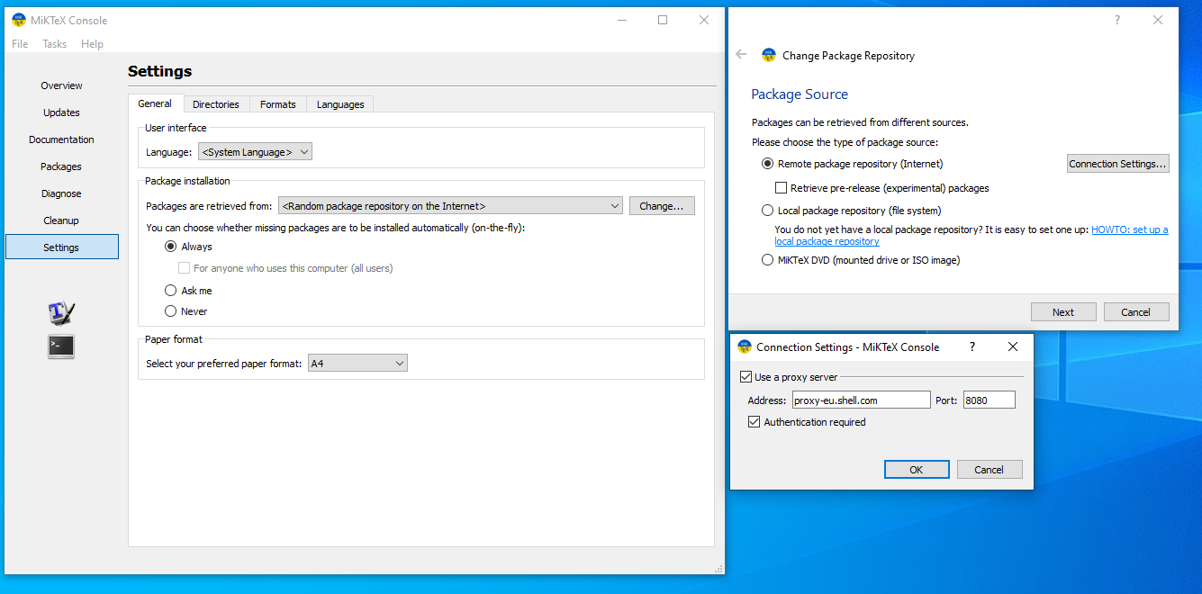
Settings Allow MiKTeX to get new Latex Package (1/3)
Settings → Change → Connection Settings
Use a proxy server
Address: proxy-eu.shell.com
Port: 8080
Authentication required

Slide 28
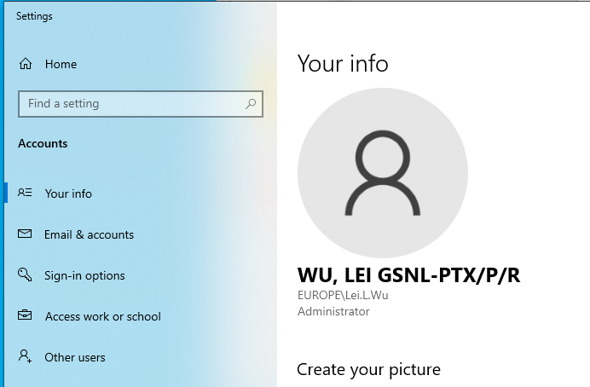
Settings Allow MiKTeX to get new Latex Package (2/3)
Name & Password
Name example
EUROPE\Lei.L.Wu
Password
Your login password

Slide 29
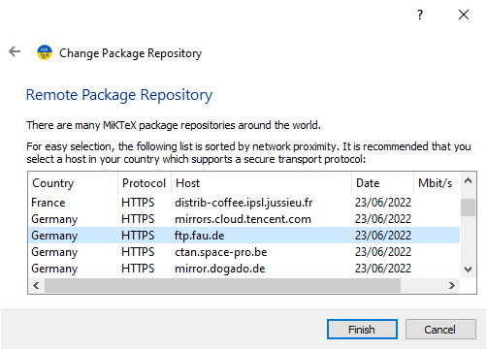
Settings Allow MiKTeX to get new Latex Package (3/3)
Remote Package Repository
Choose Host:
ftp.fau.de

Slide 30
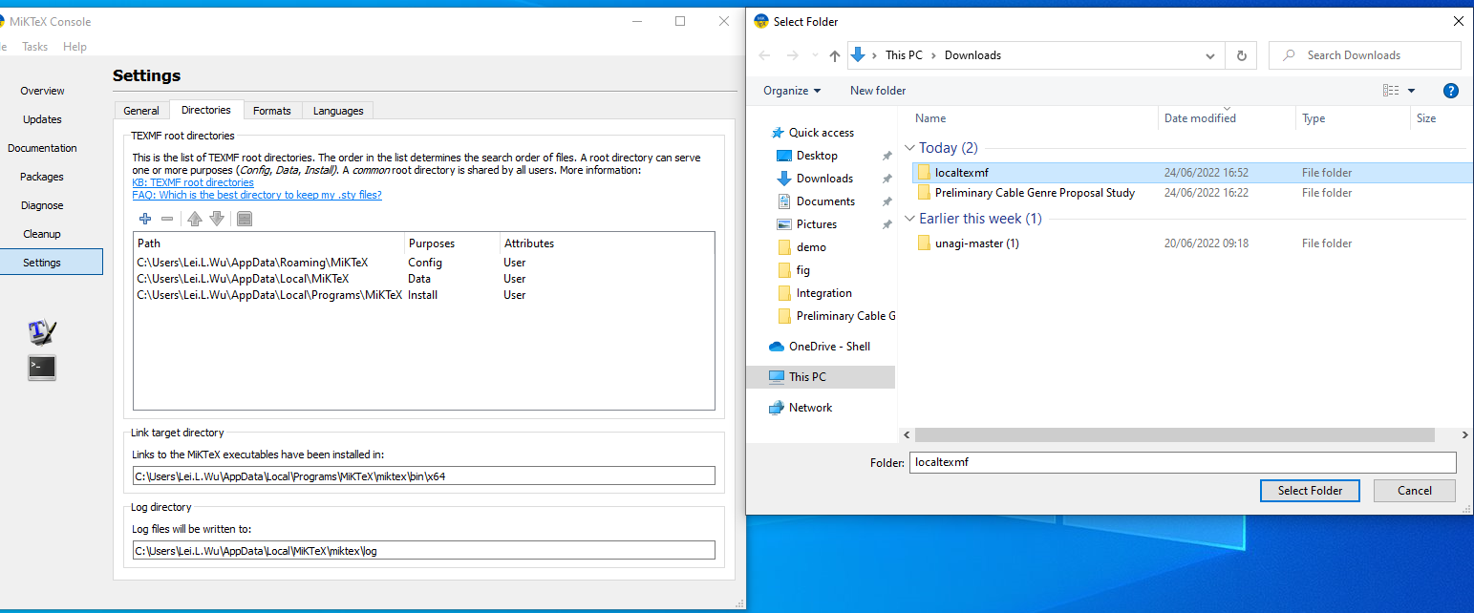
Settings [Optional] Add Shell Latex Template,
If skipped, you can just use
the common template
report_common.tex file.
If you want use:
MiKTeX → Settings
Directories → Add (+)
Select the folder of localtexmf

Slide 31
Bug and New Feature Via Jira Board
User Feedback
3

Slide 32
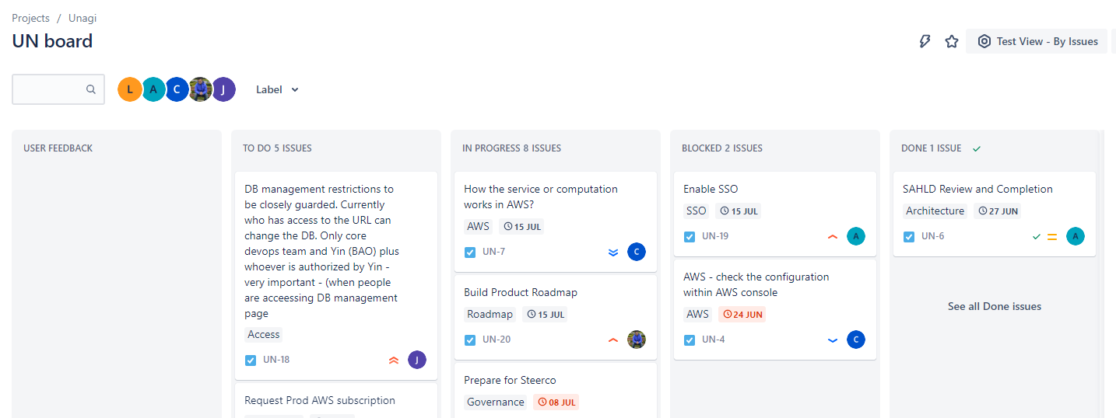
JIRA Board
Web-link: UN board - Agile board - Jira (atlassian.net)
Kanban Board: Depict work at various stages of a process using cards (tickets)
Notes:
Kanban boards visually depict work at various stages of a process using cards to represent work items and columns to represent each stage of the process. Cards are moved from left to right to show progress and to help coordinate teams performing the work

Slide 33
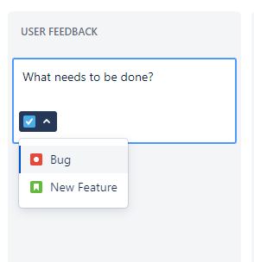
Create A Ticket Bug Report or New Feature Request
Mouse-click “Create issue” in “User FEEDBACK” column
Choose between “Bug” and “New Feature”
Provide Info in the pop-up dialog.
Place your ticket to the column “USER FEEDBACK”
We will then pick it up and relocate it to other columns.
We will contact you if we need further info.

Slide 34
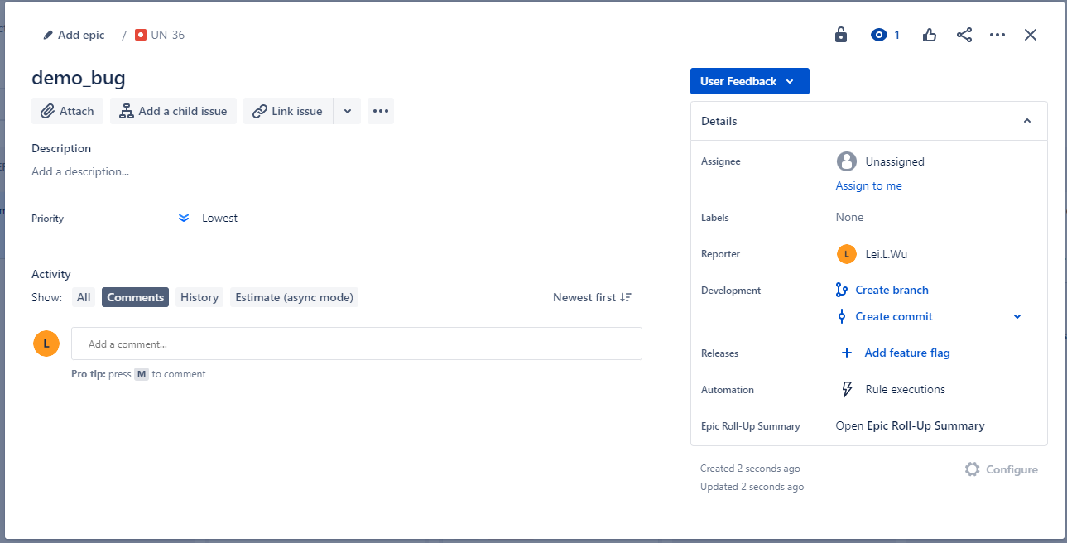
Bug Report Template
Add a one-sentence/phrase summary.
Add Description
What is the bug?
How to reproduce the bug?
Tip: You may simply export the all input on a study page, and attach the exported JSON file to this ticket.
What is the expected (correct) outcome?
When do you need it fixed (due date)?
Optional for you since we will pick it up.
Priority
Assignee

Slide 35
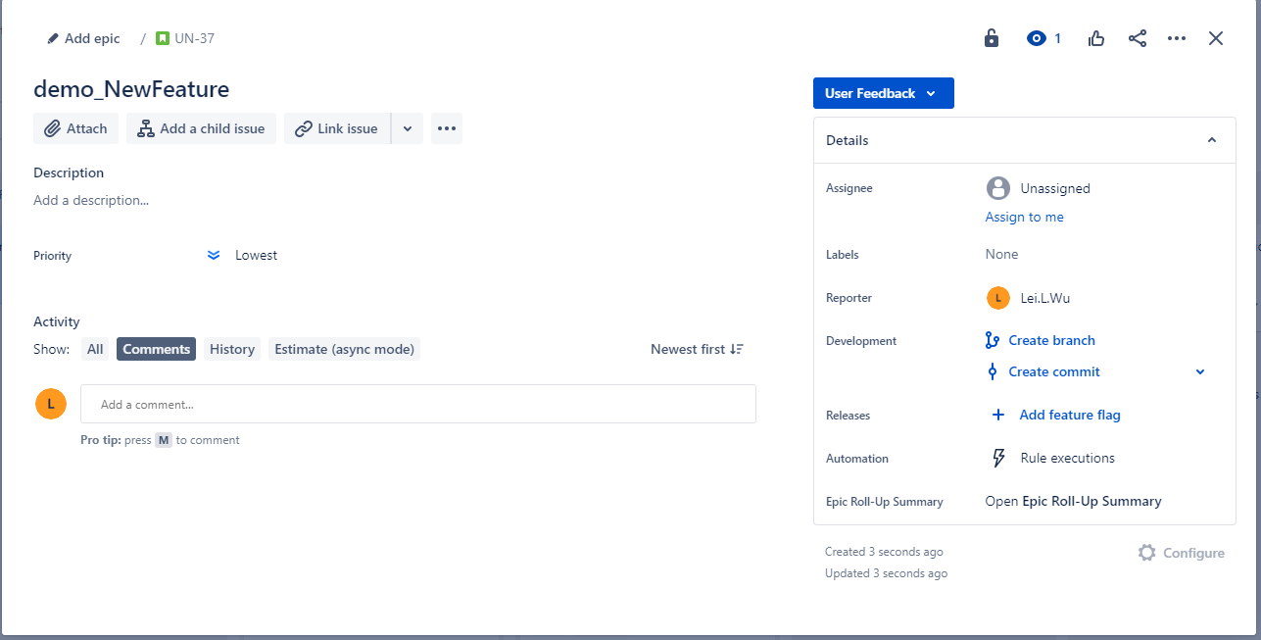
New Feature Request Template
Add a one-sentence/phrase summary.
Add Description
The content can be difficult to describe on your own. You may
first add as detail as you can. We will then contact you for further discussion and we will make it a concrete ticket.
What feature do you need?
When do you need it (due date)?
Optional for you since we will pick it up.
Priority
Assignee

Slide 36
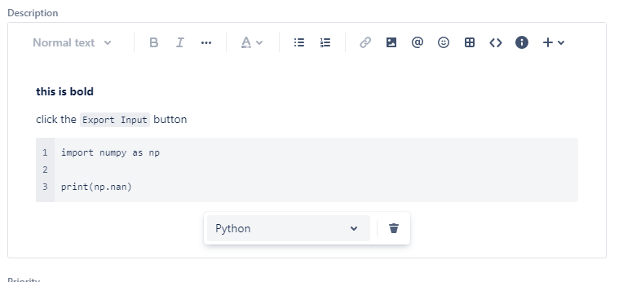
Description How to use Markdown
Description supports Markdown
**this is bold**
`inline code` or `some special term`
E.g., click the `Export Input` button.
``` and choose a language to start a code block.

Slide 37
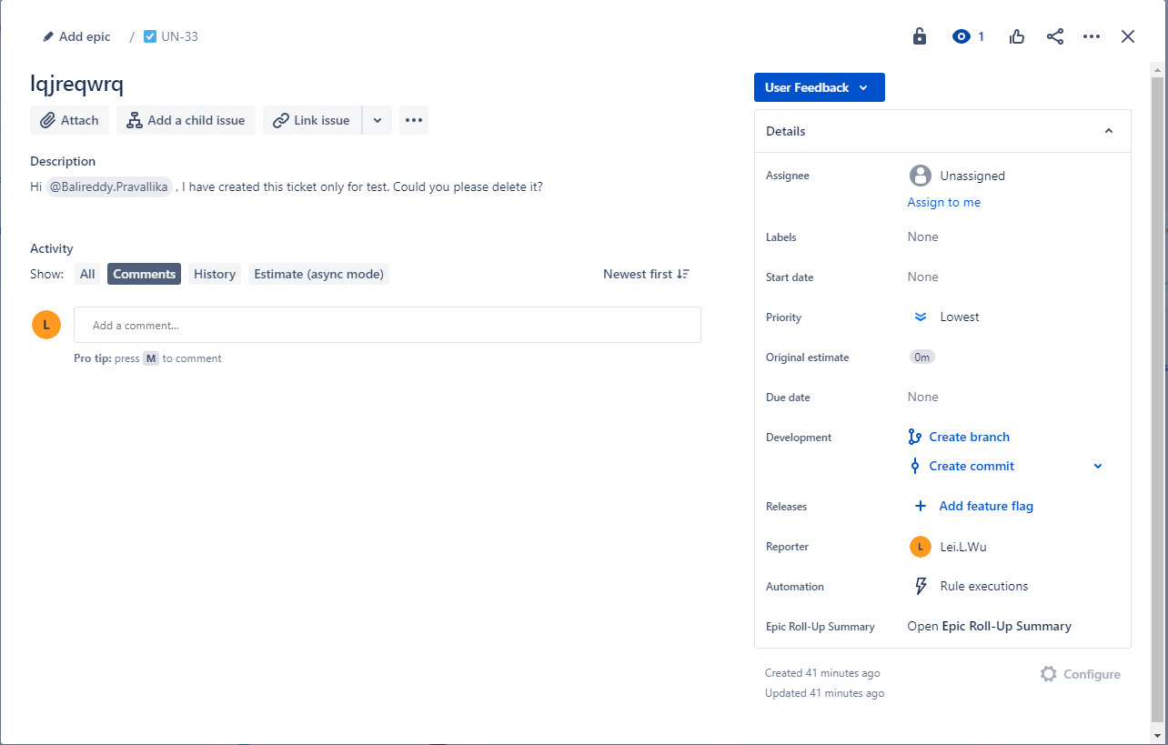
Delete A Ticket
To delete a ticket, you need to have the permission.
Otherwise:
Notify an admin (choose one of two ways)
In the description, @admin, I have created this ticket only for test. Could you please delete it?
Or assign this ticket to an admin.
admin
@Avinash.Kumar4
@Balireddy.Pravallika

Slide 38
Questions and Answers

