Slide 1


CSA1634 DATA WAREHOUSING AND DATA MINING FOR CLASSIFICATION OF ASTRONOMICAL OBJECTS
HAND GESTURE RECOGNISATION
Presented By:
K.L.V Jayaram – 192210314
M. Mahesh – 192210312
T. Anoop Chandar - 192210244

Slide 2
Problem Statement:
Sign language serves as a crucial mode of communication for individuals with hearing impairments. However, there exists a significant barrier to effective communication between individuals who are proficient in sign language and those who are not. To bridge this gap, the development of robust sign language recognition systems using computer vision techniques is essential. The problem at hand involves designing and implementing a computer vision system capable of accurately recognizing and interpreting hand gestures corresponding to various signs in sign language. This system must be able to detect and analyze intricate hand movements and configurations to accurately translate them into corresponding linguistic representations.

Slide 3
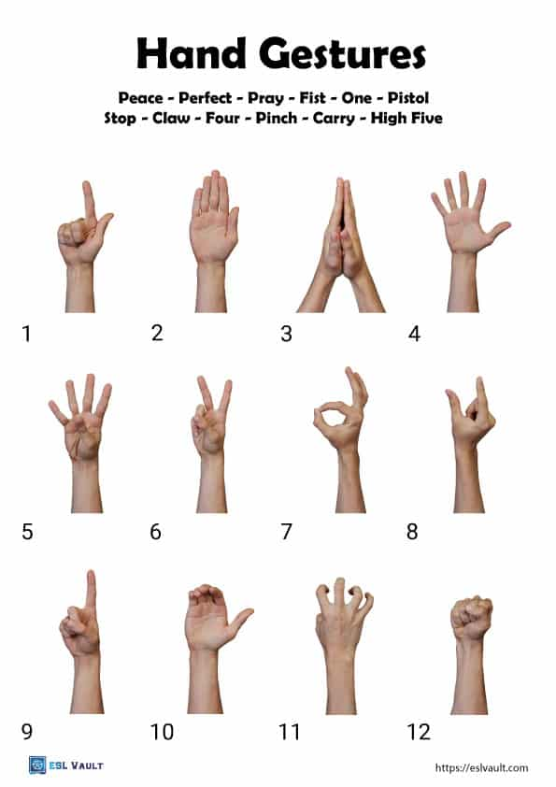
PROPOSED SYSTEM
System Architecture
Present the architecture of the proposed system,
Highlighting the key components and their functionalities.
Discuss how the proposed system addresses the
limitations of existing
systems.
Data Collection and Preprocessing
Describe the process of collecting and preprocessing the
dataset for training the sign language recognition model.
Discuss any enhancements or innovations in data processing
techniques.

Slide 4
Hand Gesture Recognition Techniques
Explain the hand gesture recognition techniques and algorithms employed in the
proposed system. Compare these techniques with those used in existing systems, emphasizing any improvements.
Integration of Machine Learning
Discuss how machine learning is incorporated into the proposed system. Highlight
the choice of algorithms, training methodologies, and model optimization techniques.
Evaluation Metrics
Specify the evaluation metrics used to assess the performance of the proposed
system. Compare these metrics with those used in the existing system to showcase the
improvements achieved.
Validation and Testing
Detail the validation and testing procedures conducted to ensure the reliability and
robustness of the proposed system. Present results and discuss the system's performance in
different scenarios.

Slide 5
CODING
import cv2
import os
def recognize_sign_language(input_image):
recognized_gesture = "one"
return recognized_gesture
input_image_path = r'C:\Users\SRAVAN\Desktop\images one.jpg'
if not os.path.exists(input_image_path):
print(f"Error: The file '{input_image_path}' does not exist.")
else:
frame_width = 640
frame_height = 480
output_video = cv2.VideoWriter('output_video.avi',
cv2.VideoWriter_fourcc(*'XVID'), 10, (frame_width, frame_height))
input_image = cv2.imread(input_image_path)
if input_image is not None:
recognized_gesture = recognize_sign_language(input_image)
cv2.putText(input_image, recognized_gesture, (50, 50),
cv2.FONT_HERSHEY_SIMPLEX, 1, (255, 0, 0), 2, cv2.LINE_AA)
input_image = cv2.resize(input_image, (frame_width, frame_height))
output_video.write(input_image)
else:
print(f"Error: Unable to read image at '{input_image_path}'.")
output_video.release()

Slide 6
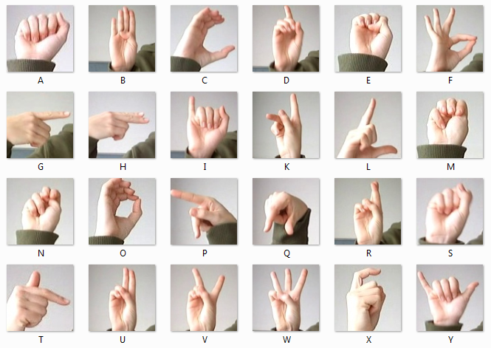

Slide 7
Conclusion
In this study, we investigated the field of hand gestures-based sign language identification, evaluating the state of the art in relation to current systems and putting forth a novel solution to recognized problems. The investigation of the current system cleared the path for the creation of a more sophisticated and effective system by offering insightful information on the approaches, architectures, and constraints of the available technologies. A more dependable and flexible system is produced by combining machine learning algorithms with inventive preprocessing approaches, a well-curated dataset, and other factors. The evaluation measures used show that the suggested approach is more effective than previous systems at precisely identifying hand gestures connected to sign language.
A more dependable and flexible system is produced by combining machine learning algorithms with inventive preprocessing approaches, a well-curated dataset, and other factors. The evaluation measures used show that the suggested approach is more effective than previous systems at precisely identifying hand gestures connected to sign language. In summary, this study's research marks a major advancement in the field of hand gesture-based sign language recognition. We contribute to the ongoing efforts to make technology more inclusive and accessible for people with hearing impairments by critically evaluating the current systems and introducing a fresh method. With the ultimate goal of promoting communication, there is still hope for more progress in sign language recognition as technology develops.

Slide 8


