Slide 1

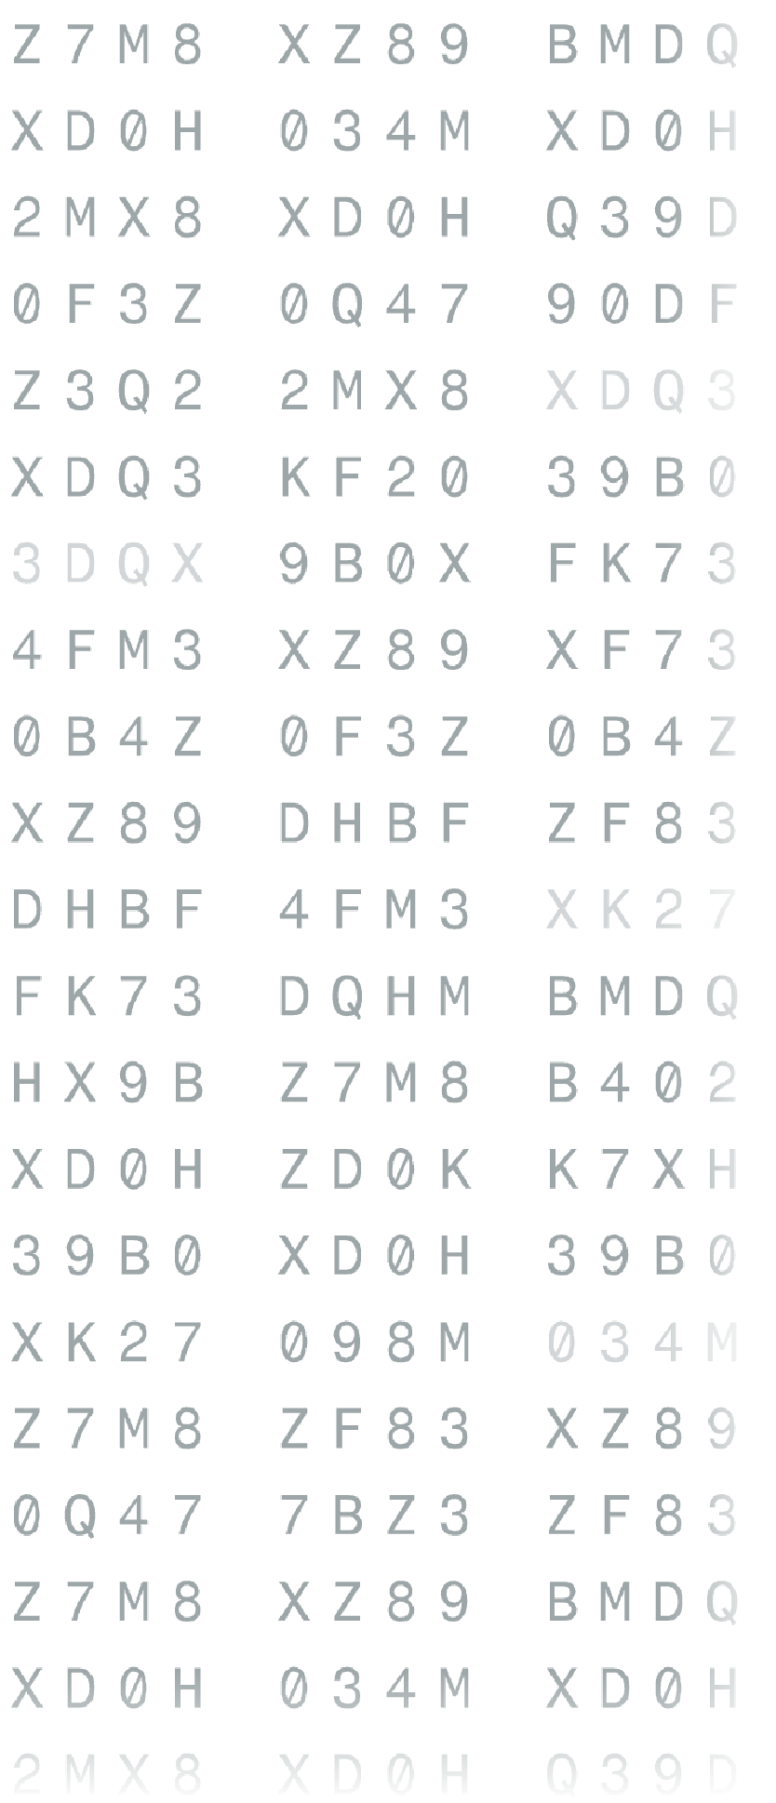
CSE4074 · FORENSIC ANALYTICS · FALL 2026–27
A Forensic Analytics Framework
for Detecting Fraud and Operational Anomalies in Integrated Logistics Management Systems
VELLORE INSTITUTE OF TECHNOLOGY, CHENNAI
FACULTY: DR. S. JOHANAN JOYSINGH
Team members: Bhuvan Rajesh – 23MIA1020 | Jayaram P – 23MIA1173
Notes:
Good morning. Today we present our forensic analytics framework for integrated logistics management systems. This is an academic prototype evaluated exclusively on synthetic data. Flagged anomalies indicate potential inconsistencies for human review, not confirmed fraud determinations.

Slide 2
PROBLEM DEFINITION
One shipment, five tools, no shared record of what changed
ARCHITECTURE SILOS
FORENSIC VULNERABILITIES
Five independent applications record the exact same logistics shipment: Workflow Synchroniser, B.I.I.L. document generator, 3D stuffing visualizer, EasyQuote, and StuffingReport.
The underlying transactional database retains only latest-state values. All intermediate edits, line-item deletions, and user identifiers are permanently overwritten.
Weights, charges, package counts, and container identifiers diverge across tools completely unnoticed by operational staff.
Apparent cross-tool agreement can mislead investigators: multiple downstream documents frequently turn out to be uncorroborated copies of a single forged source.
Notes:
Modern freight forwarding relies on federated specialized tools. Because operational databases store only the current state, auditors lose the temporal trail of who modified what. Furthermore, apparent consensus among tools is often an artifact of automated copy propagation rather than independent verification.

Slide 3
FRAMEWORK OBJECTIVES & SCOPE
Goal: capture evidence, compare across tools, state honestly what it proves
01
02
03
04
05
Capture tamper-evident logs
Link entities with confidence
Detect contradictions
Trace value provenance
Rigorous baselining
Enforce fail-closed capture before and after every state mutation.
Cluster heterogeneous application events to unified job instances.
Evaluate 18 deterministic rules and cross-system attribute discrepancies.
Distinguish genuine independent agreement from unverified copy duplication.
Compare detection efficacy against rules-only and Isolation Forest models.
Notes:
Our research addresses five core objectives, moving from fail-closed ingest to lineage verification. We maintain strict scientific restraint: we make no claims regarding judicial admissibility and explicitly preserve domain edge cases that lack clear business consensus.

Slide 4
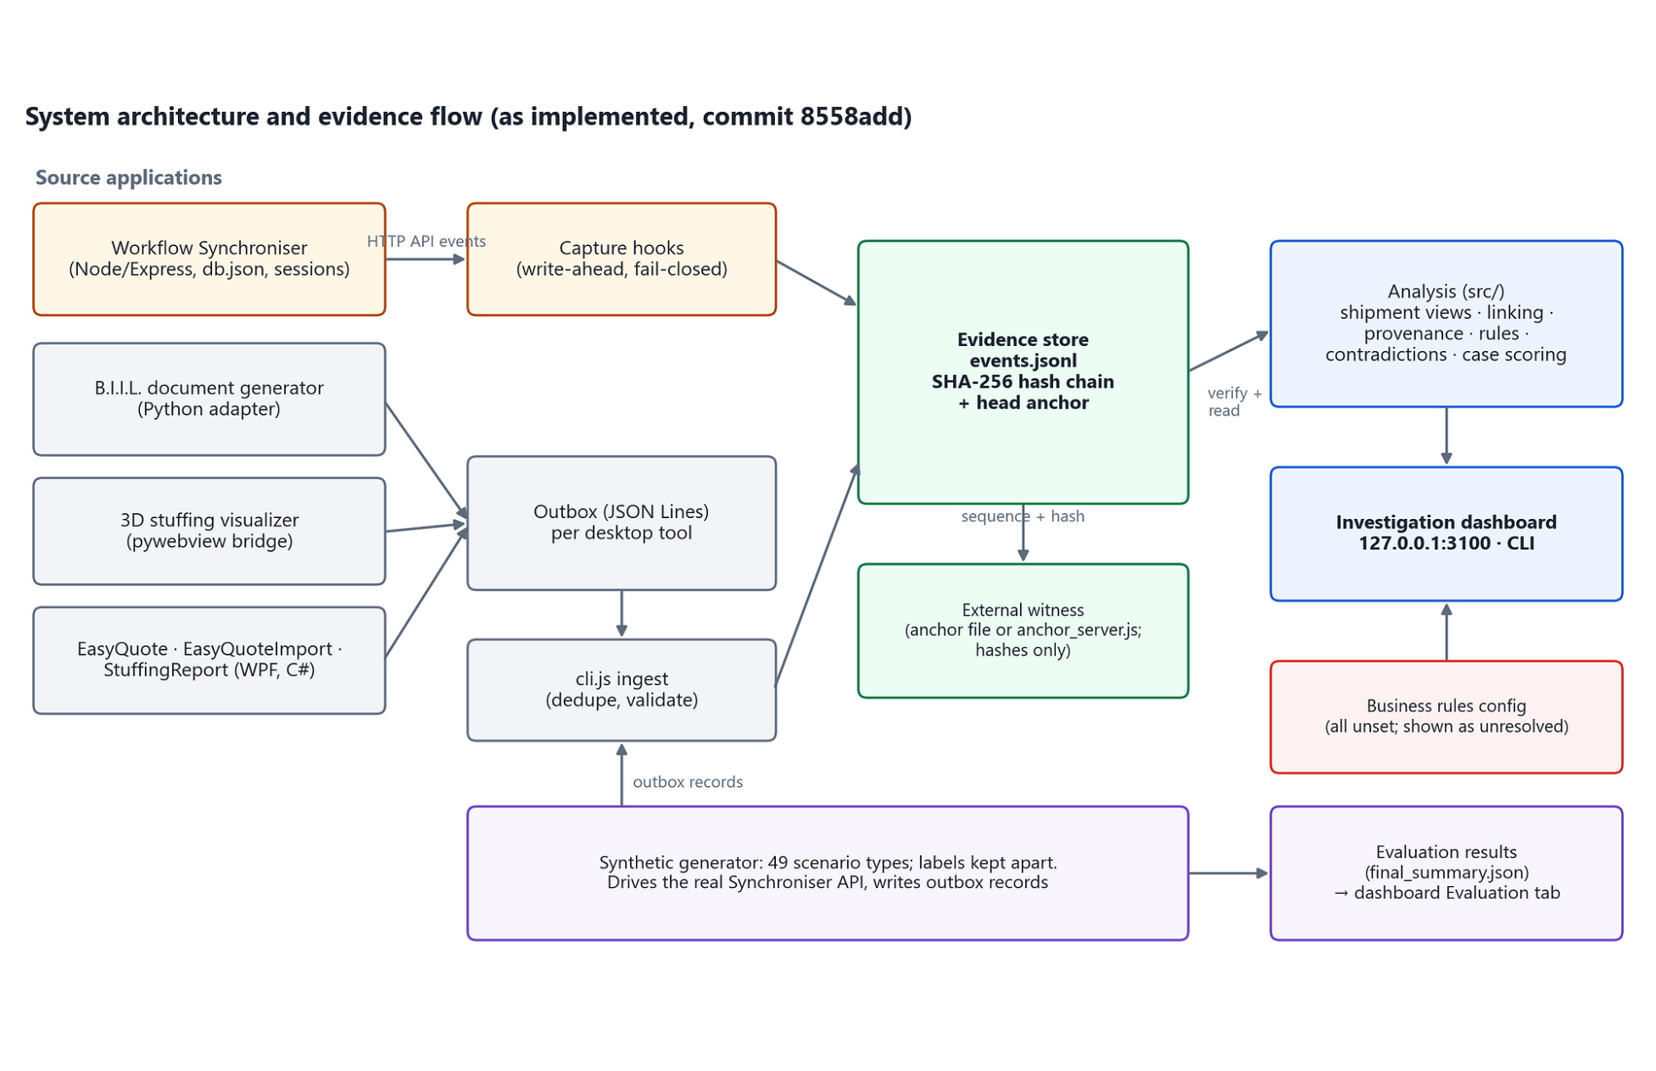
SYSTEM DATAFLOW
Every application feeds one hash-chained evidence store; analysis reads only from it
Synchroniser: evidence before and after each change; if it cannot be saved, the change is refused (HTTP 503).
Desktop tools: outbox records validated and de-duplicated on ingest.
Evidence store: append-only, SHA-256 chain, head anchor, optional external witness.
Analysis: reads only from the store and feeds the localhost dashboard and CLI.
Notes:
This architectural flow diagram shows how disparate operational tools are bridged to the evidence store. The Synchroniser intercepts API payloads synchronously: if the SHA-256 hash chaining fails or the disk is full, the operational transaction itself fails closed with HTTP 503.

Slide 5
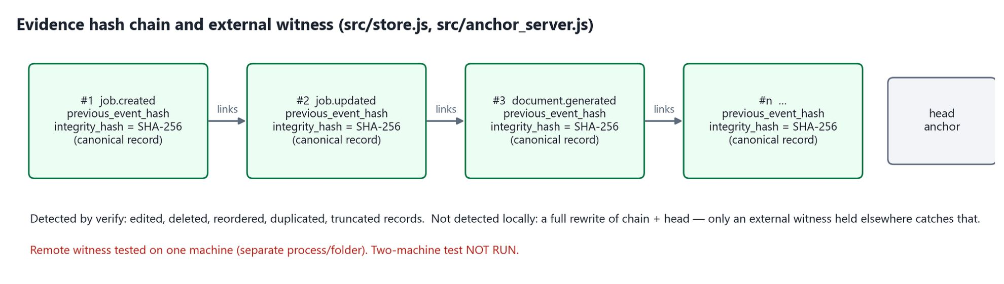
CRYPTOGRAPHIC INTEGRITY
The hash chain makes tampering evident; a remote witness covers a full rewrite
SHA-256 linear chain
Local limit and remote witness
Each record stores the previous record's hash and its own SHA-256 hash. Full verification detects edited, deleted, inserted, reordered, duplicated and truncated records (tested).
Rewriting the chain and head anchor together escapes local detection (tested). The witness holds only hashes, refuses changes and catches forged re-anchoring.
Notes:
Integrity relies on backward SHA-256 hash linkage. Our synthetic experiments proved that local chain verification catches any record mutation. However, we also proved its blind spot: complete local regeneration. The external witness resolves this by committing anchors out-of-band.

Slide 6
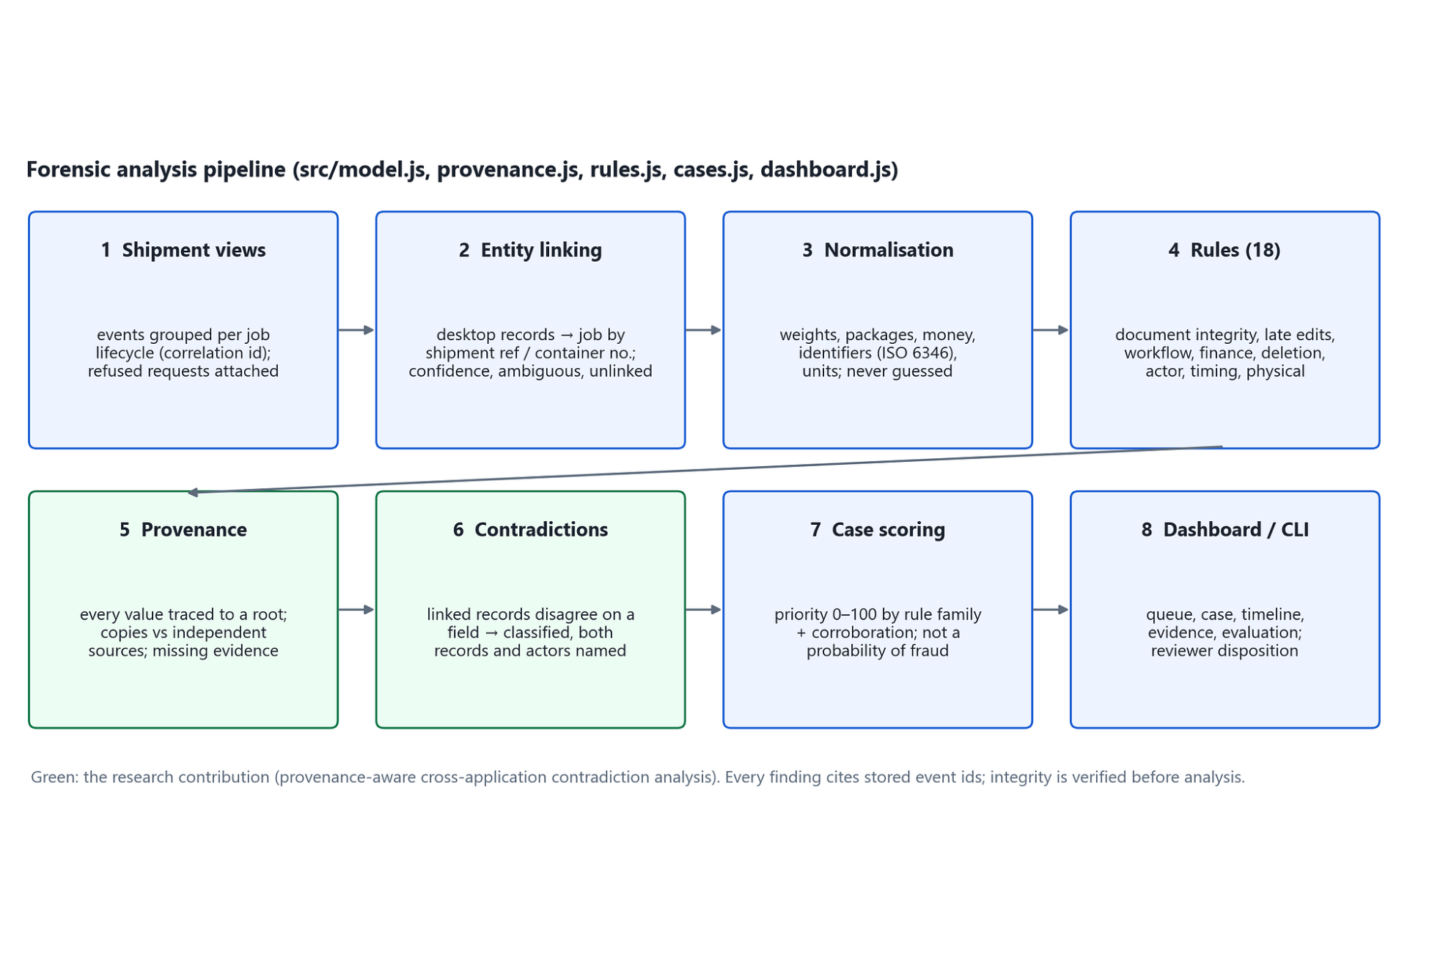
DETECTION ARCHITECTURE
Eight stages turn raw events into explainable, evidence-cited cases
Every finding cites stored event IDs: 598/598 traceable in the primary test.
No guessed values
Unparseable values are marked not comparable.
Priority (0–100)
Orders the review queue; it is not a probability of fraud.
Notes:
The forensic pipeline transforms raw JSON evidence into scored case files across eight discrete stages: shipment views, entity linking, normalisation, 18 rules, provenance, contradictions, case scoring, and dashboard. Every assertion made by the system is strictly linked to raw event IDs. Priority scoring is purely an operational ordering metric, not a posterior probability of intentional deceit.

Slide 7
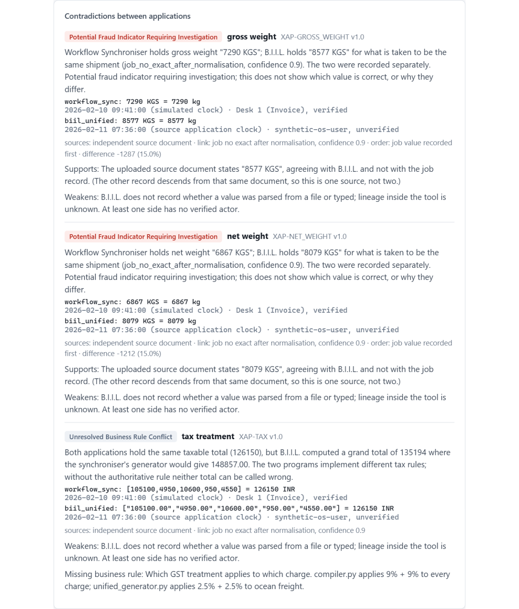
CORE CONTRIBUTION
Finding tool disagreement & testing independent agreement
18 rules
Document integrity, late edits, quantities, finance, workflow, deletion, actor mismatch, refused privileged actions, implausible pace and physical feasibility.
Cross-application contradictions
Weight, packages, invoice or bill numbers, containers, totals and timing. Gross weight: 7290 KGS in Synchroniser vs 8577 KGS in B.I.I.L.
Provenance
Copies of one source count as one source; a false value repeated everywhere needs an independent source.
Notes:
Contradictions are classified as confirmed inconsistency, potential indicator requiring investigation, insufficient evidence, or unresolved business rule. Three agreeing records may trace to one source: a copy, not corroboration.
Our main technical contribution is twofold: catching cross-system contradictions and unraveling false consensus. In the screenshot, Synchroniser logs 7290 KGS while B.I.I.L. logs 8577 KGS. Our provenance engine checks whether three matching documents represent corroboration or simply copies.

Slide 8
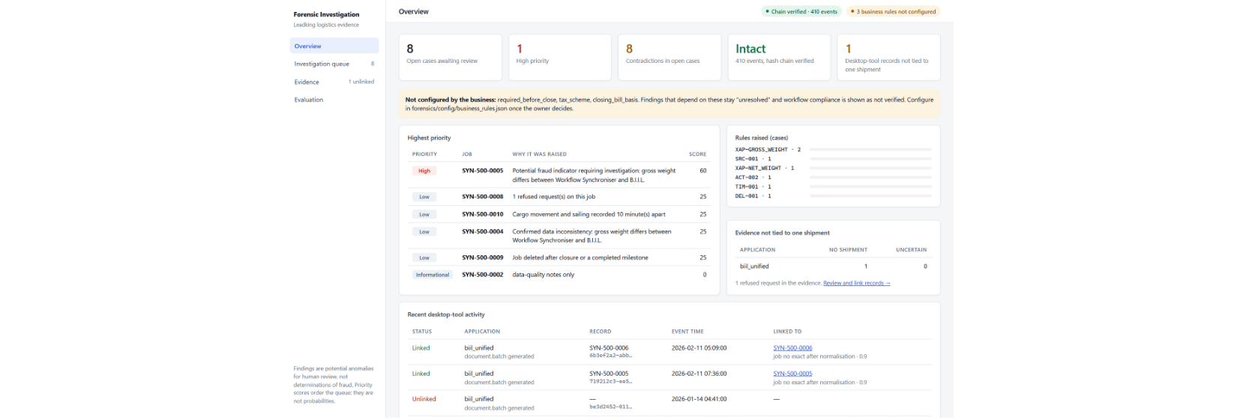
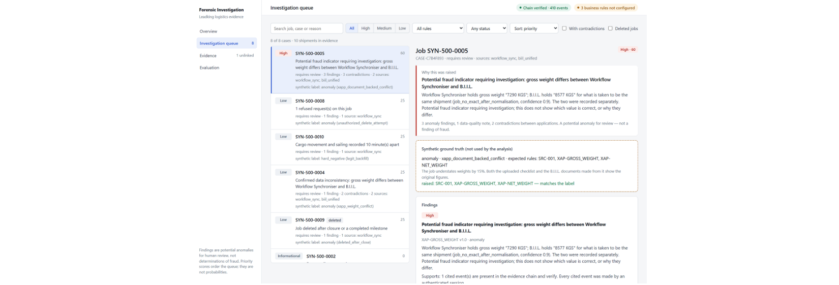
INVESTIGATOR EXPERIENCE
An investigator goes from a ranked queue to a case that shows why it was raised
Overview: chain verified (410 events), business-rule status, open cases, contradictions and unlinked evidence.
Queue filters → case view: findings, contradictions, value provenance, timeline and review outcome.
Evidence tab: integrity and link status. Evaluation tab: metrics.
Runs on 127.0.0.1 only. Findings are potential anomalies for human review, not determinations of fraud.
Notes:
The user interface provides complete evidentiary drill-down. When an investigator opens a high-priority job from the queue, every contradiction displays the exact timestamped evidence items and raw fields that triggered it. The UI operates on localhost only.

Slide 9
EVALUATION METHODOLOGY
Controlled synthetic tests with separate tuning, training and test sets
Partition | Dataset & scale | Purpose & isolation
Primary test | Seeds 7–9 · 900 jobs · 328 anomalous / 572 clean | Main benchmark: variants A, C, X and D
Tuning & train | tune-11 · train-201 | Tuning set; Isolation Forest fit on train-201
Unseen test | 150 jobs · 58 anomalous / 92 negative | Separate test: 10 pre-registered families
Variants: A rules only · C + provenance · X + contradictions without lineage · D full framework · Isolation Forest alone and combined
Evaluation: Per-job precision, recall, F1 and false-positive rate with 95% Wilson intervals.
Notes:
To eliminate data leakage, ground truth labels were generated by an independent process and isolated from the detection pipeline. Our tuning sets and unsupervised model training partitions remained strictly sequestered from the test suites. We test four architectural ablations plus machine learning baselines.

Slide 10
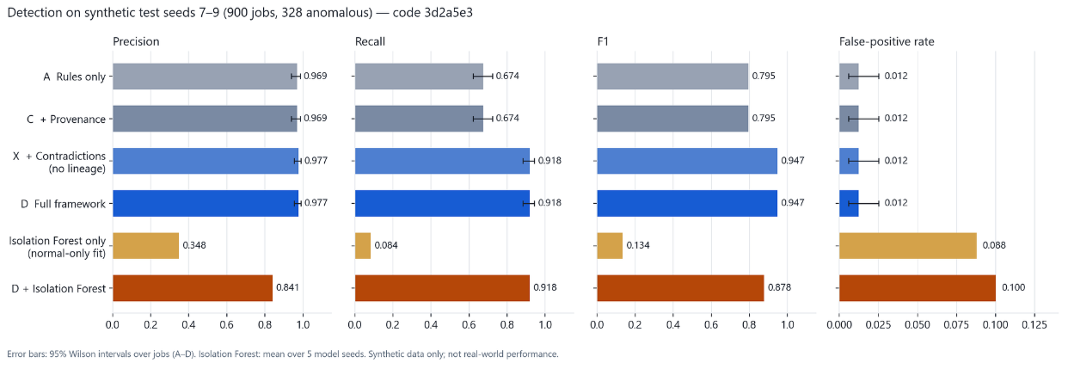
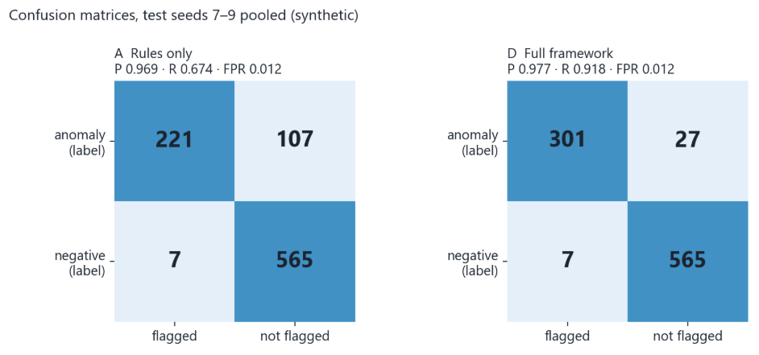
EXPERIMENTAL RESULTS · SEEDS 7–9
Recall rises 24.4 points, from 0.674 to 0.918, with no added false positives
+24.4
percentage points recall
Rules only 0.674 → full framework 0.918
Unseen families
Full: 58/58 anomalies, 0/92 negatives; rules only: 14/58.
Lineage checks
61/61 with lineage vs 23/61 without.
Isolation Forest
Recall 0.084–0.154 alone; no recall gain when added, FPR 0.068–0.100.
Notes:
On seeds 7–9, precision rises from 0.969 to 0.977; F1 from 0.795 to 0.947; false-positive rate remains 0.012 to 0.012. Precision is flagged jobs that were truly anomalous; recall is anomalies that were caught; F1 is the balance of both; false-positive rate is normal jobs wrongly flagged.
Confusion matrices: rules only TP 221, FP 7, FN 107, TN 565; full framework TP 301, FP 7, FN 27, TN 565. Isolation Forest alone has recall 0.084–0.154. Added to the full framework, it gives no recall gain and raises false-positive rate to 0.068–0.100.
In the separate unseen families test, the full framework caught 58/58 anomalies and flagged 0/92 negatives, versus 14/58 anomalies for rules only. In separate lineage checks, 61/61 were caught with lineage versus 23/61 without. These are synthetic results; the same author wrote the rules, scenarios and labels. Flagged anomalies are not confirmed fraud.

Slide 11
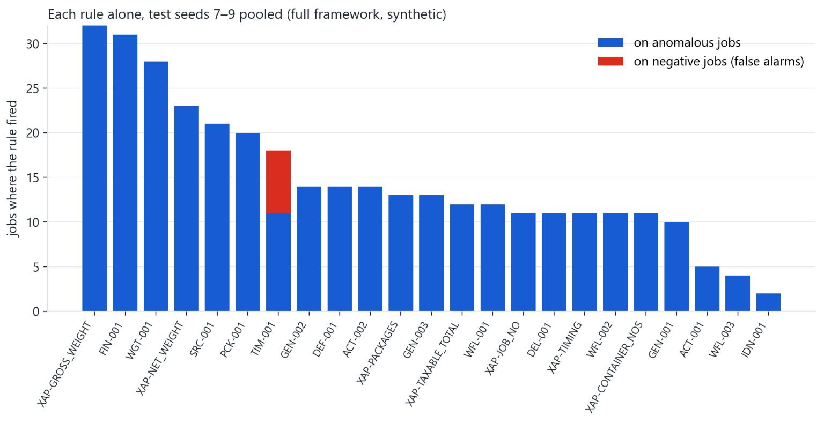
SYNTHETIC DATA ONLY
LIMITATIONS
The prototype demonstrates synthetic-case performance, not validated real-world fraud detection.
Observed errors (full framework, seeds 7–9)
7 false positives: all back-entered jobs triggering timing rule TIM-001, a known false-positive source. TIM-001 fired on 11 anomalous and 7 negative jobs; every other rule fired only on anomalies.
27 missed anomalies: 18 consistent-falsification and 9 common-source-falsification cases. A false value repeated across all copies rests on a single source and needs independent evidence.
Each rule alone, test seeds 7–9 pooled (full framework, synthetic)
Other limitations
.
One author wrote the rules, scenarios, labels and unseen families.
Priority scores are not calibrated probabilities.
Tax treatment, mandatory workflow steps and closing-bill basis remain unresolved.
EasyQuote quotation-rate analysis not implemented.
Notes:
This prototype performed well on synthetic cases, but that is not proof of real-world fraud detection. On seeds 7–9, the full framework made 7 false positives, all from back-entered jobs hitting timing rule TIM-001, and missed 27 anomalies. The chart shows TIM-001 as the only rule with false alarms. Labels, scenarios and rules all came from one author, and priority scores are not calibrated probabilities.

Slide 12
CONCLUSION
Tamper-evident evidence, provenance, and contradiction analysis produce explainable investigation leads.
Implemented
Future work
Operational evidence capture
SHA-256 hash chain and remote-witness integration
Cross-application record linking
18 detection rules
Provenance and contradiction analysis
Investigation dashboard
Reproducible synthetic evaluation
Validate on labelled real or independently audited shipments.
Use independent authors for scenarios and labels.
Complete a two-machine remote-witness test.
Run a reviewer study measuring investigation time and agreement.
Resolve business-rule definitions with domain owners.
Implement quotation-rate analysis.
Takeaway: Results show the implementation meets its specification on synthetic data; real-world validation is the next step.
Notes:
The system is implemented end to end: evidence capture, a SHA-256 hash chain with remote-witness integration, cross-application linking, 18 detection rules, provenance and contradiction analysis, and a dashboard. Results meet the specification on synthetic data only. We do not claim fraud is eliminated or that the system is production-ready. The next steps are real-data validation, independent scenario authors, the two-machine witness test, a reviewer study, and the remaining business-rule and quotation-rate work.

