Slide 1



Crop and Fertilizer Recommendation System using Machine Learning

Slide 2


Learning Objectives
Enhance yield and efficiency using ML-based crop and fertilizer recommendations.
Clean, normalize, and optimize datasets for robust model training.
Analyze feature distributions and correlations for insightful predictions.
GOAL
Apply classifiers (Decision Trees, SVM, Neural Networks) for precise recommendations.
Develop an interactive engine for real-time, intelligent agricultural decisions.
Use accuracy, precision, recall, and MSE to enhance predictive performance.
Source :
www.freepik.com/

Slide 3
Tools and Technology used
Python: Programming language used for data manipulation and machine learning model implementation.
Pandas: Library for data manipulation and analysis.
NumPy: Library for numerical computations.
Matplotlib: Library for data visualization.
Seaborn: Library for statistical data visualization.
Scikit-learn: Machine learning library for model building and evaluation.
VS Code: Interactive environment for writing and running code.

Slide 4
Methodology
1. Data Collection:
- Collected crop and fertilizer datasets from reliable sources.
2. Data Preprocessing:
- Handled missing values and duplicates.
- Encoded categorical variables.
- Scaled numerical features for better model performance.
3. Exploratory Data Analysis (EDA):
- Visualized data distributions and relationships using histograms, scatter plots, and heatmaps.
- Identified patterns and correlations in the data.
4. Feature Selection:
- Selected relevant features for model training based on EDA insights.

Slide 5
Problem Statement:
The goal of this project is to develop a machine learning-based recommendation system for crops and fertilizers. The system aims to assist farmers in making informed decisions about the best crops to grow and the most suitable fertilizers to use based on various environmental and soil conditions. By leveraging data analysis and predictive modeling, the project seeks to enhance agricultural productivity and sustainability.

Slide 6
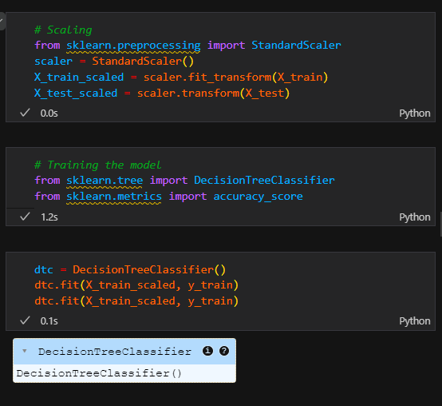
Solution:
The solution involves developing two machine learning-based recommendation systems: one for crop recommendation and another for fertilizer recommendation.
1. Crop Recommendation System:

Slide 7
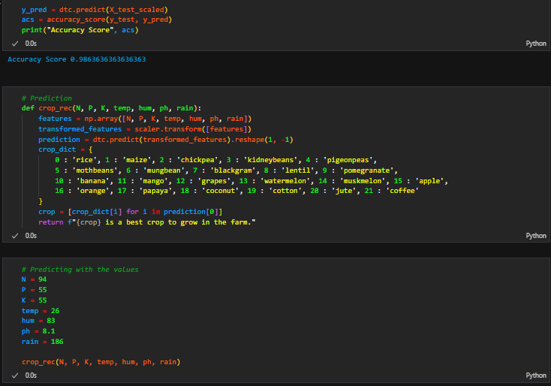
Screenshot of Output:

Slide 8
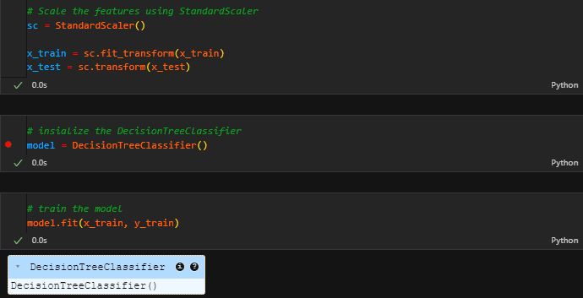
Solution:
2. Fertilizer Recommendation System

Slide 9
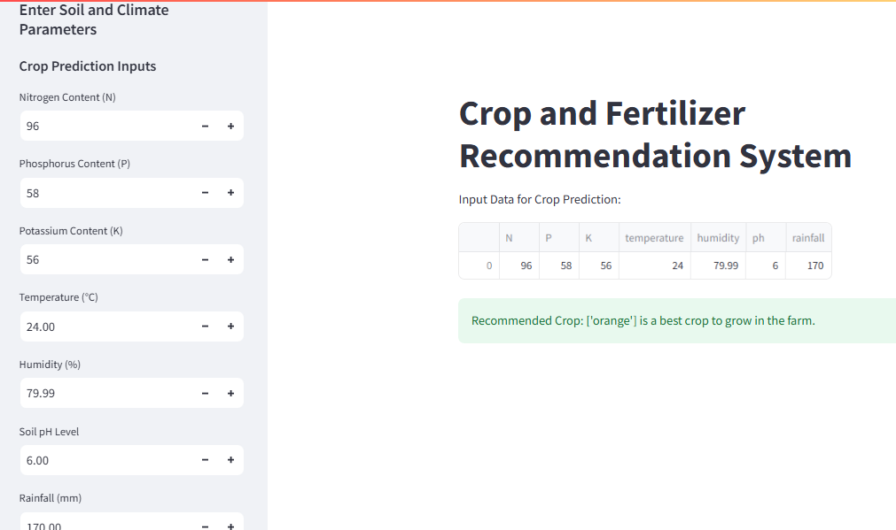
Screenshot of Streamlit Application:

Slide 10
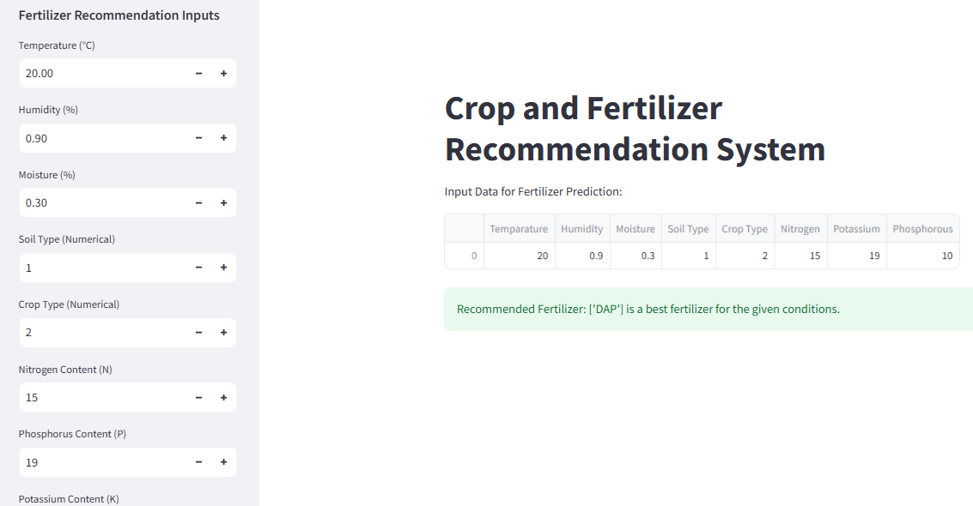
Screenshot of Streamlit Application:

Slide 11
The Crop and Fertilizer Recommendation Systems use data-driven insights to optimize crop selection and fertilizer use, enhancing productivity and sustainability. Together, they promote efficient resource usage, reduce waste, and support informed farming decisions.
1 Crop Recommendation System:
Uses machine learning to analyze soil and environmental conditions.
Recommends the best crops based on predictive models.
Increases crop yield potential and reduces risks in crop selection.
2 Fertilizer Recommendation System:
Leverages data on soil properties and crop types for precise recommendations.
Suggests the most effective fertilizers to improve plant health.
Minimizes fertilizer wastage and ensures optimal nutrient uptake.
3 Impact on Agriculture:
Both systems improve farming efficiency by providing tailored, data-driven insights.
Support sustainable practices by optimizing resource usage.
Help farmers make informed decisions, leading to higher productivity and reduced environmental impact.

