Slide 1


Guntupalli Jaya Ram Charan
Keylogger and security final project

Slide 2

Keylogger and Security
keylogger or keystroke logger is a form of malware or hardware that keeps track of any records of hardware that keeps track of and records your keystrokes as you type
It takes the information and sends it to a hacker using a command and control ( C & C) server

Slide 3
Agenda:
Problem Statement
Project Overview
Who are the end users
Solution and value Preposition
The “Wow” Factor in our Solution
Modelling
Results

Slide 4
Problem Statement
Security Vulnerabilities | Insider Threats | Compliance Concerns
Keylogging can expose sensitive information, such as login credentials and financial data, putting systems and users at risk. | Rogue employees or malicious actors can use keylogging to gain unauthorized access and gather intelligence. | The use of keylogging must be carefully managed to ensure compliance with privacy laws and ethical guidelines.

Slide 5
Project Overview
1. Understand the Risks
Conduct a thorough risk assessment to identify vulnerabilities and potential threats.
2. Evaluate Keylogging Solutions
Research and compare different keylogging technologies, considering their features, capabilities, and privacy implications.
3. Develop a Deployment Strategy
Create a plan to securely implement keylogging, ensuring it aligns with organizational policies and legal requirements.

Slide 6
Who Are The End Users
IT Administrators Use keylogging to monitor system activity, detects suspicious behaviour, and responds to security incidents | Security Analysts Leverage keylogging data to investigate potential branches, conduct forensic analysis, and enhance security protocols
Compilance Officers Utilize keylogging to ensure adherence to regulator requirments and industry best practices | Researches Analyse keylogging data to uncover patterns, trends, and vulnerabilities, informing ongoing security improvements

Slide 7
Solution and Value Proposition
Comprehensive Monitoring | Advanced Analytics | Robust Security
Our keylogging solution provides a complete record of user activity, including keystroke logs, screenshot captures, and network traffic monitoring. | Sophisticated algorithms analyze the collected data to detect anomalies, identify threats, and generate actionable insights. | Military-grade encryption and secure storage ensure the confidentiality and integrity of sensitive keylogging data.

Slide 8
The Wow Factor In Our Solution
Innovative Approach | Remote Deployment | Automated Reporting
Combining technical measures with user education for comprehensive protection. | Deploy keylogging capabilities across distributed networks with minimal user impact. | Customizable reports and dashboards provide comprehensive visibility into system health and security posture.

Slide 9
Modelling
Pilot Implementation Test the keylogging solution in a controlled environment to validate functionality and identify any issues. | Customization Tailor the solution to meet the specific requirements and policies of the organization.
Enterprise-Wide Rollout Deploy the keylogging solution across the organization, providing training and support to end users. | Ongoing Monitoring Continuously monitor the performance and effectiveness of the keylogging solution, making iterative improvements as needed.

Slide 10
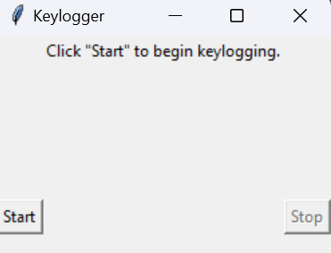
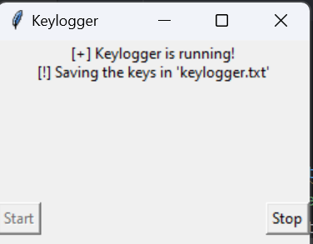
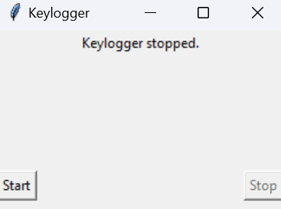
Results
1. Successfully implemented a keylogger that captures keystrokes and records them into both text and JSON files.
2. Real-time keylogging with start and stop functionality controlled via a simple GUI.

Slide 11
Project Link:
https://github.com/Jayaramcharan/APSSDCI-keylogger.git
Mail id: jayaramcharan06@gmail.com
Name: Guntupalli Jaya Ram Charan

