Slide 1
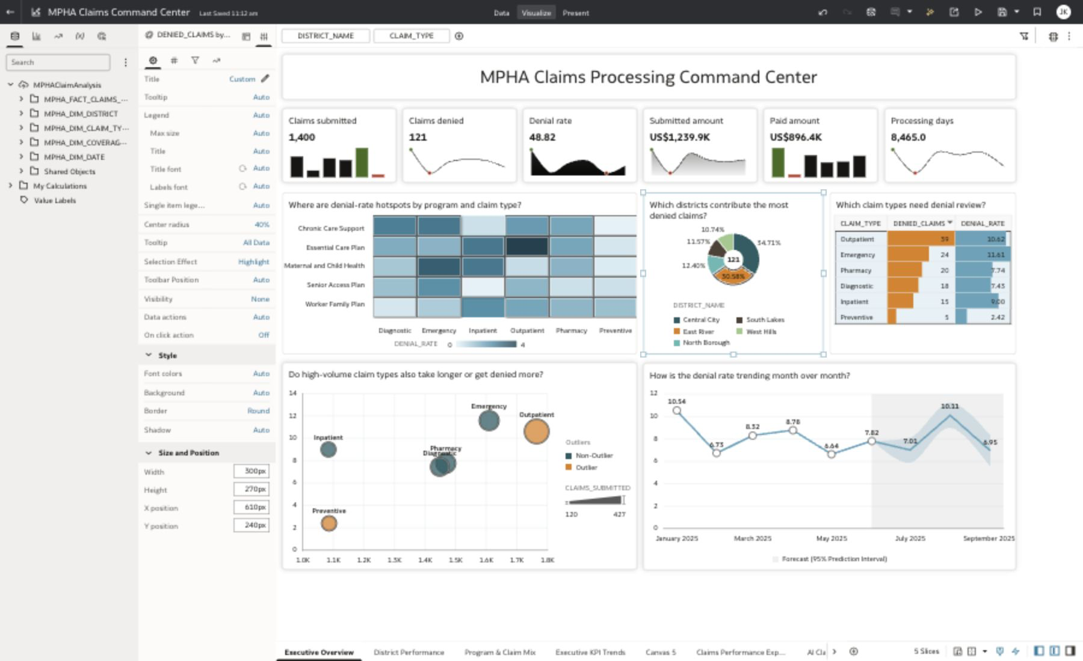
AGENTIC AI + HUMAN IN LOOP
A repeatable way to build industry use cases with PHIC as the proof
Codex acts as the delivery agent; humans provide industry judgment, service access, validation, and final approval.
Agentic build loop
PHIC example output
1
Read the industry signal
Use public research, business goals, and participant personas.
2
Generate the workshop system
Synthetic data, medallion notebooks, star schema, ML, agents, guide.
3
Human validates in real OCI
Log in, test each step, correct product behavior, approve checkpoints.
4
Publish reusable assets
GitHub Pages site, PDF guide, raw data bundle, notebooks, SQL, deck.
A working public healthcare claims command center, backed by generated data, AIDP pipelines, AI Lakehouse star schema, OAC analytics, ML, and an AI policy copilot.
PHIC example: Public Healthcare AIDP Workshop
Agentic AI with Human in Loop

Slide 2
The pattern has three distinct flows, all validated through the same loop
Data-to-insights, ML/MLOps, and Agentic AI are related, but each has its own build path and checkpoint rhythm.
FLOW 1
Core data-to-insights
SOURCE
BUILD
BUILD
USE
Business users consume governed analytics and Assistant-ready dashboards.
Object Storage
raw data
AIDP
Bronze/Silver/Gold
AI Lakehouse
claims star schema
OAC
executive insights
FLOW 2
ML and MLOps
SOURCE
BUILD
BUILD
USE
Model work is grounded in the same gold-layer facts and dimensions.
AI Lakehouse
feature data
AIDP ML
train/test/eval
Experiment run
metrics + model
Scored output
for action
FLOW 3
AI Agent flow
SOURCE
BUILD
BUILD
USE
The agent combines structured claims data with policy context.
AI Lakehouse
SQL source
Knowledge base
policy documents
SQL + RAG
tools
Supervisor agent
answers + actions
Human checkpoints sit between every major transition: data realism, product setup, successful notebook runs, model metrics, agent test answers, and published GitHub Pages.
PHIC example: Public Healthcare AIDP Workshop
Agentic AI with Human in Loop

Slide 3
Human-in-loop turns Codex from a content generator into a delivery partner
The method is intentionally interactive: Codex proposes and builds; humans approve, log in, test, and correct product-specific steps.
Agentic AI responsibilities
Human validation responsibilities
Discover
Research current industry challenges and propose use cases.
Approve
Confirm business story, personas, lab sequence, and data realism.
Synthesize
Create raw data with depth, geographic spread, hierarchy, and useful noise.
Access
Log in to OCI, AIDP, AI Lakehouse, and OAC where live validation is needed.
HIL
Build
Generate notebooks, SQL, star schema, ML flow, agent prompts, guide, and deck.
Observe
Capture true product screens and correct wrong assumptions immediately.
Validate Artifacts
Run local checks for links, downloads, PDF/deck quality, and layout.
Sign off
Verify the final workshop can be executed by new participants.
Result: repeatable industry-specific workshops that are generated fast, but still grounded in real product behavior and human domain judgment.
PHIC example: Public Healthcare AIDP Workshop
Agentic AI with Human in Loop

Slide 4
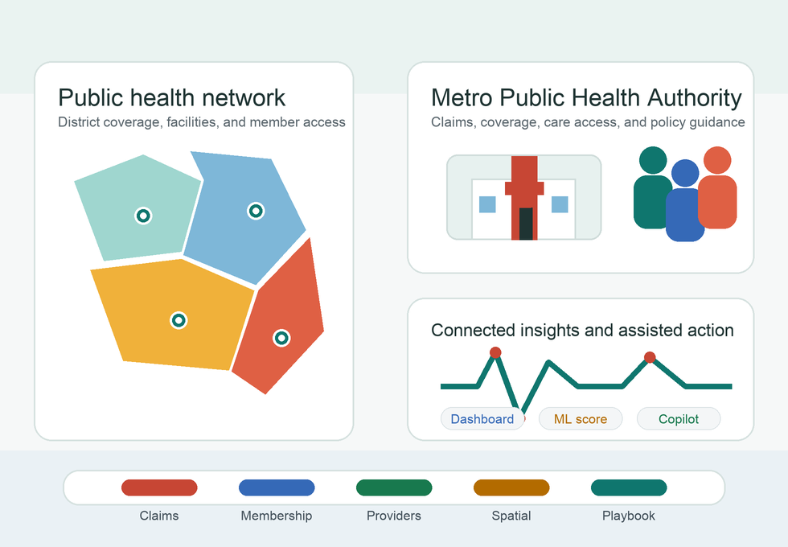
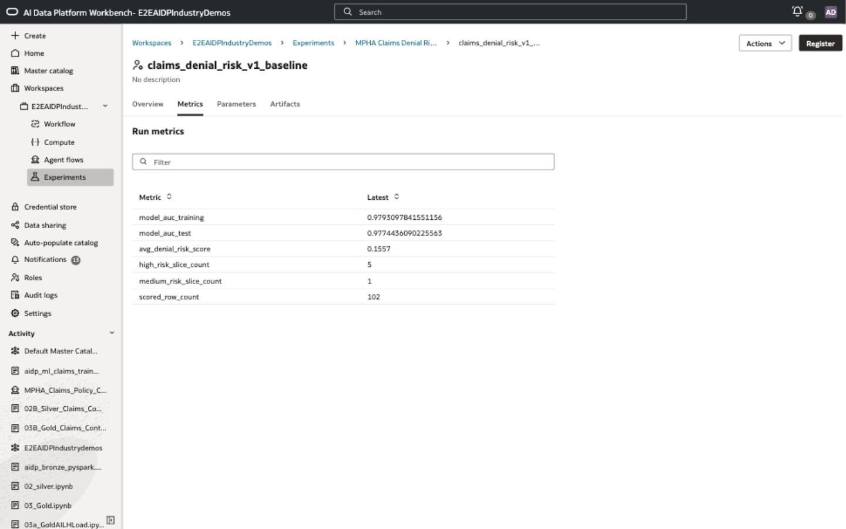
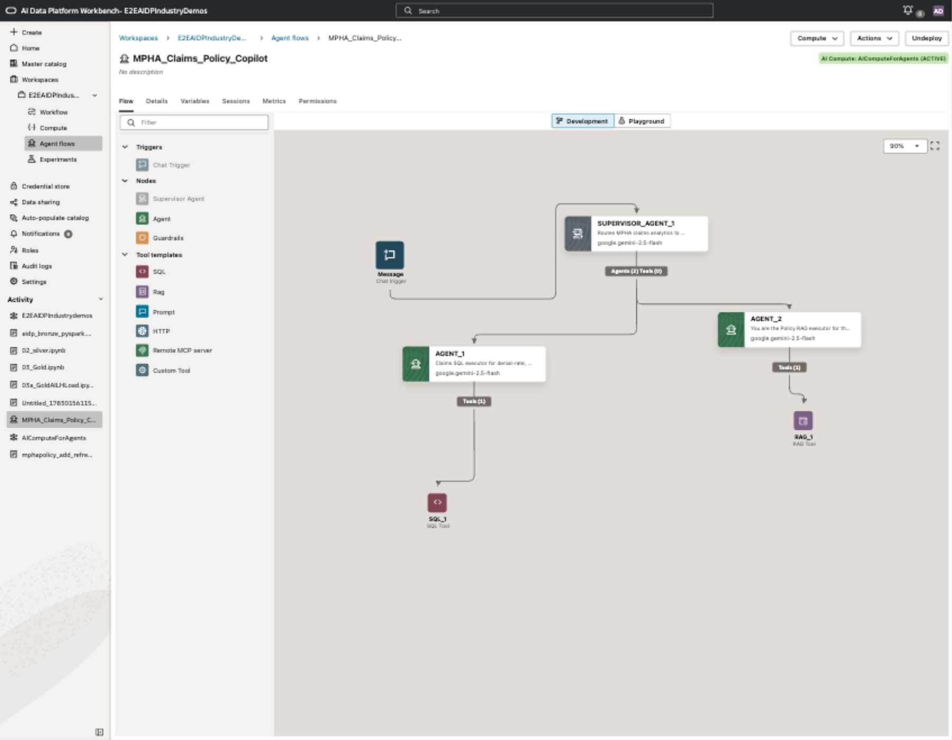
PHIC demonstrates the approach end to end
The proof sequence follows the actual build order: data story, AIDP medallion to AI Lakehouse, OAC, ML, and Agent.
1. Business context and data story
2. AIDP medallion to AI Lakehouse
3. OAC executive insight layer
AIDP medallion architecture
Raw
Bronze
Silver
Gold
AI
Lakehouse
Gold star schema push
PHIC business problems are translated into synthetic claims, membership, provider, disbursement, JSON event, spatial, and policy-document data.
AIDP prepares Bronze, Silver, and Gold data, then writes the Claims star schema into AI Lakehouse for consumption.
The AI Lakehouse Claims star schema powers KPI tiles, denial analysis, geography, detailed tables, trends, and Assistant responses.
4. ML train-test-evaluate flow
5. Agentic claims copilot
AIDP ML uses gold-layer claims features, splits train and test data, logs metrics, and registers the model for reuse.
The AIDP Agent Flow combines SQL over the claims star schema with RAG over policy documents through a supervised agent experience.
The same proof pattern can be reused for banking, manufacturing, insurance, public sector, telecom, or any business function with similar human validation checkpoints.
PHIC example: Public Healthcare AIDP Workshop
Agentic AI with Human in Loop

Slide 5
Scaling the method: one factory package, many industry workshops
Teams can reuse the prompt package, folder structure, quality checklist, GitHub publishing flow, and service-specific patterns.
1
2
3
4
Name industry
Approve design
Build and test
Publish
Codex researches current public business challenges first.
Human reviews use case, personas, labs, data, ML, and agent plan.
Codex creates assets; human validates in OCI services screen by screen.
Git commands push the workshop to GitHub Pages for a stable URL.
Reusable data design standard
Codex service skill memory
Global delivery governance
Target raw volumes should create 100K-200K rows in the primary fact table, with trend depth, hierarchy, geography, segments, and controlled noise.
The reusable package tells Codex to apply learned OCI, AIDP, AI Lakehouse, OAC, ML/MLOps, and Agent Flow patterns before producing new workshops.
Quality checks cover step-screen alignment, executable notebooks, clean downloads, working GitHub Pages, and participant-safe wording.
Takeaway: this is an Agentic AI with Human in Loop factory for repeatable, industry-specific Oracle data and AI use cases.
PHIC example: Public Healthcare AIDP Workshop
Agentic AI with Human in Loop

