Slide 1
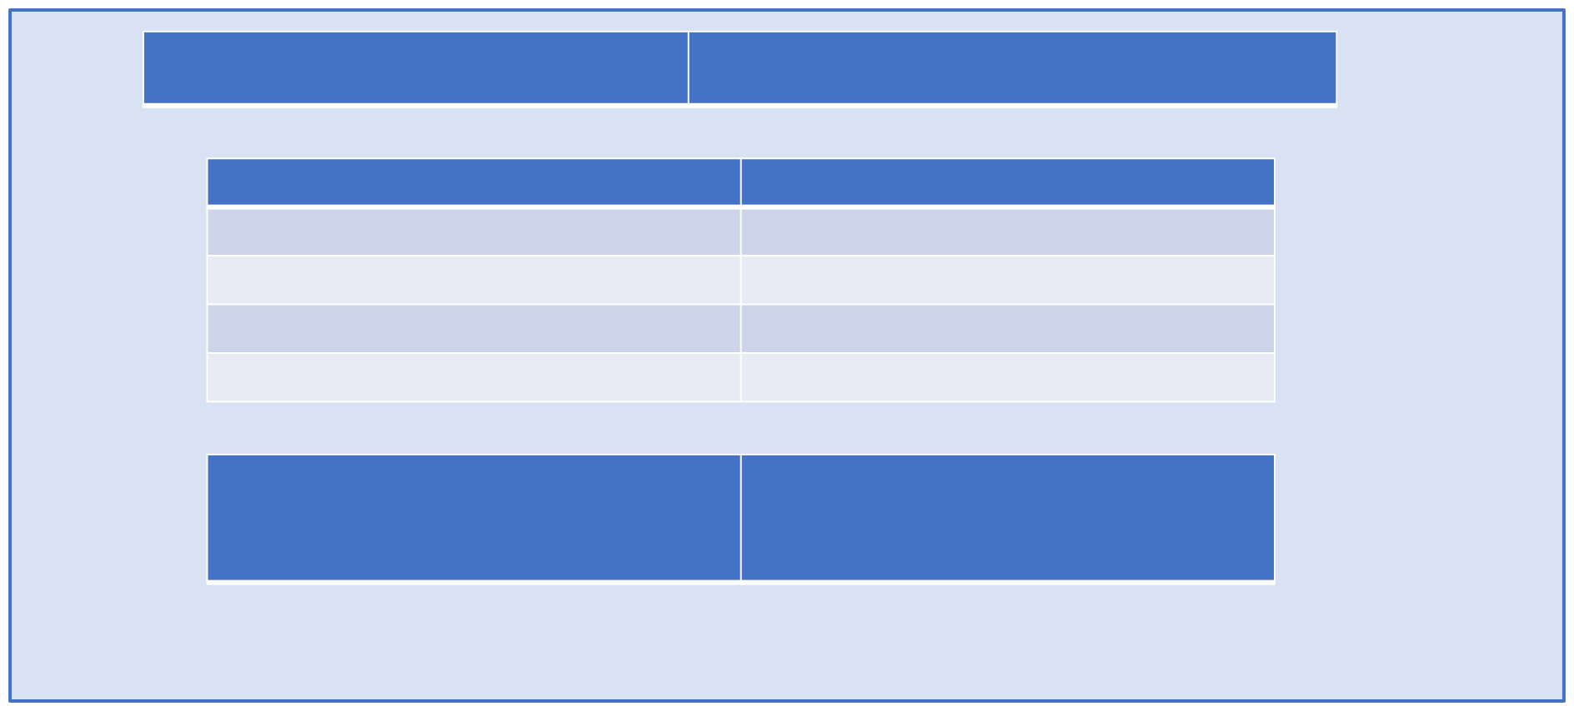
Department of Computer Science and Engineering Jyothy Institute of Technology
Mini Project Title
Gesture controlled car infotainment system
USN
1JT23CS067
1JT23CS105
1JT23CS108
1JT23CS120
Name of Student Jayashankar P
Parnika S M
Prajwal Mudrabett
Rahul R Vasisht
Guide
NAGARAJ. A Professor of Practice Dept of CSE, JIT
Date : 11-11-2025

Slide 2


Problem statement
“Modern car infotainment systems primarily depend on touchscreens and physical controls, which require drivers to take their eyes off the road and hands off the steering wheel. This distraction can delay driver reactions and increase the likelihood of accidents. Furthermore, existing voice-controlled systems often struggle with accuracy in noisy environments or when faced with unclear speech inputs. Hence, there is a need for a safer, more reliable, and intuitive interaction method to enhance driver safety and usability.”
Department of CSE, 2025-2026
2

Slide 3
Functional and Non-Functional requirements
Functional (What it does)
  Real-time Finger Tracking
  Gesture-Based Click (Pinch)
  Dashboard Section Navigation
  Audio & Map Controls
  Responsive UI Design
  Interactive Visual Feedback
Non-Functional (How well it works)
  Usability: Intuitive
  Performance: Real-time
  Reliability: Accurate
  Compatibility: Cross-browser
  Aesthetics: Modern
  Architecture: Scalable & Maintainable
Department of CSE, 2025-2026
3

Slide 4
List of Technologies used:
1. Frontend & UI
  HTML5: Main structure for the dashboard.
  CSS3: Styling, layout, and responsive design.
  JavaScript (ES6+): Dynamic updates and event handling.
2. Backend & Database
  PHP: Server-side logic (e.g., song uploads, API).
  SQL (MySQL): Manages user data like contacts and playlists.
3. Key Feature Libraries
  MediaPipe Hands (Google): For real-time hand and finger tracking.
  Leaflet.js: Powers interactive maps and navigation.
Department of CSE, 2025-2026
4

Slide 5
List of Tools used:
1. Development Environment
  XAMPP / Apache Server: Local server for running PHP.
  Visual Studio Code (IDE): Primary code editor.
  Browser Developer Tools: For debugging and performance tuning.
2. Hardware & APIs
  Webcam / Laptop Camera: Required hardware for gesture input.
  OpenStreetMap (Nominatim API): Used for geocoding and routes.
  HTML5 Audio API: Handles media playback and controls.
3. Data & Communication
  JSON: Data format for API communication.
  Fetch API (HTTP): Manages frontend-to-backend requests.
Department of CSE, 2025-2026
5

Slide 6
Work breakdown structure – Week 1 to 4 activities
Foundation & Setup
  Week 1: Project Definition
    Topic: Gesture Controlled Car Infotainment System
    Conducted literature survey (MediaPipe, Infotainment UX)
  Week 2: Requirement Analysis
    Identified hardware (webcam) & software (HTML, JS, PHP)
  Week 3: System Design
    Designed 3-layer architecture (Frontend, Backend, DB)
    Created UI wireframes & database schema
  Week 4: Environment Setup
    Installed XAMPP; tested MediaPipe camera & DB connection
Department of CSE, 2025-2026
6

Slide 7

Work breakdown structure – Week 5 to 8 activities
Core UI & Gesture Integration
  Week 5: UI Development (HTML/CSS)
    Built base layout, navigation cards & modern CSS UI
  Week 6: JavaScript Framework
    Created JS logic for view switching & UI controls
  Week 7: Gesture Recognition Integration
    Integrated MediaPipe Hands & camera feed
    Enabled hand landmark capture
  Week 8: Core Gesture Logic
    Implemented pinch-to-click & hover
    Mapped gestures for volume (Thumb Up/Down)
Department of CSE, 2025-2026
7

Slide 8

Work breakdown structure – Week 9 to 12 activities
Module Development & Refinement
  Week 9: Pointer Stability
    Added crosshair cursor & advanced smoothing (EMA)
  Week 10: Music Player Module
    Built audio playback, playlist & gesture controls
  Week 11: Navigation Module
    Integrated Leaflet.js maps & destination search
  Week 12: Calls & Backend Module
    Created PHP/MySQL backend for contacts/songs
    Dynamically fetched contacts & simulated calls
Department of CSE, 2025-2026
8

Slide 9

Work breakdown structure – Week 13 to 15 activities
Final Integration, Testing & Delivery
  Week 13: Settings & System Controls:
    Completed settings panels (Climate, Brightness).
    Unified system controls and finalized all UI panels.
  Week 14: Backend Integration & Testing:
    Linked frontend to all backend API routes.
    Conducted full functional testing and fixed bugs.
  Week 15: Final Testing & Documentation:
    Performed end-to-end testing and performance tuning.
    Prepared final project report and demonstration video.
Department of CSE, 2025-2026
9

Slide 10





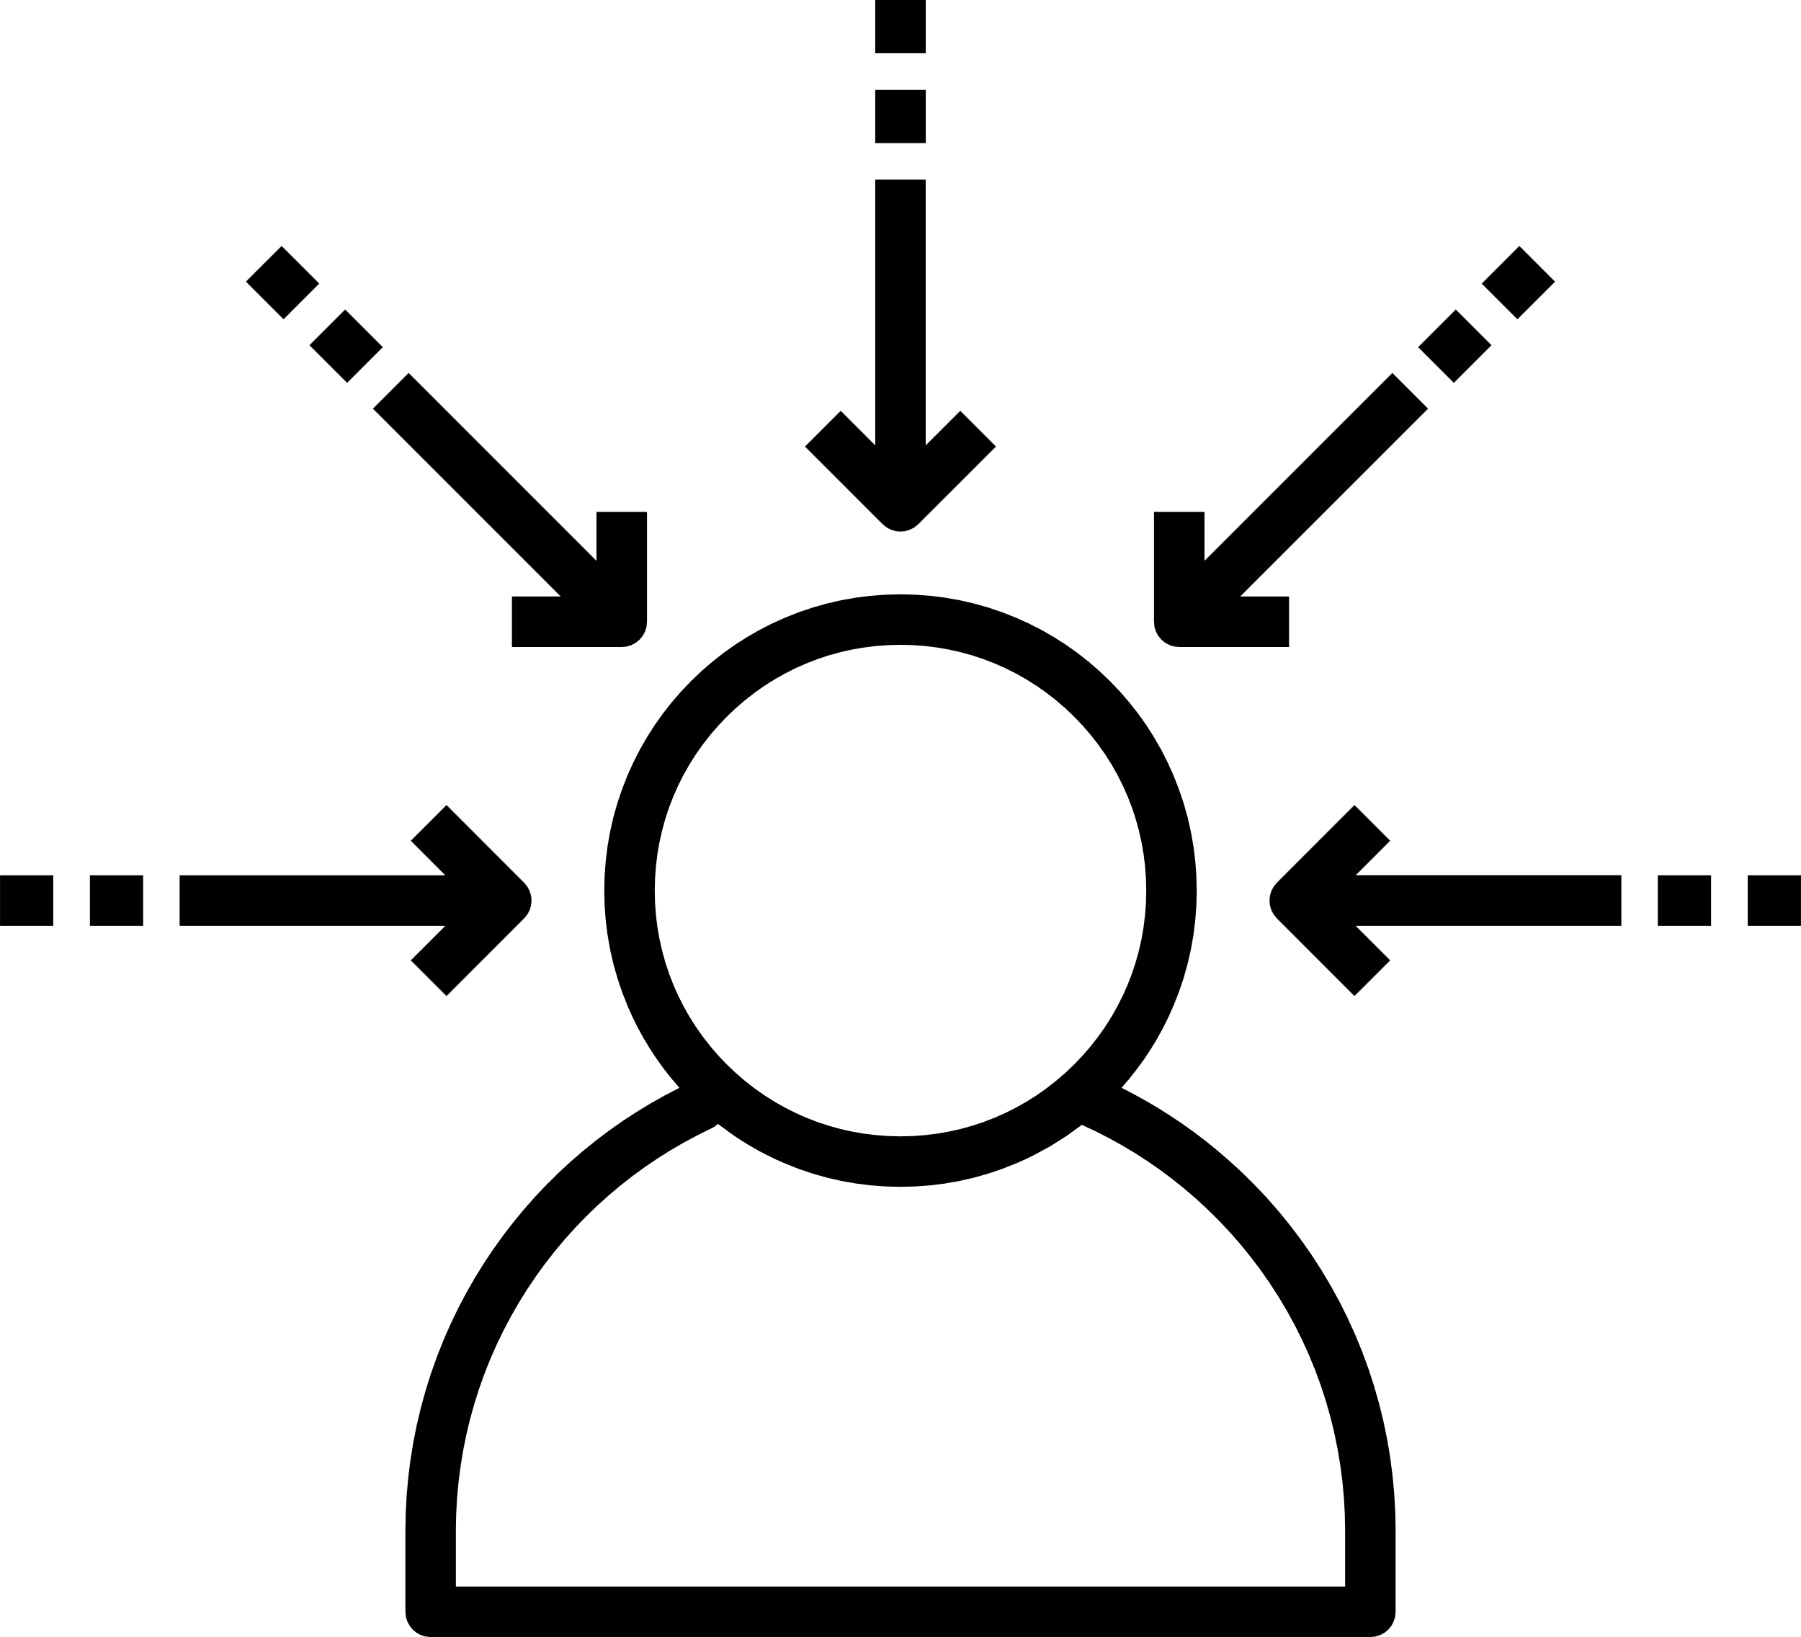



Design document
Dashboard Views
Home: Quick controls & status
Music: Player & volume controls
Navigation: Map interface
Calls: Answer / decline functions
Settings: Brightness & AC adjustment
Interaction & Principles
Interaction: Cards, sliders, &
buttons
Minimalism: Clean, focused
interface
Accessibility: Simple & easy to
use
Safety: Designed for driving
focus
Department of CSE, 2025-2026
10

Slide 11

Implementation details
Stack & Architecture
  3-Tier Model: HTML/CSS/JS → PHP → MySQL
  Pattern: MVC
Gesture Engine
  Core: MediaPipe Hands API
  Input: Real-time landmark detection (Pinch, Thumb, Fist)
Core Modules (Gesture-Controlled)
  Music Player
  Navigation (Leaflet.js & OpenStreetMap)
  Calls (Simulated)
  System Settings (AC, Brightness)
Backend & UI
  API: PHP scripts manage MySQL data (songs, contacts)
  UI: EMA smoothing for stable pointer + crosshair feedback
Department of CSE, 2025-2026
11

Slide 12

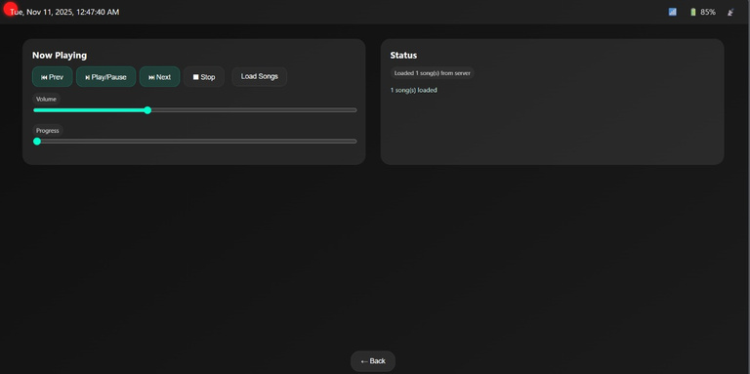
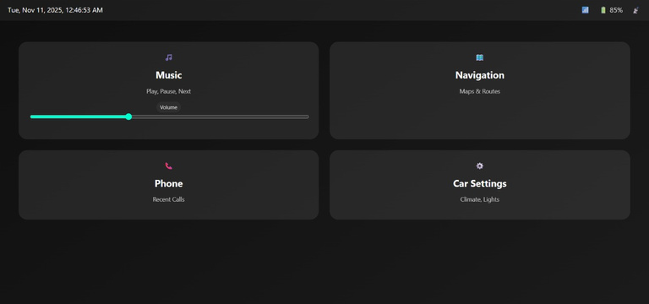
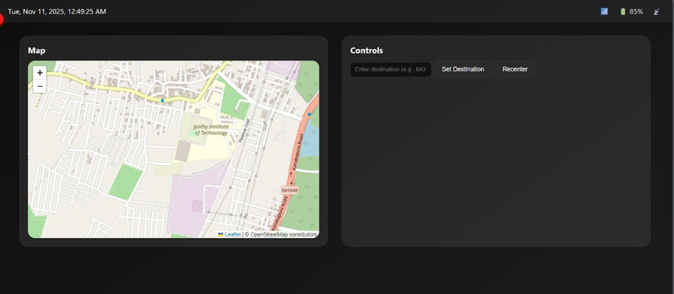
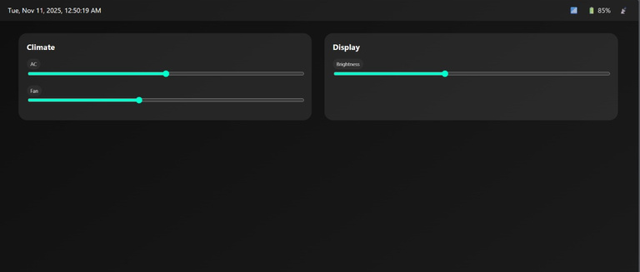
Screen shots
Department of CSE, 2025-2026
12

Slide 13
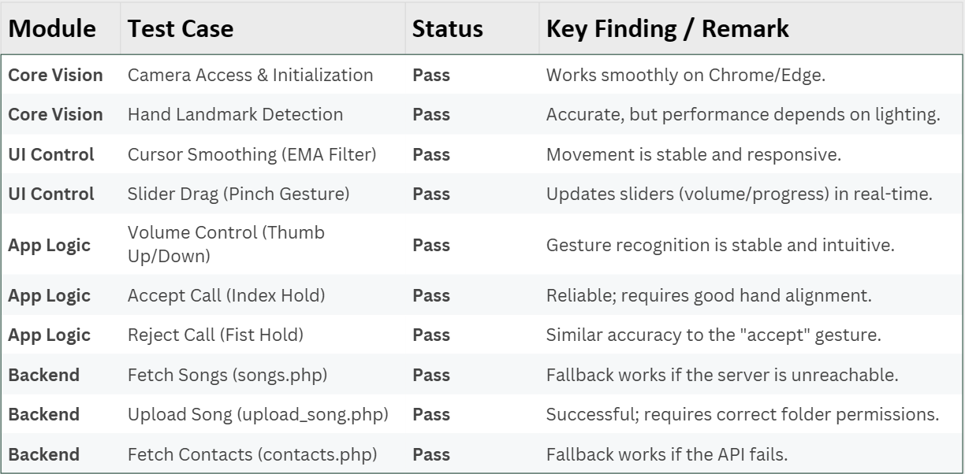
Testing Plan
Department of CSE, 2025-2026
13

Slide 14
Conclusion
  Successfully demonstrated a gesture-based infotainment system for touch-free control of music, navigation, calls, and settings.
  MediaPipe Hands API integration provides real-time, accurate gesture recognition, enhancing driver safety and convenience.
  The system is modular, responsive, and extensible, built on a PHP-MySQL backend for effective data management.
  A stable and user-friendly interface was achieved through smooth pointer tracking and a clear UI.
  Overall Goal Achieved: The project successfully combined computer vision and web technologies to create an intelligent, human-centric solution for modern vehicles.
Department of CSE, 2025-2026
14

Slide 15
What you have learnt during Mini Project
  AI Integration: Gained hands-on experience with AI gesture recognition (MediaPipe Hands).
  Full-Stack Development: Built a modular web application using HTML, CSS, JavaScript, PHP, and MySQL.
  Real-Time Data: Handled live camera input, data processing, and UI smoothing via algorithmic optimization.
  API & Communication: Understood frontend-backend communication through API design and JSON data exchange.
  Problem-Solving: Enhanced debugging skills for tracker lag, UI responsiveness, and network fallbacks.
  SDLC: Experienced the complete software development lifecycle (planning, implementation, testing).
  Core Engineering Skills: Developed teamwork, documentation, and project management skills.
Department of CSE, 2025-2026
15

Slide 16
References
  Google MediaPipe Hands:
https://developers.google.com/mediapipe/solutions/vision/hand_landmarker
  Leaflet.js:
https://leafletjs.com/
  OpenStreetMap:
https://www.openstreetmap.org/
  PHP (Documentation):
https://www.php.net/manual/en/
  MySQL (Documentation):
https://dev.mysql.com/doc/
Department of CSE, 2025-2026
16

