Slide 1


VizTalk
Conversational AI for Instant Business Intelligence Dashboards
BY:
ANISHA PATURI
SRAVANI JANAK
T JAYASHREE INDRANI

Slide 2
PROBLEM STATEMENT
Businesses rely heavily on data-driven decisions.
Accessing insights usually requires technical skills like SQL or BI tools.
Non-technical users struggle to generate dashboards.
Data teams spend time creating basic reports instead of advanced analysis.
PROPOSED SOLUTION
Our system allows users to generate dashboards using natural language queries.
Users simply ask questions like:
“Show revenue trend by date”
The system will automatically:
Understand the query using DeepSeek LLM
Generate SQL query
Retrieve data
Select appropriate visualization
Display an interactive dashboard
This removes the need for technical knowledge.

Slide 3
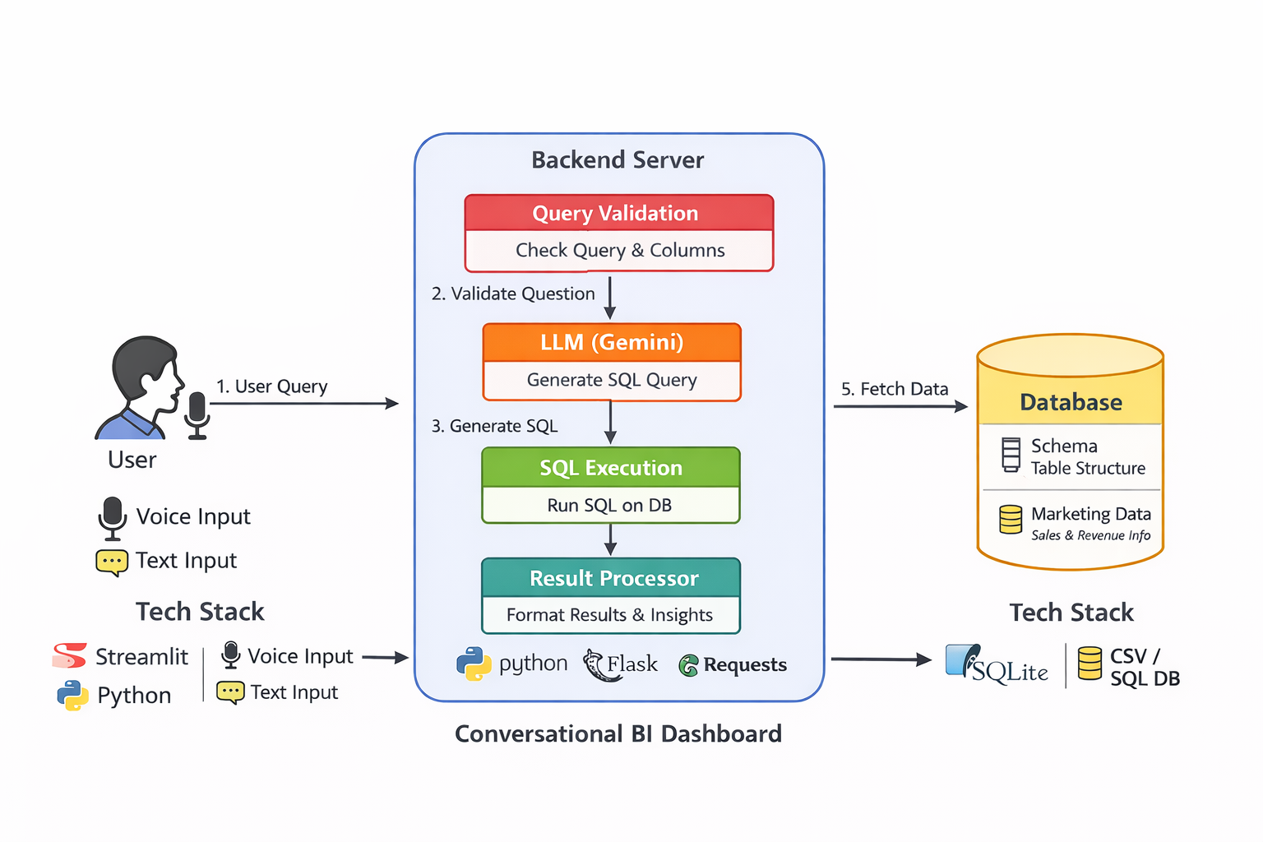
Architecture Diagram
Technologies Used
Frontend
Streamlit
Backend
Python
AI Model
DeepSeek LLM
Data Processing
Pandas
Visualization
Streamlit charts

Slide 4
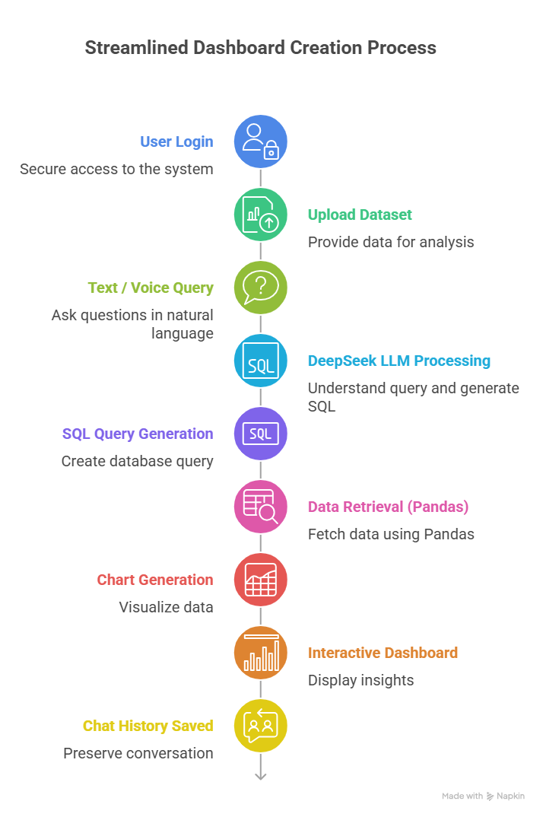
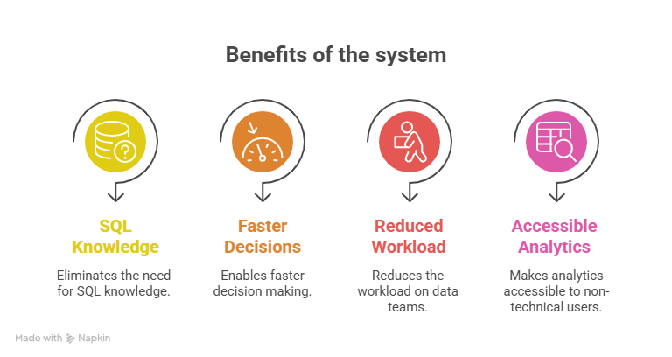
BENEFITS
WORK FLOW

Slide 5
