Slide 1
Department of Computer Science and Engineering
ANNA UNIVERSITY REGIONAL CAMPUS COIMBATORE
AD3811 & PROJECT WORK
SECOND REVIEW
Title of the project :
Reverse Engineering of Voyager-Based GraphQL APIs for Automated Professional Profile Data Extraction Date : 10.03.2026
Project Guide Name/Designation: | Name / Desn. / CSE Dr.P.Marikkannu AP/CSE
Name and Regn. Number of Student: | Name (Regn. No.) S.Sidharthan (710022243043)

Slide 2
AGENDA
INTRODUCTION
PROBLEM STATEMENT
ABSTRACT
PROPOSED WORK
ARCHITECTURE DIAGRAM
ER DIAGRAM
ALGORITHMS/TECHNIQUES
EXPECTED OUTCOME
IMPLEMENTATION OF 1ST MODULE
IMPLEMENTATION(30% CODE)
REFERENCES

Slide 3
INTRODUCTION
Professional platforms (LinkedIn, GitHub, X) serve structured data via internal GraphQL APIs
Direct API access is costly, restricted, and rate-limited
This project builds an automated system to extract publicly available professional data
Extended scope: GitHub candidate discovery via keyword search using Scraplin

Slide 4
PROBLEM STATEMENT
No affordable access to professional profile data at scale
Official APIs: LinkedIn charges $0.30–$0.50/profile; X/Twitter $100–$42K/month
Manual collection: 5–10 minutes per profile, error-prone
Existing open-source tools are outdated and break with platform updates
Gap: No unified, transparent, multi-platform extraction solution

Slide 5
ABSTRACT
This system reverse-engineers internal GraphQL APIs of LinkedIn and GitHub
Uses Playwright for browser automation and session management
Scrapling is used for lightweight, fast HTML parsing on GitHub search
Extracts profile data, posts, activity, and media in structured formats
Output: JSON, CSV, PDF — ready for recruitment analytics and research

Slide 6
PROPOSED WORK
Module 1: Authentication & Session Management (Playwright + cookie reuse)
Module 2: LinkedIn Profile Extractor (Voyager GraphQL API)
Module 3: LinkedIn Activity Fetcher (posts, comments, media)
Module 4: GitHub Candidate Search (keyword-based, powered by Scrapling)
Module 5: Data Export Engine (JSON → PDF / CSV)

Slide 7
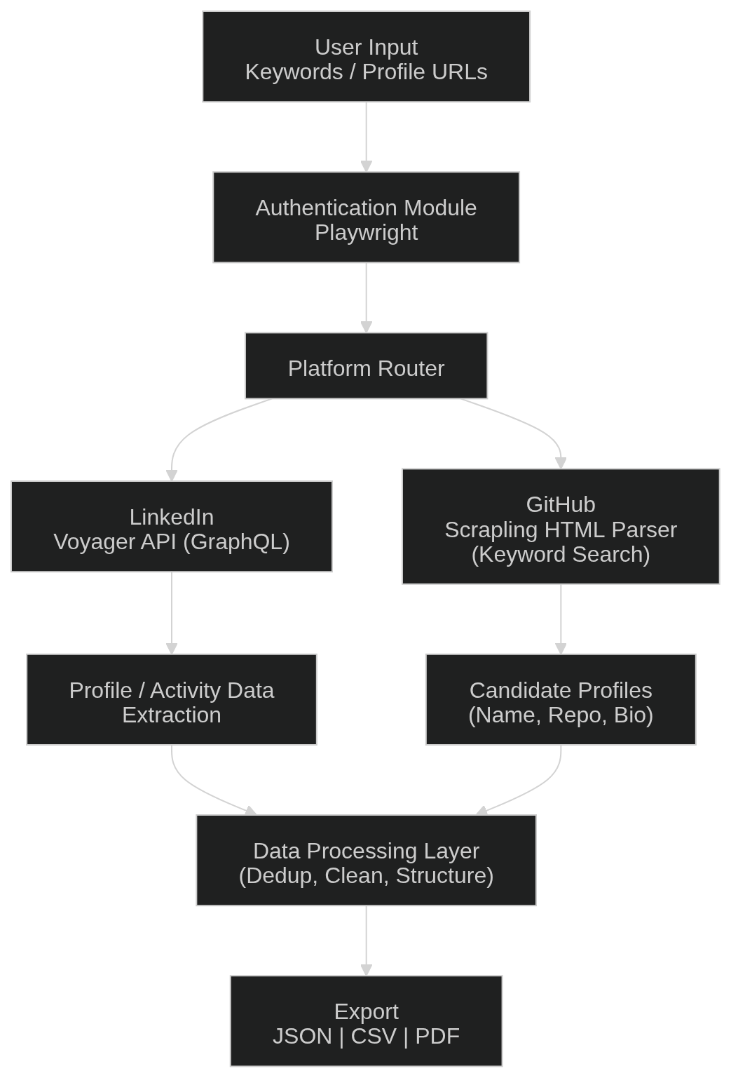
ARCHITECTURE DIAGRAM

Slide 8
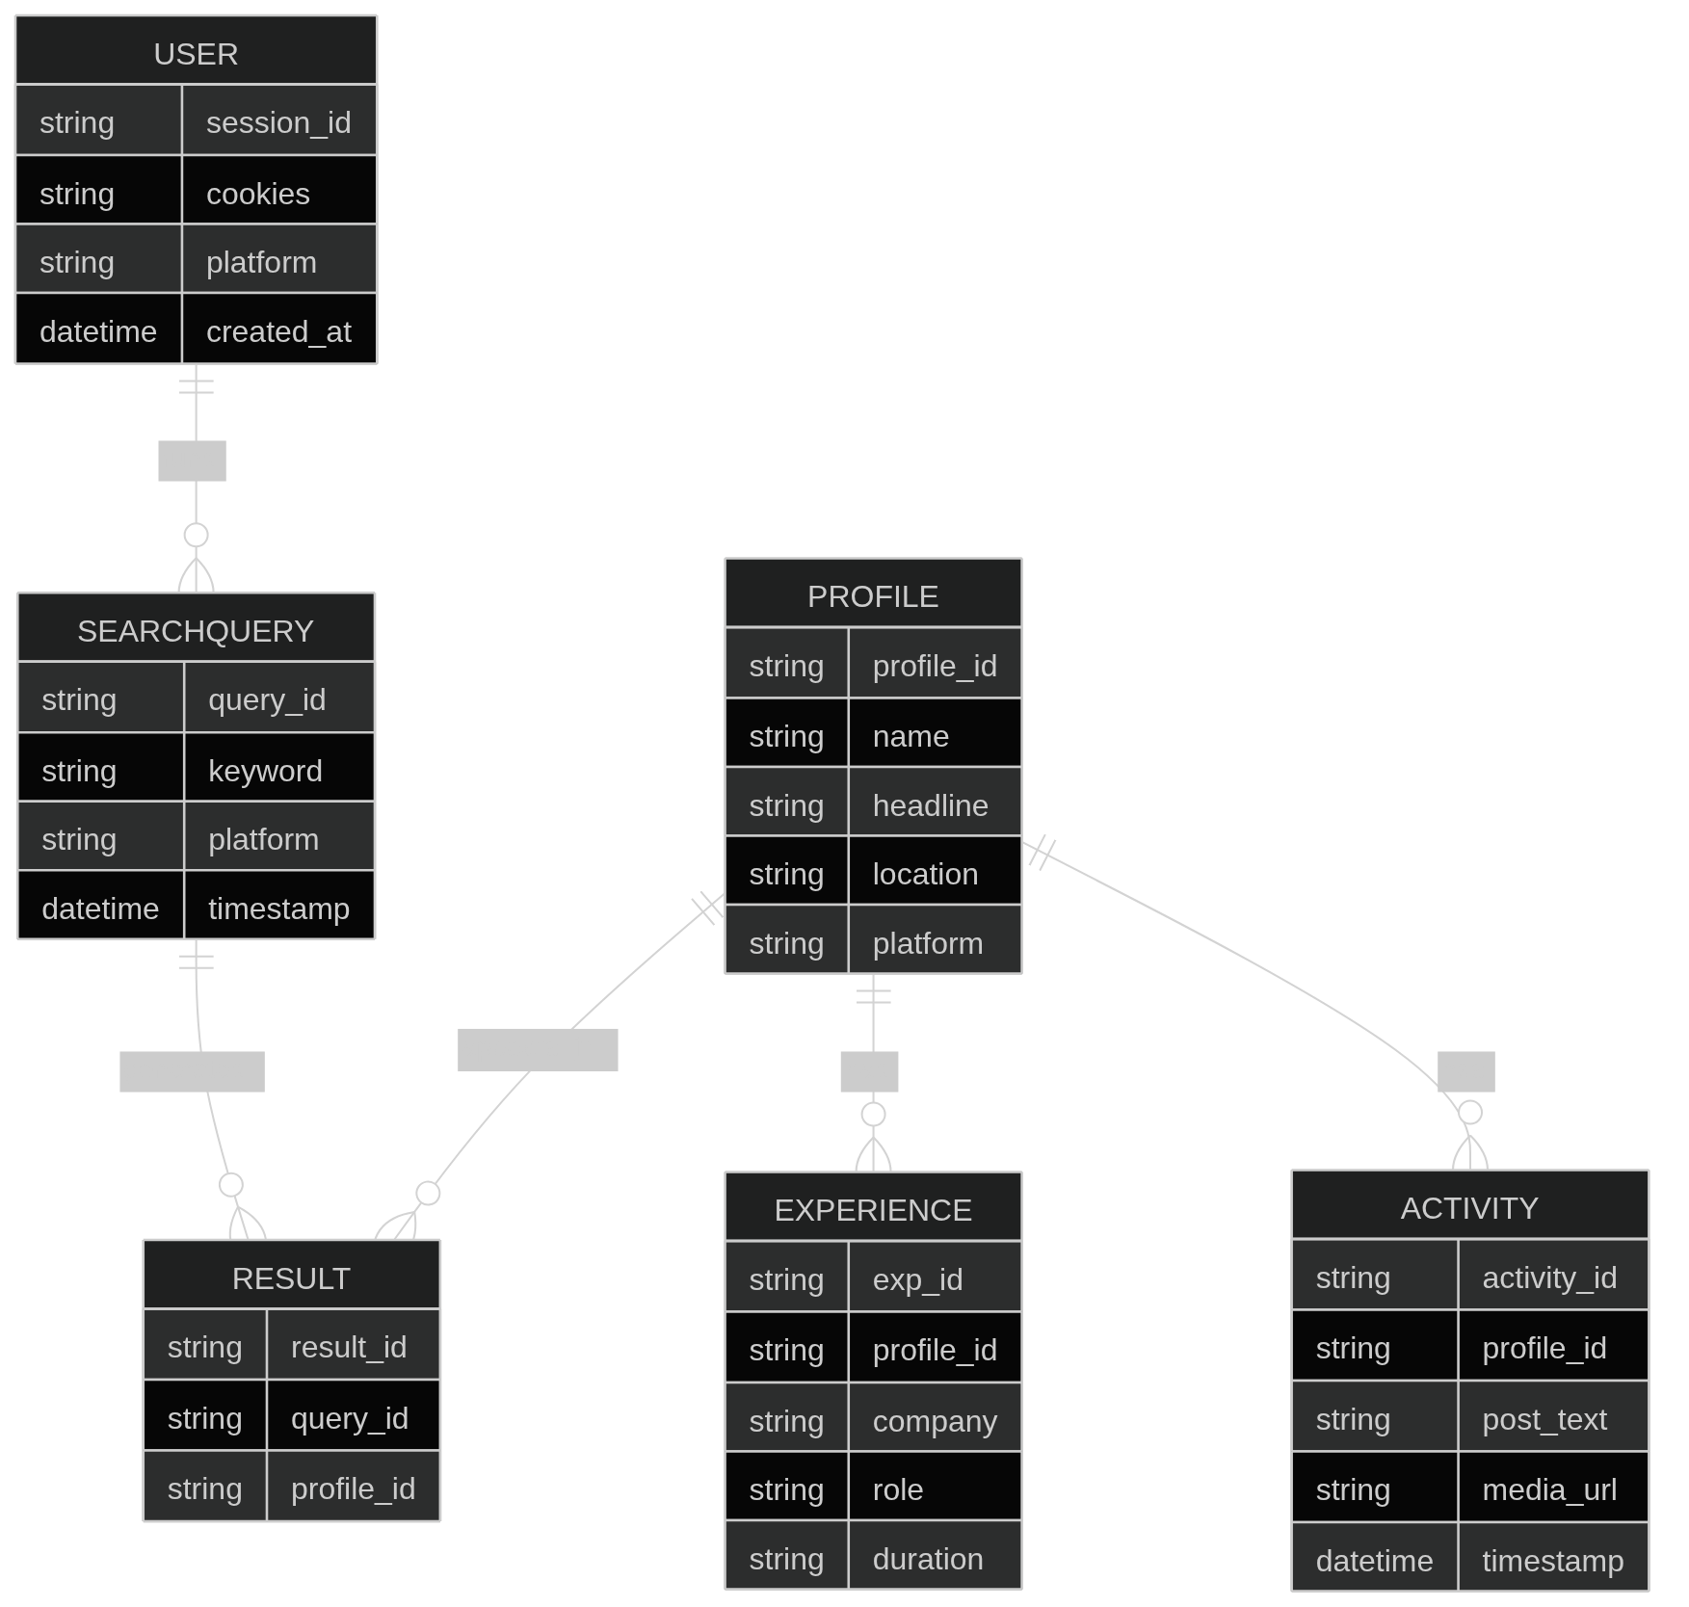
ER DIAGRAM

Slide 9
ALGORITHMS & TECHNIQUES
Technique | Purpose
GraphQL Query Reverse Engineering | Extract LinkedIn Voyager API structure from browser traffic
Playwright Browser Automation | Login, cookie capture, headless browsing
Scrapling HTML Parsing | Fast, lightweight GitHub search result extraction
Session Cookie Reuse | Avoid repeated logins; persist authenticated state
Rate Limiting & Backoff | Prevent detection; respect platform limits
JSON Schema Normalization | Unify data structure across LinkedIn and GitHub

Slide 10
EXPECTED OUTCOME
Multi-platform pipeline: LinkedIn profiles + GitHub candidates from one system
Keyword-based GitHub search returns name, bio, top repos, location
LinkedIn extractor returns full profile: experience, education, skills, posts
Reusable session management — authenticate once, run multiple queries
Clean exports: structured JSON, tabular CSV, downloadable PDFs

Slide 11
IMPLEMENTATION OF 1ST MODULE
Tool: Playwright (Python)
Flow: Launch browser → Navigate to platform → Login → Extract cookies → Save session
Cookie storage: JSON file, reloaded on next run
Handles: LinkedIn and GitHub session separately
Fallback: Re-authenticate if session expires

Slide 12
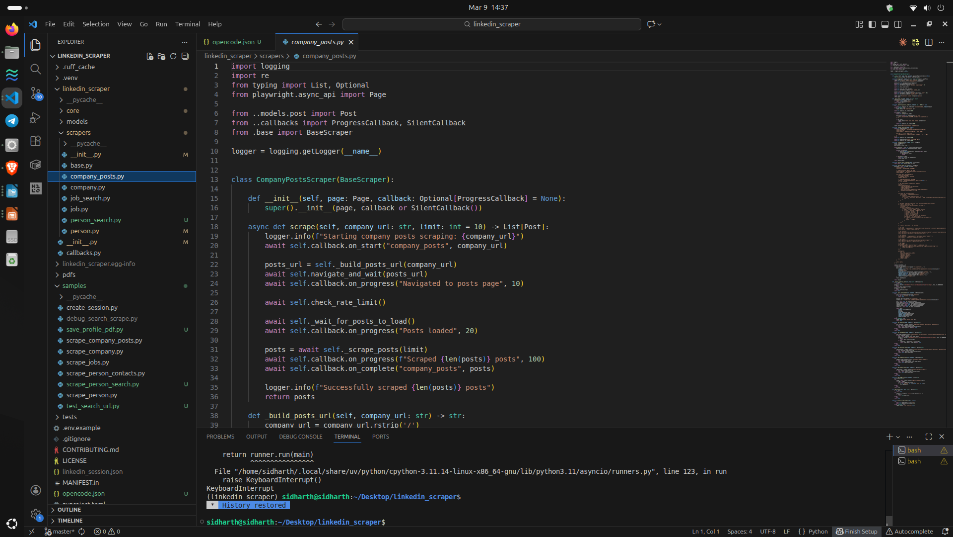
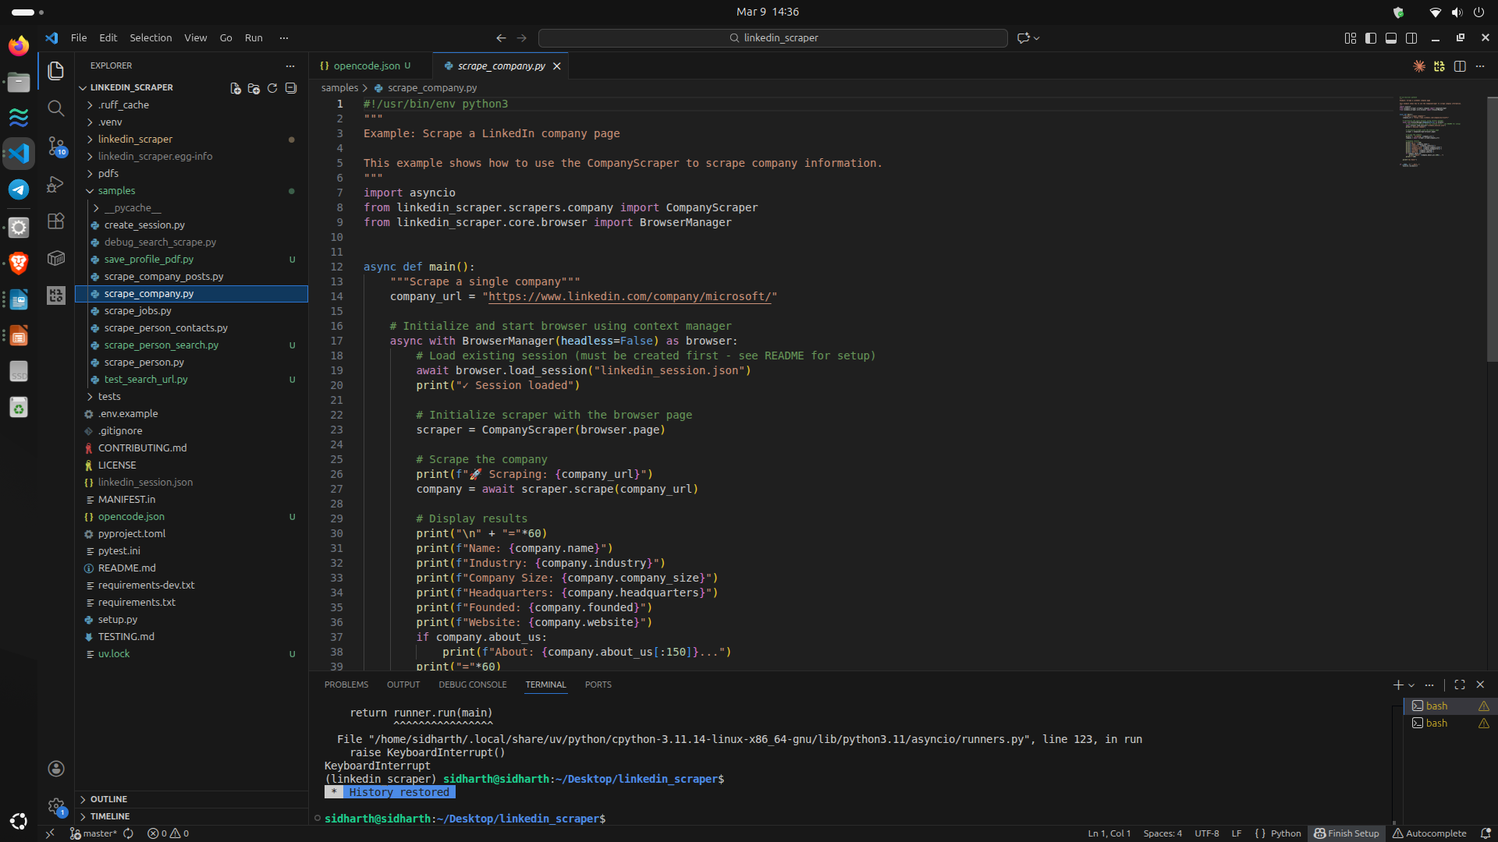
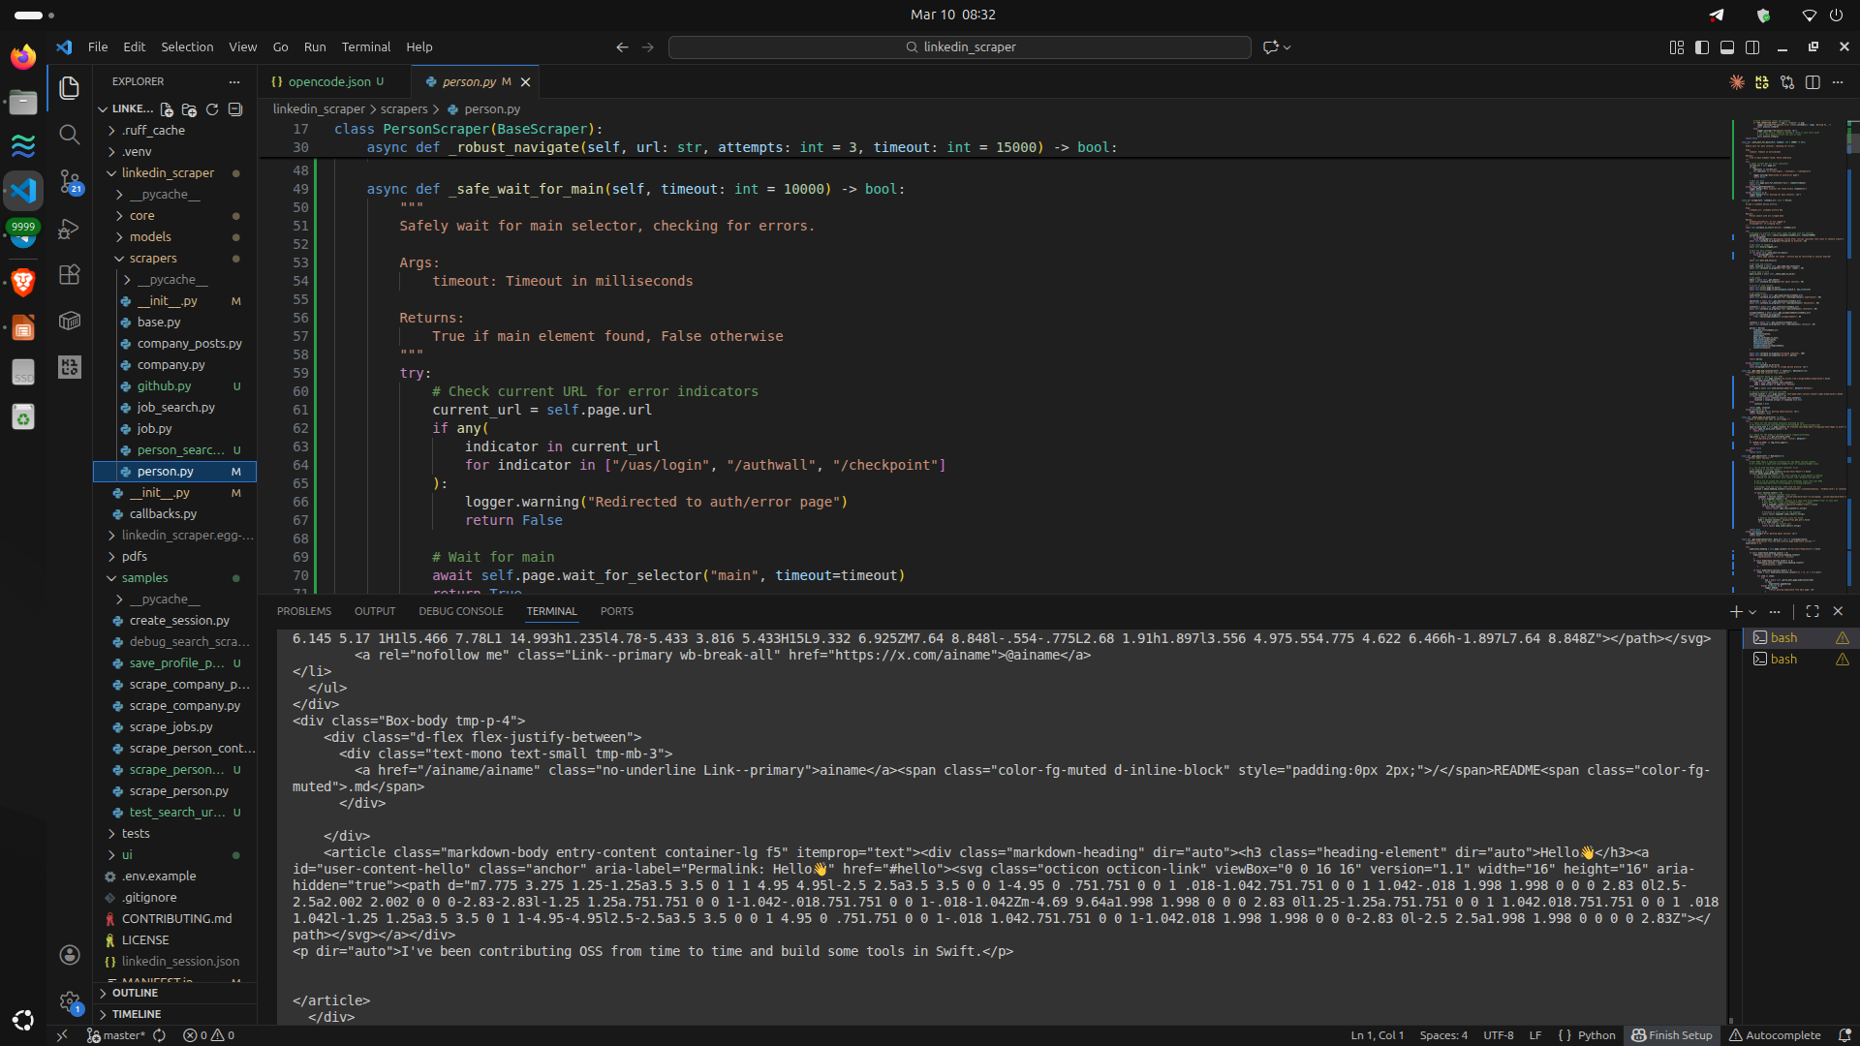
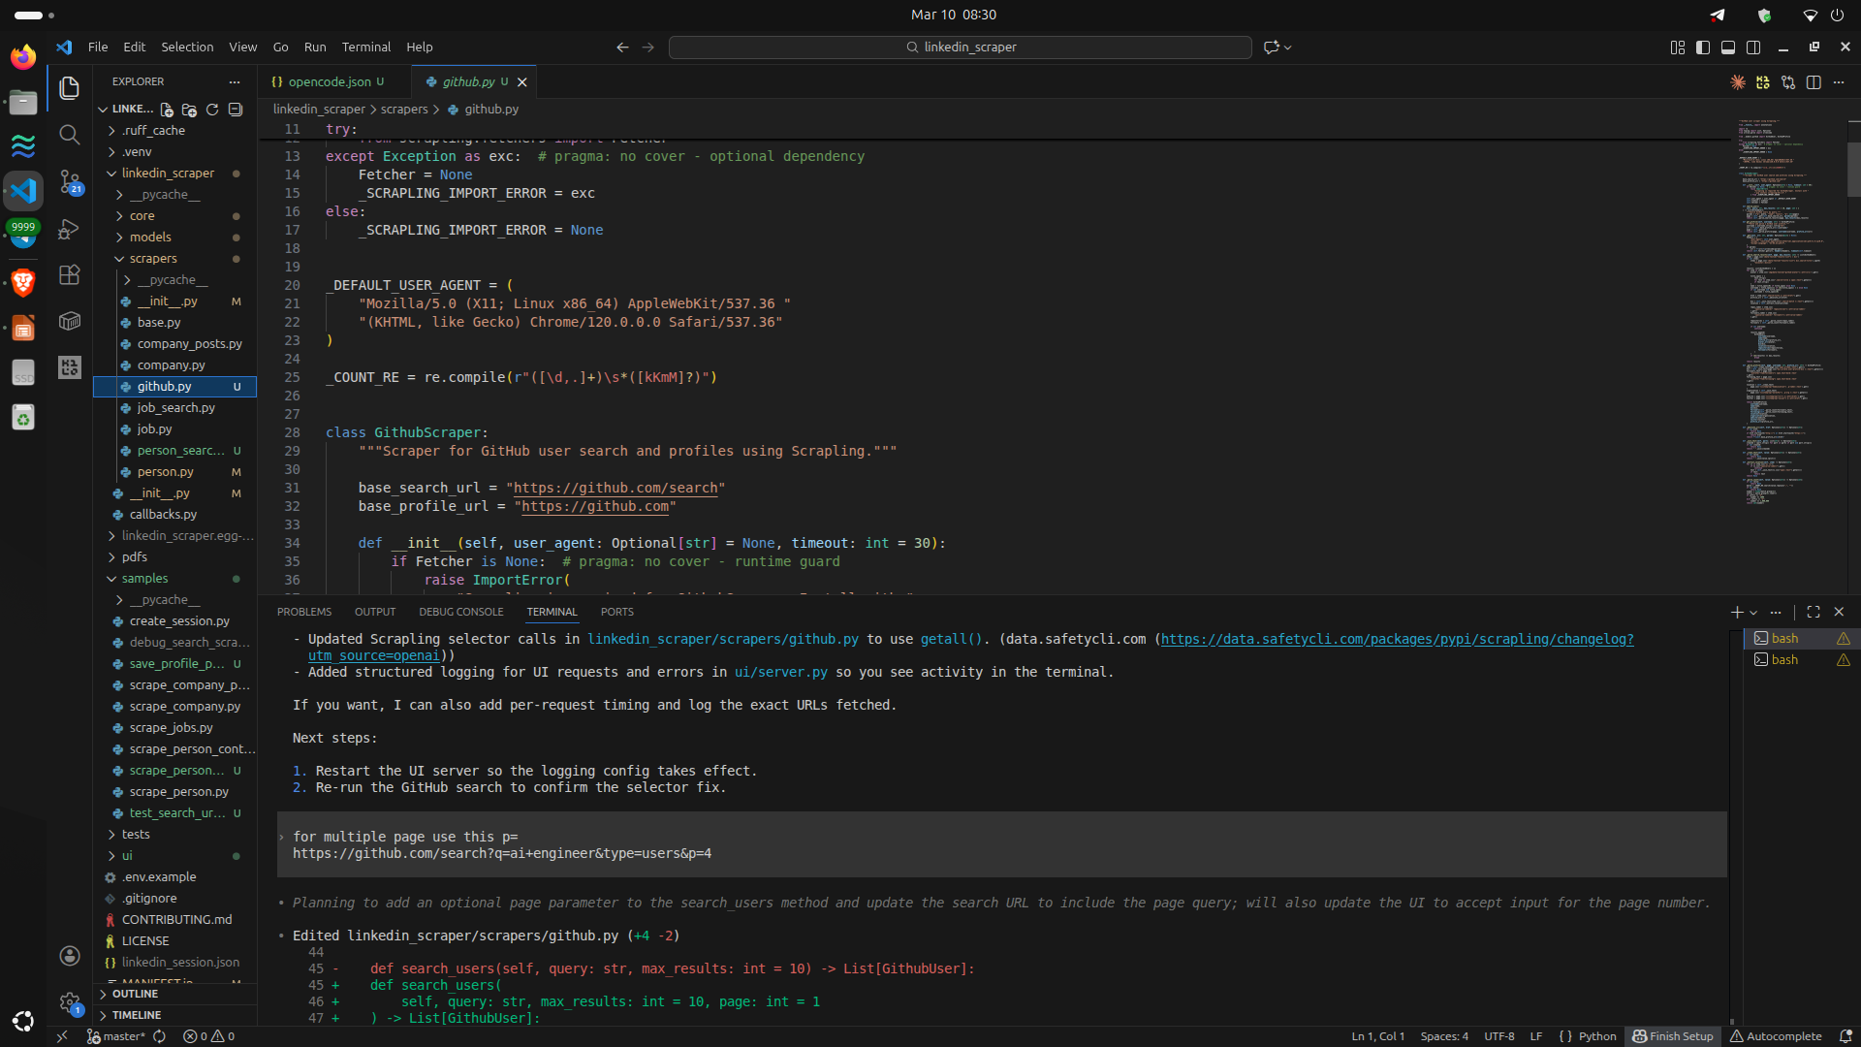
IMPLEMENTATION(30% CODE)

Slide 13
REFERENCES
[1] LINKSOCIAL: Linking User Profiles Across Multiple Social Media Platforms.Vishal Sharma, Curtis E. Dyreson https://ieeexplore.ieee.org/document/8588801/
2] Hartig, O., Pérez, J. (2018). "Semantics and Complexity of GraphQL."
Proceedings of the 2018 World Wide Web Conference, pp. 1155-1164.
DOI: 10.1145/3178876.3186014
[3] Vogel, M., Weber, S., Zirpins, C. (2017). "Experiences on Migrating
RESTful Web Services to GraphQL." International Conference on
Service-Oriented Computing (ICSOC), pp. 283-295.
DOI: 10.1007/978-3-319-69035-3_20
[4] Wittern, E., Cha, A., Davis, J.C., Baudart, G., Mandel, L. (2019).
"An Empirical Study of GraphQL Schemas."
IEEE International Conference on Service-Oriented System Engineering,
pp. 3-13. DOI: 10.1109/SOSE.2019.00011
[5] GitHub GraphQL API v4 Documentation (2024).
Official Documentation. URL: https://docs.github.com/en/graphql
Accessed: February 2026

Slide 14
THANK YOU

