Slide 1
gRPC

Slide 2
gRPC Introduction
gRPC is free and open-source framework developed by Google. New technology on top of RPC
Modern, fast and efficient , low latency , language independent, built on top of HTTP2
Client Code
server.get_domain_info()
Server code
def get_domain_info:
.
.
.
return domain
Over the network

Slide 3
gRPC use Protocol Buffers to define messages and service.
We have to define the service in .proto file and the code will be generated for us !

Slide 4
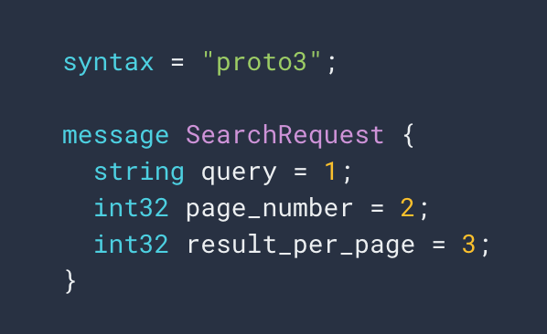
Message Type - Data
We are using proto3
We define messages
Field Type
Field Tag (eg. Number)
Field Name

Slide 5
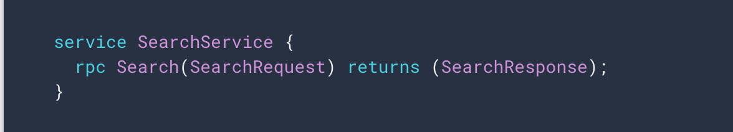
Message Type - RPC
RPC service interface in a .proto file and the protocol buffer compiler will generate service interface code and stubs in your chosen language
Notes:
Show unary.proto and unary_pb2_grpc.py & unary_pb2.py

Slide 6
protoc
protoc –I=proto ==python_output=python proto/simple.proto
simple_pb2.py
python -m grpc_tools.protoc --proto_path=. ./unary.proto --python_out=. --grpc_python_out=.

Slide 7
.proto scheme message SimpleMessage {
int32 id = 1;
.
.
}
Byte Streams
Ex – 12 07 74 65 74
Encoding
+
Add values to Message (any language)
Notes:
Protocol buffers have same serialization and deserialization for all the languages

Slide 8
Byte Streams
Ex – 12 07 64 65
Message containing values ( Any Language) Ex:
id=32
+
Decoding
.proto schema file
message SimpleMessage {
int32 id = 1;
.
.
}
Notes:
Afetr simple.proto and then speak about unary.proto showing RPC

Slide 9
WHY PROTO BUFFERS ?
Create Objects
Automatic creation of code
Java
.proto
(Human Readbale)
Python
Serialized Data
(Can be interpreted by any language)
Go
(all)
Programming Languages
Notes:
gRPC clients and servers can run and talk to each other in a variety of environments - from servers inside Google to your own desktop - and can be written in any of gRPC’s supported languages. So, for example, you can easily create a gRPC server in Java with clients in Go, Python, or Ruby
Data is very small since its in binary when serialized
Good for transfer of huge data

Slide 10
Protocol Buffers. Vs JSON
Payload size is way less compared to JSON. Saves lot of network bandwidth !
Parsing JSON is CPU intensive ( human readbable)
Parsing ProtoBuf binary format which is compressive is very less CPU intensive. Its almost closer to machine level data.
Perfect schema in ProtoBuf which is not followed in JSON.
Docuemtation is embedded in proto files
Notes:
Github results with different grpc servers to prove protobufs are way faster than XML and JSON.

Slide 11
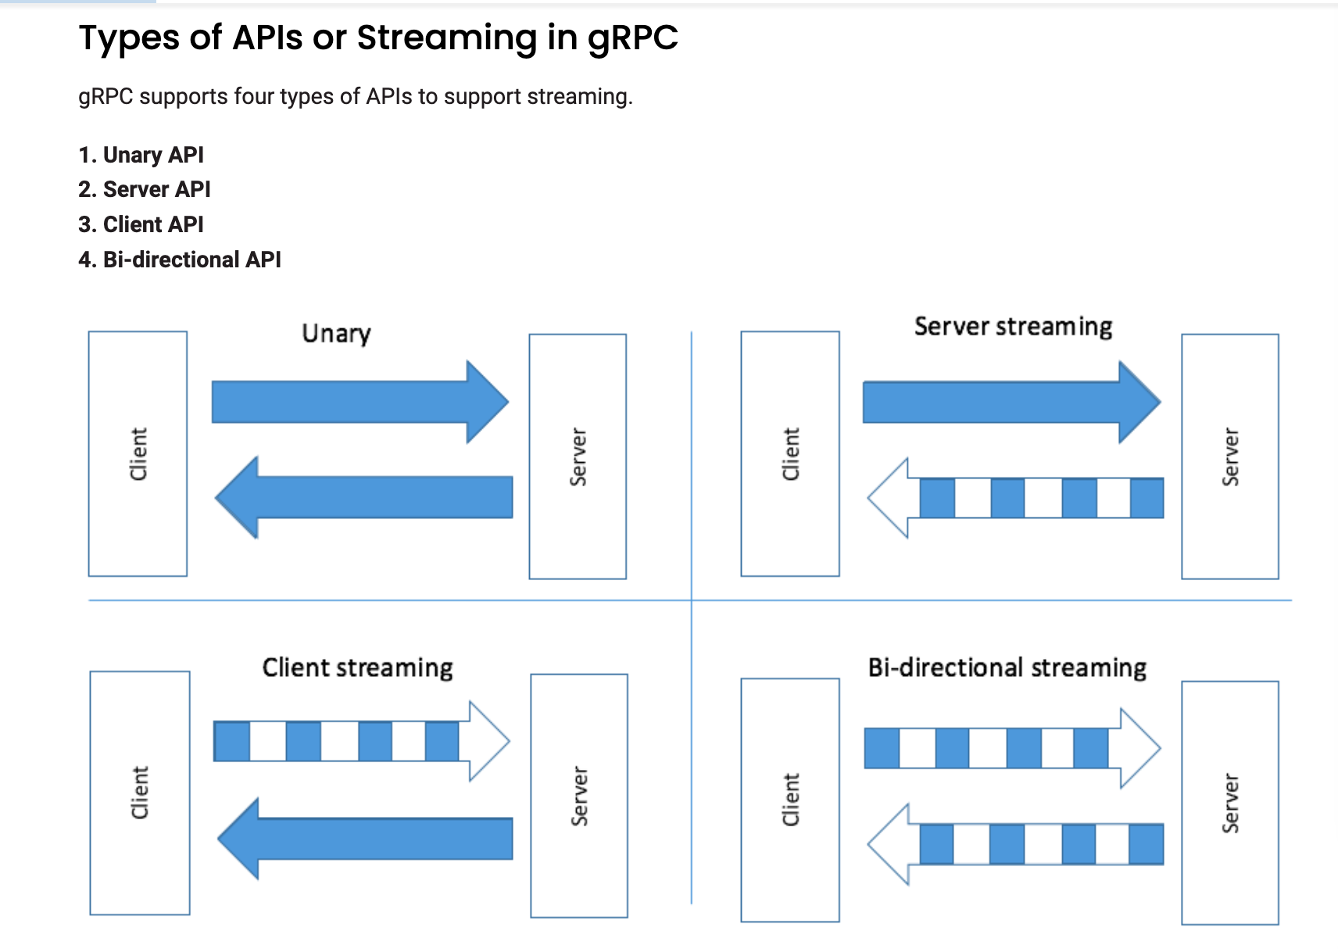
Notes:
Unary
Send one request from client and get one response back from serve
Server Streaming –
Client will send one message to the server and will receive many responses from the server.
Sever needs to send lots of data
Server needs to PUSH data to the client. Eg – live feed, chat etc..
Client Streaming –
The client will send many messages to the server and will receive one response from the server ( at any time)
Client needs to send lot of data
Server processing is expensive. Lot of processing in the sever.
Client needs to PUSH data to the server
Bi Directional Streaming
Client will send many messages to the server and server will send many messages to the client
Client and server need to send a lot of data asynchronously
“Chat” protocol
Long running connections

Slide 12
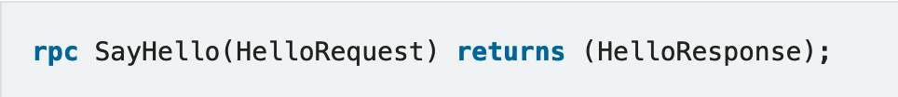
Types of API in gRPC
UNARY
CLIENT STREAMING
SERVER STREAMING
BIDIRECTIONAL STREAMING

Slide 13
gRPC scalability
gRPC servers are by default asynchronous
gRPC server can serve millions of request in parallel
Google has 10 billion gRPC requests being made per second internally
gRPC clients can be asynchronous or synchronous (blocking)
gRPC can perform client side load balancing

Slide 14
gRPC vs REST
gRPC | REST
Protocol Buffers – binary, smaller in size & faster | JSON – text based, slower & bigger in size
HTTP/2 – lower latency | HTTP1.1 higher latency
Bidirectional & Async - 4 types of API | Client to Server requests only
Streaming Support | Request & Response only
Notes:
REST – POST, GET, PUT DELETE

Slide 15
ESA
Talos Micro Service 1 (Java)
ProtoBuf request & response
ESA
(Python)
stub
Talos Micro Service 2
(Go)
ProtoBuf request & response
hermes
ip_rep_client
beaker_connector/stub
Notes:
API to exchange the data – Is it REST, gRPC ?
Data format – Do you want to use JSON, XML, protobuf ?
Load balancing
If we use REST – design end points – GET, POST
Invoking Error handling
Latency, Scalability
Authentication, logging,

Slide 16
Protocol Buffer Services
Java Server
gRPC client
(Automatically generated)
Go Client
gRPC server which exposes services
proto response
proto request
Python Client
gRPC client
(Automatically generated)
proto response
proto request

