Slide 1
STUDENT GRADE PREDICTION
by
JAYASHREE K
220701104
Guide

Slide 2

Introduction
Student grade prediction is an essential task in educational analytics, aimed at identifying academic trends and helping educators make data-informed decisions. Traditional evaluation methods often fall short in capturing underlying patterns in student performance. This project adopts a machine learning approach—specifically the Decision Tree Classifier—to predict final grades based solely on students' previous academic scores. By analyzing historical exam results or subject-wise marks, the system learns to classify students into grade categories (such as A, B, C, etc.). The goal is to improve prediction accuracy while ensuring the model remains interpretable and practically useful in real academic environments.

Slide 3
Literature Survey
Student performance prediction has gained significant attention in the educational data mining domain, with various statistical and machine learning methods being applied. Traditional approaches such as linear regression often fall short in modeling the nonlinear patterns found in academic performance data. Decision Tree classifiers have emerged as a popular alternative due to their interpretability, ease of implementation, and suitability for categorical target variables like letter grades.
Research shows that Decision Trees provide clear visualizations of decision paths, making them ideal for educational applications where transparency is essential. Their ability to handle both numerical and categorical data makes them versatile for diverse academic datasets. In many studies, Decision Trees have been employed to classify students into grade categories (e.g., A to F) based on input features such as previous scores, attendance, and assessment results. Compared to black-box models like neural networks, Decision Trees are easier to understand and explain to educators and stakeholders.

Slide 4
Literature Survey
Recent studies have also emphasized the importance of model tuning to improve classification accuracy. Techniques like pruning, limiting maximum tree depth, and setting minimum samples per split help reduce overfitting and enhance generalization. Several works have compared Decision Trees with other models like Naive Bayes, SVM, and k-NN, and found Decision Trees to offer competitive performance when well-tuned. Literature highlights that educational institutions benefit most when models balance accuracy with explainability—an area where Decision Trees consistently perform well.

Slide 5
Objectives
To develop a machine learning model that accurately predicts student grades based on their academic scores.
To apply the Decision Tree Classifier due to its simplicity, interpretability, and effective handling of categorical data.
To improve the model’s performance and prevent overfitting using pruning and parameter tuning techniques.
To evaluate the model using performance metrics such as accuracy, precision, recall, and F1-score.

Slide 6
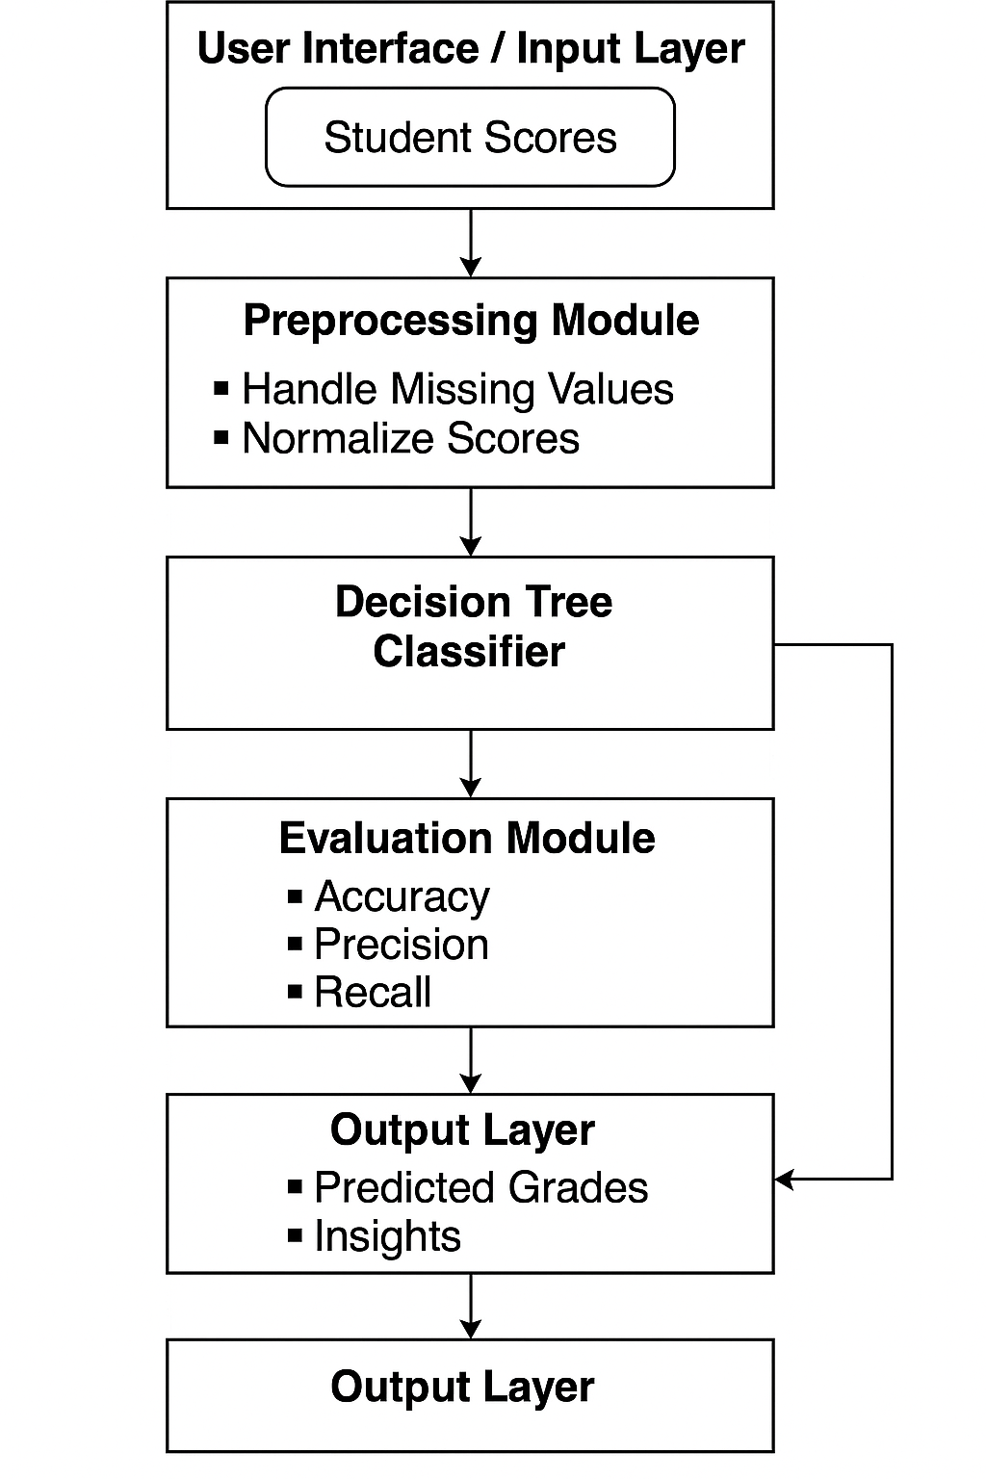
System Architecture

Slide 7
Methodology
Collected student academic score data, which includes marks or grades from various subjects.
Preprocessed the data by handling missing or inconsistent values and transforming categorical data
if present.
Scaled or normalized the features (if needed) to ensure balanced learning by the model.
Split the dataset into training and testing sets using an 80:20 ratio to assess model performance.
Trained a Decision Tree Classifier to learn patterns in student scores for predicting final grade outcomes.
Performed hyperparameter tuning (like setting max_depth, min_samples_split) to avoid overfitting and optimize
decision boundaries.
Evaluated the model using accuracy, precision, recall, and F1-score on the test set to measure
predictive effectiveness

Slide 8
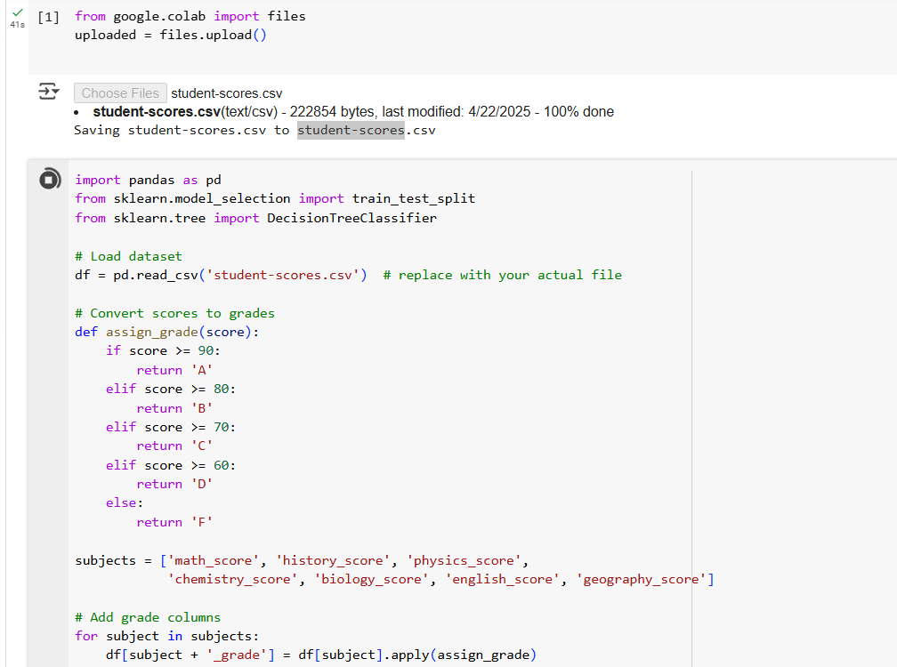
Implementation

Slide 9
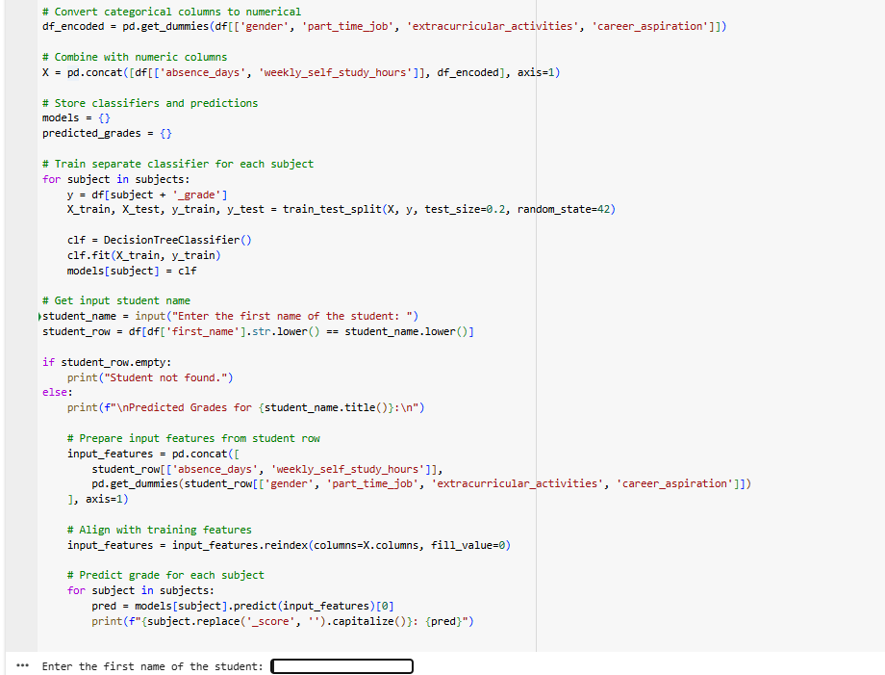
Implementation

Slide 10
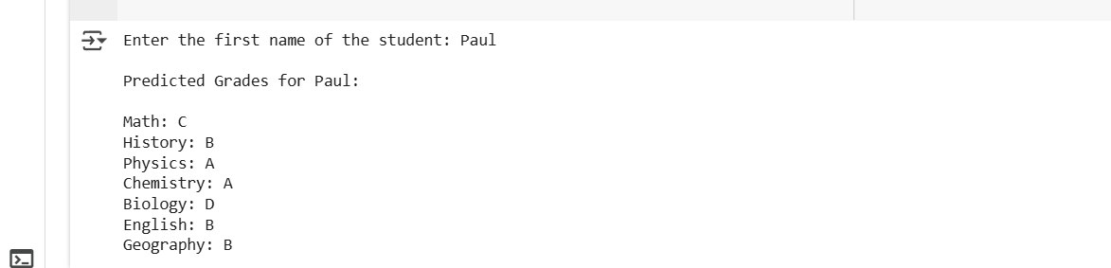
Results

Slide 11
1."Student Performance Prediction Using Machine Learning" – Kumar et al., 2021 This study applied Naive Bayes and K-Nearest Neighbors (KNN) to predict student outcomes based on
demographic and academic data.
Limitations: The accuracy was limited due to lack of tuning and low interpretability.
Improvement in My Work: My project uses a Decision Tree Classifier, which offers better interpretability
through visual decision paths. Additionally, tuning parameters such as max_depth improved prediction accuracy
over their baseline models.
Comparison with existing work
2."Predicting Academic Performance of Students using Decision Trees" – Sharma et al., 2022 The study used decision trees without focusing on score-based features alone. It also lacked preprocessing steps such as handling missing values.
Limitations: Incomplete preprocessing and unbalanced dataset led to biased predictions.
Improvement in My Work: My model focuses only on student scores, ensuring simplicity, and applies proper preprocessing, data splitting, and evaluation. Metrics like accuracy and F1-score confirm improved performance and reduced overfitting.

Slide 12
Conclusion and Future Work
Conclusion
The Decision Tree model, trained solely on student score data, proved effective in predicting academic performance outcomes. By applying hyperparameter tuning and cross-validation, the model achieved improved accuracy and generalization. This highlights the capability of interpretable machine learning models like Decision Trees for educational data analysis and grade prediction tasks.
Future Work
Future enhancements could include integrating more features such as attendance, assignment scores, and socio-economic data for better accuracy. Exploring ensemble methods like Gradient Boosting or Random Forests may improve prediction robustness. Incorporating explainability tools like SHAP or LIME can provide insights into feature influence on student performance, aiding educators in targeted interventions.

Slide 13
Reference
Student Performance Prediction using Decision Tree Technique https://www.researchgate.net/publication/332050291_Student_Performance_Prediction_using_Decision_Tree_Technique
Predicting Students’ Academic Performance Using Machine Learning: A Case Study https://www.sciencedirect.com/science/article/pii/S1877050920302961
Educational Data Mining and Learning Analytics for Student Performance Prediction: A Survey https://www.sciencedirect.com/science/article/pii/S1877050920310896
Machine Learning Approach to Predict Student Performance in Higher Education https://ieeexplore.ieee.org/document/9073170
Student Academic Performance Prediction Using Decision Tree Algorithms https://ieeexplore.ieee.org/document/9072790

Slide 14
THANK YOU

